Slide 1
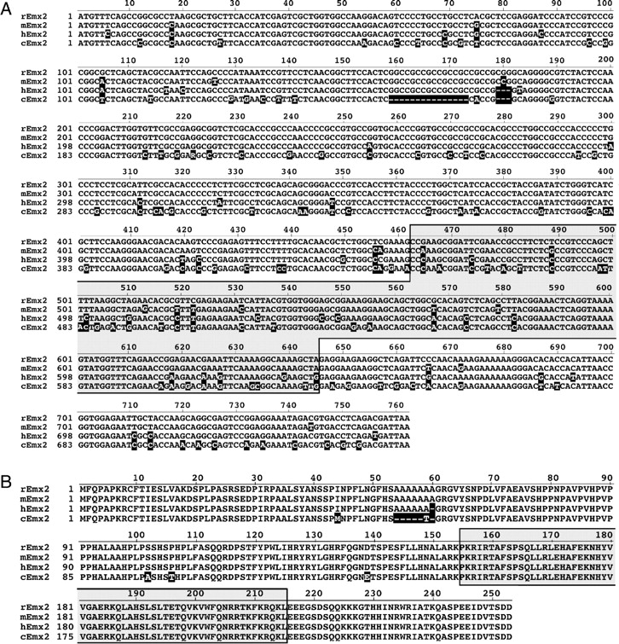
Figure 1. Comparison of cDNA and predicted protein sequences of rat, mouse, human and chick Emx2. (A) Clones containing ...
Notes:
Figure 1. Comparison of cDNA and predicted protein sequences of rat, mouse, human and chick Emx2. (A) Clones containing rat Emx2 were derived from cDNA libraries of E18 rat whole brain. Sequence analysis was performed on 1.5_kb, which included some 5′ and 3′ untranslated regions. The open reading frame is shown (rEmx2), and compared with the sequence for mouse Emx2 (mEmx2), which we derived from the database of mouse genomic DNA sequence, as well as published sequences of Emx2 from human (hEmx2) (Noonan et al., 2001) and chick (cEmx2) (Bell et al., 2001). Numbers refer to the nucleotide sequence. (B) The 251 amino acids in the predicted sequence for rat and mouse EMX2 protein are shown, and compared with those for human and chick. Numbers refer to the protein sequence. In A and B, non-conserved nucleotides or amino acids, and gaps in sequence which are indicated by dashes, are highlighted in black. The homeodomain is boxed and shaded. See text for a comparison of Emx2 sequences between species.
Unless provided in the caption above, the following copyright applies to the content of this slide: © Oxford University Press

Slide 2
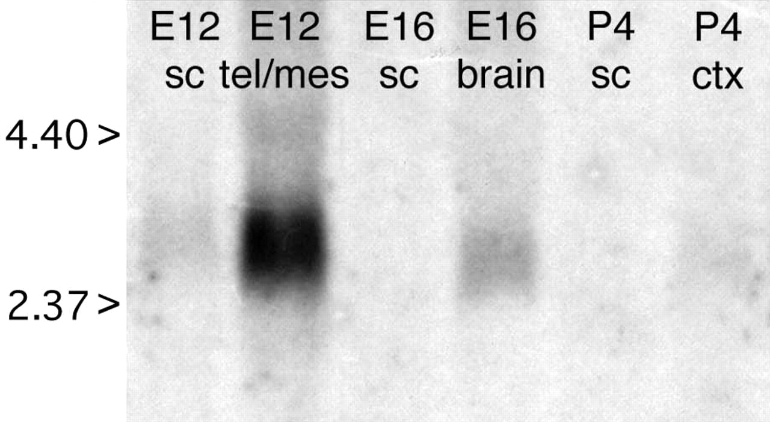
Figure 2. Northern blot analysis of the developmental expression of Emx2. Total-RNA samples were isolated from brain ...
Notes:
Figure 2. Northern blot analysis of the developmental expression of Emx2. Total-RNA samples were isolated from brain tissue derived from different embryonic (E) and postnatal (P) ages of rats. Agarose gel electrophoresis and Northern blotting were performed (see Methods). Northern blots were probed with 32P labeled Emx2 cDNA probes, revealing a single band of ∼2.8 kb at E12 and E16. Controls were done to show that RNA loading was equivalent across lanes (not shown). Abbreviations: ctx, cortex; mes, mesencephalon; sc, spinal cord; tel, telencephalon.
Unless provided in the caption above, the following copyright applies to the content of this slide: © Oxford University Press

Slide 3
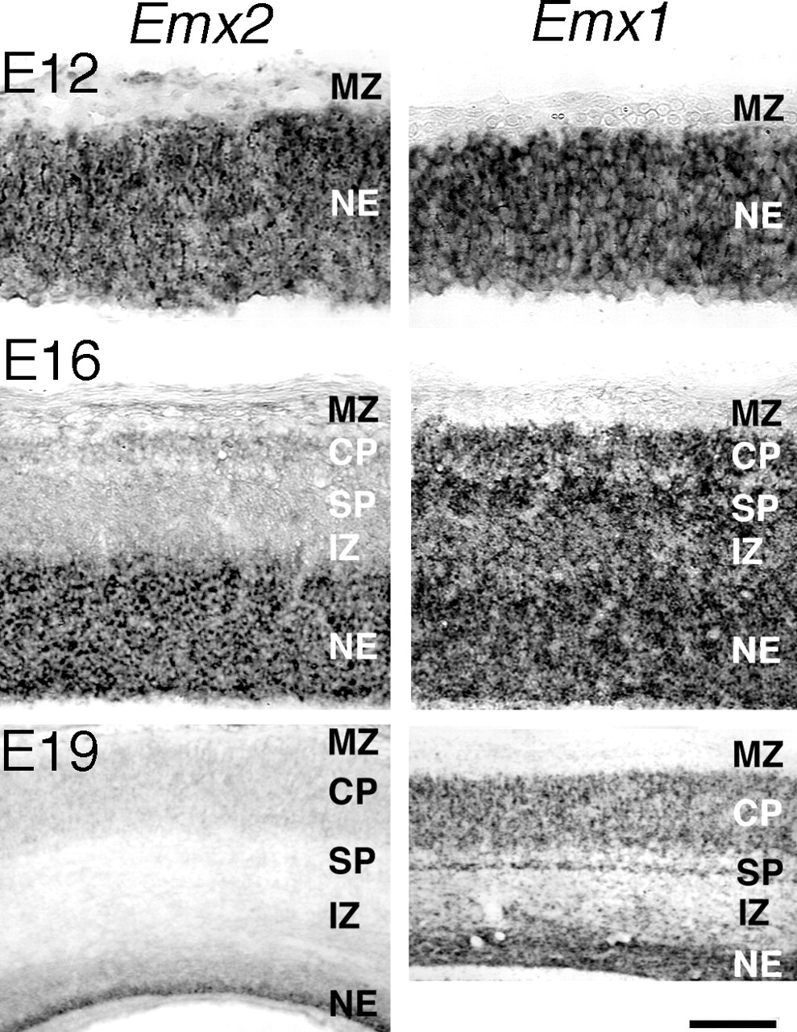
Figure 3. Laminar distribution of Emx2 and Emx1 in embryonic rat neocortex. Emx2 (left panels) and Emx1 (right panels) ...
Notes:
Figure 3. Laminar distribution of Emx2 and Emx1 in embryonic rat neocortex. Emx2 (left panels) and Emx1 (right panels) expression in E12, E16 and E19 neocortex was examined using digoxigenin-labeled cRNA probes. At E12, most, if not all, cells in the neuroepithelium (NE) were heavily labeled with both Emx2 and Emx1. At E16, Emx2 expression remained high in the neuroepithelium, but was not detected outside of it. Emx1 was also found at high levels in the subplate (SP) and newly formed cortical plate (CP), and at moderate levels in the intermediate zone (IZ). At E19, Emx2 expression was limited to the deepest aspect of the reduced neuroepithelium, adjacent to the ventricle, whereas a broader band of high Emx1 expression was seen in the neuroepithelium, and moderate Emx1 expression was evident in the cortical plate and subplate. Scale bar = 50μm at E12; 100 μm at E16; 200 μm at E19.
Unless provided in the caption above, the following copyright applies to the content of this slide: © Oxford University Press

Slide 4
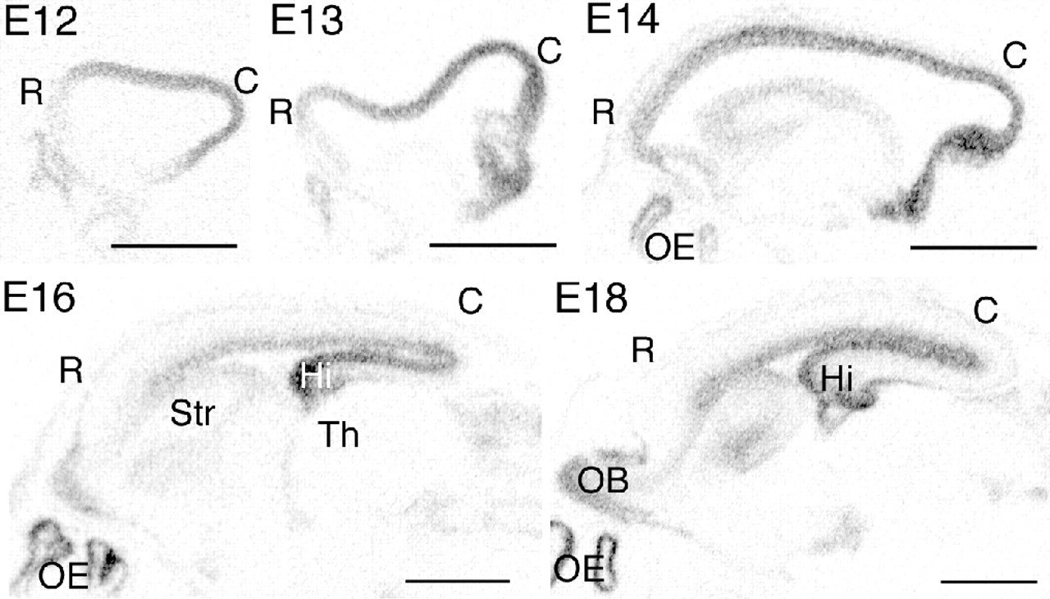
Figure 4. Emx2 exhibits graded expression along the caudal–rostral axis of embryonic rat cortex. Autoradiograms were ...
Notes:
Figure 4. Emx2 exhibits graded expression along the caudal–rostral axis of embryonic rat cortex. Autoradiograms were generated using an 35S-labeled Emx2 cRNA probe. These autoradiographic images demonstrate expression patterns of Emx2 in sagittal sections of embryonic rat brain at the ages indicated. A high-caudal (C) to low-rostral (R) gradient in Emx2 expression was apparent in the neuroepithelium of the neocortex, as well as the cerebral cortex as a whole, from E12 through E18. Smaller domains of Emx2 expression are seen elsewhere, including the olfactory bulb (OB), the olfactory epithelium (OE) and the ganglionic eminence — the germinal zone of the striatum (Str). Hi, hippocampus. Scale bars = 200 μm.
Unless provided in the caption above, the following copyright applies to the content of this slide: © Oxford University Press

Slide 5
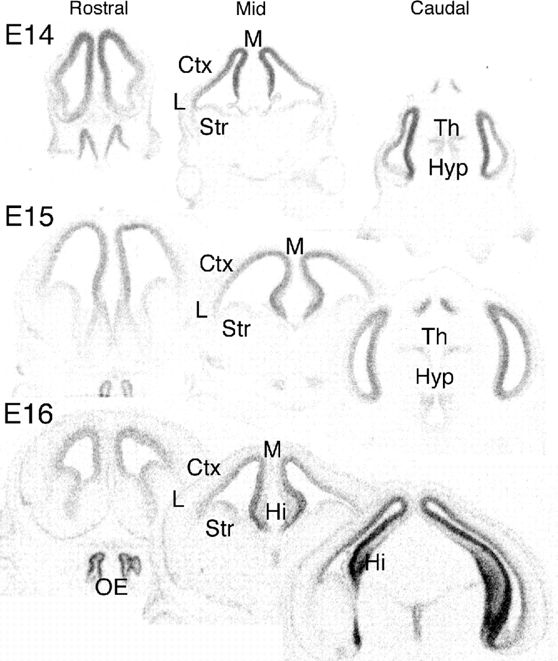
Figure 5. Emx2 exhibits graded expression along the medial–lateral axis of embryonic rat cortex. Autoradiograms were ...
Notes:
Figure 5. Emx2 exhibits graded expression along the medial–lateral axis of embryonic rat cortex. Autoradiograms were generated using an 35S-labeled Emx2 cRNA probe. These autoradiographic images illustrate temporal and spatial patterns of Emx2 expression in adjacent sections of rat brain at E14, E15 and E16 in coronal sections at three rostral to caudal levels. A high-medial (M) to low-lateral (L) graded expression of Emx2 is apparent. Smaller domains of Emx2 expression are seen elsewhere, including the olfactory epithelium (OE), the thalamus (Th), hypothalamus (Hyp), and the ganglionic eminence — the germinal zone of the striatum (Str). Hi, hippocampus. Scale bars = 200 μm.
Unless provided in the caption above, the following copyright applies to the content of this slide: © Oxford University Press

Slide 6
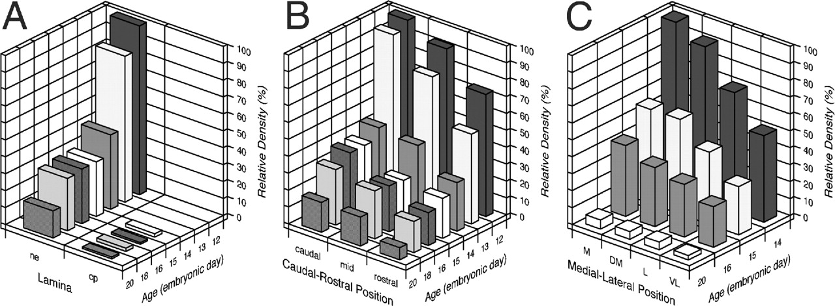
Figure 6. Densitometry analysis of Emx2 expression in rat neocortex across embryonic development. To quantify the ...
Notes:
Figure 6. Densitometry analysis of Emx2 expression in rat neocortex across embryonic development. To quantify the relative levels of Emx2 expression across ages and axes of the neocortex, densitometry of the relative expression levels were done for sections processed at the same time in the same manner with the same probe, and apposed to the same film. (A) Expression levels of Emx2 were highest in the ventricular neuroepithelium (ne) at E12, decreased precipitously at E14, and declined slowly thereafter. Emx2 expression was mainly restricted to the neuroepithelium (ne) throughout development, with levels only slightly above background in the cortical plate (cp) and marginal zone. (B) Densitometric measurements in sagittal sections from equally spaced locations in the caudal, rostral and middle thirds of the developing neocortex from E12 to E20 embryos. Emx2 is expressed in a high-caudal to low-rostral gradient between E12 and E18; by E20, when neurogenesis is concluding, graded expression is virtually absent. (C) Densitometry measurements from four equally spaced, positions along the medial–lateral axis of the neocortex (D, dorsal; DM, dorsal–medial; L, lateral; VL, ventral–lateral) indicate a M–L graded expression for Emx2 at E14 to E16, but not at E20.
Unless provided in the caption above, the following copyright applies to the content of this slide: © Oxford University Press

Slide 7
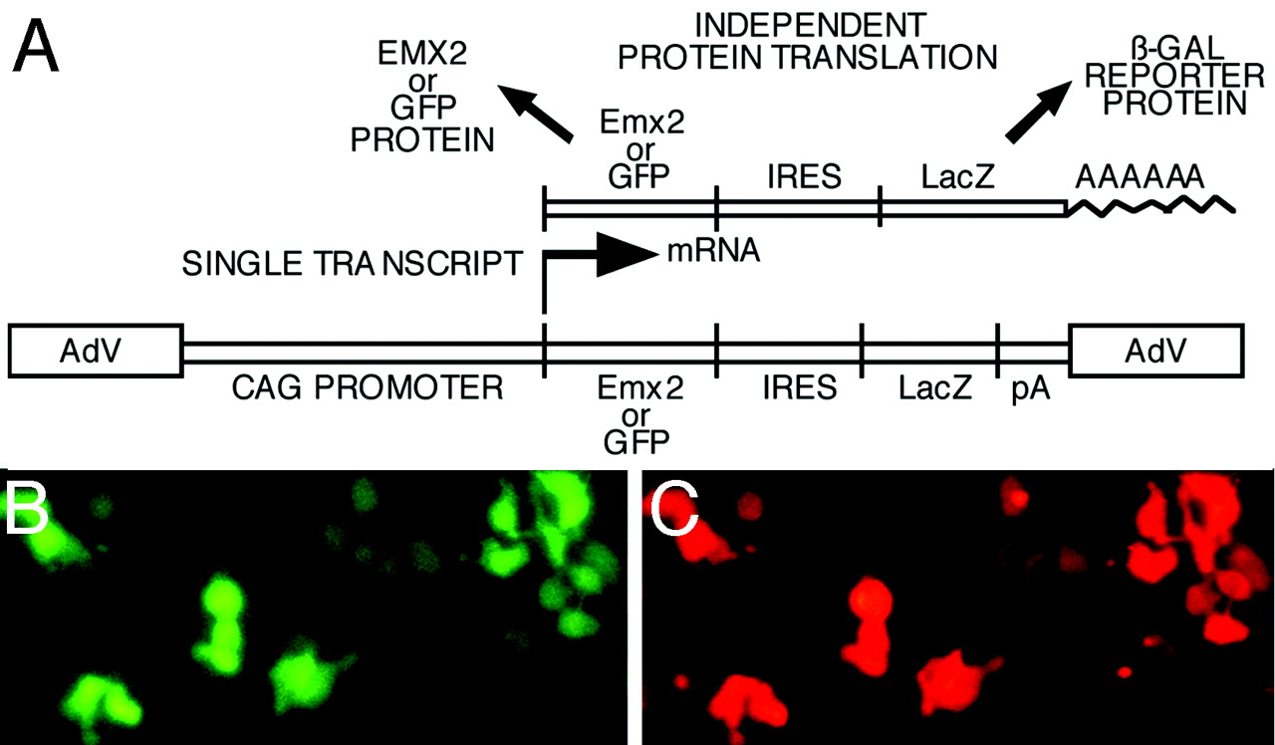
Figure 7. The dicistronic expression construct results in efficient translation of two distinct proteins. (A) Diagram ...
Notes:
Figure 7. The dicistronic expression construct results in efficient translation of two distinct proteins. (A) Diagram of the dicistronic expression construct engineered into a replication defective recombinant AdV; expression was under the control of the strong and ubiquitous CAG promoter (Niwa et al., 1991). The use of the IRES to make a dicistronic expression construct results in a single transcript that is translated into two independent proteins in transfected or infected cells. Abbreviations: AdV, adenovirus DNA; IRES, internal ribosomal entry site; β-GAL, β-galactosidase; CAG, cytomegalovirus/chick β-actin hybrid promoter; GFP, green fluorescent protein. (B, C) The same field showing colocalization of GFP (B) and β-gal (C) proteins in 293T cells transfected with the dicistronic expression construct, CAG/GFP/IRES/LacZ pA. All cells that express GFP, also express β-gal (the protein product of the LacZ gene), and vice versa. Cells were transfected using liposomes (Lipofectamine) with 10 μg of the expression construct cDNA per 35 mm dish. After 3 days, cells were fixed, stained with a β-gal antibody and a rhodamine-conjugated secondary, and viewed with a fluorescence microscope using a fluorescein filter for GFP and a rhodamine filter for β-gal immunostaining.
Unless provided in the caption above, the following copyright applies to the content of this slide: © Oxford University Press

Slide 8
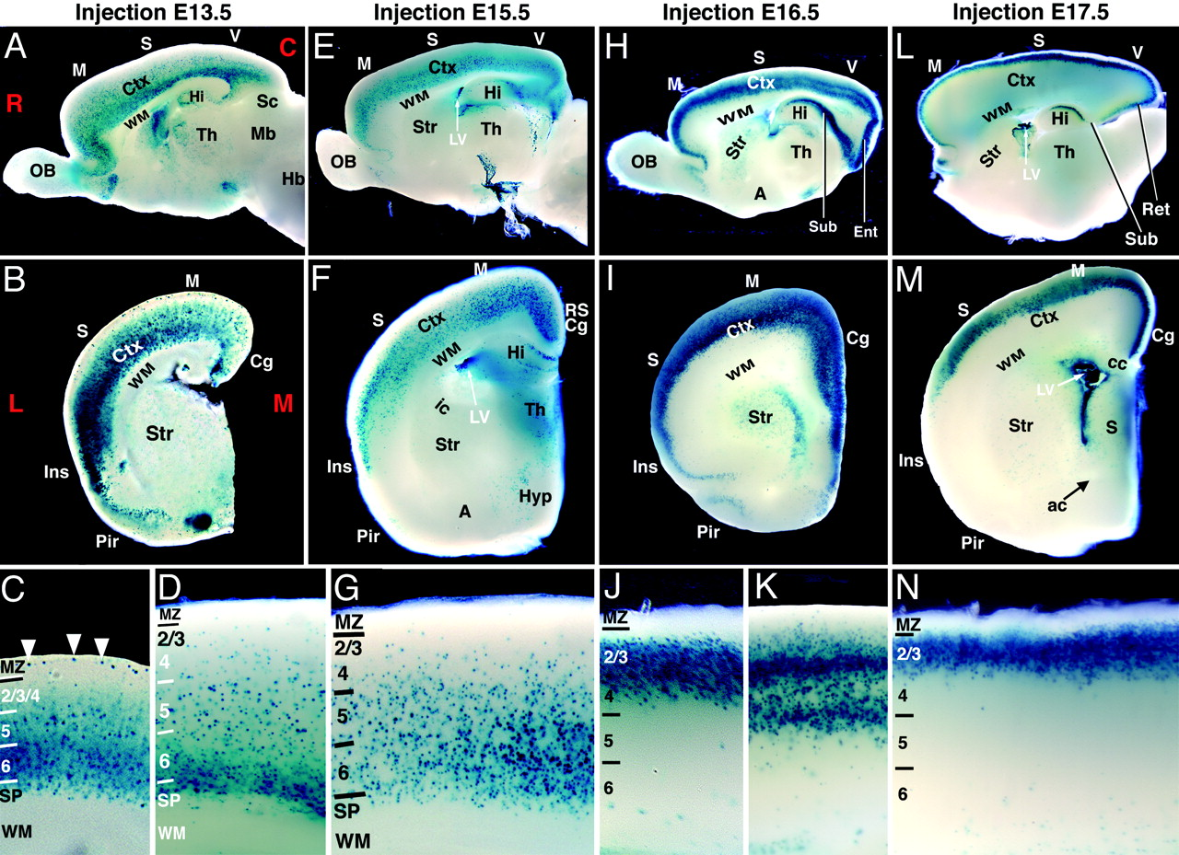
Figure 8. Transgene expressing cells have widespread tangential distribution but restricted laminar distribution ...
Notes:
Figure 8. Transgene expressing cells have widespread tangential distribution but restricted laminar distribution dependent on age of AdV injection. A replication defective AdV containing a CAG/LacZ pA expression construct was injected unilaterally into the lateral ventricle of the cerebral hemispheres at E13.5 (A–D), E15.5 (E–G), E16.5 (H–K) or E17.5 (L–N). Brains were fixed and analyzed for LacZ expression at P12, with the exception of the case shown in panels B–D, which was fixed at P4. AdV-infected cells were identified by expression of the β-gal reporter. (A, E, H, L) Sagittal sections; (B, F, I, M) coronal sections. (C, D, G, J, K, N) High power views of sections through the neocortex. AdV injections performed at each age resulted in a high density of β-gal positive cells throughout the tangential extent of the cerebral cortex, from rostral (R) to caudal (C) (A, E, H, L) and from medial (M) to lateral (L) (B, F, I, M). The AdV transgene was usually predominantly expressed in cerebral cortex, including neocortex (Ctx) (e.g. S: somatosensory areas, M: motor areas; V: visual areas), cingulate cortex (Cg), entorhinal cortex (Ent), subiculum (Sub) and hippocampus (Hi), and was often only weakly expressed in most other brain regions. The choroid plexus was always heavily infected (see lateral ventricle; LV, in E, F, L, M). The radial expression pattern in neocortex varied in relation to the developmental stage of the AdV injection, roughly matching the temporal–spatial patterns of neurogenesis and laminar formation: injections at E13.5 (A–D) led to the most dense expression in subplate, layer 6 and to some extent layer 5, but only weak expression in the more superficial layers 2,3,4 (C, D). Cells in the marginal zone (MZ) cells (arrowheads in C), which are co-generated with subplate neurons, are also labeled. Injections at E15.5 (E, F, G) result in densest expression in layers 6 and 5, lower expression in superficial layers, no expression in the marginal zone, and weak to no expression in the subplate (G). In contrast, injections at E16.5 (H, I, J, K) led to a high density of expressing cells in superficial layers 2/3 and 4, but virtually no expression in deeper layers or the marginal zone (J, K). In caudal and medial cortex [e.g. visual cortex (V) and cingulate cortex (Cg)], we often saw two stripes of heavy expression, separated by a stripe of weak expression (H, I, K). Injections at E17.5 (L, M, N) led to an even more restricted laminar expression pattern with a high density of expressing cells in superficial layers 2/3 and to some extent in layer 4 (N). Abbreviations: A, amygdala; ac, anterior commissure; Hb, hindbrain; Ins, insular cortex; Mb, midbrain; Pir, piriform cortex; RS, retrosplenial cortex; OB, olfactory bulb; ic, internal capsule; Hyp, hypothalamus; cc, corpus callosum; LV, lateral ventricle; S, septum; Sc, superior colliculus; Str, striatum; Th, thalamus; wm, white matter.
Unless provided in the caption above, the following copyright applies to the content of this slide: © Oxford University Press

Slide 9
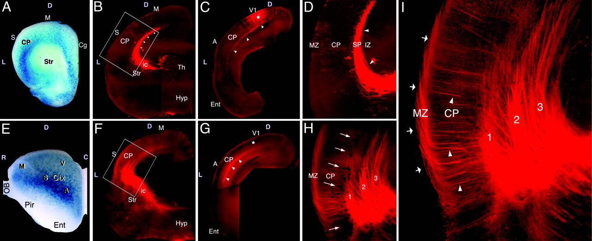
Figure 9. Aberrant area-specific thalamocortical projections correlate with domains of ectopic Emx2–AdV infection. ...
Notes:
Figure 9. Aberrant area-specific thalamocortical projections correlate with domains of ectopic Emx2–AdV infection. Recombinant AdV, containing a CAG/LacZ pA expression construct as a control (A–D) or a CAG/Emx2/IRES/LacZ pA dicistronic expression construct (E–I), was injected unilaterally into the lateral ventricle of the cortical hemisphere of E13.5 rat embryos. Pups were delivered normally, and later their brains were fixed and processed for X-gal histochemistry (blue) to β-gal protein product of LacZ. In cases infected with the CAG/Emx2/IRES/LacZ pA AdV, β-gal positive cells express both β-gal and EMX2 proteins. DiI was injected into the dorsal lateral geniculate nucleus (dLG) to anterogradely label its TCA projection that normally targets the primary visual area (V1). Later, the brains were coronally sectioned and photographed. β-gal labeled cells were not detected in X-gal processed, uninfected control brains (data not shown). (A–D) A control virus injected case fixed at P2 exhibits normal TCA pathfinding and targeting as typically observed in uninfected control brains. (A) After fixation, the part of the brain rostral to the internal capsule was cut off from the rest of the brain and processed for X-gal histochemistry. The rest of the brain was postfixed and used for DiI tracing. Strong blue staining demonstrates heavy infection with control AdV (S: somatosensory, M: motor, Cg: cingulate cortex). A high density of infected cells are seen in the subplate and deep layers of the cortical plate (CP). This high expression near the level of the internal capsule suggests heavy labeling throughout most of the tangential extent of the neocortex, as shown in control AdV infection studies (Fig. 8A,B). (B) A coronal section at a mid rostral–caudal level demonstrates DiI labeled dLG axons extending through the internal capsule (ic) and entering the cortex. TCAs from the dLG turn dorsally, accumulate in the subplate, and grow tangentially dorsally and caudally toward V1. (C) A more caudal coronal section shows labeled dLG axons growing along their tangential path (arrowheads) towards their final target, V1. The axons heavily invade the cortical plate of the primary visual area (V1) (asterisk). (D) A higher power view of the boxed area in B. The labeled dLG TCAs accumulate as a dense bundle centered on the subplate (SP; arrowheads); no labeled dLG axons invade the cortical plate (CP) at this lateral part of the neocortex, the location of the primary somatosensory area (S1). (E–I) An example of aberrant dLG TCA pathfinding and areal targeting in an Emx2/IRES/LacZ AdV injected case perfused shortly after time of birth (P0) and processed similar to the control case. (E) The entire brain was processed for X-gal histochemistry and photographed as a whole mount prior to sectioning to analyze DiI labeling. A high density of β-gal positive cells is found in lateral neocortex along its entire rostral–caudal extent; medially the density of β-gal positive cells is more moderate. (F) Labeled TCAs from the dLG extend normally through the internal capsule (ic), but upon entering the cortex, they exhibit highly aberrant pathfinding. (G) A more caudal section at a level similar to panel C. Relatively few TCAs reach their target area, V1 (asterisk). (H) Higher power view of the boxed area in E. This single exposure photo combines darkfield illumination with rhodamine fluorescence. Some of the more heavily labeled Emx2/IRES/LacZ AdV-infected cells can be seen in the deep cortical layers (clusters of black dots marked by arrows). The DiI labeled dLG TCAs fail to accumulate as a single dense bundle on the subplate, as in controls (see B, D), but instead form multiple bundles (marked as 1, 2 and 3) that extend tangentially within what appears to be (1) the deep layers of the cortical plate, (2) the subplate and (3) the intermediate zone. This aberrancy, and others, can be better seen in panel I. (I). A higher magnification view of the same region in panel H but photographed with only with rhodamine fluorescence. Many labeled TCAs extend from the aberrant bundles (1, 2, 3) radially across the cortical plate (CP, arrowheads), enter the marginal zone (MZ), turn dorsally, and extend tangentially within it (arrows). Abbreviations: A, auditory areas; C, caudal; CP, cortical plate; Ctx, neocortex; D, dorsal; Ent, entorhinal cortex; Hyp, hypothalamus; IZ, intermediate zone; L, lateral; M, motor areas; MZ, marginal zone; Pir, piriform cortex; OB, olfactory bulb; ic, internal capsule; R, rostral; S, somatosensory areas; SP, subplate; Str, striatum; Th, thalamus; V, visual areas; V1, primary visual area.
Unless provided in the caption above, the following copyright applies to the content of this slide: © Oxford University Press

