Slide 1
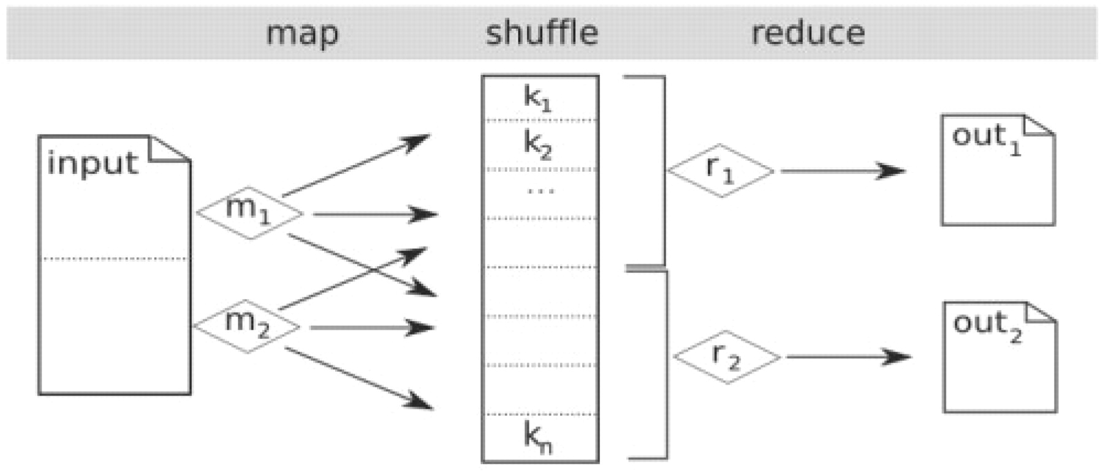
Fig. 1. Schematic overview of MapReduce. The input file(s) are automatically partitioned into chunks depending on ...
Notes:
Fig. 1. Schematic overview of MapReduce. The input file(s) are automatically partitioned into chunks depending on their size and the desired number of mappers. Each mapper (shown here as m1 and m2) executes a user-defined function on a chunk of the input and emits key–value pairs. The shuffle phase creates a list of values associated with each key (shown here as k1, k2 and kn). The reducers (shown here as r1 and r2) evaluate a user-defined function for their subset of the keys and associated list of values, to create the set of output files.
Unless provided in the caption above, the following copyright applies to the content of this slide: © 2009 The Author(s)This is an Open Access article distributed under the terms of the Creative Commons Attribution Non-Commercial License (http://creativecommons.org/licenses/by-nc/2.0/uk/) which permits unrestricted non-commercial use, distribution, and reproduction in any medium, provided the original work is properly cited.

Slide 2
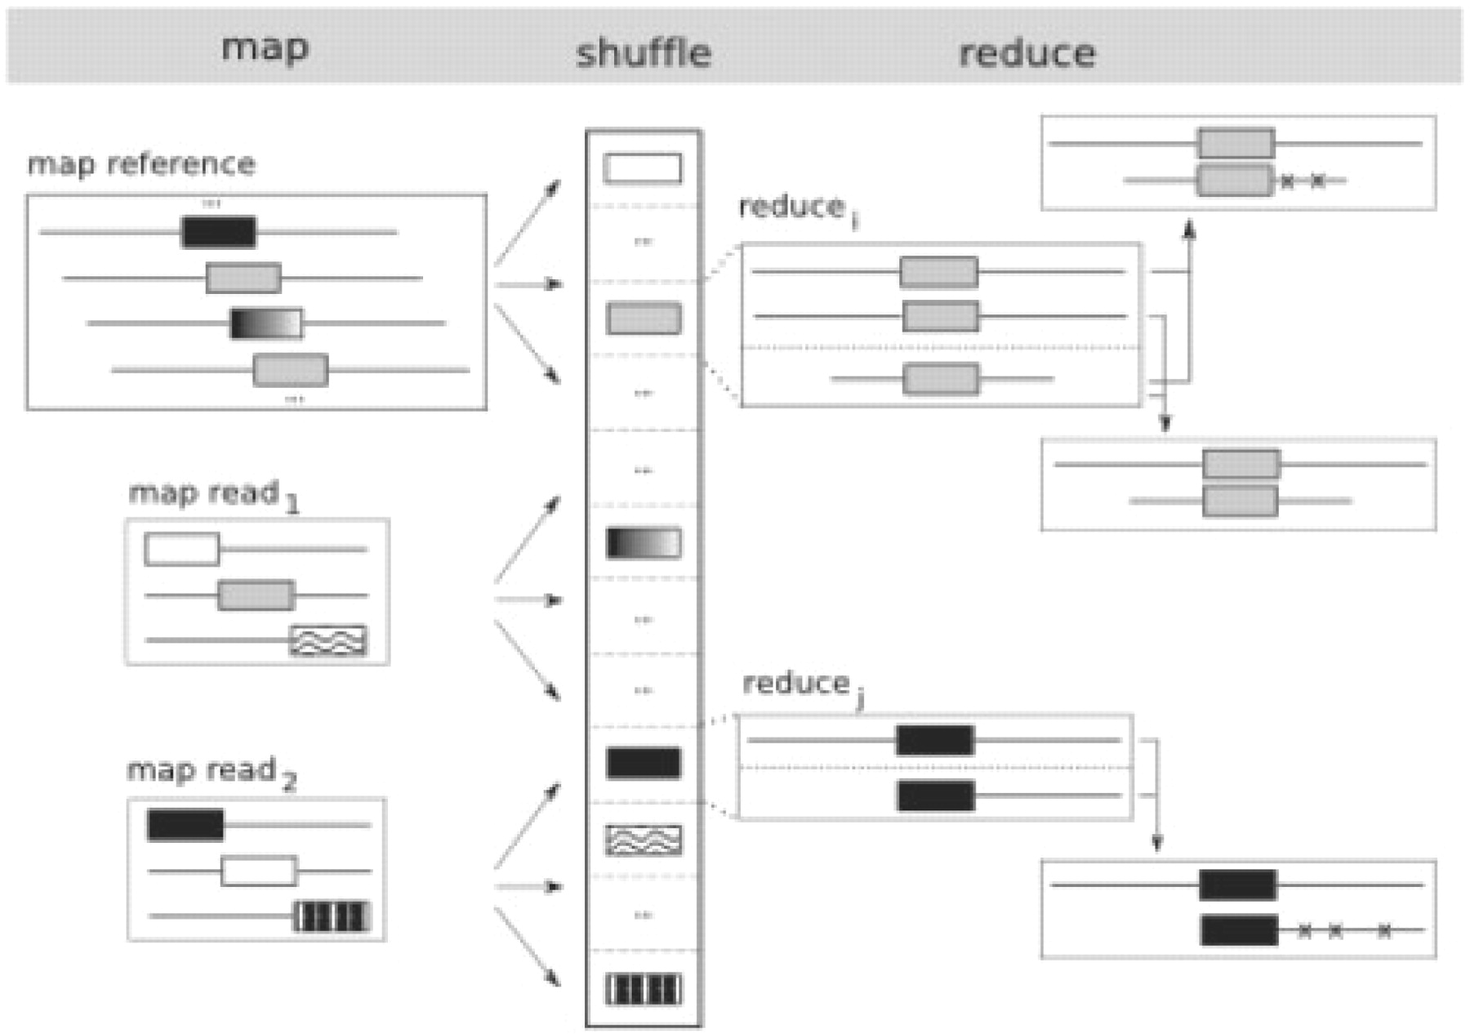
Fig. 2. Overview of the CloudBurst algorithm. The map phase emits k-mers as keys for every k-mer in the reference, ...
Notes:
Fig. 2. Overview of the CloudBurst algorithm. The map phase emits k-mers as keys for every k-mer in the reference, and for all non-overlapping k-mers in the reads. The shufle phase groups together the k-mers shared between the reads and the reference. The reduce phase extends the seeds into end-to-end alignments allowing for a fixed number of mismatches or indels. Here, two grey reference seeds are compared with a single read creating one alignment with two errors and one alignment with zero errors, while the black shared seed is extended to an alignment with three errors.
Unless provided in the caption above, the following copyright applies to the content of this slide: © 2009 The Author(s)This is an Open Access article distributed under the terms of the Creative Commons Attribution Non-Commercial License (http://creativecommons.org/licenses/by-nc/2.0/uk/) which permits unrestricted non-commercial use, distribution, and reproduction in any medium, provided the original work is properly cited.

Slide 3
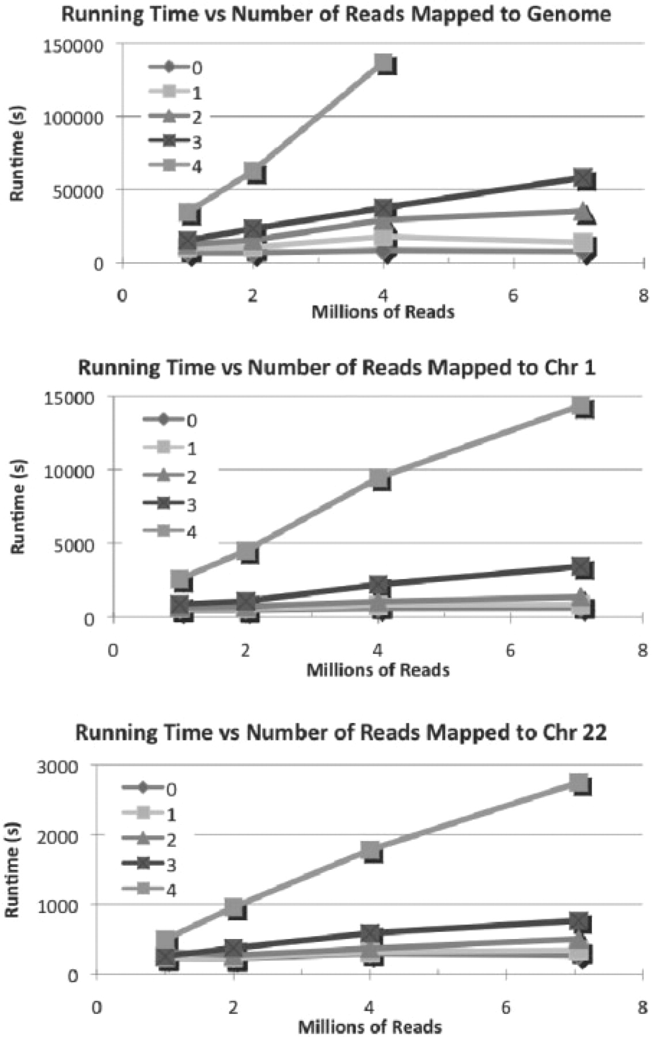
Fig. 3. Evaluation of CloudBurst running time while scaling the number of reads and sensitive for mapping to the (A) ...
Notes:
Fig. 3. Evaluation of CloudBurst running time while scaling the number of reads and sensitive for mapping to the (A) full human genome; (B) chromosomes 1; and (C) 22 on the local cluster with 24 cores. Tinted lines indicate timings allowing 0 (fastest) through four (slowest) mismatches between a read and the reference. As the number of reads increases, the running time increases linearly. As the number of allowed mismatches increases, the running time increases superlinearly from the exponential increase in seed instances. The four mismatch computation against the full human genome failed to complete due to lack of available disk space after reporting ∼25 billion end-to-end alignments.
Unless provided in the caption above, the following copyright applies to the content of this slide: © 2009 The Author(s)This is an Open Access article distributed under the terms of the Creative Commons Attribution Non-Commercial License (http://creativecommons.org/licenses/by-nc/2.0/uk/) which permits unrestricted non-commercial use, distribution, and reproduction in any medium, provided the original work is properly cited.

Slide 4
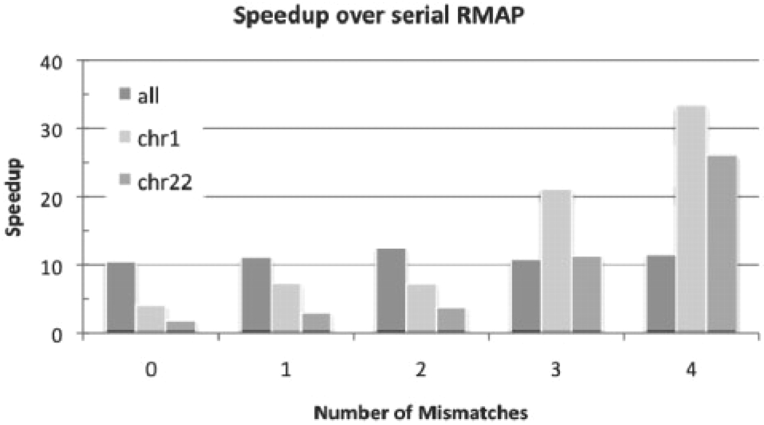
Fig. 4. CloudBurst running time compared with RMAP for 7M reads, showing the speedup of CloudBurst running on 24 ...
Notes:
Fig. 4. CloudBurst running time compared with RMAP for 7M reads, showing the speedup of CloudBurst running on 24 cores compared with RMAP running on 1 core. As the number of allowed mismatches increases, the relative overhead decreases allowing CloudBurst to meet and exceed 24× linear speedup.
Unless provided in the caption above, the following copyright applies to the content of this slide: © 2009 The Author(s)This is an Open Access article distributed under the terms of the Creative Commons Attribution Non-Commercial License (http://creativecommons.org/licenses/by-nc/2.0/uk/) which permits unrestricted non-commercial use, distribution, and reproduction in any medium, provided the original work is properly cited.

Slide 5
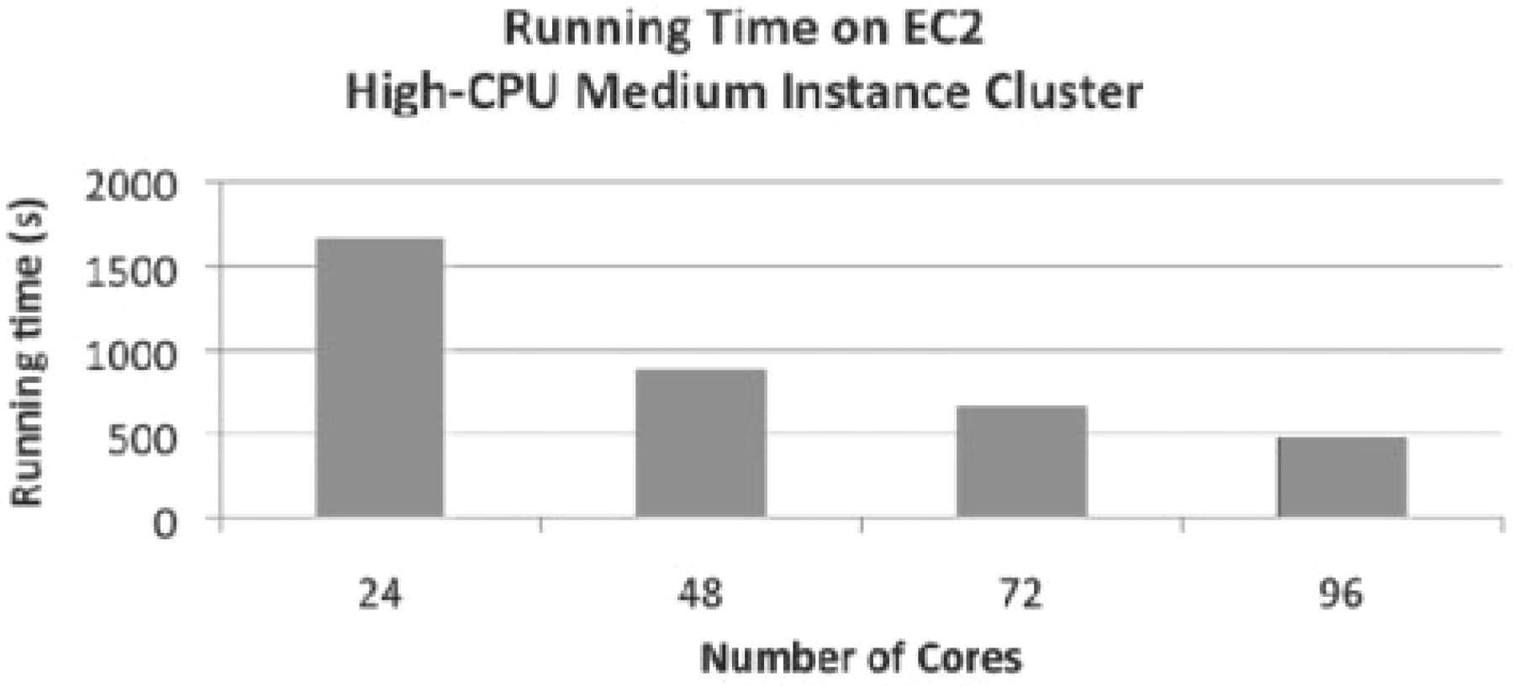
Fig. 5. Comparison of CloudBurst running time (in seconds) while scaling size of the cluster for mapping 7M reads to ...
Notes:
Fig. 5. Comparison of CloudBurst running time (in seconds) while scaling size of the cluster for mapping 7M reads to human chromosome 22 with at most four mismatches on the EC2 Cluster. The 96-core cluster is 3.5× faster than the 24-core cluster.
Unless provided in the caption above, the following copyright applies to the content of this slide: © 2009 The Author(s)This is an Open Access article distributed under the terms of the Creative Commons Attribution Non-Commercial License (http://creativecommons.org/licenses/by-nc/2.0/uk/) which permits unrestricted non-commercial use, distribution, and reproduction in any medium, provided the original work is properly cited.

