Slide 1
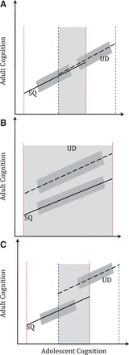
Figure 1 Graphical representation showing cognitive selection into educational attainment and educational benefits on ...
Notes:
Figure 1 Graphical representation showing cognitive selection into educational attainment and educational benefits on adult cognition. Secondary Qualifications (SQ) lines are solid; University Degree (UD) lines are dashed. Dark grey bands represent confidence intervals. Light grey bands show regions where different qualifications have graduates with similar adolescent intelligence. (A) Cognitive processes: adolescent and adult cognition are correlated; adolescent intelligence defines propensity for educational attainment with no educational benefits. (B) Educational benefits: no cognitive selection for educational attainment; adult cognition determined by both adolescent intelligence and educational benefits. (C) Multiple processes: evidence for both cognitive selection into education and benefit of education on adult cognition
Unless provided in the caption above, the following copyright applies to the content of this slide: Published by Oxford University Press on behalf of the International Epidemiological Association © The Author 2012; all rights reserved.This is an Open Access article distributed under the terms of the Creative Commons Attribution Non-Commercial License (http://creativecommons.org/licenses/by-nc/3.0/), which permits non-commercial re-use, distribution, and reproduction in any medium, provided the original work is properly cited. For commercial re-use, please contact journals.permissions@oup.com

Slide 2
Figure 2 Adult fluid cognition by adolescent intelligence for those who were educated to a university degree (UD) as ...
Notes:
Figure 2 Adult fluid cognition by adolescent intelligence for those who were educated to a university degree (UD) as compared with those with secondary qualifications (SQ). We provide OLS estimates using thick black lines, and 95% confidence intervals using mirrored solid thin grey lines. For explanatory purposes, we use horizontal solid lines capped by circles and dashed vertical lines to estimate a point estimate for the cognitive offset evaluated at the sample average (ΔC0). (A) In the U.S. 1939 cohort, ΔC0 is large at 1.49 (1.44–1.54; P < 0.001). (B) In the 1946 G.B. cohort, ΔC0 was 0.40 (−0.01 to 0.81; P > 0.05). (C) In the 1958 G.B. cohort, ΔC0 was 0.49 (0.45–0.53; P < 0.001)
Unless provided in the caption above, the following copyright applies to the content of this slide: Published by Oxford University Press on behalf of the International Epidemiological Association © The Author 2012; all rights reserved.This is an Open Access article distributed under the terms of the Creative Commons Attribution Non-Commercial License (http://creativecommons.org/licenses/by-nc/3.0/), which permits non-commercial re-use, distribution, and reproduction in any medium, provided the original work is properly cited. For commercial re-use, please contact journals.permissions@oup.com

Slide 3
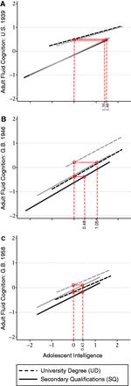
Figure 3 Adolescent cognition related to adult fluid cognition for women and men. Results for women are grey, whereas ...
Notes:
Figure 3 Adolescent cognition related to adult fluid cognition for women and men. Results for women are grey, whereas those for men are black. In both G.B. cohorts, women had higher adult fluid cognition than did men. (A) In the U.S. 1939 cohort, no gender differences were evident. (B) In the G.B. 1946 cohort, women benefited twice as much (P < 0.05) from higher education [ΔC0 = 1.05 (0.86–1.24)] as men [ΔC0 = 0.46 (0.28–0.64)]. (C) In the 1958 G.B. cohort, women and men benefited equally
Unless provided in the caption above, the following copyright applies to the content of this slide: Published by Oxford University Press on behalf of the International Epidemiological Association © The Author 2012; all rights reserved.This is an Open Access article distributed under the terms of the Creative Commons Attribution Non-Commercial License (http://creativecommons.org/licenses/by-nc/3.0/), which permits non-commercial re-use, distribution, and reproduction in any medium, provided the original work is properly cited. For commercial re-use, please contact journals.permissions@oup.com

