Slide 1
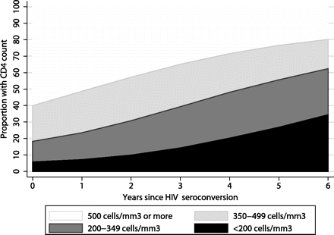
Figure 1. Distribution of CD4+ cell count and percentage of subjects reaching CD4 cell count category and year ...
Notes:
Figure 1. Distribution of CD4+ cell count and percentage of subjects reaching CD4 cell count category and year following HIV seroconversion, estimated from a linear mixed model.
Unless provided in the caption above, the following copyright applies to the content of this slide: © The Author 2011. Published by Oxford University Press on behalf of the Infectious Diseases Society of America. All rights reserved. For Permissions, please e-mail: journals.permissions@oup.com.

