Slide 1
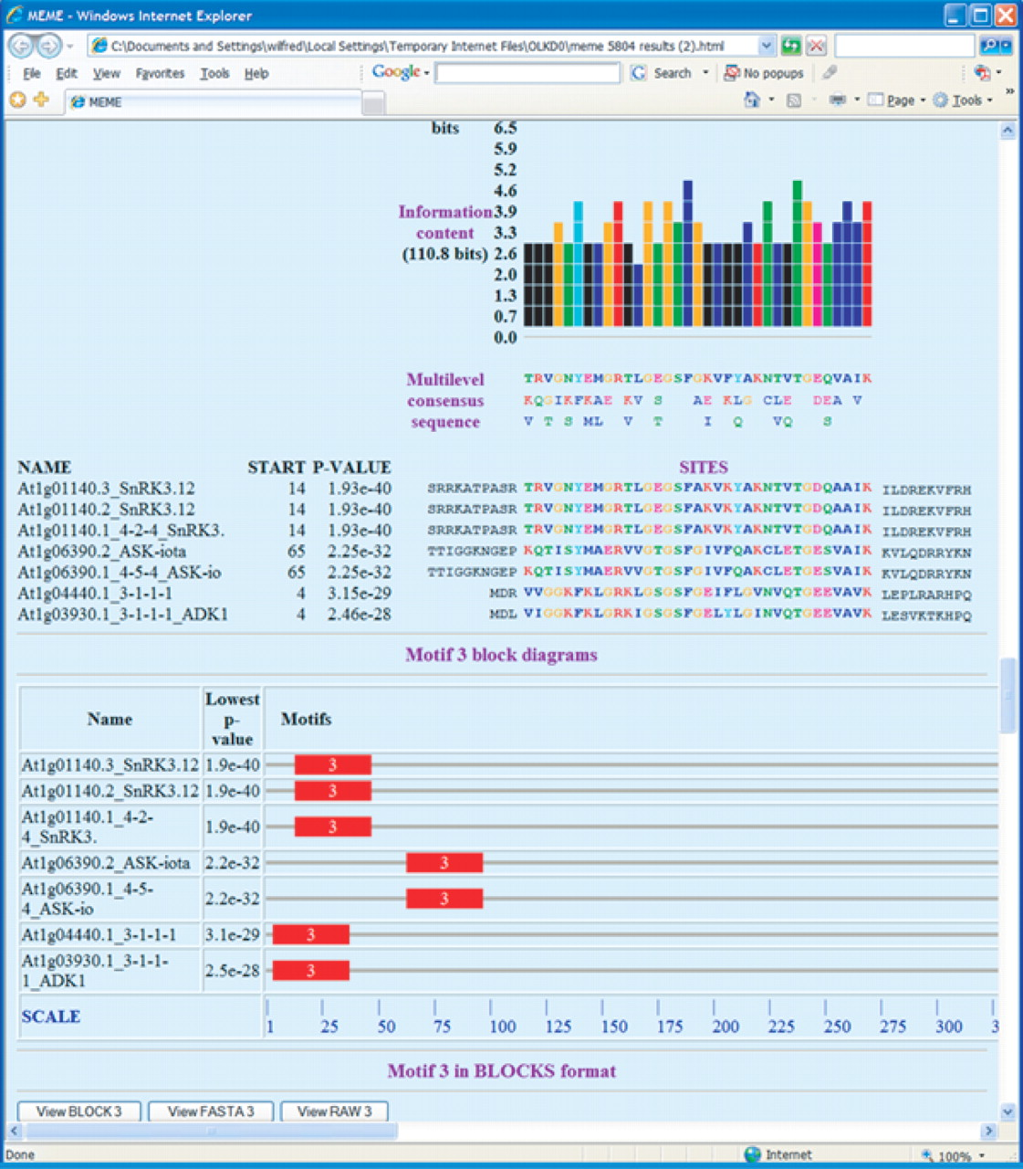
Figure 1 Sample MEME output.This portion of an MEME HTML output form shows a protein motif that MEME has discovered in ...
Notes:
Figure 1 Sample MEME output.This portion of an MEME HTML output form shows a protein motif that MEME has discovered in the input sequences. The sites identified as belonging to the motif are indicated, and above them is the ‘consensus’ of the motif and a color-coded bar graph showing the conservation of each position in the motif. Some of the hyperlinked buttons that allow the motif to be viewed and analyzed in other ways can be seen at the bottom of the screen shot.
Unless provided in the caption above, the following copyright applies to the content of this slide: © The Author 2006. Published by Oxford University Press. All rights reserved The online version of this article has been published under an open access model. Users are entitled to use, reproduce, disseminate, or display the open access version of this article for non-commercial purposes provided that: the original authorship is properly and fully attributed; the Journal and Oxford University Press are attributed as the original place of publication with the correct citation details given; if an article is subsequently reproduced or disseminated not in its entirety but only in part or as a derivative work this must be clearly indicated. For commercial re-use, please contact journals.permissions@oxfordjournals.org

Slide 2
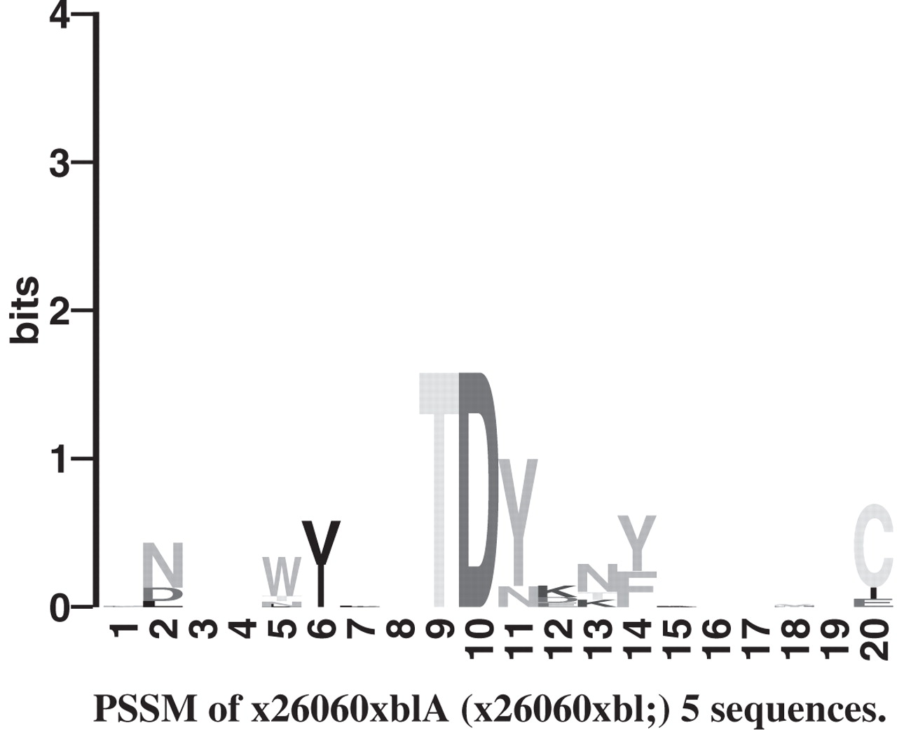
Figure 2 LOGO of protein motif. LOGOS are a visualization tool for motifs. The height of a letter indicates its ...
Notes:
Figure 2 LOGO of protein motif. LOGOS are a visualization tool for motifs. The height of a letter indicates its relative frequency at the given position ( x -axis) in the motif.
Unless provided in the caption above, the following copyright applies to the content of this slide: © The Author 2006. Published by Oxford University Press. All rights reserved The online version of this article has been published under an open access model. Users are entitled to use, reproduce, disseminate, or display the open access version of this article for non-commercial purposes provided that: the original authorship is properly and fully attributed; the Journal and Oxford University Press are attributed as the original place of publication with the correct citation details given; if an article is subsequently reproduced or disseminated not in its entirety but only in part or as a derivative work this must be clearly indicated. For commercial re-use, please contact journals.permissions@oxfordjournals.org

Slide 3
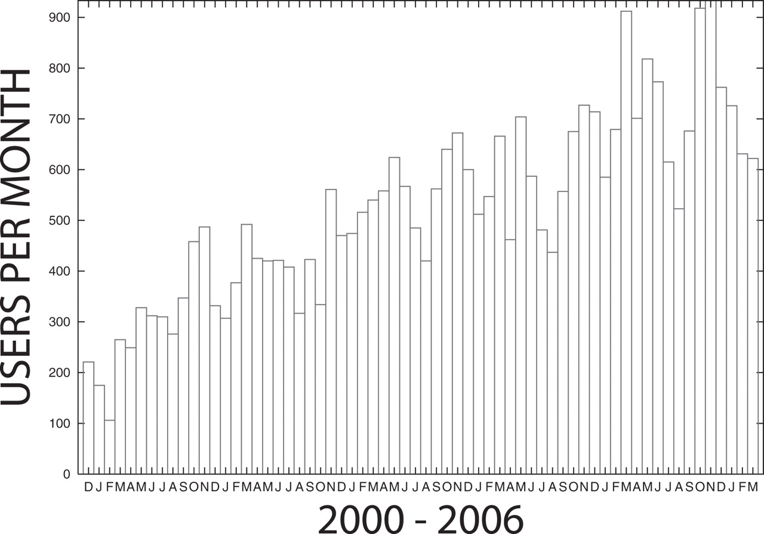
Figure 3 Usage of MEME at the NBCR web server. The plot shows the number of different users submitting jobs to the ...
Notes:
Figure 3 Usage of MEME at the NBCR web server. The plot shows the number of different users submitting jobs to the NBCR MEME web server each month since December 2000. Usage figures for March 2006 include up to March 20 only.
Unless provided in the caption above, the following copyright applies to the content of this slide: © The Author 2006. Published by Oxford University Press. All rights reserved The online version of this article has been published under an open access model. Users are entitled to use, reproduce, disseminate, or display the open access version of this article for non-commercial purposes provided that: the original authorship is properly and fully attributed; the Journal and Oxford University Press are attributed as the original place of publication with the correct citation details given; if an article is subsequently reproduced or disseminated not in its entirety but only in part or as a derivative work this must be clearly indicated. For commercial re-use, please contact journals.permissions@oxfordjournals.org

