Slide 1
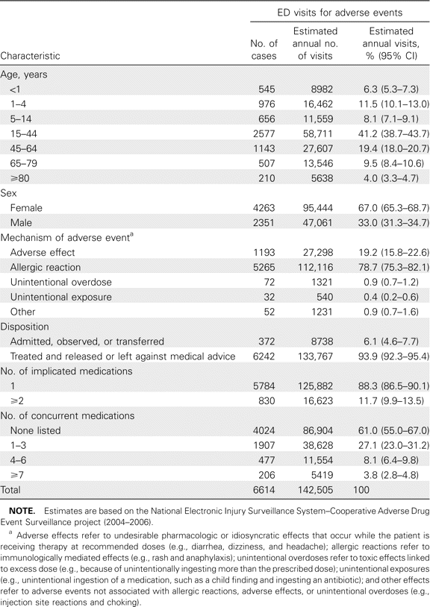
Table 1 Number of cases and national estimates of emergency department (ED) visits for adverse events associated with ...
Notes:
Table 1 Number of cases and national estimates of emergency department (ED) visits for adverse events associated with systemic antibiotics, by patient and case characteristics—United States, 2004–2006.
Unless provided in the caption above, the following copyright applies to the content of this slide: © 2008 Infectious Diseases Society of America.

Slide 2
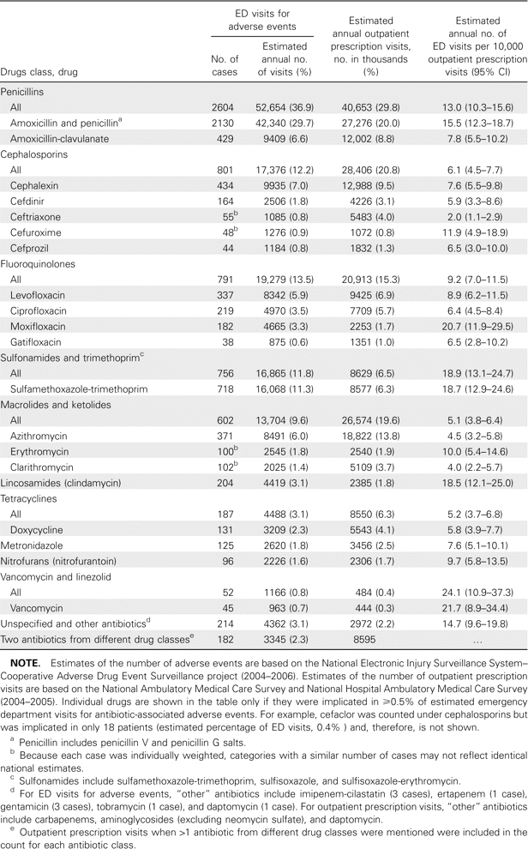
Table 2 Number of cases and national estimates of emergency department (ED) visits for adverse events associated with ...
Notes:
Table 2 Number of cases and national estimates of emergency department (ED) visits for adverse events associated with systemic antibiotics, by drug—United States, 2004–2006.
Unless provided in the caption above, the following copyright applies to the content of this slide: © 2008 Infectious Diseases Society of America.

Slide 3
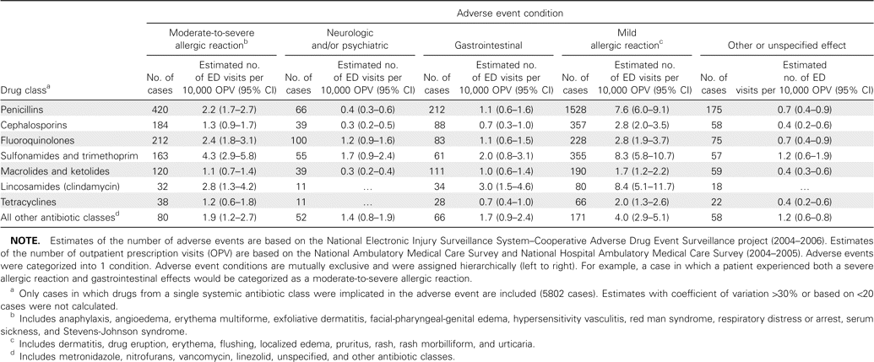
Table 3 Number of cases and national estimates of the rate of emergency department (ED) visits for adverse events ...
Notes:
Table 3 Number of cases and national estimates of the rate of emergency department (ED) visits for adverse events associated with a single systemic antibiotic class, by adverse event condition—United States, 2004–2006.
Unless provided in the caption above, the following copyright applies to the content of this slide: © 2008 Infectious Diseases Society of America.

