Slide 1
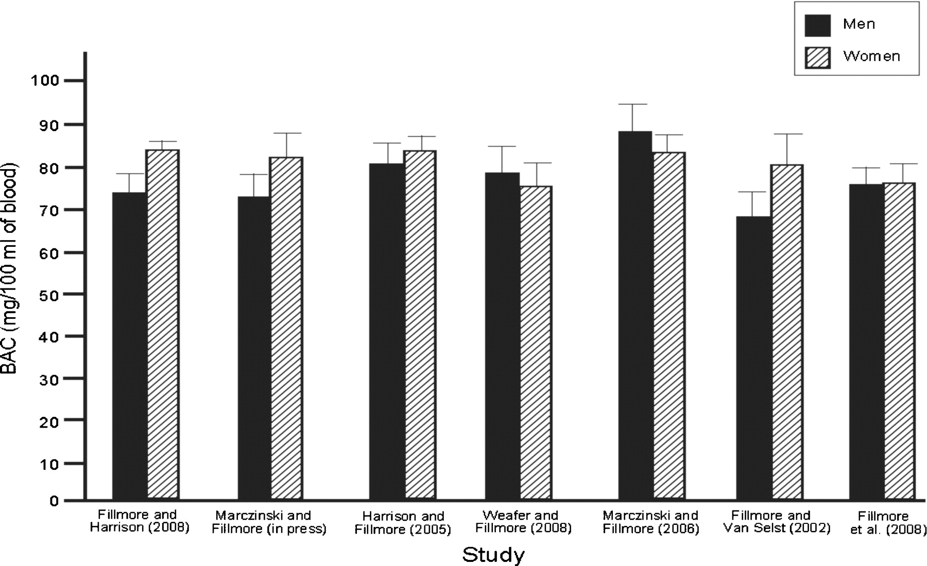
Fig. 1 Mean blood alcohol concentration (mg/100 mL of blood) for men and women in each experiment.
Notes:
Fig. 1 Mean blood alcohol concentration (mg/100 mL of blood) for men and women in each experiment.
Unless provided in the caption above, the following copyright applies to the content of this slide: © Oxford University Press 2009

