Slide 1
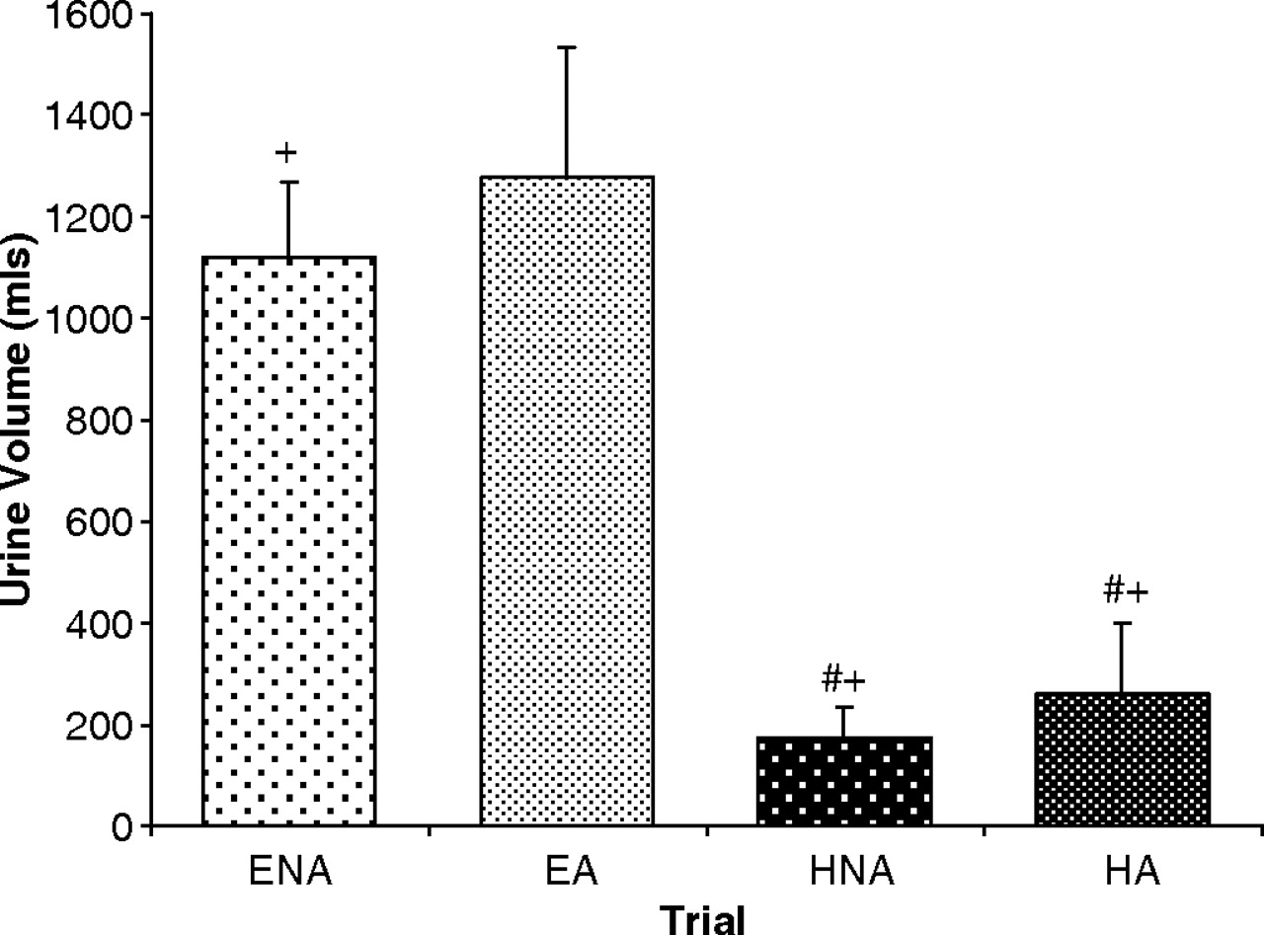
Fig. 1 Total cumulative urine volume produced over the 4-h observation period post-drink ingestion. The number signs ...
Notes:
Fig. 1 Total cumulative urine volume produced over the 4-h observation period post-drink ingestion. The number signs denote a significantly smaller volume produced than ENA. The plus signs denote a significantly smaller volume than EA. ENA, euhydrated without alcohol; EA, euhydrated with alcohol; HNA, hypohydrated without alcohol; HA, hypohydrated with alcohol.
Unless provided in the caption above, the following copyright applies to the content of this slide: © Oxford University Press 2010

Slide 2
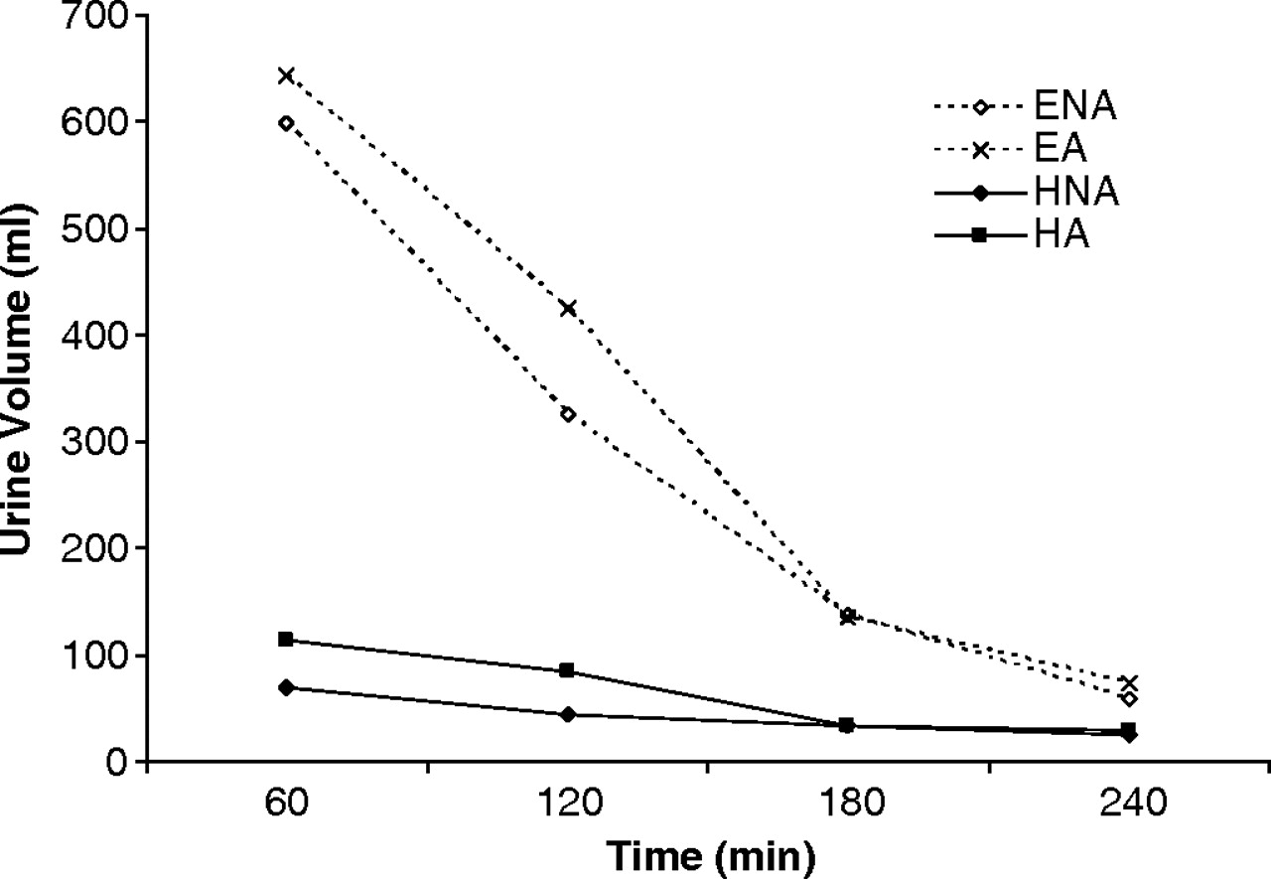
Fig. 2 Hourly urine output for the 4-h observation period after drink ingestion.
Notes:
Fig. 2 Hourly urine output for the 4-h observation period after drink ingestion.
Unless provided in the caption above, the following copyright applies to the content of this slide: © Oxford University Press 2010

Slide 3
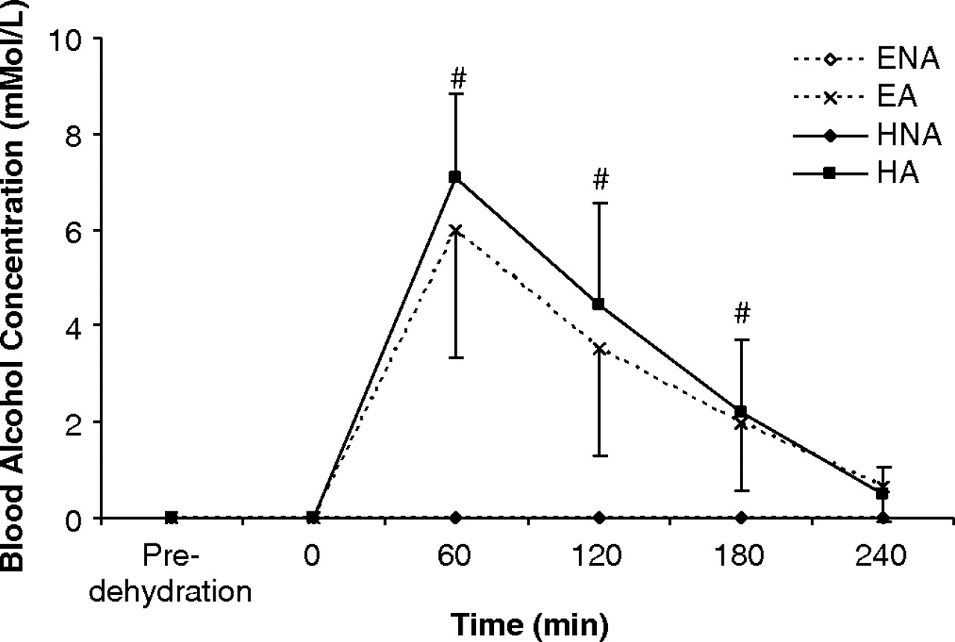
Fig. 3 Blood alcohol concentration over the duration of the trials. The number signs denote a significantly greater ...
Notes:
Fig. 3 Blood alcohol concentration over the duration of the trials. The number signs denote a significantly greater blood alcohol concentration for both EA and HA compared with either ENA or HNA.
Unless provided in the caption above, the following copyright applies to the content of this slide: © Oxford University Press 2010

Slide 4
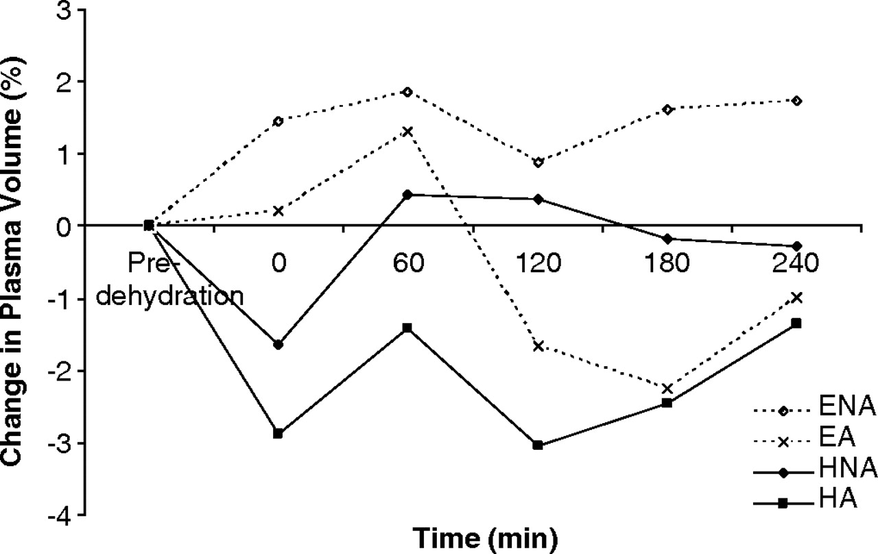
Fig. 4 Percentage change in plasma volume compared with the pre-dehydration baseline over the duration of the ...
Notes:
Fig. 4 Percentage change in plasma volume compared with the pre-dehydration baseline over the duration of the trials. There were no significant differences between the trials and no effect of time.
Unless provided in the caption above, the following copyright applies to the content of this slide: © Oxford University Press 2010

Slide 5
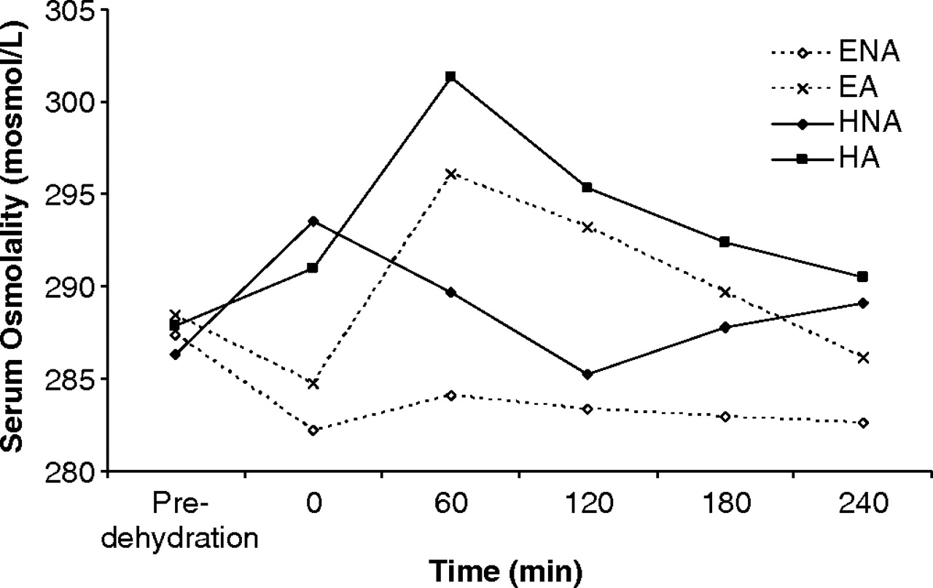
Fig. 5 Serum osmolality over the duration of the trials.
Notes:
Fig. 5 Serum osmolality over the duration of the trials.
Unless provided in the caption above, the following copyright applies to the content of this slide: © Oxford University Press 2010

Slide 6
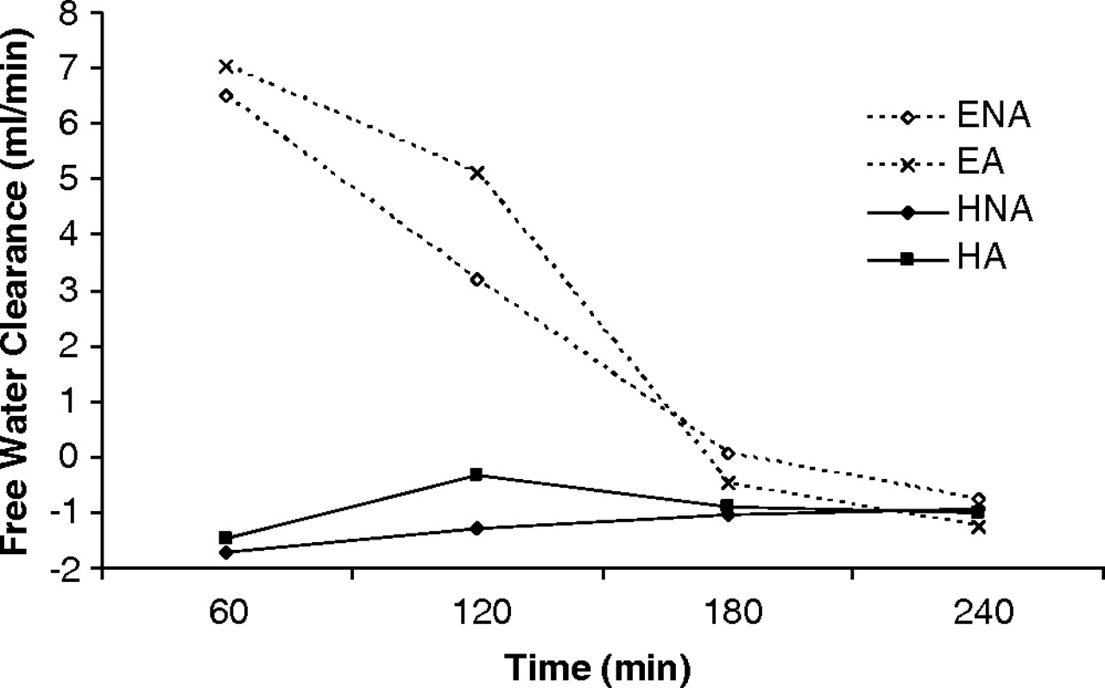
Fig. 6 Free water clearance in the 4-h observation period after drink ingestion. There was a significant difference ...
Notes:
Fig. 6 Free water clearance in the 4-h observation period after drink ingestion. There was a significant difference between the euhydrated trials and the hypohydrated trials (P < 0.001), and after 120 min there was a significant difference between ENA and EA and between HNA and HA.
Unless provided in the caption above, the following copyright applies to the content of this slide: © Oxford University Press 2010

