Slide 1
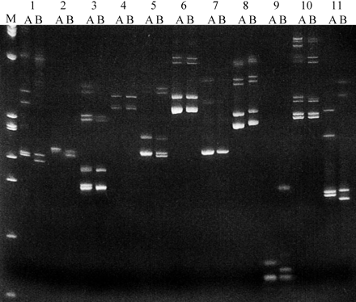
Figure 1. Scoring of fox amplified microsatellites with dog-specific primers. Each marker was amplified on DNA from two ...
Notes:
Figure 1. Scoring of fox amplified microsatellites with dog-specific primers. Each marker was amplified on DNA from two unrelated foxes (A, B). A 10 μl aliquot of each PCR product (from a total reaction volume 25 μl) was electrophoresed in 10% native polyacrylamide gel. (M) Ø/HaeIII; (1) DGN3; (2) REN112I02; (3) REN162B09; (4) REN242N13; (5) AHTK338; (6) REN149E24; (7) FH2274; (8) REN229P15; (9) REN123E09; (10) REN47D17; (11) FH2613. For each marker, amplification robustness was scored, on a five-point scale, as the estimated intensity of the most prominent band. Markers 3, 5, 6, 7, 8, 10, and 11 received a score of 5; markers 1, 2, and 9 received a score of 4; marker 4 received a score of 3
Unless provided in the caption above, the following copyright applies to the content of this slide: © 2004 The American Genetic Association

Slide 2
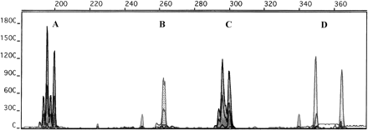
Figure 2. An example of a multiplex set amplified from DNA of a domestic fox and analyzed with the ABI 310. (A) ...
Notes:
Figure 2. An example of a multiplex set amplified from DNA of a domestic fox and analyzed with the ABI 310. (A) REN162B09: dinucleotide repeat labeled with Hex; allele sizes are 195 and 199 bp; (B) FH2174: tetra repeat labeled with Tet; allele size is 262 bp; (C) FH3019: dinucleotide repeat labeled with Hex; allele sizes are 296 and 300 bp; (D) FH2309: tetra repeat labeled with 6Fam; allele sizes are 250 and 364 bp
Unless provided in the caption above, the following copyright applies to the content of this slide: © 2004 The American Genetic Association

Slide 3
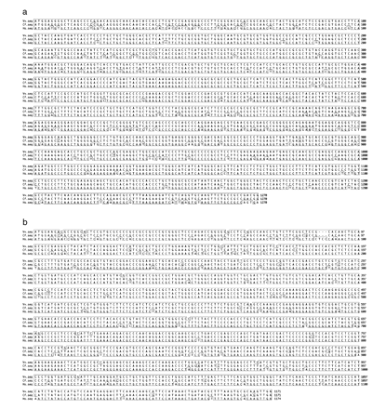
Figure 3. (A) Alignment of coding regions of fox (Vv), dog (Cf), and human (Hs) 5-HT_{1A} receptor gene. (B) ...
Notes:
Figure 3. (A) Alignment of coding regions of fox (Vv), dog (Cf), and human (Hs) 5-HT1A receptor gene. (B) Alignment of coding regions of fox (Vv), dog (Cf), and human (Hs) 5-HT1B receptor gene
Unless provided in the caption above, the following copyright applies to the content of this slide: © 2004 The American Genetic Association

