Slide 1
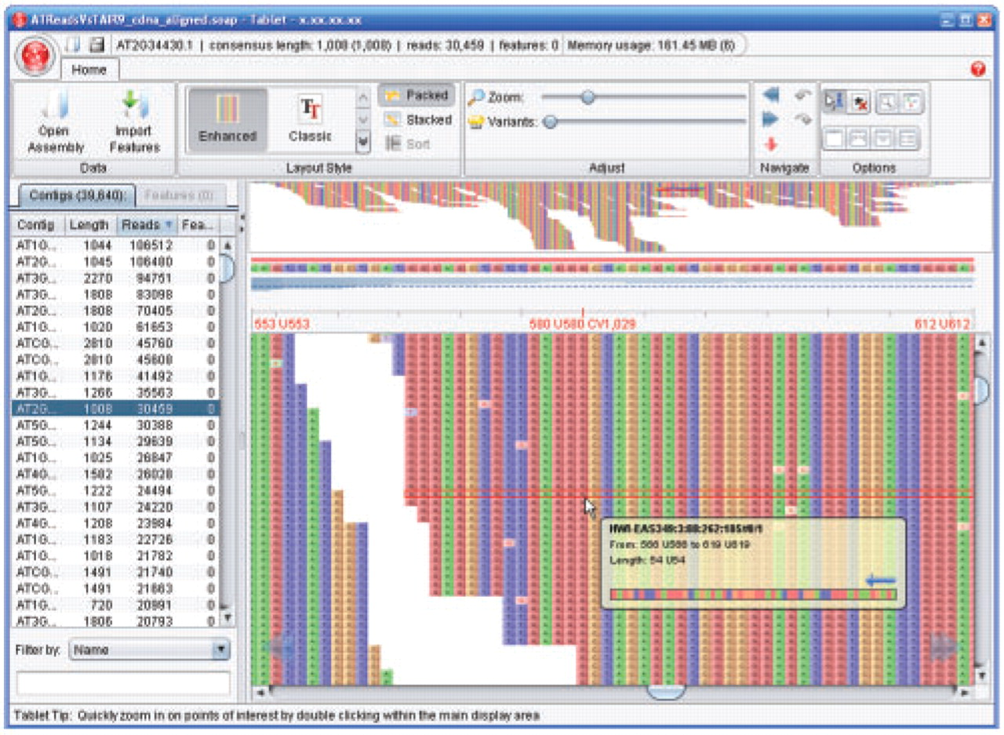
Fig. 1. Tablet showing Illumina Solexa reads against an Arabidopsis thaliana cDNA reference sequence (additional ...
Notes:
Fig. 1. Tablet showing Illumina Solexa reads against an Arabidopsis thaliana cDNA reference sequence (additional screenshots can be seen online at http://bioinf.scri.ac.uk/tablet/screenshots.shtml).
Unless provided in the caption above, the following copyright applies to the content of this slide: © The Author(s) 2009. Published by Oxford University Press.This is an Open Access article distributed under the terms of the Creative Commons Attribution Non-Commercial License (http://creativecommons.org/licenses/by-nc/2.5) which permits unrestricted non-commercial use, distribution, and reproduction in any medium, provided the original work is properly cited.

