Slide 1
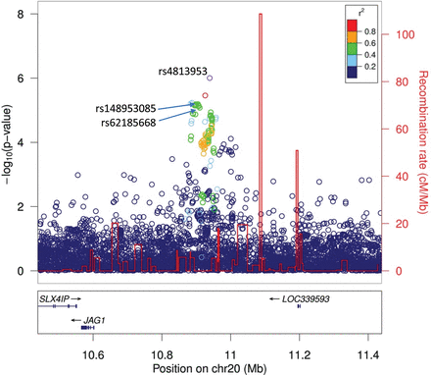
Figure 1. Regional association plot for the 20p12.2 locus. The figure shows the −log10 P-values (left vertical axis) of ...
Notes:
Figure 1. Regional association plot for the 20p12.2 locus. The figure shows the −log10 P-values (left vertical axis) of variant associations with UBC in the Icelandic discovery samples against their positions at the 20p12.2 locus. The purple circle highlights the most significant SNP, rs4813953, in the discovery analysis and circles corresponding to other SNPs are color coded to reflect their LD with rs4813953 estimated in the Icelandic dataset. The red line indicates recombination rates (right axis), based on the Icelandic recombination map for males and females (19) combined with the peaks indicating recombination hotspots defining LD blocks. Known genes in the region are shown underneath the plot, taken from the UCSC genes track in the UCSC genome browser. All positions are in NCBI Build 36 coordinates. The plot was created using a standalone version of the LocusZoom software (http://csg.sph.umich.edu/locuszoom/) (20).
Unless provided in the caption above, the following copyright applies to the content of this slide: © The Author 2014. Published by Oxford University Press. All rights reserved. For Permissions, please email: journals.permissions@oup.com

