Slide 1
Table 1 Methodological Details: Primer Information and List of Reference Sequences Used to Generate Phylogenetic ...
Notes:
Table 1 Methodological Details: Primer Information and List of Reference Sequences Used to Generate Phylogenetic Trees
Unless provided in the caption above, the following copyright applies to the content of this slide: © 2010 by the Infectious Diseases Society of America

Slide 2
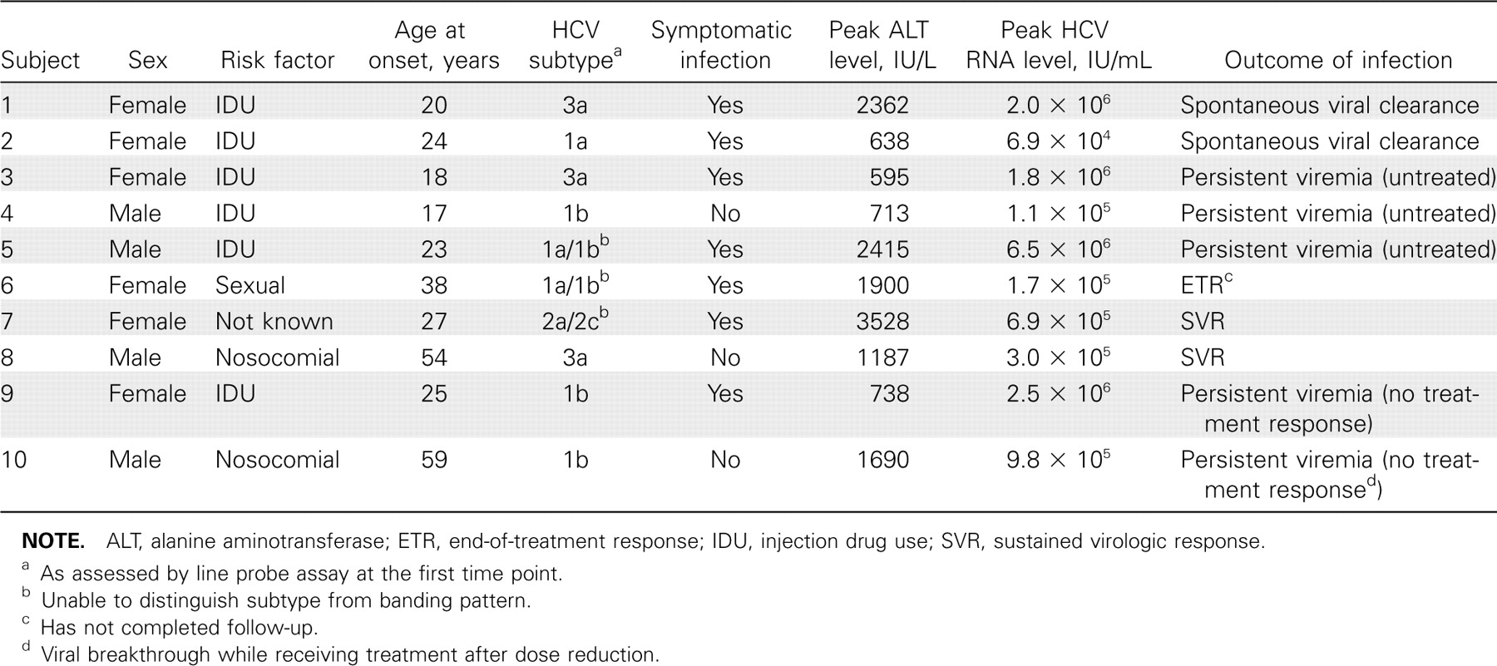
Table 2 Summary of Clinical and Virologic Features of Patients with Acute Hepatitis C Virus (HCV) Infection
Notes:
Table 2 Summary of Clinical and Virologic Features of Patients with Acute Hepatitis C Virus (HCV) Infection
Unless provided in the caption above, the following copyright applies to the content of this slide: © 2010 by the Infectious Diseases Society of America

Slide 3
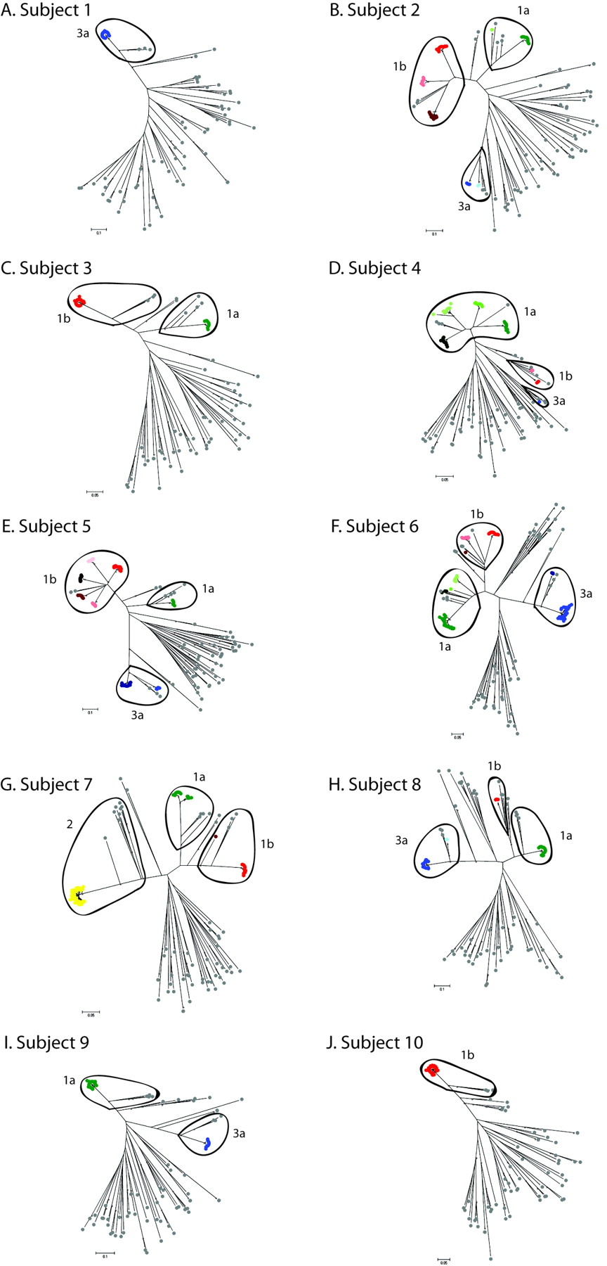
Figure 1 Neighbor-joining trees based on the 225-base pair E2 fragment, which includes hypervariable region 1, showing ...
Notes:
Figure 1 Neighbor-joining trees based on the 225-base pair E2 fragment, which includes hypervariable region 1, showing all sequences from all subjects throughout acute hepatitis C virus infection. Colored and gray spots represent patient samples and reference sequences from all verified genotypes, respectively. Different colors are used to distinguish distinct viral clades. Sample sequences are colored according to subtype: shades of green indicate 1a; red, 1b; yellow, 2; and blue, 3a. Marked ovals contain all sequences (sample and reference) assigned to the annotated subtype. The same shade in different graphs does not imply the same clone. Asterisks indicate nodes with >75% bootstrap support.
Unless provided in the caption above, the following copyright applies to the content of this slide: © 2010 by the Infectious Diseases Society of America

Slide 4
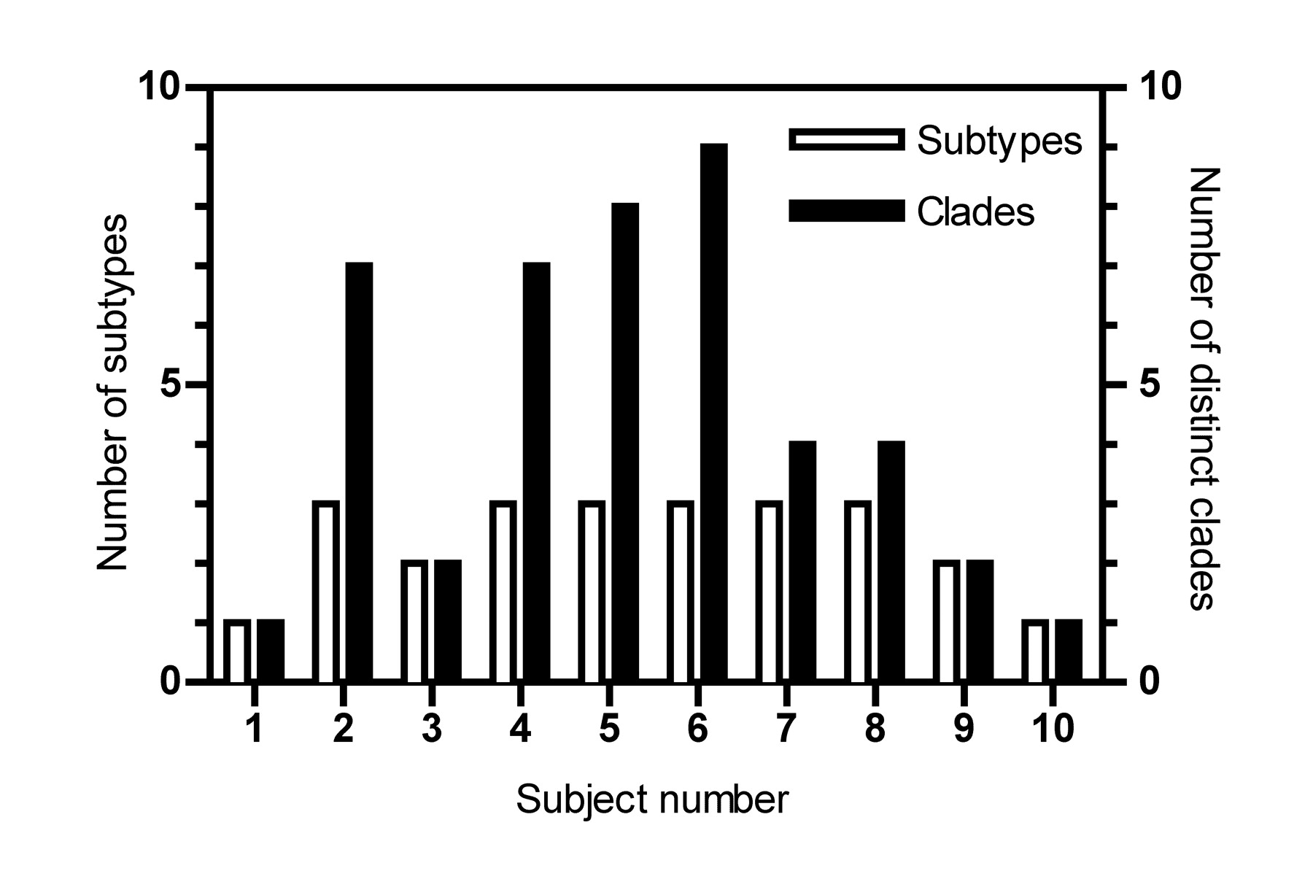
Figure 2 Number of hepatitis C virus (HCV) strains detected in each subject during acute infection. Sequences are ...
Notes:
Figure 2 Number of hepatitis C virus (HCV) strains detected in each subject during acute infection. Sequences are amalgamated across all samples for each subject; subtypes were identified using an online HCV subtyping tool. Within-subtype clades were identified by comparison with reference sequences from GenBank (Table 1).
Unless provided in the caption above, the following copyright applies to the content of this slide: © 2010 by the Infectious Diseases Society of America

Slide 5
Table 3 Comparison of Line Probe Assay (LiPA)- Derived Genotype with Hypervariable Region 1 (HVR1)-Derived Genotype
Notes:
Table 3 Comparison of Line Probe Assay (LiPA)- Derived Genotype with Hypervariable Region 1 (HVR1)-Derived Genotype
Unless provided in the caption above, the following copyright applies to the content of this slide: © 2010 by the Infectious Diseases Society of America

Slide 6
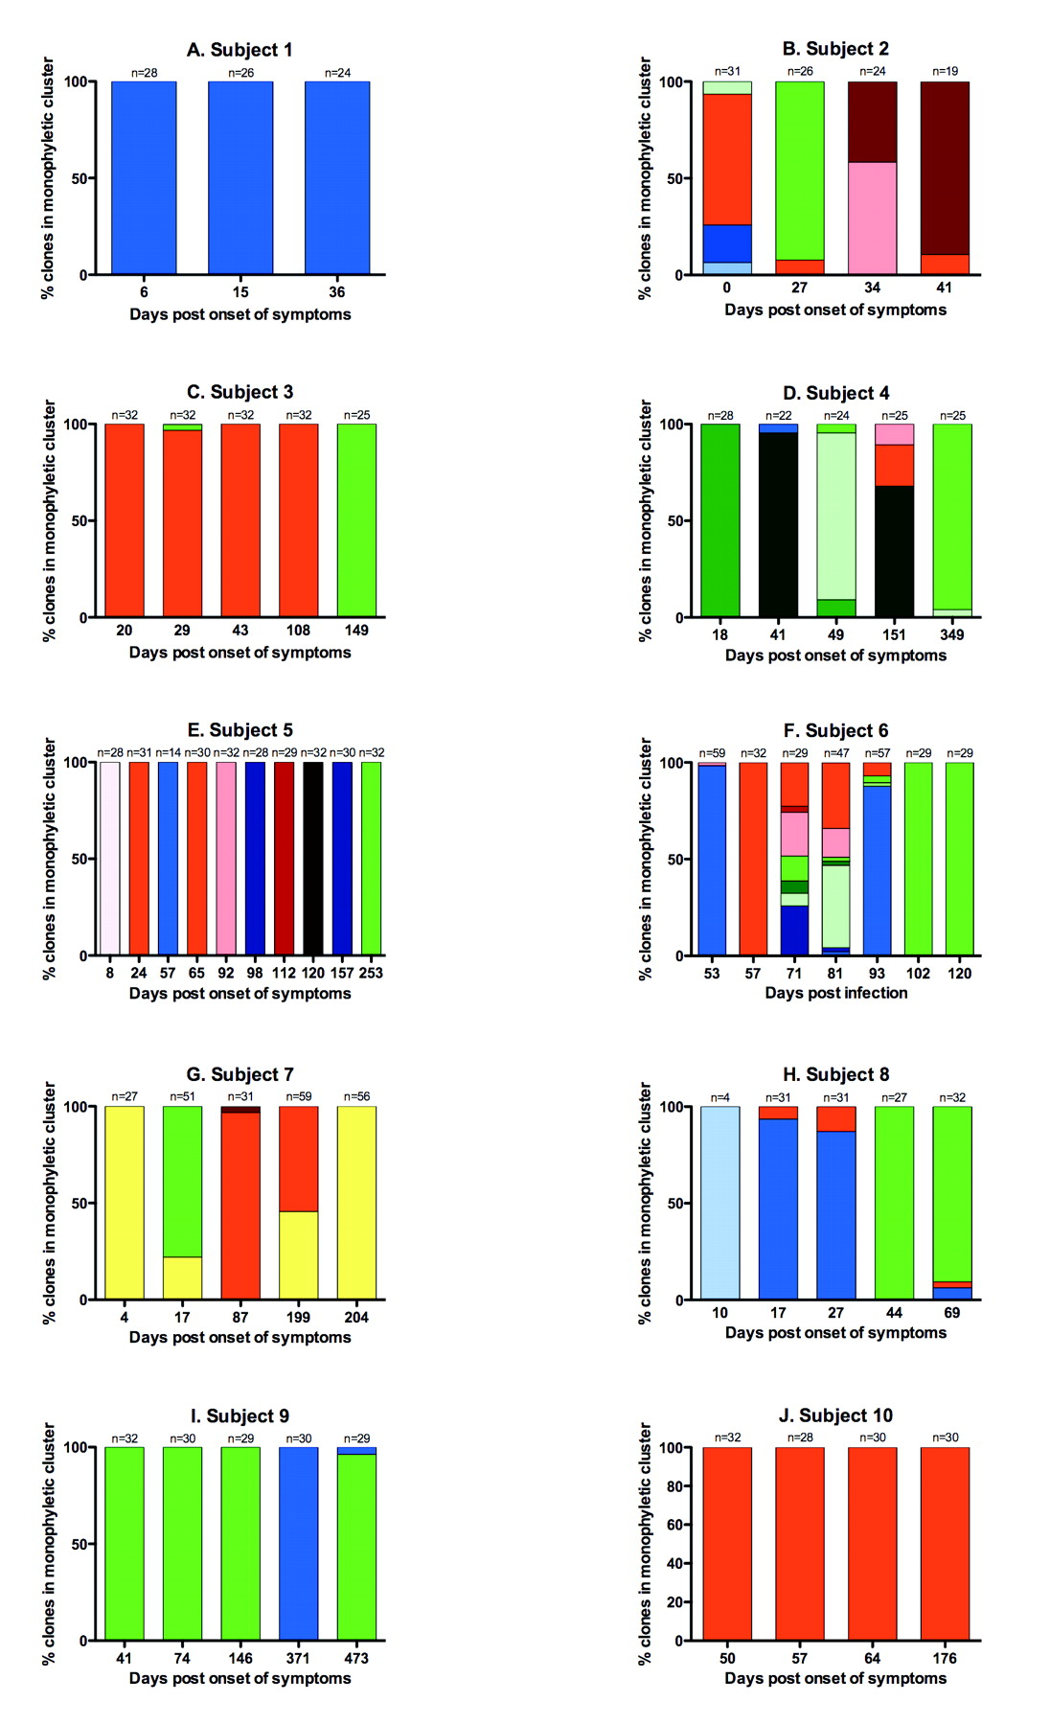
Figure 3 Hepatitis C virus (HCV) quasispecies clades in subjects through acute infection. Different colors represent ...
Notes:
Figure 3 Hepatitis C virus (HCV) quasispecies clades in subjects through acute infection. Different colors represent within-patient clades, expressed as a percentage of the total clones retrieved; the colors used for each viral clade correspond to those in Figure 1. Clades are colored according to subtype: shades of green indicate 1a; red, 1b; yellow, 2; and blue, 3a. The same shade in different graphs does not imply the same clone. The number of clones analyzed is shown above each time-point bar. Note that samples from subject 6 on days 53, 81, and 93 and from subject 7 on days 17, 199, and 204 were cloned twice with different primer combinations and the results amalgamated; hence, where multiple distinct clones are present the percentages do not accurately reflect clone proportions.
Unless provided in the caption above, the following copyright applies to the content of this slide: © 2010 by the Infectious Diseases Society of America

Slide 7
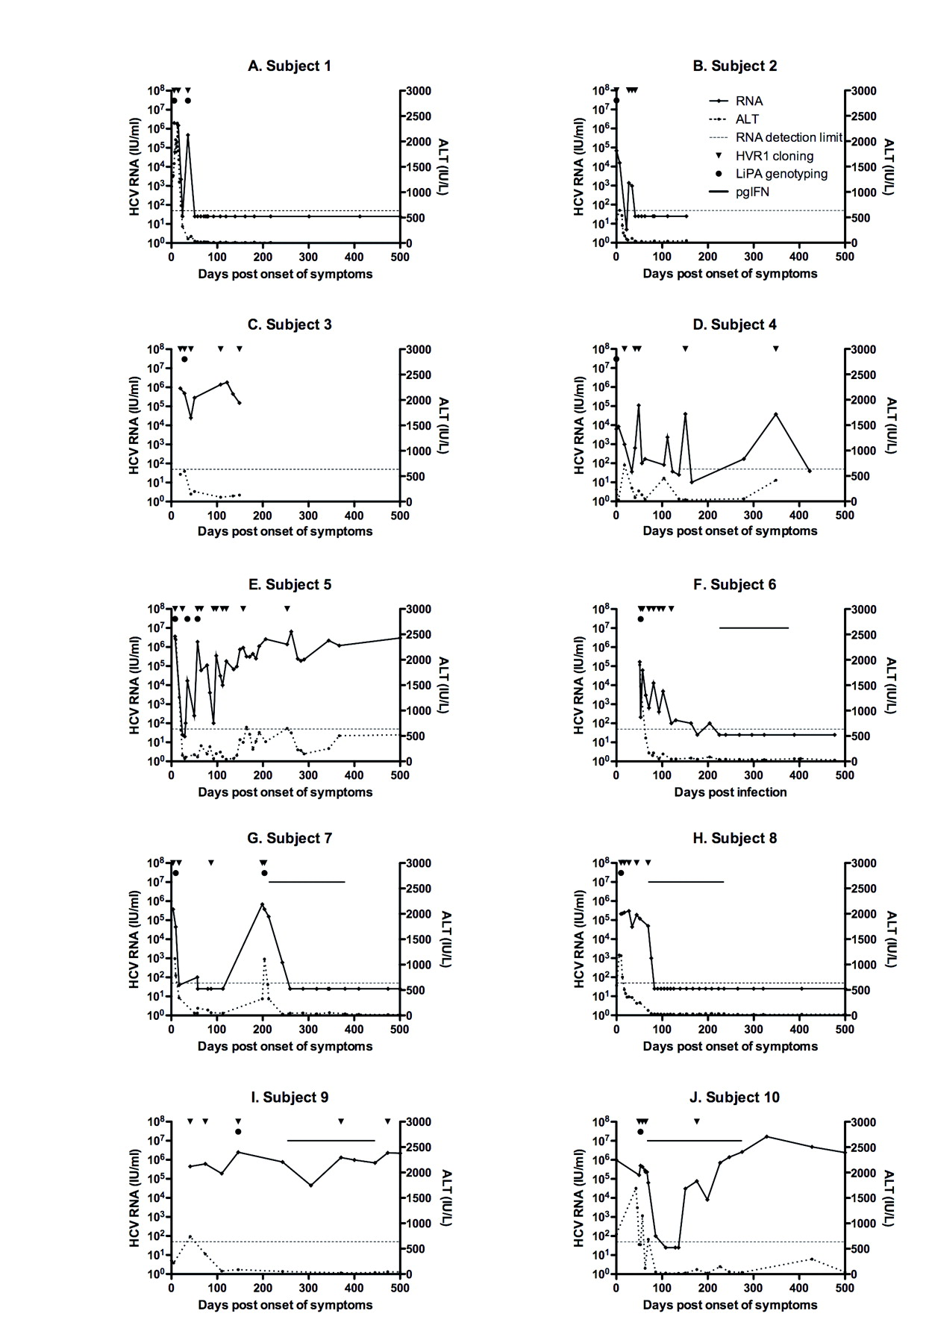
Figure 4 Hepatitis C virus (HCV) load (solid lines with diamonds) and alanine aminotransferase (ALT) levels (hatched ...
Notes:
Figure 4 Hepatitis C virus (HCV) load (solid lines with diamonds) and alanine aminotransferase (ALT) levels (hatched lines with circles) during acute infection, pegylated interferon (pgIFN) treatment (subjects 6–10; solid lines), or progression to chronicity (subjects 4, 5, 9, and 10). Time points from which samples were analyzed by hypervariable region 1 (HVR1) phylogenetics are indicated by an inverted triangle; these correspond to the time points shown in Figure 3. Line probe assay (LiPA) genotyping was performed on samples indicated by a solid circle.
Unless provided in the caption above, the following copyright applies to the content of this slide: © 2010 by the Infectious Diseases Society of America

