Slide 1
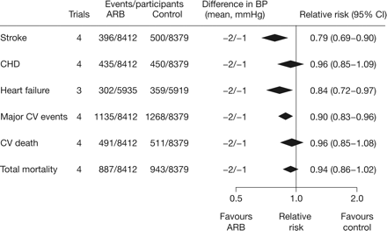
Figure 1 Meta-analysis by the Blood Pressure Lowering Treatment Trialists' Collaboration of data from outcome trials ...
Notes:
Figure 1 Meta-analysis by the Blood Pressure Lowering Treatment Trialists' Collaboration of data from outcome trials comparing treatment regimens based on angiotensin-receptor blockers with control regimens.20 Reproduced with permission from Turnbull.20
Unless provided in the caption above, the following copyright applies to the content of this slide: Published on behalf of the European Society of Cardiology. All rights reserved. © The Author 2009. For permissions please email: journals.permissions@oxfordjournals.org

Slide 2
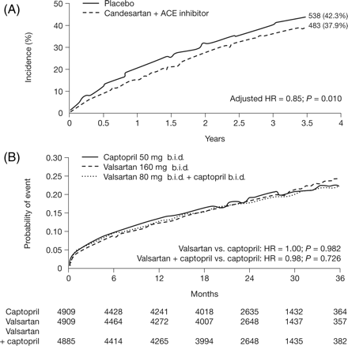
Figure 2 Reduction in mortality with combination angiotensin receptor blocker plus angiotensin converting-enzyme ...
Notes:
Figure 2 Reduction in mortality with combination angiotensin receptor blocker plus angiotensin converting-enzyme inhibitor therapy in (A) the Candesartan in Heart Failure-Assessment of Reduction in Mortality and Morbidity-Added (CHARM-Added)31 and (B) the Valsartan in Acute Myocardial Infarction Trial (VALIANT).30 Reproduced with permission from Pfeffer et al.30 and McMurray et al.31
Unless provided in the caption above, the following copyright applies to the content of this slide: Published on behalf of the European Society of Cardiology. All rights reserved. © The Author 2009. For permissions please email: journals.permissions@oxfordjournals.org

