Slide 1
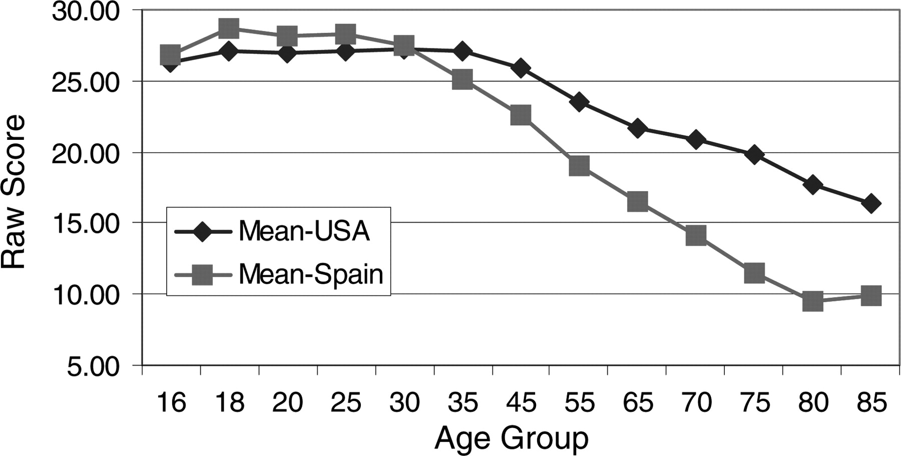
Fig. 1. Mean raw scores for the USA and Spanish versions of the third edition of the Wechsler adult intelligence ...
Notes:
Fig. 1. Mean raw scores for the USA and Spanish versions of the third edition of the Wechsler adult intelligence scale.
Unless provided in the caption above, the following copyright applies to the content of this slide: © The Author 2009. Published by Oxford University Press. All rights reserved. For permissions, please e-mail: journals.permissions@oxfordjournals.org.

Slide 2
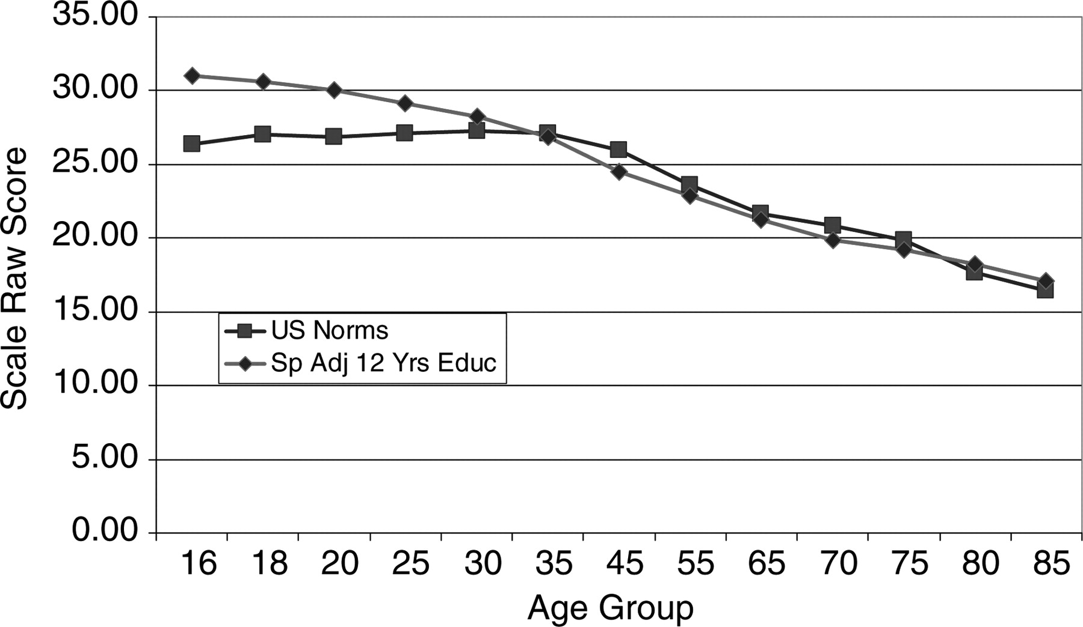
Fig. 2. Mean raw scores for the USA and Spanish versions of the third edition of the Wechsler adult intelligence ...
Notes:
Fig. 2. Mean raw scores for the USA and Spanish versions of the third edition of the Wechsler adult intelligence scale, with the Spanish norms adjusted to 12 years of education.
Unless provided in the caption above, the following copyright applies to the content of this slide: © The Author 2009. Published by Oxford University Press. All rights reserved. For permissions, please e-mail: journals.permissions@oxfordjournals.org.

Slide 3
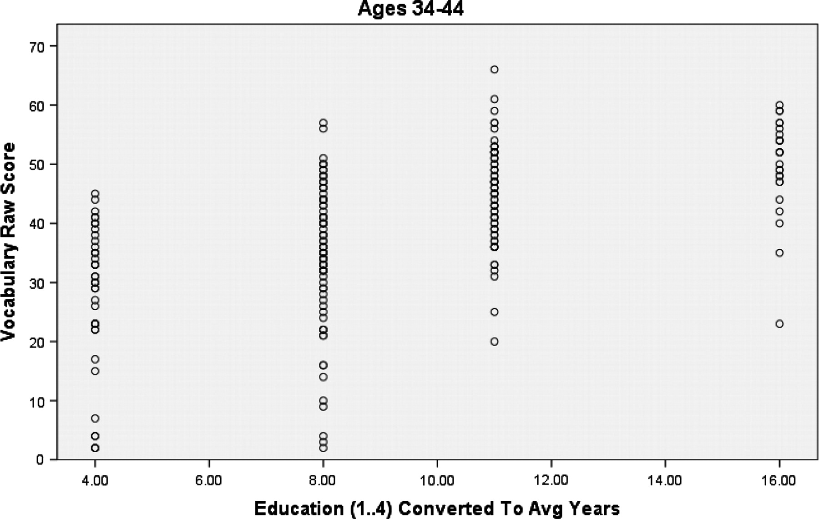
Fig. 3. Example of the variance of raw scores at specified levels of education. The variance of raw scores of the ...
Notes:
Fig. 3. Example of the variance of raw scores at specified levels of education. The variance of raw scores of the vocabulary subtest for individuals of 35–44 years of age at different levels of education.
Unless provided in the caption above, the following copyright applies to the content of this slide: © The Author 2009. Published by Oxford University Press. All rights reserved. For permissions, please e-mail: journals.permissions@oxfordjournals.org.

