Slide 1
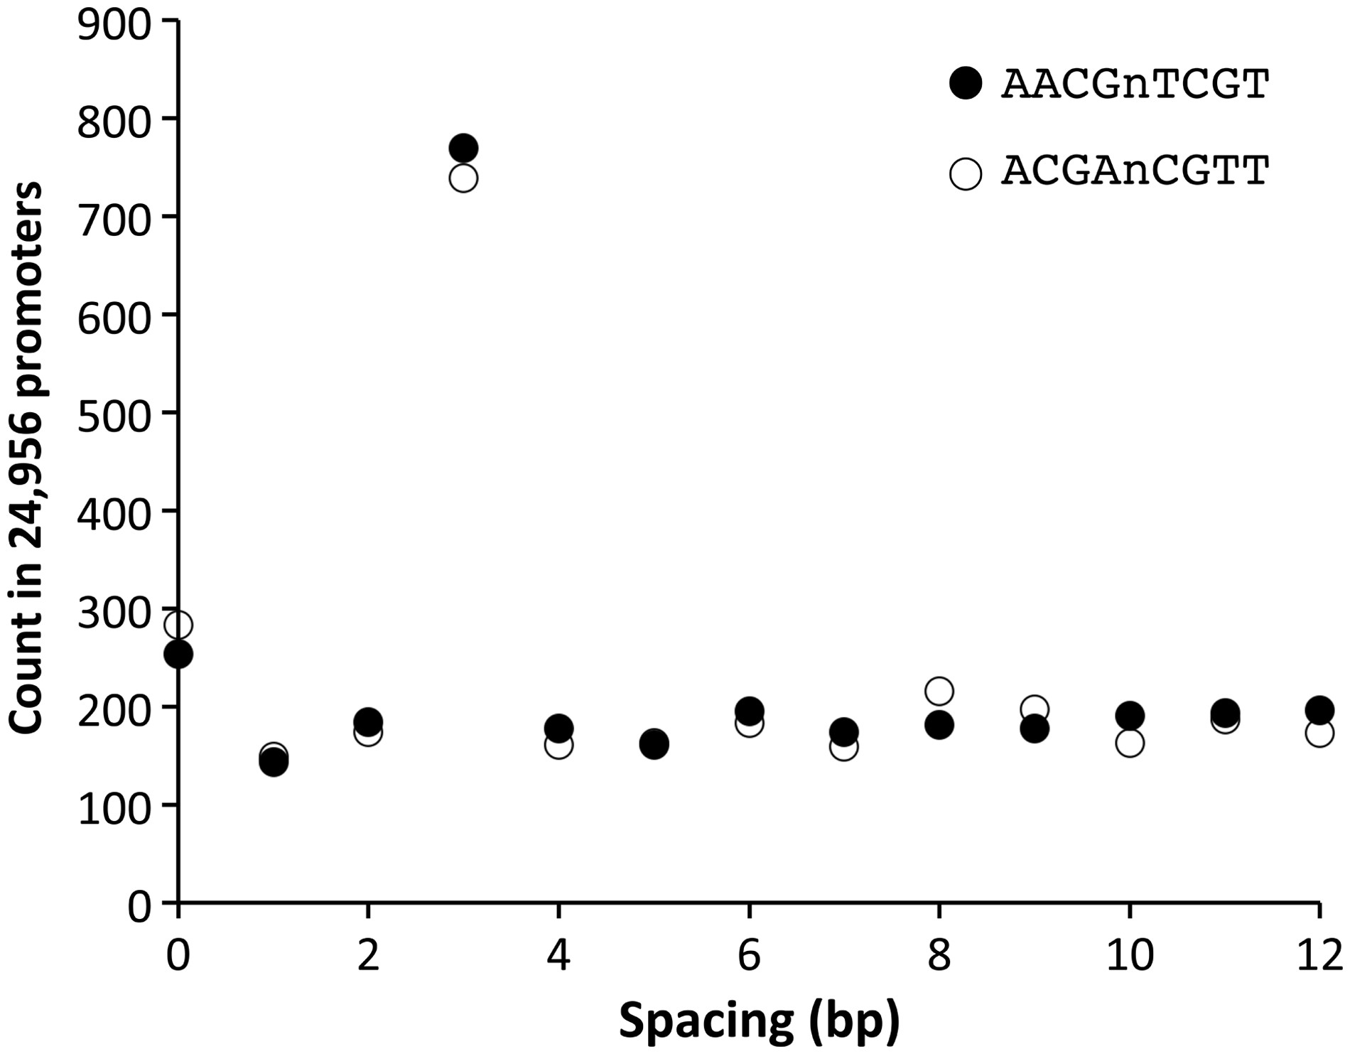
Figure 1 Overrepresentation of a specific length of spacer in promoter sequences. Counts of a bipartite-type octamer ...
Notes:
Figure 1 Overrepresentation of a specific length of spacer in promoter sequences. Counts of a bipartite-type octamer with a spacer in all the promoters of the Arabidopsis genome are shown. The horizontal axis indicates the number of ‘n’s, i.e. the length of the spacer between the two tetramers. The two octamers shown (AACGnTCGT and ACGAnCGTT) are mutually complementary.
Unless provided in the caption above, the following copyright applies to the content of this slide: © The Author 2017. Published by Oxford University Press on behalf of Kazusa DNA Research Institute.This is an Open Access article distributed under the terms of the Creative Commons Attribution Non-Commercial License (http://creativecommons.org/licenses/by-nc/4.0/), which permits non-commercial re-use, distribution, and reproduction in any medium, provided the original work is properly cited. For commercial re-use, please contact journals.permissions@oup.com

Slide 2
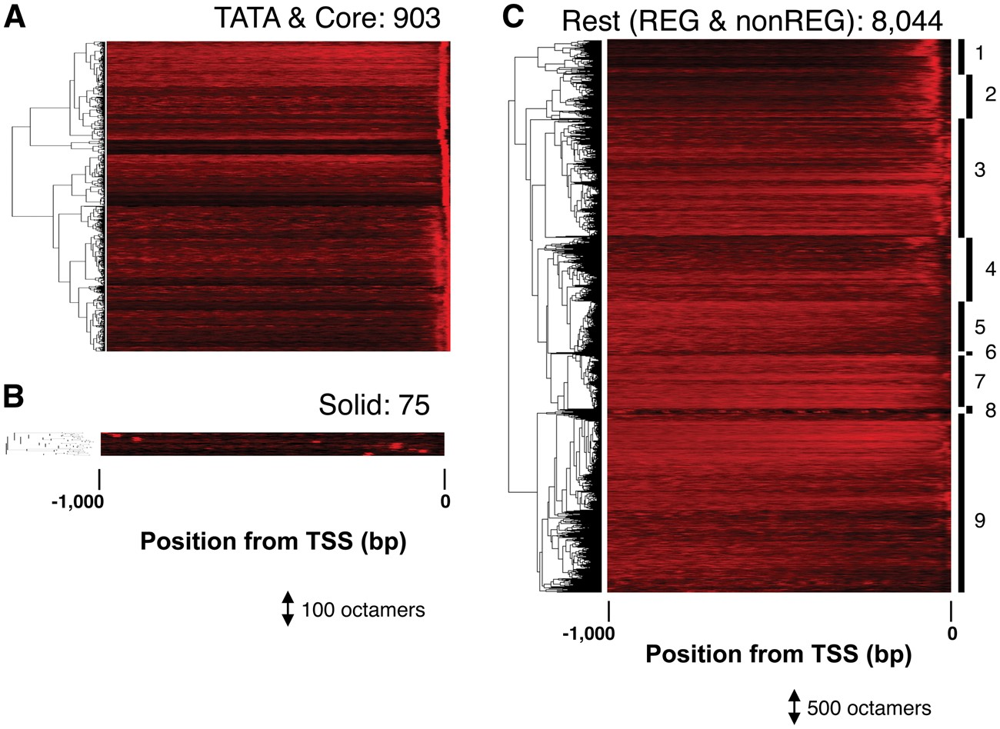
Figure 2 LDSS analysis of bipartite octamers. The distribution profiles of each octamer are shown. Each profile is ...
Notes:
Figure 2 LDSS analysis of bipartite octamers. The distribution profiles of each octamer are shown. Each profile is shown as a colored horizontal line (rare = black, frequent = red), and the profiles of 903 (A), 75 (B), and 8,044 (C) octamers were subjected to hierarchical clustering. The cluster number of the ‘Rest’ group is indicated at the right end of the heat map (C). REG (1, 2), REG-like (3, 4), and non-REG (5–9).
Unless provided in the caption above, the following copyright applies to the content of this slide: © The Author 2017. Published by Oxford University Press on behalf of Kazusa DNA Research Institute.This is an Open Access article distributed under the terms of the Creative Commons Attribution Non-Commercial License (http://creativecommons.org/licenses/by-nc/4.0/), which permits non-commercial re-use, distribution, and reproduction in any medium, provided the original work is properly cited. For commercial re-use, please contact journals.permissions@oup.com

Slide 3
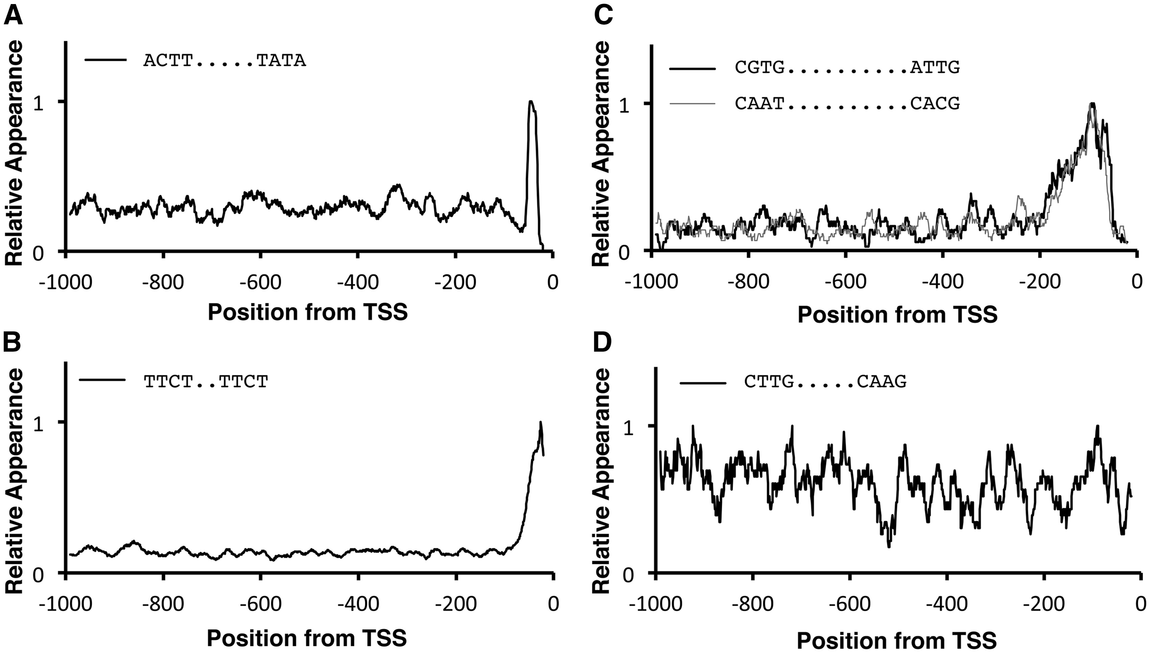
Figure 3 Typical LDSS profiles of bipartite octamers. Typical distribution profiles are shown: TATA type (A), Y ...
Notes:
Figure 3 Typical LDSS profiles of bipartite octamers. Typical distribution profiles are shown: TATA type (A), Y Patch-related Core type (B), REG type (C), and non-REG type (D). Profiles were subjected to smoothing with a bin of 21 bp, and the maximum value was adjusted to 1.0. The peak position of Panel A is -47, which means the first T of the TATA within the sequence, ‘ACTT….TATA’, comes at -38. The two sequences in Panel C are complementary each other.
Unless provided in the caption above, the following copyright applies to the content of this slide: © The Author 2017. Published by Oxford University Press on behalf of Kazusa DNA Research Institute.This is an Open Access article distributed under the terms of the Creative Commons Attribution Non-Commercial License (http://creativecommons.org/licenses/by-nc/4.0/), which permits non-commercial re-use, distribution, and reproduction in any medium, provided the original work is properly cited. For commercial re-use, please contact journals.permissions@oup.com

Slide 4
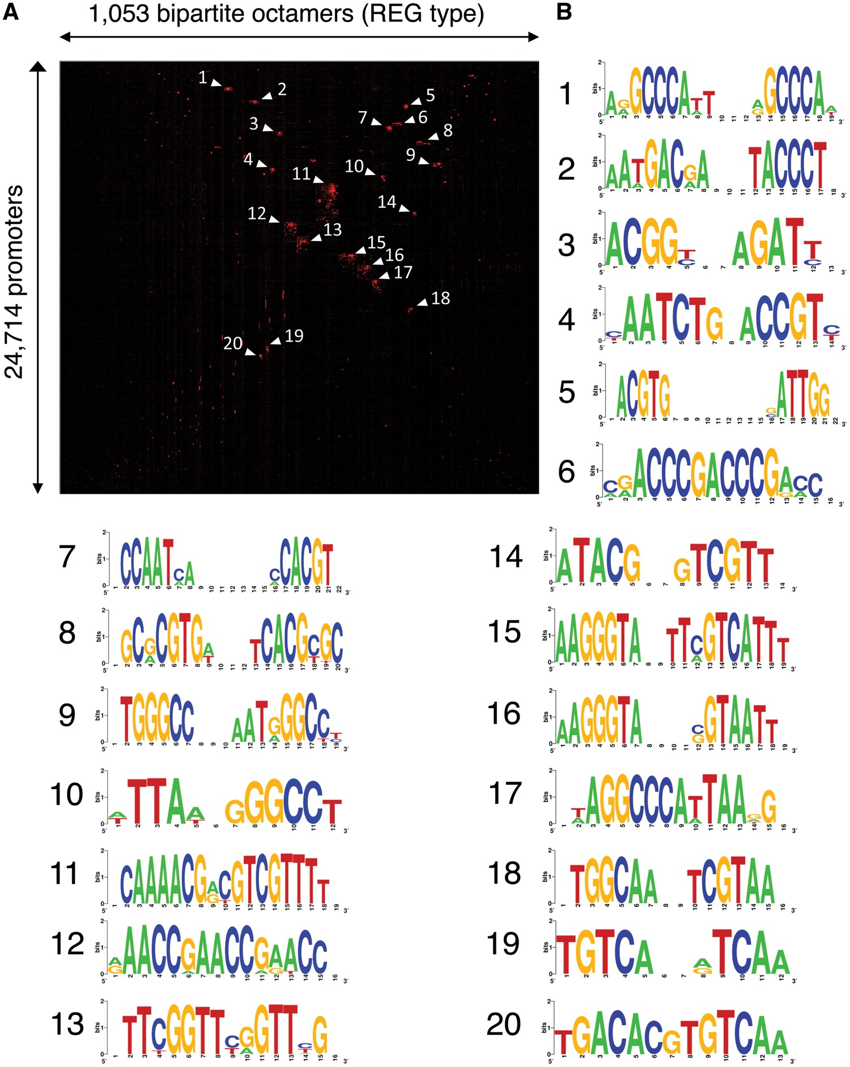
Figure 4 Several groups in the REG-type bipartite octamers. 1,053 bipartite octamers with distribution profiles of the ...
Notes:
Figure 4 Several groups in the REG-type bipartite octamers. 1,053 bipartite octamers with distribution profiles of the REG type (Fig. 2C) were mapped to 24,714 Arabidopsis promoters, and a resultant presence/absence matrix (1,053 × 24,714) was subjected to 2D clustering analysis (A). Presence and absence of an octamer in a promoter is shown as red and black, respectively. Labels of the matrix in vertical and horizontal dimensions are omitted. Octamers of 20 largest clusters were subjected to WebLogo (B). Some pairs of cluster (1–9, 2–15, 3–4, 5–7, 10–17, 12–13) are complementary, respectively. Clusters 5 and 7 are ERSE (CCAAT-N9-CCACG).
Unless provided in the caption above, the following copyright applies to the content of this slide: © The Author 2017. Published by Oxford University Press on behalf of Kazusa DNA Research Institute.This is an Open Access article distributed under the terms of the Creative Commons Attribution Non-Commercial License (http://creativecommons.org/licenses/by-nc/4.0/), which permits non-commercial re-use, distribution, and reproduction in any medium, provided the original work is properly cited. For commercial re-use, please contact journals.permissions@oup.com

Slide 5
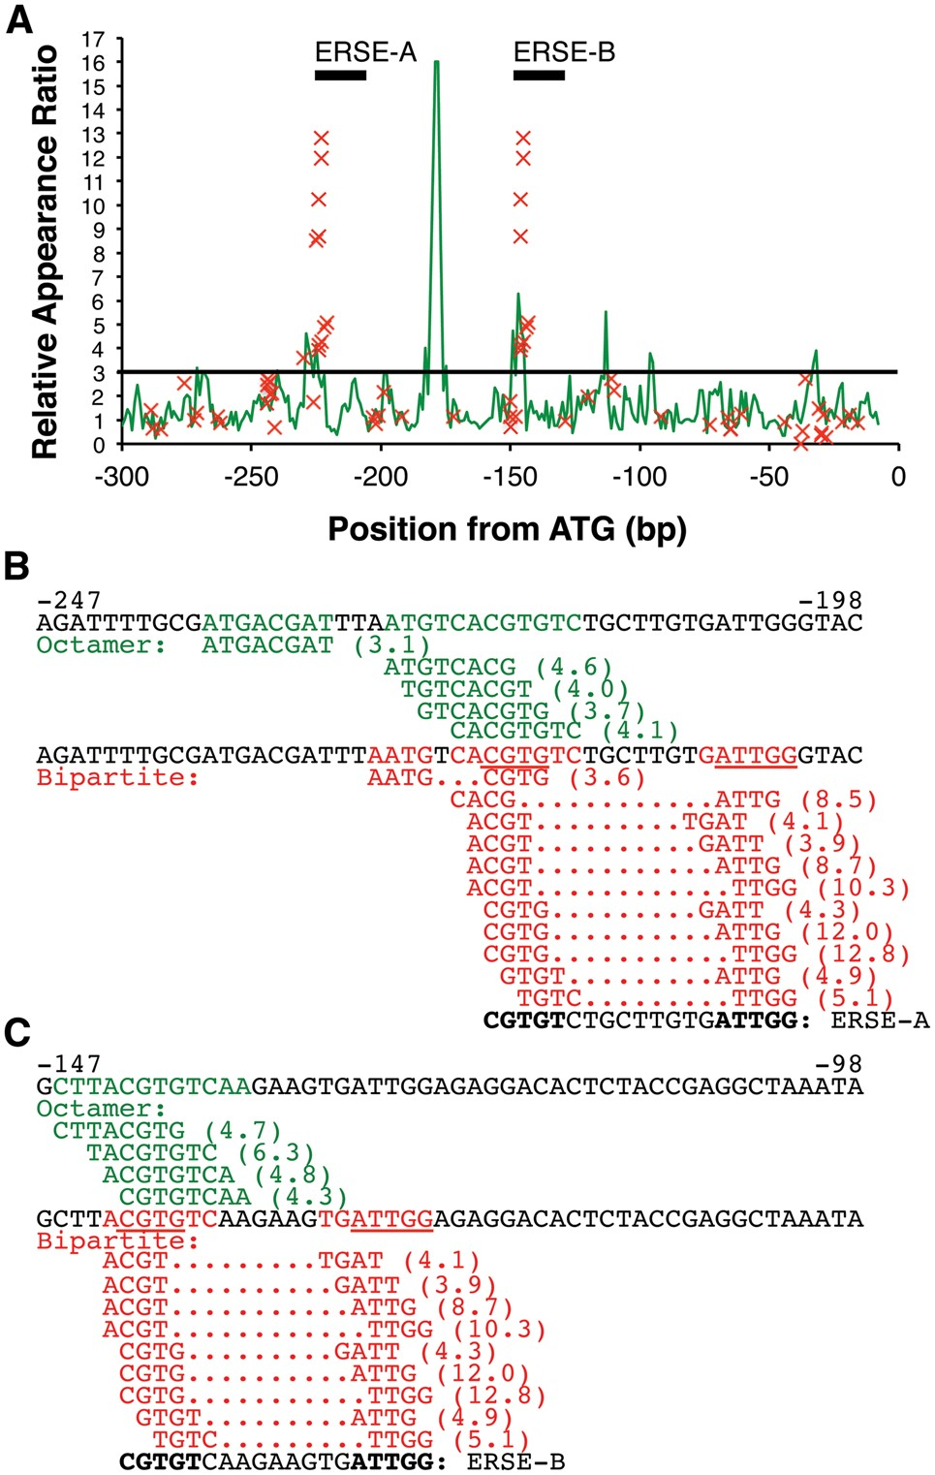
Figure 5 Promoter prediction of BiP3/BiP-L for tunicamycin response. Application of the bipartite sequences for ...
Notes:
Figure 5 Promoter prediction of BiP3/BiP-L for tunicamycin response. Application of the bipartite sequences for prediction of tunicamycin-responsive elements in a BiP/BiP-L (AT1G09080) promoter. (A) Results of promoter scans using octamers (green line graph) and bipartite octamers (red X mark) are shown. The Relative Appearance Ratio (RAR) means the degree of overrepresentation in tunicamycin-responsive promoters over the total promoters and thus high RAR sites predict corresponding regulatory elements. A height of RAR = 3.0, a conventional threshold,3 is indicated by a black horizontal line. Positions of experimentally identified ERSEs, ERSE-A and ERSE-B, are also shown in the graph. (B and C) Sequences from -247 to -198 (B) and from -147 to -98 (C), relative to the translation start site (ATG), are shown. Green letters show predictions based on continuous octamers, and red letters are predictions based on bipartite octamers. Underlining indicates sequences that match with the ERSE motif (CCAAT-N9-CCACG). Values in parentheses are RAR scores that show the ratio of overrepresentation in tunicamycin-responsive promoters over the global promoter set in the Arabidopsis genome. ERSE-A and ERSE-B are functionally confirmed ERSEs reported by Noh et al.19 Sequence in bold means an ERSE motif in ERSE-A and ERSE-B, as reported by Noh et al.
Unless provided in the caption above, the following copyright applies to the content of this slide: © The Author 2017. Published by Oxford University Press on behalf of Kazusa DNA Research Institute.This is an Open Access article distributed under the terms of the Creative Commons Attribution Non-Commercial License (http://creativecommons.org/licenses/by-nc/4.0/), which permits non-commercial re-use, distribution, and reproduction in any medium, provided the original work is properly cited. For commercial re-use, please contact journals.permissions@oup.com

Slide 6
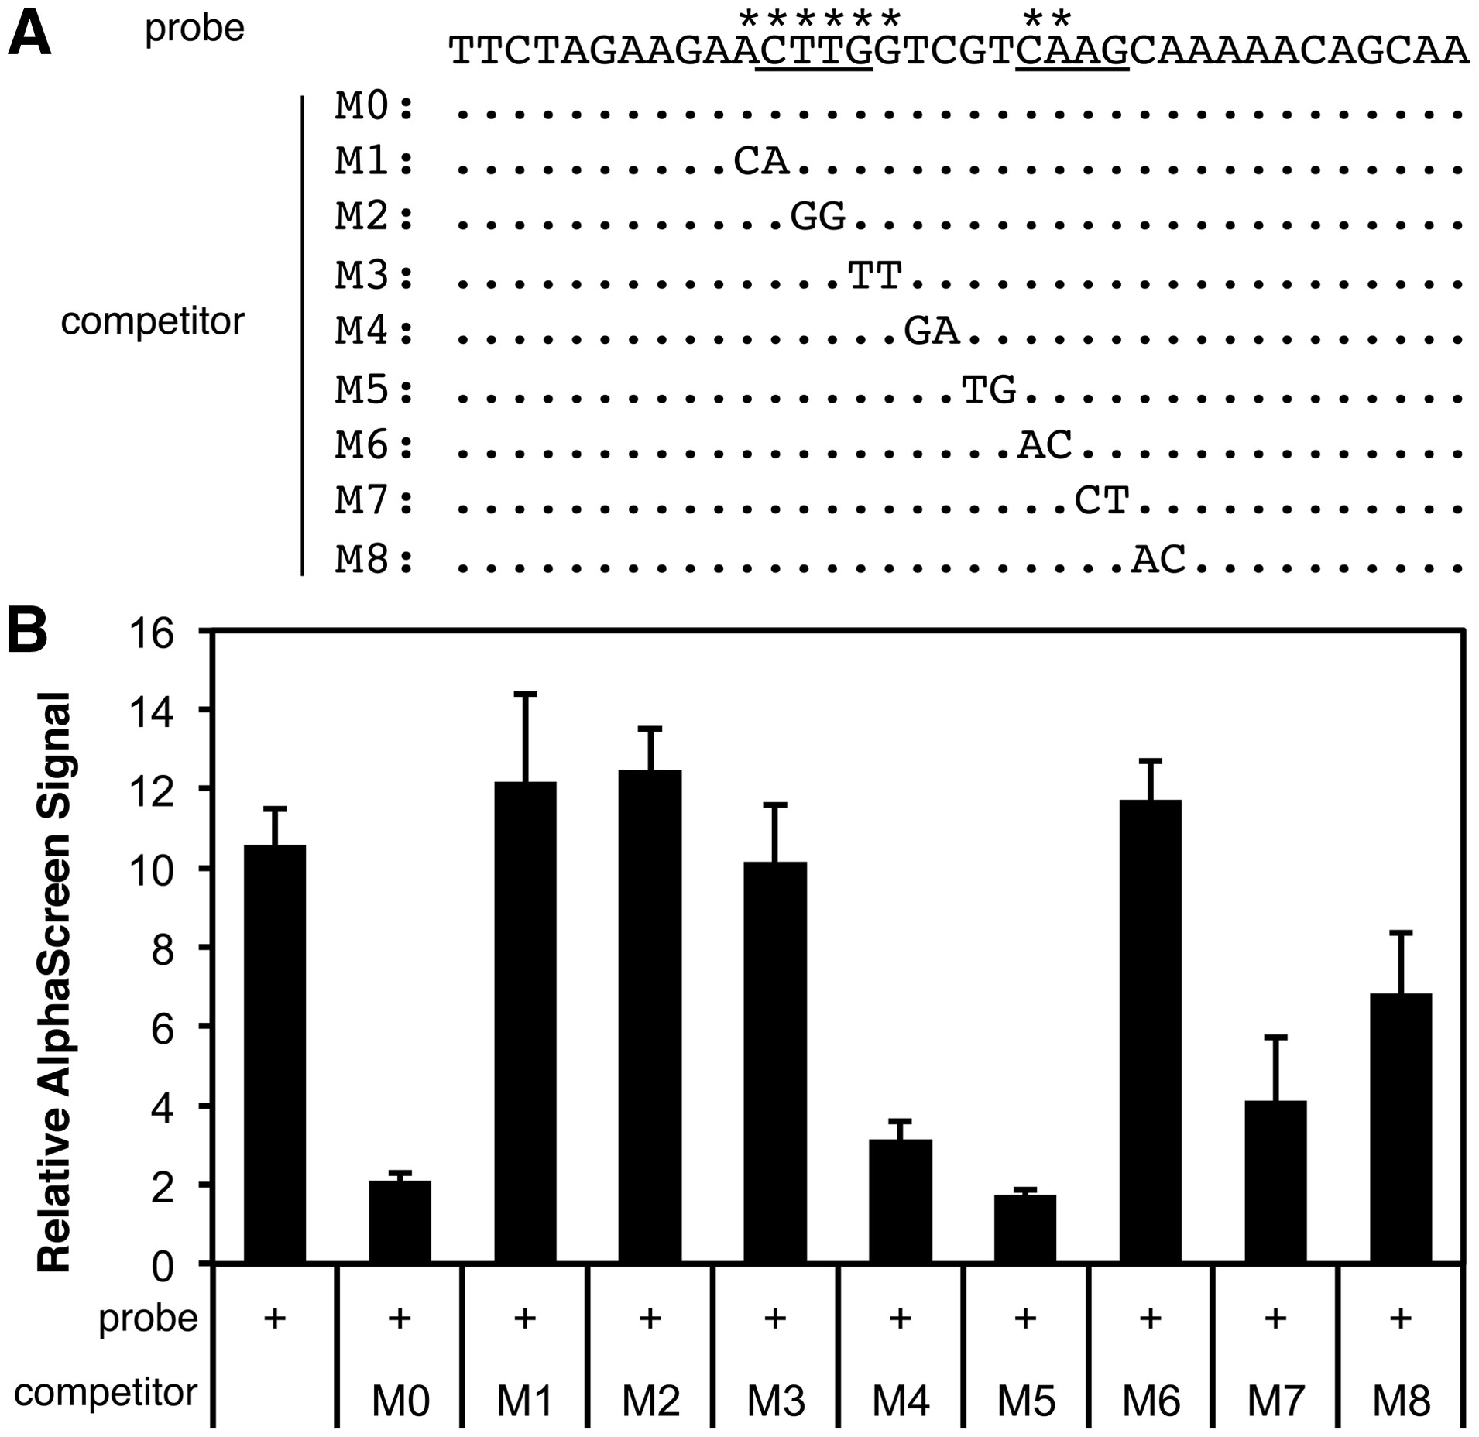
Figure 6 Direct binding of ANAC017 to a bipartite octamer predicted for H₂O₂ response. (A) The ...
Notes:
Figure 6 Direct binding of ANAC017 to a bipartite octamer predicted for H2O2 response. (A) The predicted target site of ANAC017 in an ATERF71 (AT2G47520) promoter was used as a biotinylated DNA probe in a DNA–protein binding assay by AlphaScreen. Underlining shows the predicted target site identified by the bipartite analysis. The sequences of unbiotinylated competitor DNAs with base substitutions from the biotinylated probe are shown (M0–M8, unsubstituted bases are shown as dots). Asterisks on the top of the probe sequence indicate critical bases for binding by ANAC017 protein, revealed by Panel B. (B) Results of the AlphaScreen assay are shown as the relative AlphaScreen signal (the signal obtained with non-biotinylated probe/signal with biotinylated probe). The average and standard error of four assays are shown.
Unless provided in the caption above, the following copyright applies to the content of this slide: © The Author 2017. Published by Oxford University Press on behalf of Kazusa DNA Research Institute.This is an Open Access article distributed under the terms of the Creative Commons Attribution Non-Commercial License (http://creativecommons.org/licenses/by-nc/4.0/), which permits non-commercial re-use, distribution, and reproduction in any medium, provided the original work is properly cited. For commercial re-use, please contact journals.permissions@oup.com

