Slide 1
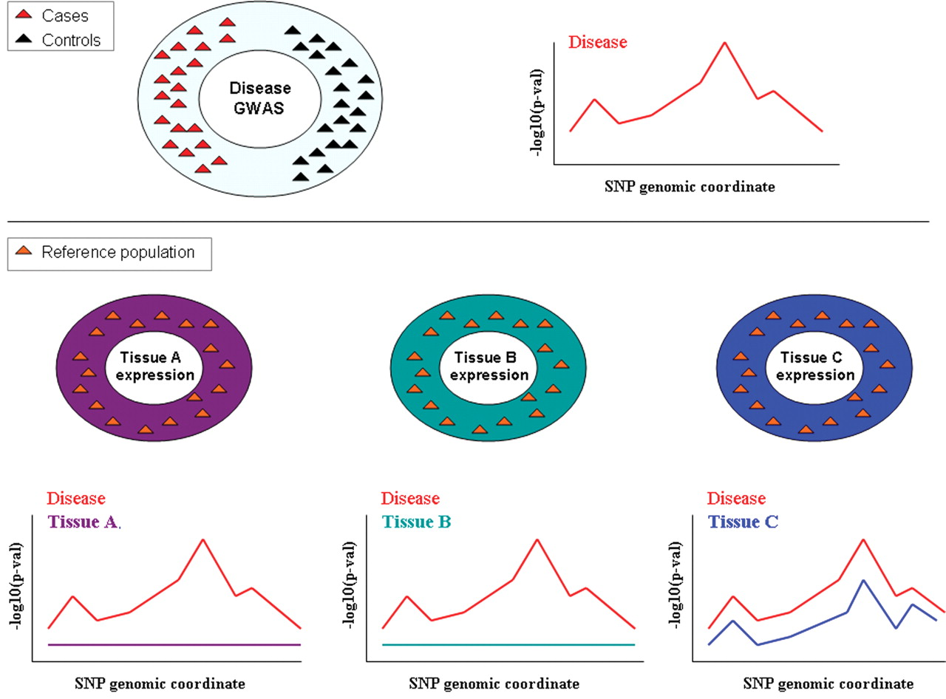
Figure 1. Expression and disease association studies. Current expression studies are performed on a limited number of ...
Notes:
Figure 1. Expression and disease association studies. Current expression studies are performed on a limited number of tissues derived from a small number of individuals compared with disease association studies. The availability of large collections of cell types from a large number of individuals will allow the identification of eQTLs that explain disease effects, such as the one at the top of the panel, when the relevant cell type/tissue is analyzed, as indicated for Tissue C at the bottom of the panel. This may not be successful in less relevant tissues such as in the case of Tissues A and B at the bottom of the panel.
Unless provided in the caption above, the following copyright applies to the content of this slide: © The Author 2008. Published by Oxford University Press. All rights reserved. For Permissions, please email: journals.permissions@oxfordjournals.org

Slide 2
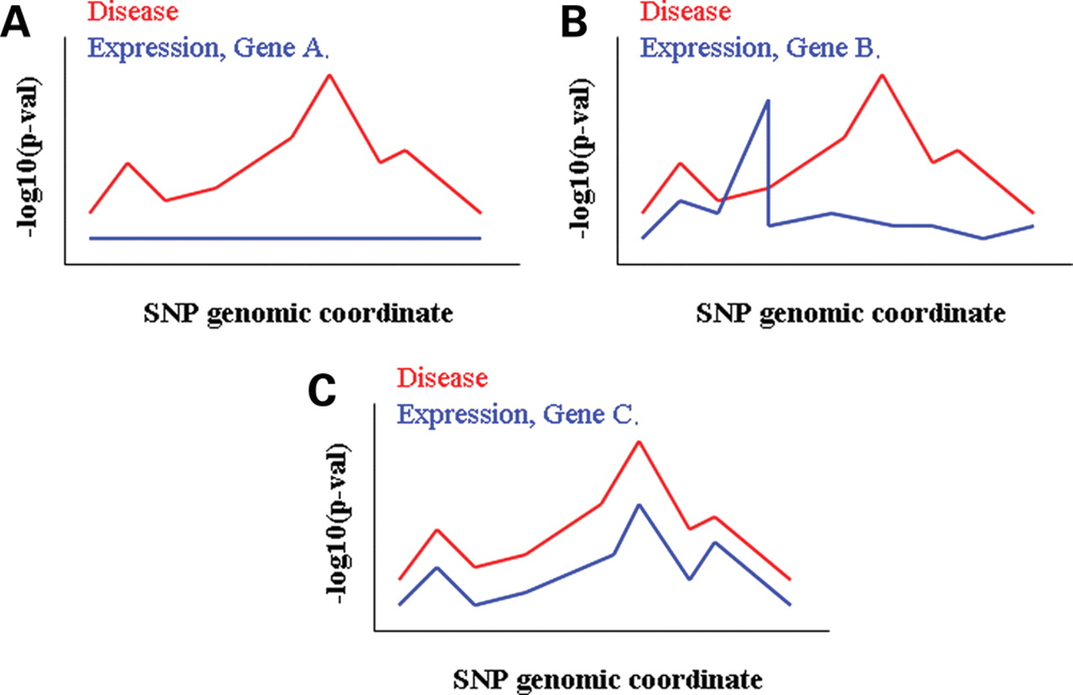
Figure 2. Local superimposition of whole-genome disease and expression associations. For any given genomic interval, ...
Notes:
Figure 2. Local superimposition of whole-genome disease and expression associations. For any given genomic interval, same SNPs will have been independently tested for associations with a disease and transcript levels of a set of genes, respectively. ( A ) No significant eQTLs detected in the interval for Gene A. ( B ) Significant eQTLs for Gene B do not also display significant disease associations. ( C ) The association patterns of disease and Gene C expression fit very well, making it the most likely candidate out of the three for a possible regulatory-mediated disease effect.
Unless provided in the caption above, the following copyright applies to the content of this slide: © The Author 2008. Published by Oxford University Press. All rights reserved. For Permissions, please email: journals.permissions@oxfordjournals.org

