Slide 1
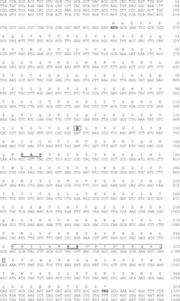
1 Nucleotide and protein sequence of the HwHog1p. Deduced amino acid sequence is given above the nucleotide ...
Notes:
1 Nucleotide and protein sequence of the HwHog1p. Deduced amino acid sequence is given above the nucleotide sequence of the coding region. Conserved TGY motif is underlined. D denotes active site. Boxed amino acids represent the C-terminal common docking (CD) motif, in which the conserved hydrophobic amino acids tyrosine (Y) and histidine (H) are underlined, and conserved acidic aspartic acids (D) are depicted by apostrophes. The stop codon is depicted by an asterisk. GenBank accession number AF516914.
Unless provided in the caption above, the following copyright applies to the content of this slide: © 2002 Federation of European Microbiological Societies

Slide 2
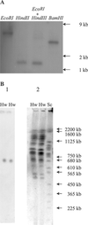
2 Determination of HwHOG1 gene copies in H. werneckii. A: Southern blot analysis of H. werneckii genomic DNA, ...
Notes:
2 Determination of HwHOG1 gene copies in H. werneckii. A: Southern blot analysis of H. werneckii genomic DNA, digested with different restriction endonucleases (Eco RI, Hin dIII, Eco RI+Hin dIII, Bam HI). The Southern blot of the gel with separated digested DNA was probed with a radiolabeled HwHOG1 fragment. B: Chromosomal localization of the HwHOG1 gene. Lane 1, Southern blot analysis of H. werneckii chromosomes, separated by pulsed-field gel electrophoresis (PFGE). Chromoblot of the gel was probed with radiolabeled HwHOG1 fragment. Lane 2, PFGE gel of H. werneckii chromosomes. S. cerevisiae chromosomes were used as standard. Hw, H. werneckii chromosomes; Sc, S. cerevisiae standards.
Unless provided in the caption above, the following copyright applies to the content of this slide: © 2002 Federation of European Microbiological Societies

Slide 3
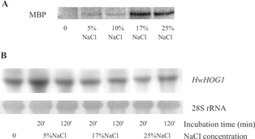
3 In vitro activity of HwHog1p. A: Activity of HwHog1p detected by phosphorylation of exogenous substrate ...
Notes:
3 In vitro activity of HwHog1p. A: Activity of HwHog1p detected by phosphorylation of exogenous substrate myelin basic protein (MBP) in in vitro kinase reaction at various NaCl concentrations. Time of exposure of H. werneckii cells to NaCl was 20 min. For loading control Western blot analysis was performed using S. cerevisiae anti-Hog1 polyclonal antibodies. B: Northern blot analysis of the HwHOG1 transcript in the cells of H. werneckii, exposed to different concentrations of NaCl.
Unless provided in the caption above, the following copyright applies to the content of this slide: © 2002 Federation of European Microbiological Societies

Slide 4
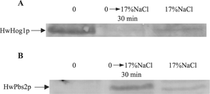
4 Localization of MAP kinases HwPbs2p and HwHog1p. Western blot analysis of H. werneckii proteins from purified ...
Notes:
4 Localization of MAP kinases HwPbs2p and HwHog1p. Western blot analysis of H. werneckii proteins from purified plasma membranes of the cells grown with no salt (left column), cells exposed to 17% NaCl for 30 min (central column) and cells grown with 17% NaCl (right column). The presence of MAP kinases HwPbs2p and HwHog1p was determined by using S. cerevisiae anti-Pbs2 (B) and anti-Hog1 (A) polyclonal antibodies. Shown are specific bands for HwPbs2p (B) with a putative size of 60 kDa and HwHog1p (A) with a putative size of 46 kDa.
Unless provided in the caption above, the following copyright applies to the content of this slide: © 2002 Federation of European Microbiological Societies

