Slide 1
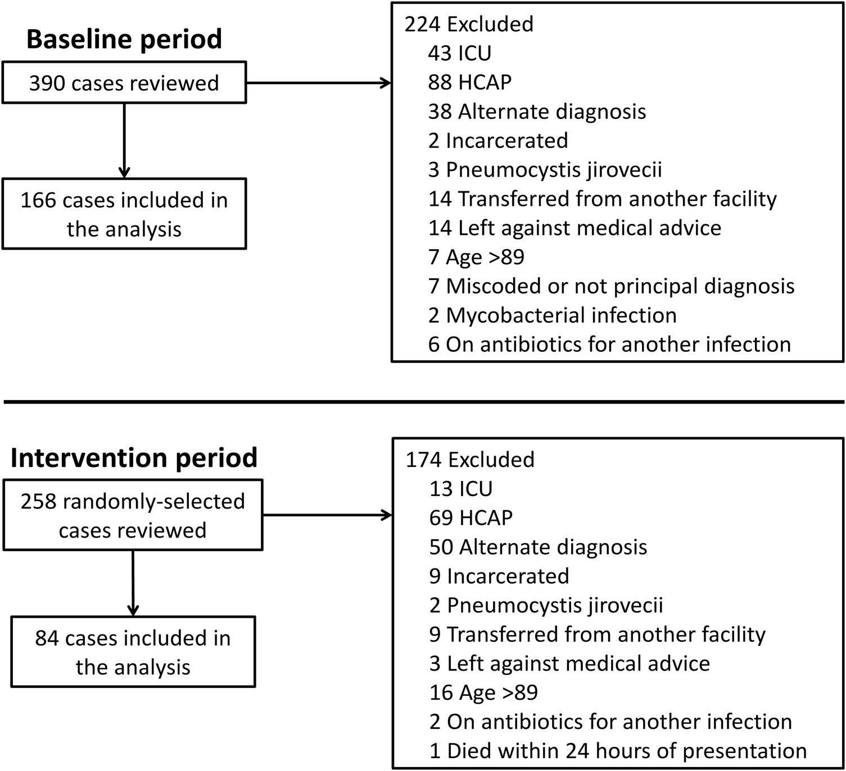
Figure 1. Study schematic.
Notes:
Figure 1. Study schematic.
Unless provided in the caption above, the following copyright applies to the content of this slide: © The Author 2016. Published by Oxford University Press on behalf of the Infectious Diseases Society of America.This is an Open Access article distributed under the terms of the Creative Commons Attribution-NonCommercial-NoDerivs licence (http://creativecommons.org/licenses/by-nc-nd/4.0/), which permits non-commercial reproduction and distribution of the work, in any medium, provided the original work is not altered or transformed in any way, and that the work is properly cited. For commercial re-use, please contact journals.permissions@oup.com.

Slide 2
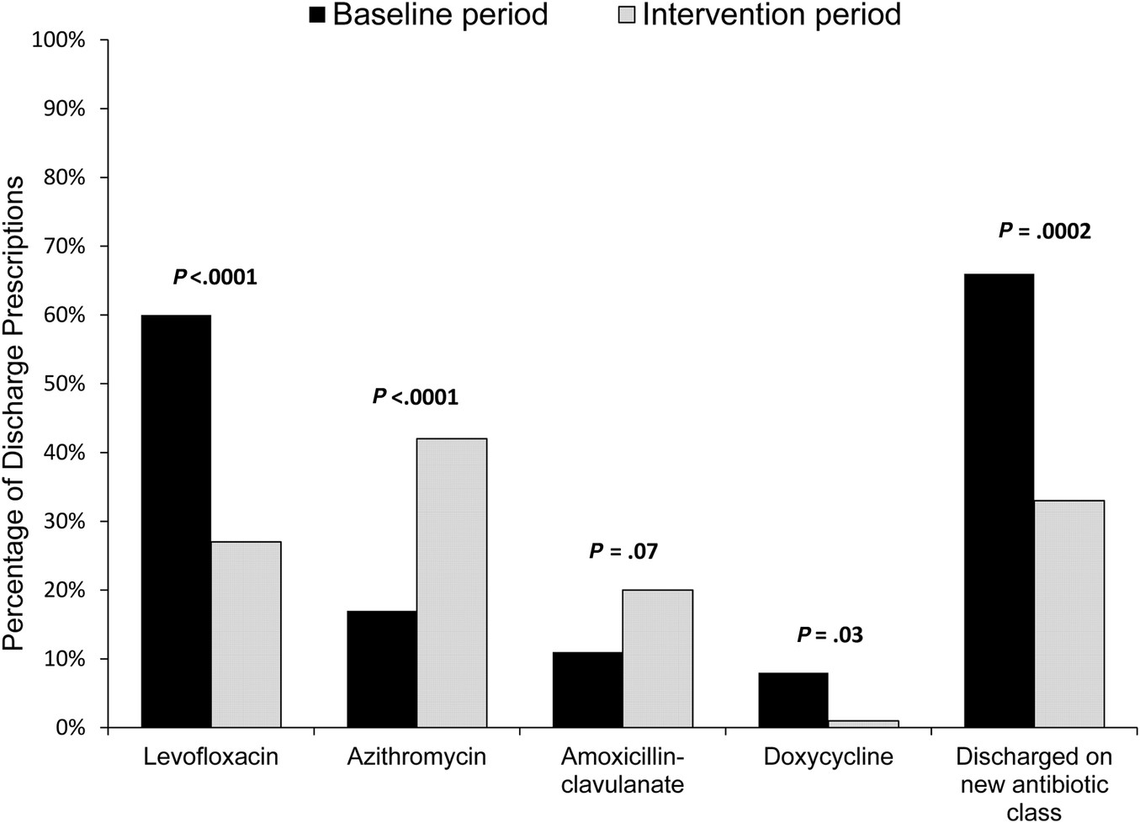
Figure 3. Comparison of antibiotics prescribed at hospital discharge before and during the intervention.
Notes:
Figure 3. Comparison of antibiotics prescribed at hospital discharge before and during the intervention.
Unless provided in the caption above, the following copyright applies to the content of this slide: © The Author 2016. Published by Oxford University Press on behalf of the Infectious Diseases Society of America.This is an Open Access article distributed under the terms of the Creative Commons Attribution-NonCommercial-NoDerivs licence (http://creativecommons.org/licenses/by-nc-nd/4.0/), which permits non-commercial reproduction and distribution of the work, in any medium, provided the original work is not altered or transformed in any way, and that the work is properly cited. For commercial re-use, please contact journals.permissions@oup.com.

Slide 3
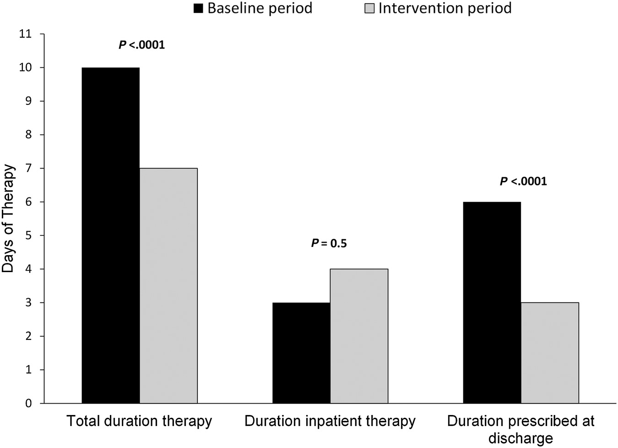
Figure 2. Comparison of duration of antibiotic therapy before and during the intervention.
Notes:
Figure 2. Comparison of duration of antibiotic therapy before and during the intervention.
Unless provided in the caption above, the following copyright applies to the content of this slide: © The Author 2016. Published by Oxford University Press on behalf of the Infectious Diseases Society of America.This is an Open Access article distributed under the terms of the Creative Commons Attribution-NonCommercial-NoDerivs licence (http://creativecommons.org/licenses/by-nc-nd/4.0/), which permits non-commercial reproduction and distribution of the work, in any medium, provided the original work is not altered or transformed in any way, and that the work is properly cited. For commercial re-use, please contact journals.permissions@oup.com.

