Slide 1
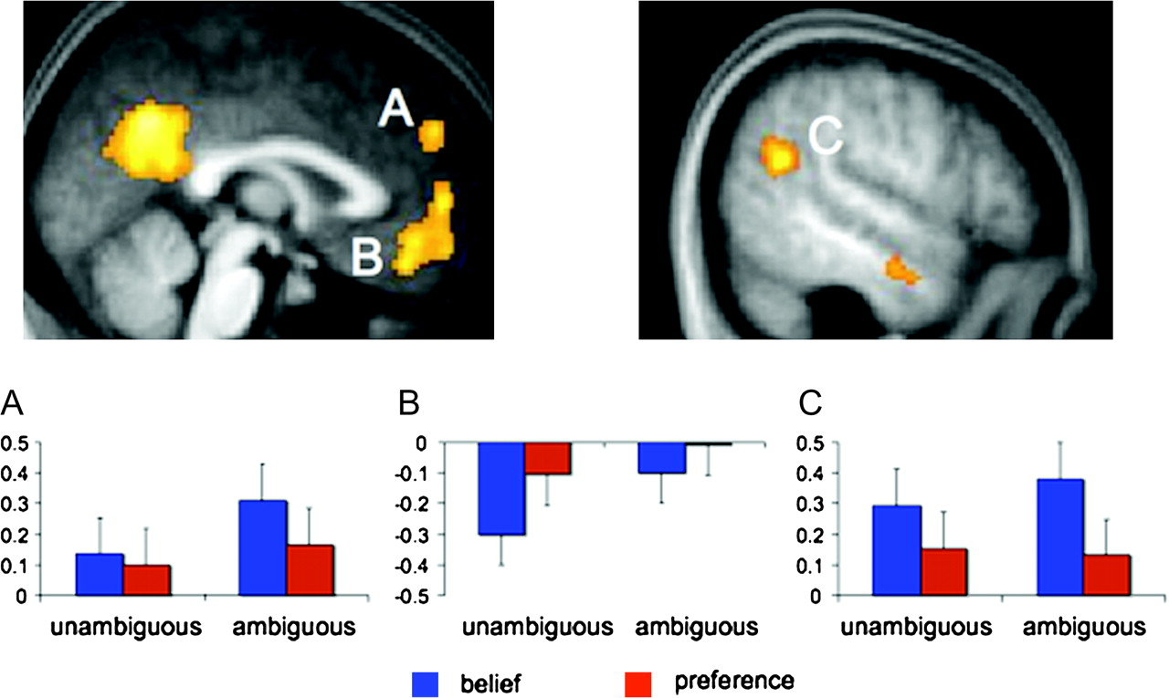
Figure 1. Average parameter estimates in dMPFC (A), vMPFC (B), and right TPJ (C) as a function of type of mental state ...
Notes:
Figure 1. Average parameter estimates in dMPFC (A), vMPFC (B), and right TPJ (C) as a function of type of mental state (belief vs. preference) and mentalizing certainty (unambiguous vs. ambiguous). Activation in both dorsal and vMPFC was characterized by a main effect of certainty, such that both regions responded more during ambiguous than unambiguous inferences, regardless of content. In contrast, activation in right TPJ was characterized only by a main effect of content type, such that it responded more during inferences about beliefs than during inferences about preferences. Error bars represent confidence interval for within-subject designs (Loftus and Masson 1994).
Unless provided in the caption above, the following copyright applies to the content of this slide: © The Author 2009. Published by Oxford University Press. All rights reserved. For permissions, please e-mail: journals.permissions@oxfordjournals.org

