Slide 1
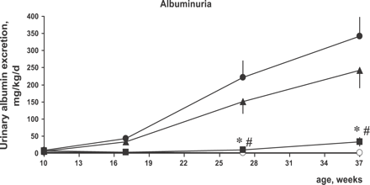
Fig. 1 Time course of albuminuria in ZDF rats. There is a progressive increase in urinary protein excretion in ...
Notes:
Fig. 1 Time course of albuminuria in ZDF rats. There is a progressive increase in urinary protein excretion in placebo animals (black circles), whereas there is virtually no albuminuria in heterozygous, lean animal (open circles). Albuminuria tended to be reduced in ZDF Rami (triangles) but was almost completely prevented in ZDF AVE (squares). *p<0.05 vs. ZDF Plac; #p<0.05 vs. ZDF Rami.
Unless provided in the caption above, the following copyright applies to the content of this slide: Copyright © 2003, European Society of Cardiology

Slide 2
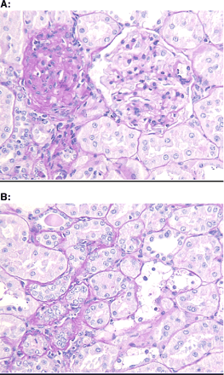
Fig. 2 Histopathological features of nephropathy in ZDF rats. (A) Glomerulosclerosis. A sclerotic glomerulum (left) ...
Notes:
Fig. 2 Histopathological features of nephropathy in ZDF rats. (A) Glomerulosclerosis. A sclerotic glomerulum (left) and a normally appearing glomerulum (right) in close vicinity. (B) Tubular atrophy and Armanni–Ebstein cells. Atrophic tubuli (lower left) are outlined by a thickened basement membrane. Cells are small, nuclei are crowded and cytoplasm is scant. Armanni–Ebstein cells (central right) are characterized by large size and clear appearance, containing hardly any remnants of PAS positive material. Objective: × 20.
Unless provided in the caption above, the following copyright applies to the content of this slide: Copyright © 2003, European Society of Cardiology

Slide 3
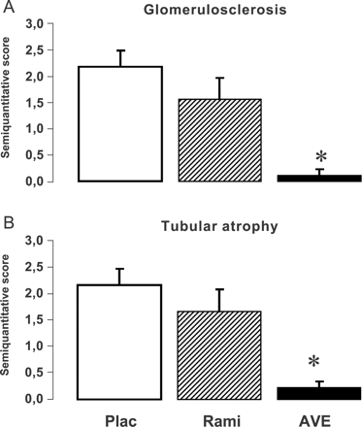
Fig. 3 Histopathological scores of glomerulosclerosis (A) and tubular atrophy (B) in the different treatment groups. ...
Notes:
Fig. 3 Histopathological scores of glomerulosclerosis (A) and tubular atrophy (B) in the different treatment groups. While ramipril tended to reduce glomerulosclerosis and tubular atrophy (n.s.), AVE7688 practically prevented both morphological features of kidney damage.
Unless provided in the caption above, the following copyright applies to the content of this slide: Copyright © 2003, European Society of Cardiology

