Slide 1
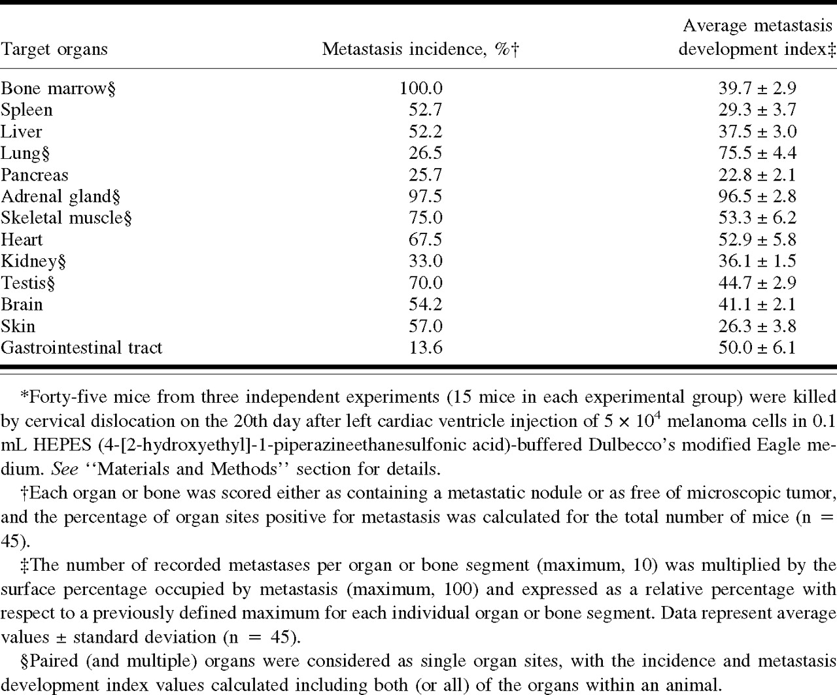
Table 1. Table 1. Organ distribution and growth of experimental metastases after injection of murine B16 melanoma ...
Notes:
Table 1. Table 1. Organ distribution and growth of experimental metastases after injection of murine B16 melanoma cells into the left cardiac ventricle of mice*
Unless provided in the caption above, the following copyright applies to the content of this slide:

Slide 2
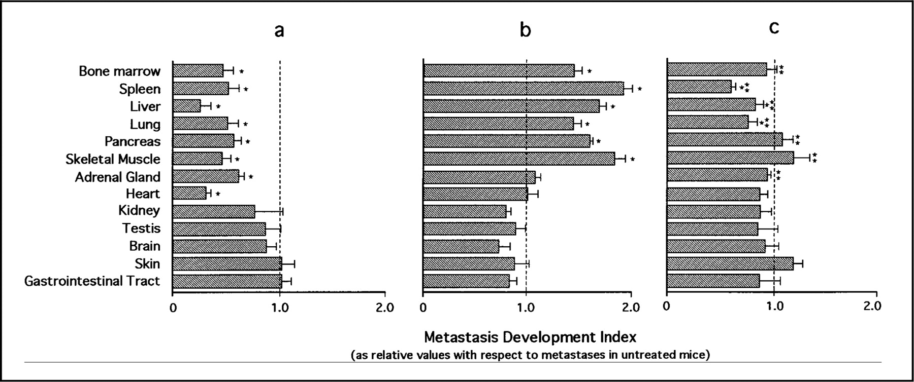
Fig. 1. Fig. 1. Variation in the metastasis development index values of major organs of mice after injection of ...
Notes:
Fig. 1. Fig. 1. Variation in the metastasis development index values of major organs of mice after injection of murine B16 melanoma cells into the left cardiac ventricle and different experimental modulations of host and melanoma-derived interleukin 1 (IL-1). a) Mice were injected intraperitoneally with 5 mgbody weight recombinant human IL-1 receptor antagonist (rHuIL-1Ra) in a volume of 0.1 mL 2 hours before the injection of5×10 4 cancer cells; thereafter, they were given a daily injection of rHuIL-1Ra for 20 days; b) mice were injected intravenously with bacterial lipopolysaccharide (LPS) (0.5 mgbody weight in a volume of 0.1 mL) 6 hours before the injection of cancer cells; c) mice were injected intraperitoneally with 5 mgbody weight rHuIL-1Ra 15 minutes before LPS administration, and 6 hours later they were injected with cancer cells, followed by no further treatment. Control mice received equivalent volumes of saline. After 20 days, the mice were killed by cervical dislocation and both the number and the degree of development of metastases were determined using morphometrical procedures. A metastasis development index, which is a measure of both the number of metastatic nodules and their extension in the target organ, was calculated ( see “ Materials and Methods” section). Results are expressed as mean relative values ± standard deviation with respect to the metastasis development index values of control mice (vertical dashed lines in each graph; the absolute values are described in Table 1). Differences that were statistically significant (two-sided P <.05) with respect to control (*) and to LPS-treated mice (**), employing the analysis of variance and the Scheffe F-test, are indicated.
Unless provided in the caption above, the following copyright applies to the content of this slide:

Slide 3
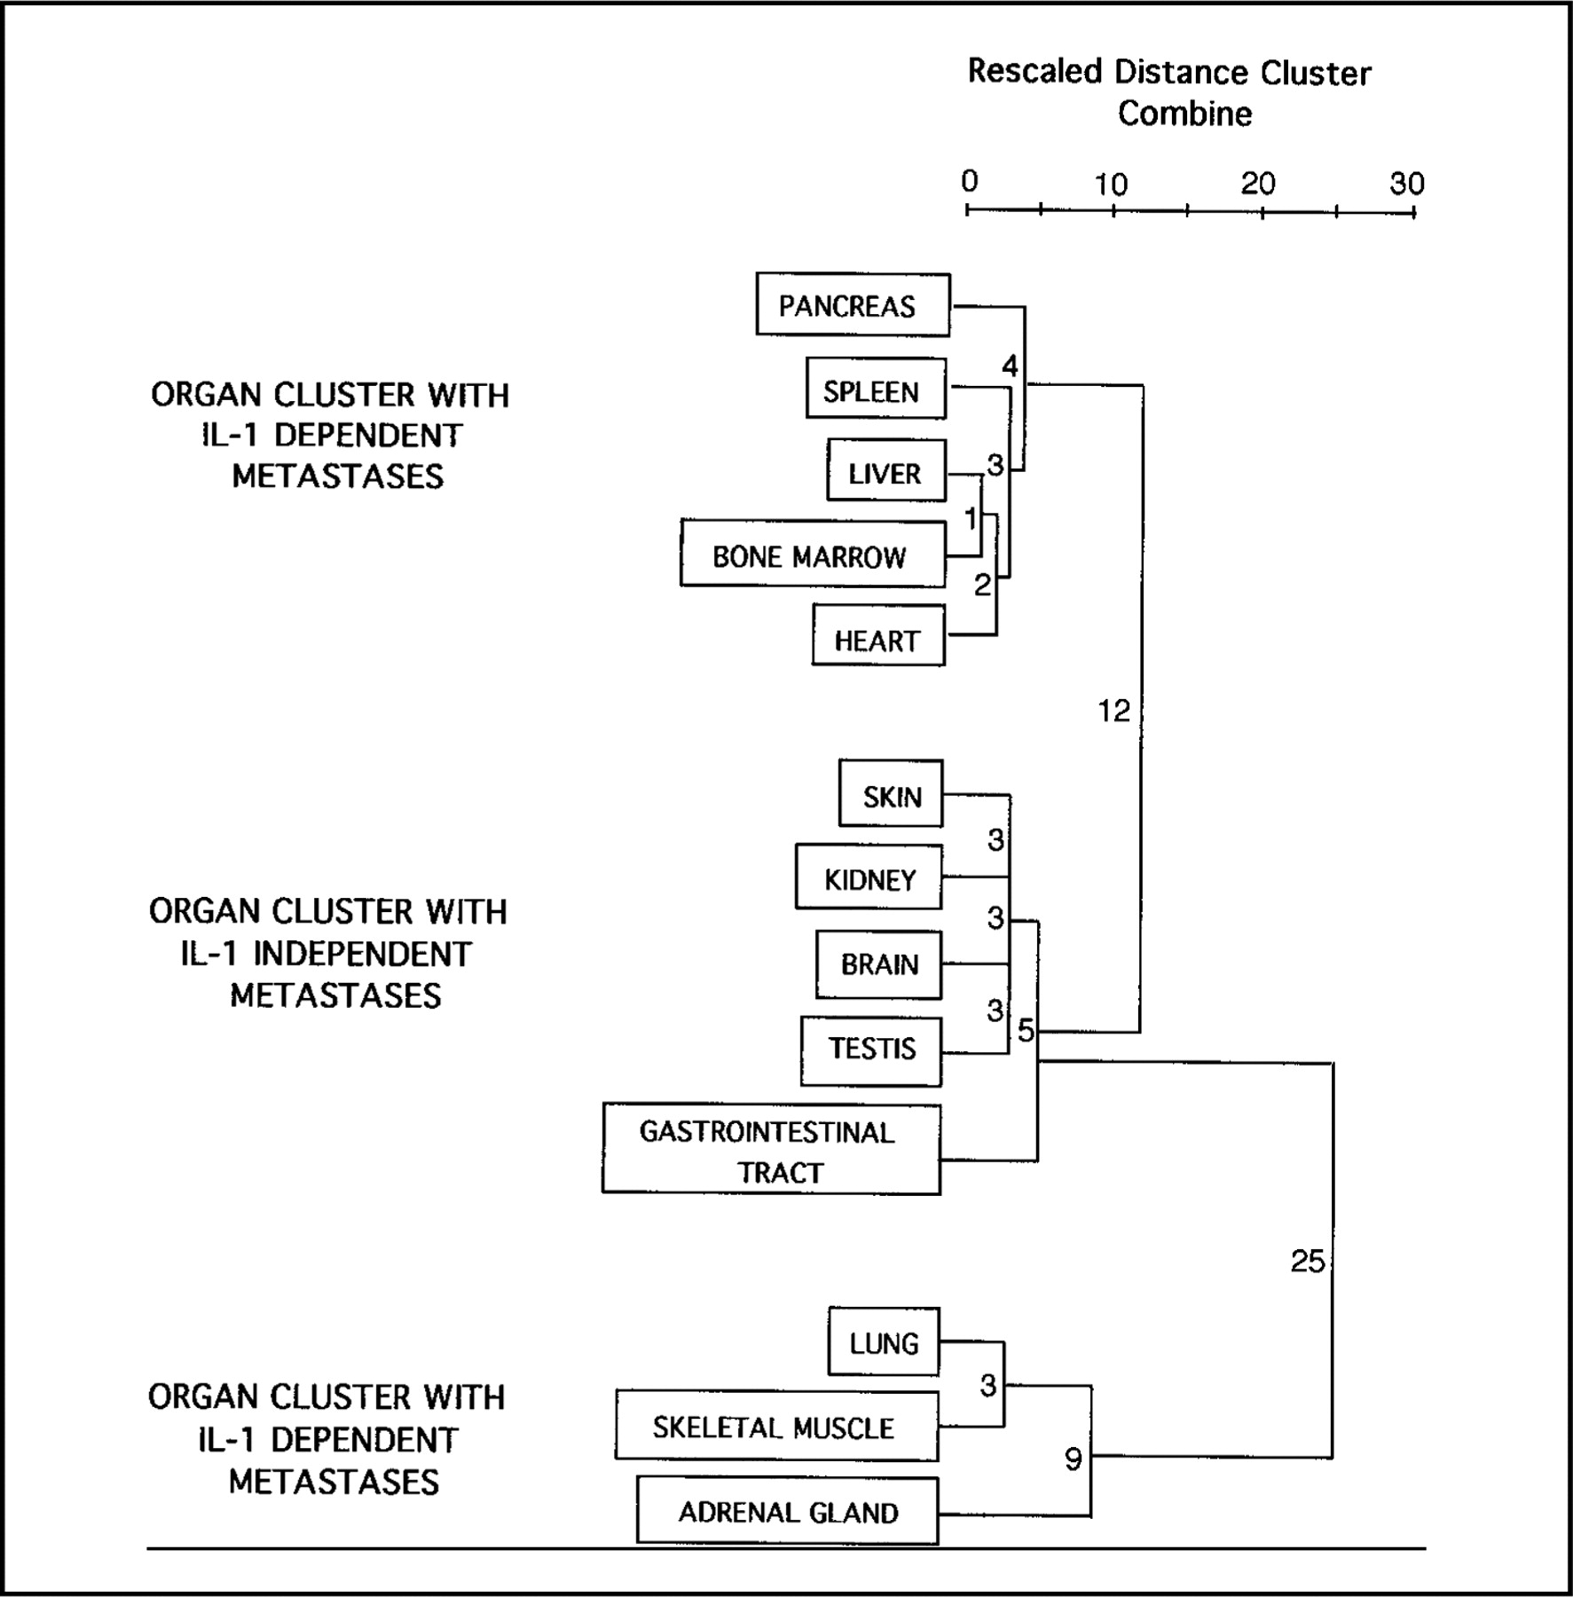
Fig. 2. Fig. 2. Dendrogram of organ aggregations visualized by means of a hierarchical cluster analysis. Three ...
Notes:
Fig. 2. Fig. 2. Dendrogram of organ aggregations visualized by means of a hierarchical cluster analysis. Three well-differentiated organ clusters, with characteristic changes in their melanoma metastasis development indices under the three treatment conditions (i.e., rHuIL-1Ra, LPS, and rHuIL-1Ra plus LPS) ( see Fig. 1), are presented. Numbers shown adjacent to lines connecting organs and organ clusters represent the euclidean distance values calculated as a measure of average linkages among the studied organs and organ clusters.
Unless provided in the caption above, the following copyright applies to the content of this slide:

