Slide 1
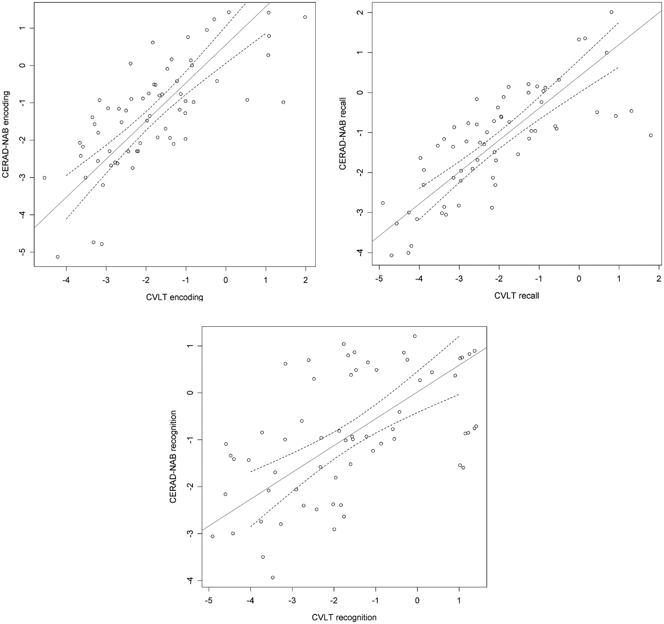
Fig. 1. Scatterplots of z-scores from CERAD-NAB Word List task and corresponding CVLT variables with first PCs and ...
Notes:
Fig. 1. Scatterplots of z-scores from CERAD-NAB Word List task and corresponding CVLT variables with first PCs and 95% confidence bands (dashed).
Unless provided in the caption above, the following copyright applies to the content of this slide: © The Author 2012. Published by Oxford University Press. All rights reserved. For permissions, please e-mail: journals.permissions@oup.com.

Slide 2
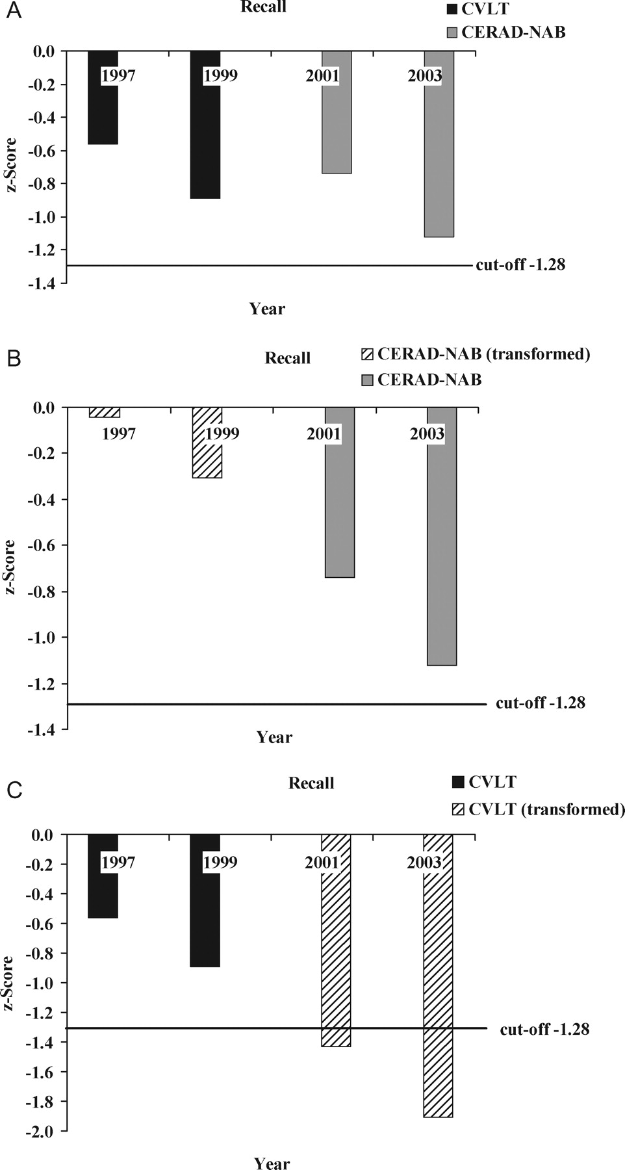
Fig. 2. Recall results of a fictive patient examined four times over 6 years. (A) The patient was administered the ...
Notes:
Fig. 2. Recall results of a fictive patient examined four times over 6 years. (A) The patient was administered the CVLT at the first two testing sessions. At follow-ups 2 and 3, he was administered the CERAD-NAB Word List task because his cognitive functioning had declined. (B) Course of recall performance with transformed CVLT recall scores. (C) Course of recall performance with transformed CERAD-NAB Word List task recall scores.
Unless provided in the caption above, the following copyright applies to the content of this slide: © The Author 2012. Published by Oxford University Press. All rights reserved. For permissions, please e-mail: journals.permissions@oup.com.

Slide 3
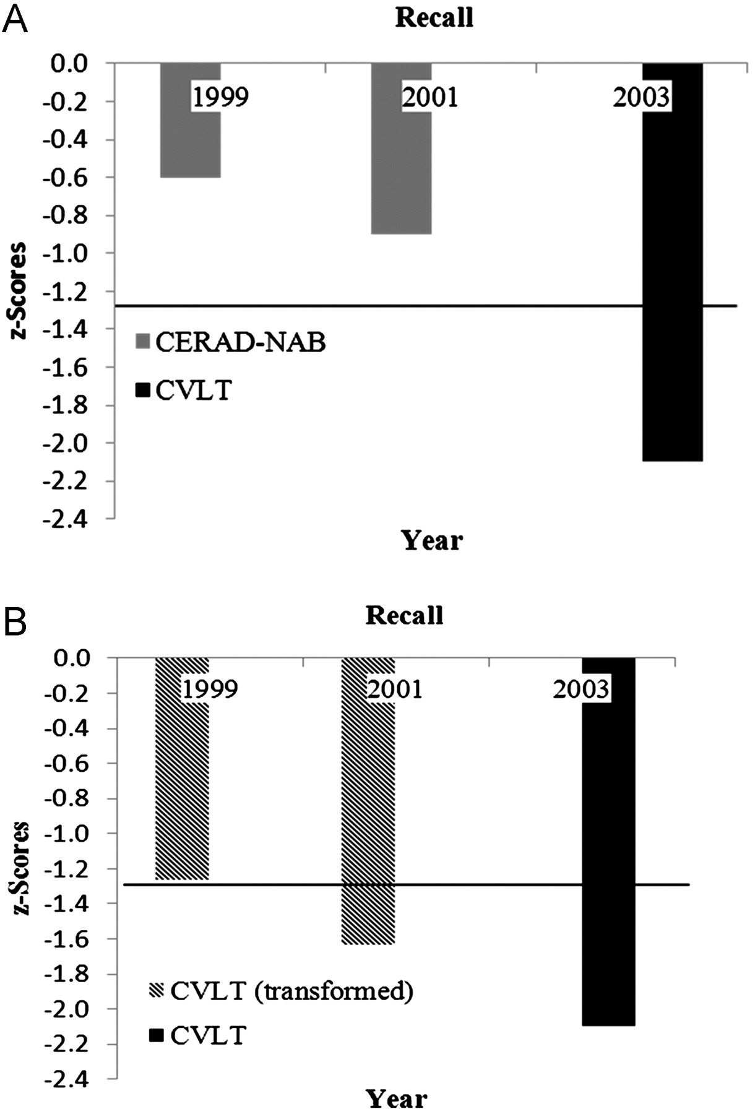
Fig. 3. Recall results of a second fictive patient examined three times over 4 years. (A) The patient was ...
Notes:
Fig. 3. Recall results of a second fictive patient examined three times over 4 years. (A) The patient was administered the CERAD-NAB Word List task at the first two testing sessions which took place in another hospital. At follow-up 3, the patient was examined at our institution. Since he was well educated, relatively young, and (according to the MMSE) mildly cognitively impaired, he was administered the CVLT. The results show a decline in recall performance over all three testing sessions, with a sudden deterioration at the third testing session. (B) The course of recall performance with transformed CVLT recall scores at baseline and follow-up 1. The transformed scores indicate that the patient would have shown marginal recall performance at baseline and moderate deficits at follow-up 1. The transformed results show a more linear decline in recall performance over the three testing sessions.
Unless provided in the caption above, the following copyright applies to the content of this slide: © The Author 2012. Published by Oxford University Press. All rights reserved. For permissions, please e-mail: journals.permissions@oup.com.

