Slide 1
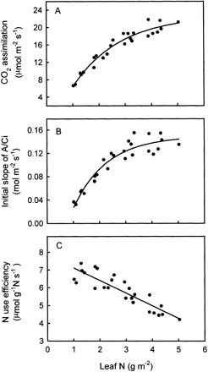
Fig. 1. Light‐saturated CO₂ assimilation at ambient CO₂ (A), the initial slope of the ...
Notes:
Fig. 1. Light‐saturated CO2 assimilation at ambient CO2 (A), the initial slope of the A/Ci curves (B), and photosynthetic N use efficiency (C) in relation to N content in apple leaves. Regression equations: (A) y=28.31× (1−e−0.548x)−5.53 (R2=0.946, P=0.0001); (B) y=0.2697(1−e−0.782x)− 0.1204 (R2=0.904, P=0.0001); (C) y=7.83–0.71x (R2=0.782, P=0.0001).
Unless provided in the caption above, the following copyright applies to the content of this slide: © Society for Experimental Biology

Slide 2
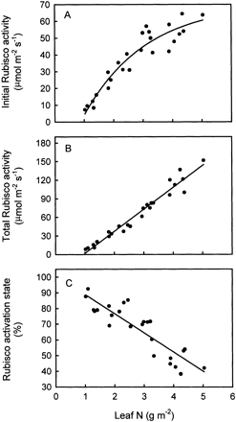
Fig. 2. Initial Rubisco activity (A), total Rubisco activity (B), and Rubisco activation state (C) in response to N ...
Notes:
Fig. 2. Initial Rubisco activity (A), total Rubisco activity (B), and Rubisco activation state (C) in response to N content in apple leaves. Regression equations: (A) y=106.5(1−e−0.476x)−36.2 (R2=0.902, P=0.0001); (B) y=–33.68+35.41x (R2=0.958, P=0.0001); (C) y=101.1−12.2x (R2=0.789, P=0.0001).
Unless provided in the caption above, the following copyright applies to the content of this slide: © Society for Experimental Biology

Slide 3
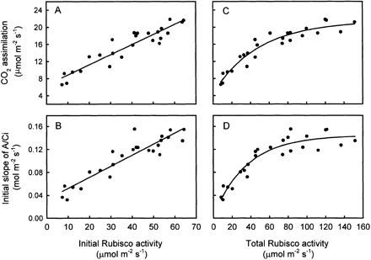
Fig. 3. Light‐saturated CO₂ assimilation at ambient CO₂ and the initial slope of the ...
Notes:
Fig. 3. Light‐saturated CO2 assimilation at ambient CO2 and the initial slope of the A/Ci curves in relation to initial Rubisco activity (A, B) and total Rubisco activity (C, D) in apple leaves. Regression equations: (A) y=6.50+0.235x (R2=0.871, P=0.0001); (B) y=0.033+0.0019x (R2=0.847, P=0.0001); (C) y=16.92(1−e−0.0205x)+4.53 (R2=0.918, P=0.0001); (D) y=0.1405(1−e−0.0281x)+0.0038 (R2=0.887, P=0.0001).
Unless provided in the caption above, the following copyright applies to the content of this slide: © Society for Experimental Biology

Slide 4
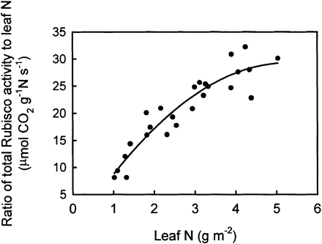
Fig. 4. The ratio of total Rubisco activity to leaf N, in response to N content in apple leaves. Regression equation: ...
Notes:
Fig. 4. The ratio of total Rubisco activity to leaf N, in response to N content in apple leaves. Regression equation: y=−1.95+11.76x−1.11x2 (R2=0.874, P=0.0001).
Unless provided in the caption above, the following copyright applies to the content of this slide: © Society for Experimental Biology

Slide 5
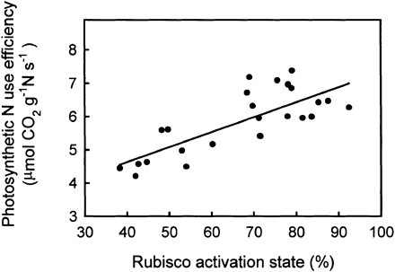
Fig. 5. Photosynthetic N use efficiency in relation to Rubisco activation state in apple leaves. Regression equation: ...
Notes:
Fig. 5. Photosynthetic N use efficiency in relation to Rubisco activation state in apple leaves. Regression equation: y=2.83+0.045x (R2=0.591, P=0.0001).
Unless provided in the caption above, the following copyright applies to the content of this slide: © Society for Experimental Biology

Slide 6
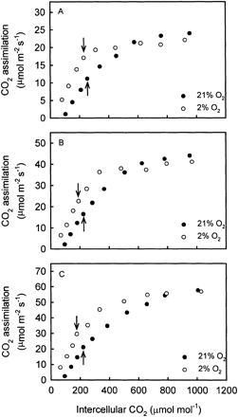
Fig. 6. Responses of CO₂ assimilation to intercellular CO₂ concentration in apple leaves at 21% ...
Notes:
Fig. 6. Responses of CO2 assimilation to intercellular CO2 concentration in apple leaves at 21% and 2% O2. Leaf N content (g m−2) is 1.52±0.07 (A), 2.54±0.09 (B), and 4.06±0.10 (C). Each data point represents the average of three replications. The arrows indicate the intercellular CO2 concentration corresponding to the ambient CO2 concentration. Measurements were made at a PFD of 1700±20 μmol m−2 s−1, a leaf temperature of 27.0±1.0 °C, and an ambient water vapour pressure of 1.28±0.05 kPa.
Unless provided in the caption above, the following copyright applies to the content of this slide: © Society for Experimental Biology

