Slide 1
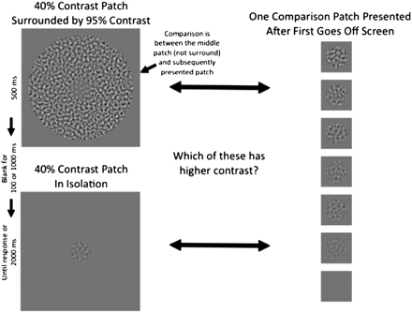
Fig. 1. Illustration of the Contrast-Contrast Effect (CCE) paradigm. On each trial, participants are presented with a ...
Notes:
Fig. 1. Illustration of the Contrast-Contrast Effect (CCE) paradigm. On each trial, participants are presented with a patch, either in isolation (left bottom patch) or surrounded by a high-contrast annulus (95% contrast, left top patch) for 500 ms. After either 1000 or 100 ms, participants were then presented with a single patch in isolation (example patches on right) and asked to decide whether the first or second patch had higher contrast. When the first patch was presented with the high-contrast surround, it was made clear to participants that the comparison was between the center patch and the subsequent patch.
Unless provided in the caption above, the following copyright applies to the content of this slide: © The Author 2011. Published by Oxford University Press on behalf of the Maryland Psychiatric Research Center. All rights reserved. For permissions, please email: journals.permissions@oup.com.

Slide 2
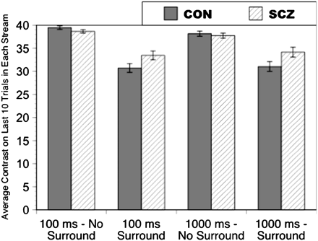
Fig. 2. Graph illustrating the mean contrast of the comparison patch on the last 10 trials of each stream, averaged ...
Notes:
Fig. 2. Graph illustrating the mean contrast of the comparison patch on the last 10 trials of each stream, averaged across the 4 streams, separately for each task condition. Error bars are SEs.
Unless provided in the caption above, the following copyright applies to the content of this slide: © The Author 2011. Published by Oxford University Press on behalf of the Maryland Psychiatric Research Center. All rights reserved. For permissions, please email: journals.permissions@oup.com.

