Slide 1
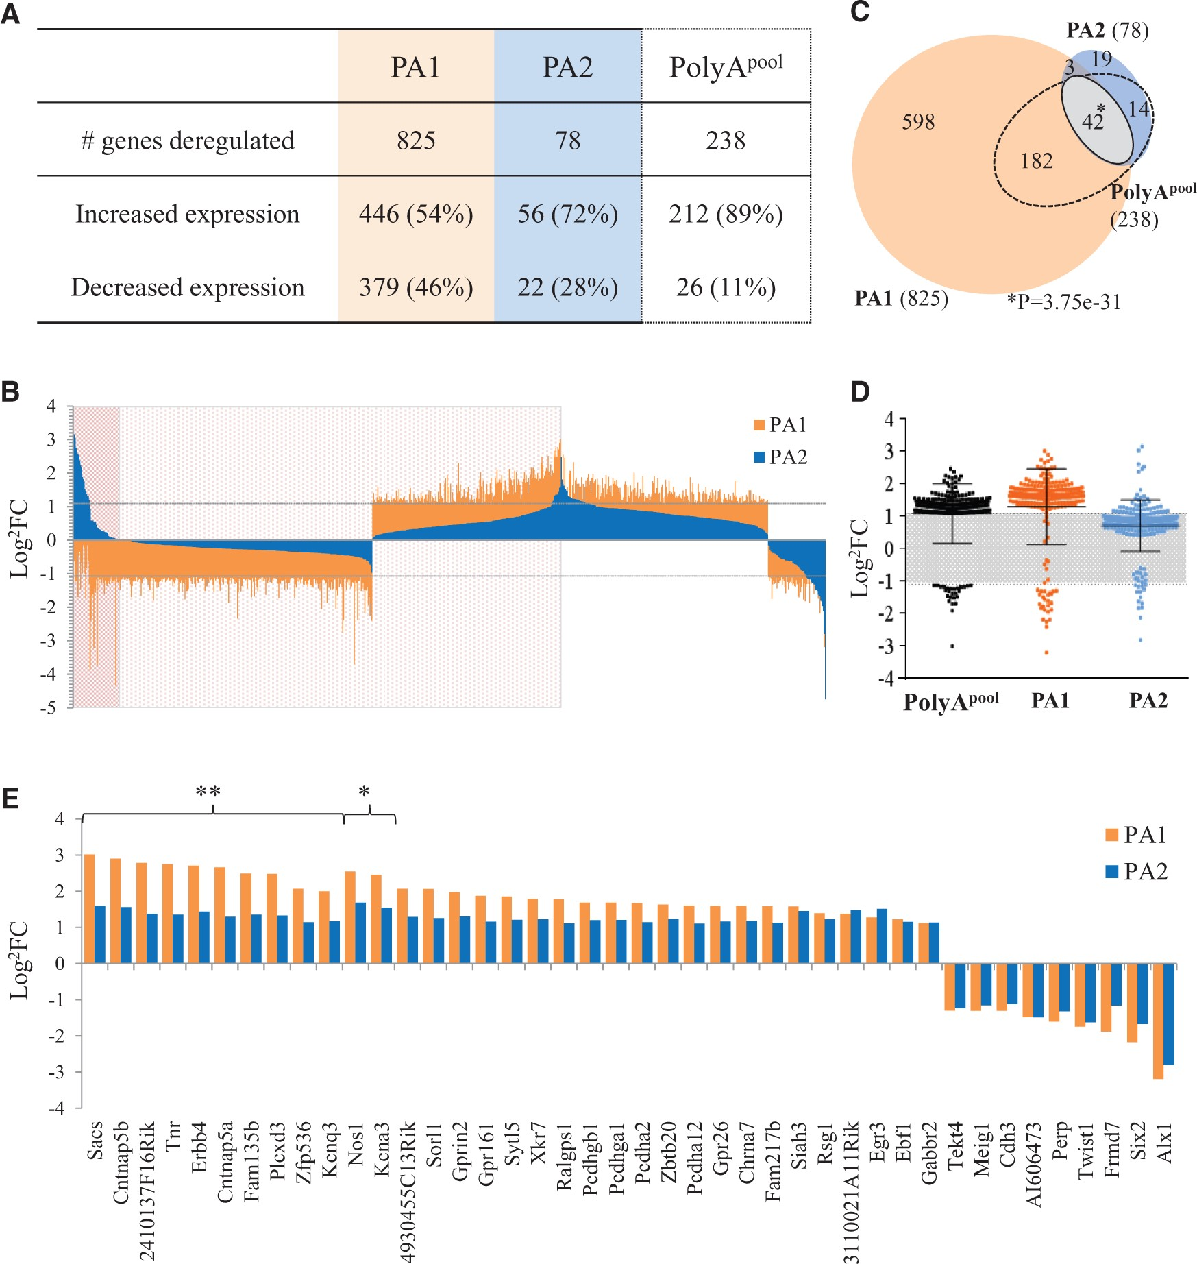
Figure 1. Transcriptome analysis of embryonic brains of PolyA Arx mutant mice. Differential expression of genes from ...
Notes:
Figure 1. Transcriptome analysis of embryonic brains of PolyA Arx mutant mice. Differential expression of genes from 12.5 dpc mice was determined using EdgeR and selected based on a Log2 fold change greater than +/- 1.1 with a P-value < 0.05. (A) Total number of deregulated genes and the proportion of either increased or decreased expression from our analysis from both mutant mice strains independently, PA1 and PA2, and analysis of pooled PA1 and PA2 strains, PolyApool when compared to WT animals. (B) Log2FC was plotted for all deregulated genes for both PA1 (orange) and PA2 (blue) (total = 858). Genes within the darker red shaded area are deregulated in different directions compared to WT with expression of genes significantly different between PA1 and PA2 (58/858, 6.75%). Genes within the lighter red area are deregulated in the same direction in both PA mutation groups compared to WT, but are still significantly different between PA1 and PA2 (498/858, 58.05%). The remaining genes are deregulated in the same direction compared to WT, but are not significantly different between PA1 and PA2 (35.2%). The dotted line indicates the log2FC +/- 1.1 cut off. (C) Gene lists from PA1 (orange), PA2 (blue) and PolyApool analysis (dotted outline) was used to determine the overlap of genes deregulated in each group and visualised as a Venn diagram. Overlapping genes in PA1 and PA2 samples with log2FC > +/−1.1 in both lists and a P-value <0.05 are highlighted in grey (solid outline) with logFC values for individual genes shown in (E). *significantly different between groups with a log2FC<1.1 and P-values +1.1 and P-values <0.05.
Unless provided in the caption above, the following copyright applies to the content of this slide: © The Author 2016. Published by Oxford University Press. All rights reserved. For Permissions, please email: journals.permissions@oup.com

Slide 2
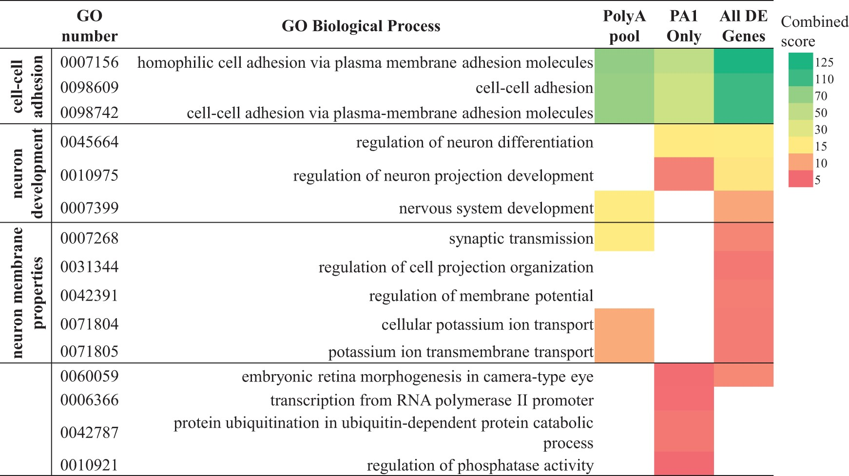
Figure 2. Gene ontology classification of deregulated genes. Functional enrichment analysis of gene ontology (GO) terms ...
Notes:
Figure 2. Gene ontology classification of deregulated genes. Functional enrichment analysis of gene ontology (GO) terms for biological processes shows the differentially expressed genes within subgroups, PolyApool, PA1 only and all deregulated genes from both PA1 and PA2 (All deregulated (DE) genes) with a log2 fold change with + >1.1 cutoff value used as the input into EnrichR. The GO terms were ranked based on the combined EnrichR score and all had a P-value <0.05.
Unless provided in the caption above, the following copyright applies to the content of this slide: © The Author 2016. Published by Oxford University Press. All rights reserved. For Permissions, please email: journals.permissions@oup.com

Slide 3
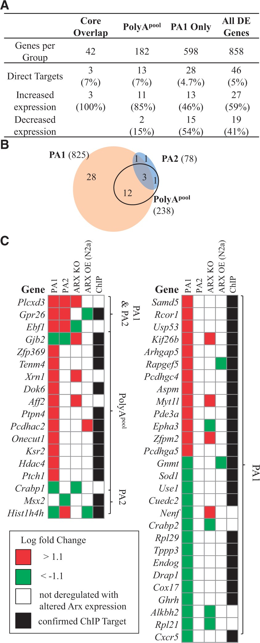
Figure 3. Disruption to putative and known ARX target genes. (A) The number of putative and known direct targets of ARX ...
Notes:
Figure 3. Disruption to putative and known ARX target genes. (A) The number of putative and known direct targets of ARX and the direction of deregulation in the PolyA mutant mice is shown for each subgroup of the RNASeq analysis. (B) The putative and known direct gene targets of ARX are spread across all subgroups of the RNASeq analysis as illustrated on the Venn diagram. (C) For each of these putative or direct gene targets of Arx identified in the PolyA mutant mice the change in expression compared to WT from this study (PA1 and PA2) with a comparison of the changes to expression in studies of Arx loss of function (ARX KO) (11,21), Arx overexpression in N2a cells (ARX OE) (24) and ChIP studies (24). Red indicates an increase in expression with Green a decrease in expression compared to WT.
Unless provided in the caption above, the following copyright applies to the content of this slide: © The Author 2016. Published by Oxford University Press. All rights reserved. For Permissions, please email: journals.permissions@oup.com

Slide 4
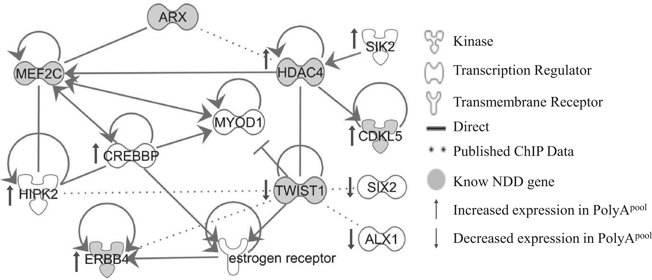
Figure 5. Arx-Hdac4-Twist1 PolyA-deregulated pathway. Pathway analysis was used to assess connectivity of deregulated ...
Notes:
Figure 5. Arx-Hdac4-Twist1 PolyA-deregulated pathway. Pathway analysis was used to assess connectivity of deregulated genes of PolyA-Arx loss-of-function embryonic brains. The geometric shapes reflect differing types of proteins as defined by ingenuity analysis (Ingenuity Systems) (see legend) with direct connections shown as solid lines. Published ChIP data highlighting relationships between genes and proteins are shown as dotted lines. The direction of deregulation in PolyApool is indicated with arrows (↑ = increased expression, ↓ = decreased expression). Known NDD genes are shaded in grey.
Unless provided in the caption above, the following copyright applies to the content of this slide: © The Author 2016. Published by Oxford University Press. All rights reserved. For Permissions, please email: journals.permissions@oup.com

Slide 5
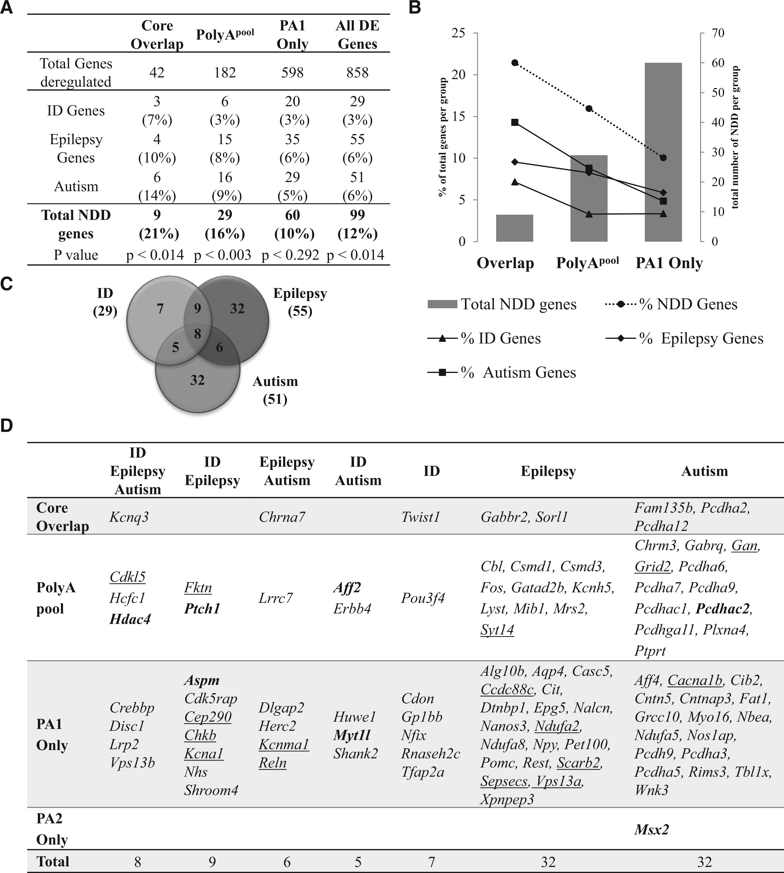
Figure 4. Genes deregulated in expanded polyA mice include known ID, epilepsy and autism genes. (A) Total number of ...
Notes:
Figure 4. Genes deregulated in expanded polyA mice include known ID, epilepsy and autism genes. (A) Total number of genes associated with overlapping phenotypes of ID, epilepsy and autism and the proportion (%) per mutation subgroup. P-value indicates the significance of overlap between each PolyA mutant subgroup and the known neurodevelopment disorder genes. (B) A combined graph showing the total number of genes per subgroup (grey bars) on the right-hand y-axis compared to the proportion of overlap with known neurodevelopmental disorder genes across RNASeq analysis subgroups shown on the left-hand y-axis (legend for line graph shown below the graph). (C) Venn diagram showing the overlap of genes associated with ID, Epilepsy and Autism comorbid phenotypes. (D) List of known neurodevelopmental disorder genes within each PolyA mutant subgroup, grouped by the associated disease phenotypes. Known movement disorder genes are underlined. The putative and known direct targets of ARX/Arx are highlighted in bold.
Unless provided in the caption above, the following copyright applies to the content of this slide: © The Author 2016. Published by Oxford University Press. All rights reserved. For Permissions, please email: journals.permissions@oup.com

