Slide 1
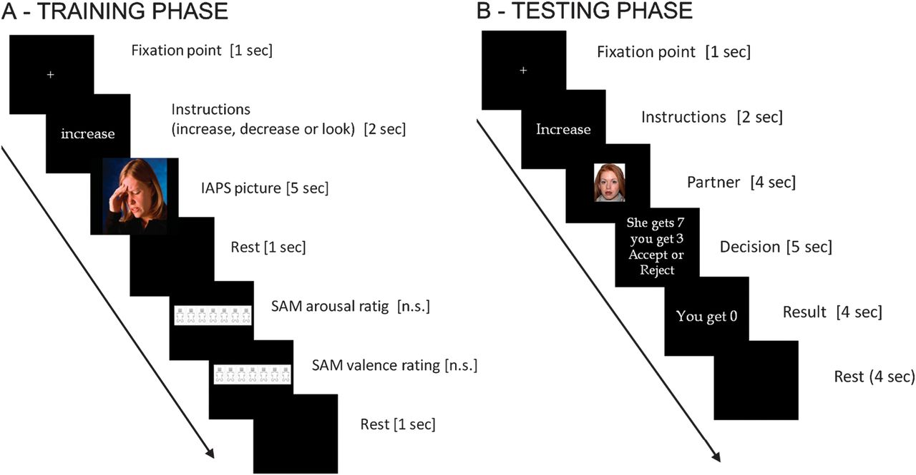
Figure 1. Experimental design, with Training phase (A) and Testing phase (B). In the training phase (outside the ...
Notes:
Figure 1. Experimental design, with Training phase (A) and Testing phase (B). In the training phase (outside the scanner) participants observed unpleasant IAPS pictures after receiving the relevant reappraisal strategy for that trial (increase, decrease, and look). After that, they rated on a two-scale Self Assessment Manikin the perceived arousal and valence. In the testing phase (inside the scanner) participants played the standard UG while applying the same reappraisal strategies.
Unless provided in the caption above, the following copyright applies to the content of this slide: © The Author 2012. Published by Oxford University Press. All rights reserved. For permissions, please e-mail: journals.permissions@oup.com

Slide 2
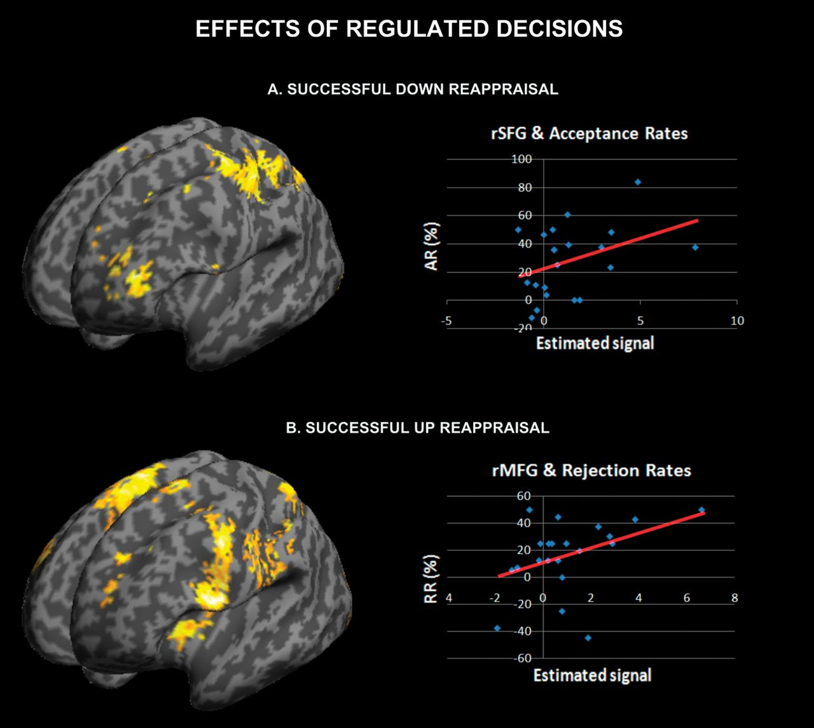
Figure 4. Brain regions involved in regulated decisions. Downregulated decisions (A) were calculated as the regions ...
Notes:
Figure 4. Brain regions involved in regulated decisions. Downregulated decisions (A) were calculated as the regions more active for unfair accepted offers, and returned predominantly the left superior and MFG. Upregulated decisions (B) were calculated as the regions more active for unfair rejected offers, and returned primarily the left IFG.
Unless provided in the caption above, the following copyright applies to the content of this slide: © The Author 2012. Published by Oxford University Press. All rights reserved. For permissions, please e-mail: journals.permissions@oup.com

Slide 3
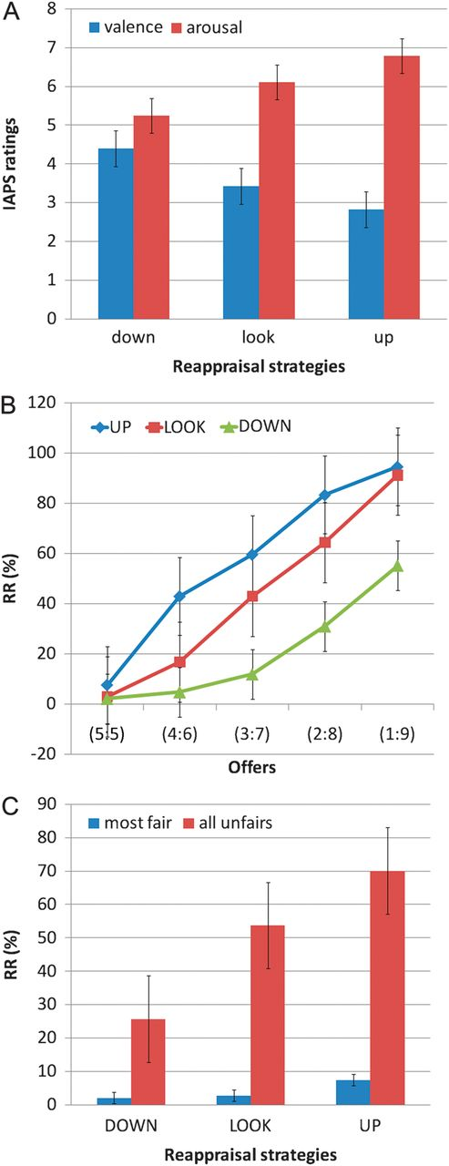
Figure 2. Behavioral data. In the Training phase (A), participants' perceived valence and arousal was significantly ...
Notes:
Figure 2. Behavioral data. In the Training phase (A), participants' perceived valence and arousal was significantly modulated by the reappraisal strategies adopted. A linear decrease (i.e., more negativity) for valence and the opposite trend for arousal were observed, showing that the perceived emotionality of the IAPS pictures was altered according to the modulation strategy. In the Testing phase (B), rejection rates (RR) interacted with strategy, with increased rejections in the Up condition for unfair offers, and increased acceptances in the Down condition for the same set of offers. Collapsing across unfair offers (from €1 to €4) (C) demonstrated a linear trend in the rejection pattern.
Unless provided in the caption above, the following copyright applies to the content of this slide: © The Author 2012. Published by Oxford University Press. All rights reserved. For permissions, please e-mail: journals.permissions@oup.com

Slide 4
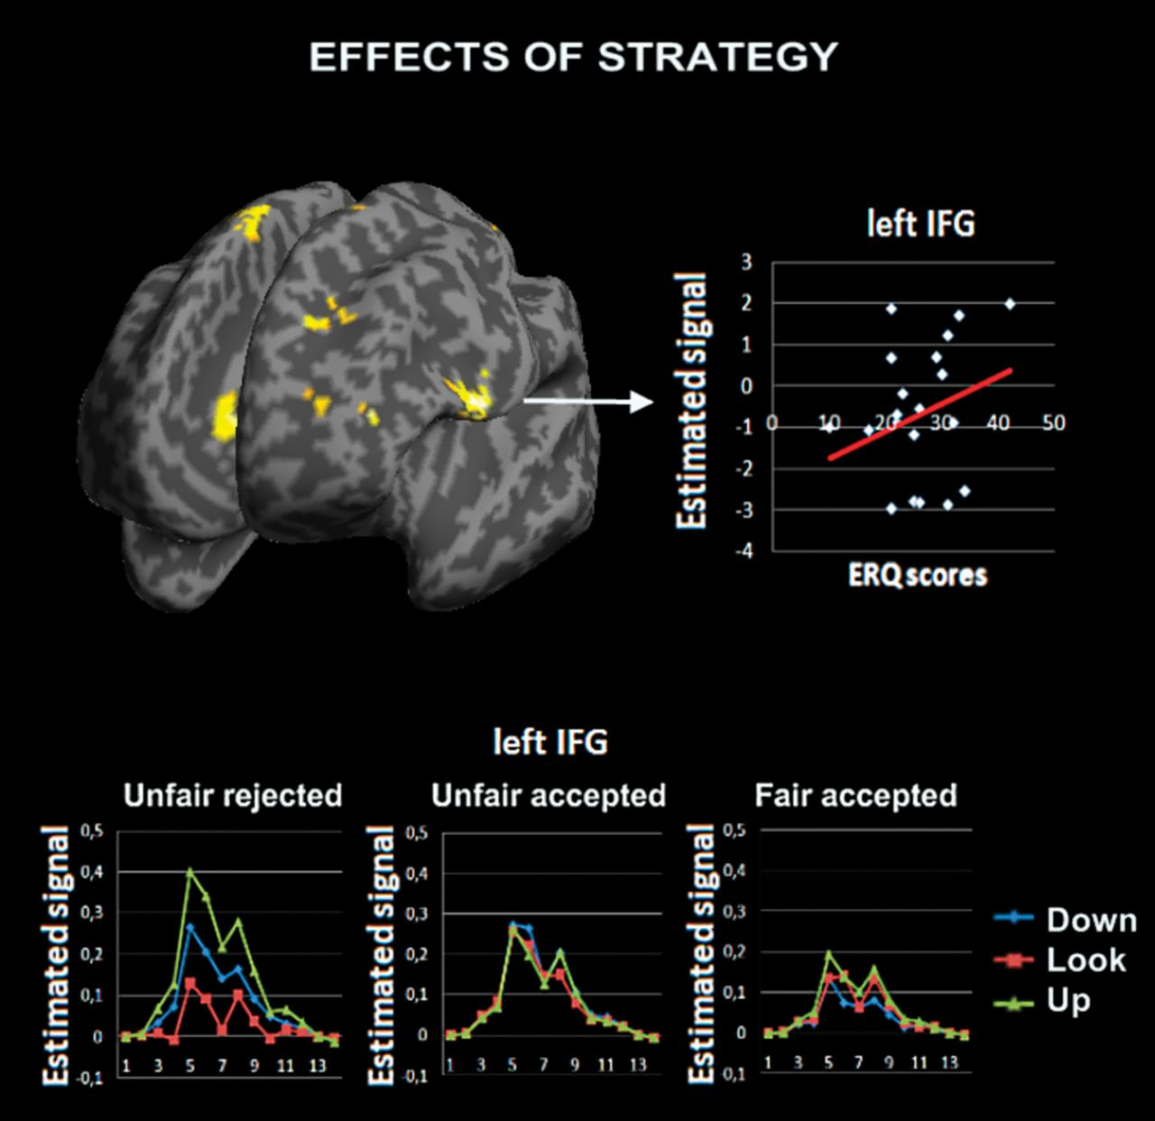
Figure 3. The main effect of strategy returned significant activations for left IFG, MFG, right SFG, and bilateral ...
Notes:
Figure 3. The main effect of strategy returned significant activations for left IFG, MFG, right SFG, and bilateral anterior cingulate (AC). Overall these regions responded more to Up and Down conditions as compared to Look, independent of offers and the decision (accept/reject). Of these regions the IFG BOLD activity showed selective activations for Up and Down compared with Look only for unfair rejected offers. Moreover, IFG correlated with the Emotion Regulation questionnaire measure, suggesting a role for this region when regulating emotions more generally.
Unless provided in the caption above, the following copyright applies to the content of this slide: © The Author 2012. Published by Oxford University Press. All rights reserved. For permissions, please e-mail: journals.permissions@oup.com

Slide 5
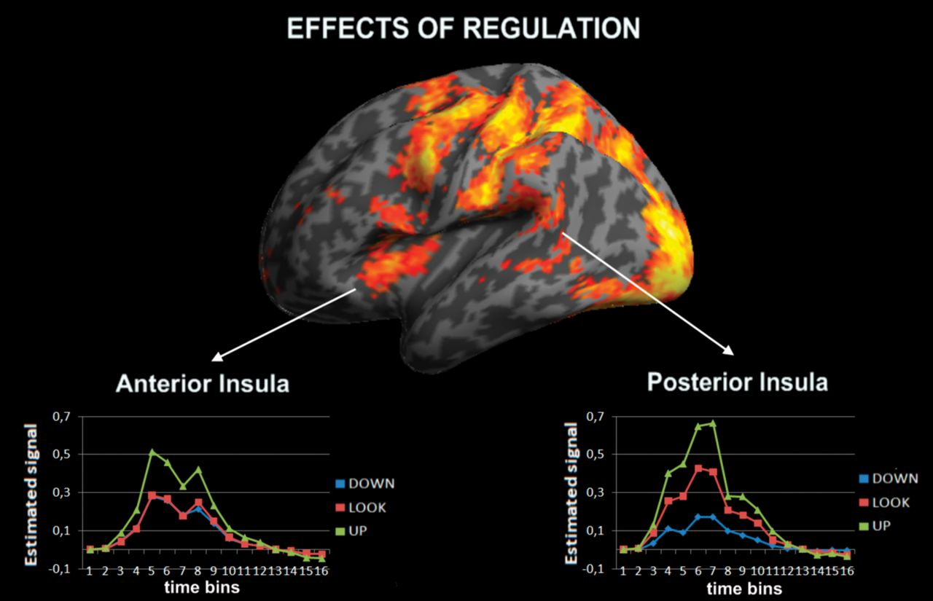
Figure 5. Regions modulated by reappraisal in line with the behavioral pattern (i.e., down < look < up, Fig. 2C), ...
Notes:
Figure 5. Regions modulated by reappraisal in line with the behavioral pattern (i.e., down < look < up, Fig. 2C), returned regions showing a linear increase only for unfair rejected offers. Anterior and posterior subregions of the left insula showed differential patterns, with the posterior part being more affected by the strategy. For display purposes, the brain reported in this figure has been thresholded at P < 0.001 uncorrected (instead of P < 0.05 FWE as reported in the tables).
Unless provided in the caption above, the following copyright applies to the content of this slide: © The Author 2012. Published by Oxford University Press. All rights reserved. For permissions, please e-mail: journals.permissions@oup.com

