Slide 1
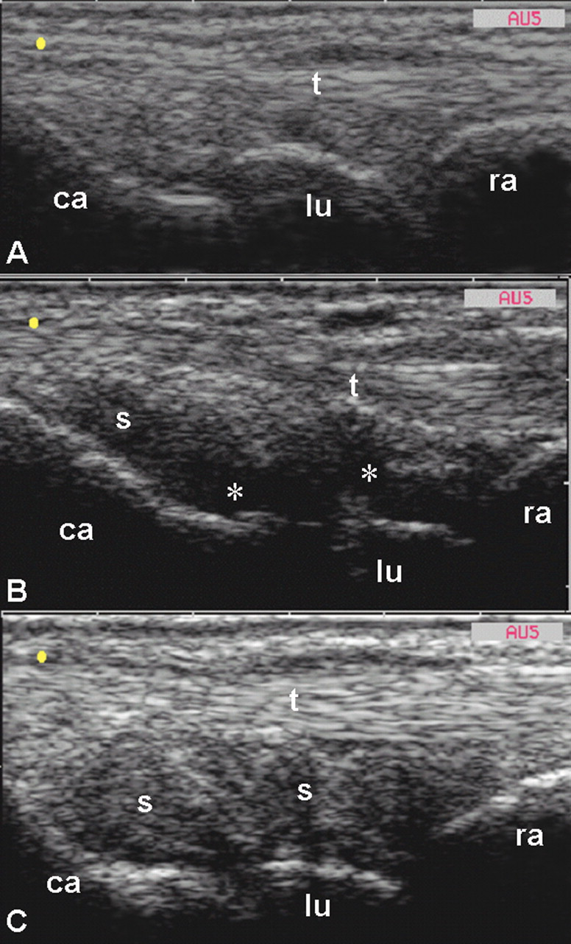
Fig. 1. Dorsal longitudinal scan of the wrist joint in patients with RA. (A) Image showing no US findings of joint ...
Notes:
Fig. 1. Dorsal longitudinal scan of the wrist joint in patients with RA. (A) Image showing no US findings of joint inflammation. (B) Note the joint cavity widening mainly due to an increased amount of synovial fluid (asterisk). (C) Representative example of joint space enlargement due to synovial hypertrophy (s) refilling the joint cavity. ra, radius; lu, lunate bone; ca, capitate bone; t, finger extensor tendons; *, synovial fluid; s, synovial hypertrophy. Images taken using an AU5 ‘Harmonics’ (Esaote Biomedica, Genoa, Italy), with a 13 MHz linear probe.
Unless provided in the caption above, the following copyright applies to the content of this slide: © The Author 2007. Published by Oxford University Press on behalf of the British Society for Rheumatology. All rights reserved. For Permissions, please email: journals.permissions@oxfordjournals.org

