Slide 1
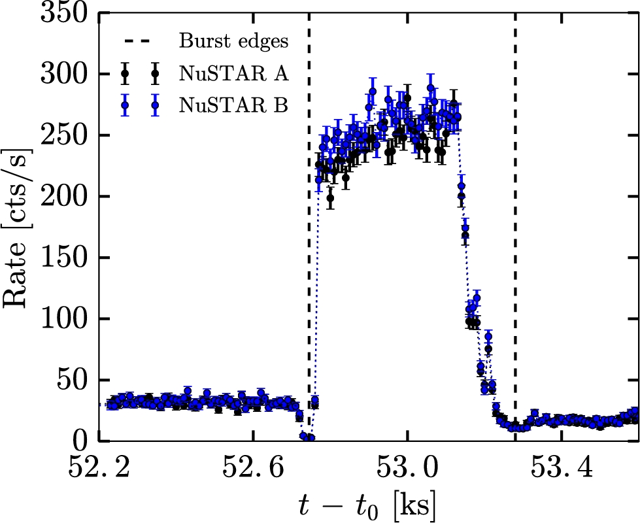
Figure 1. Representative example of a Type II burst in the NuSTAR observation. The characteristic dips, visible before ...
Notes:
Figure 1. Representative example of a Type II burst in the NuSTAR observation. The characteristic dips, visible before and after the burst, form the border between the non-burst and burst GTIs. The start time of the observation is t0.
Unless provided in the caption above, the following copyright applies to the content of this slide: © 2016 The Authors Published by Oxford University Press on behalf of the Royal Astronomical Society

Slide 2
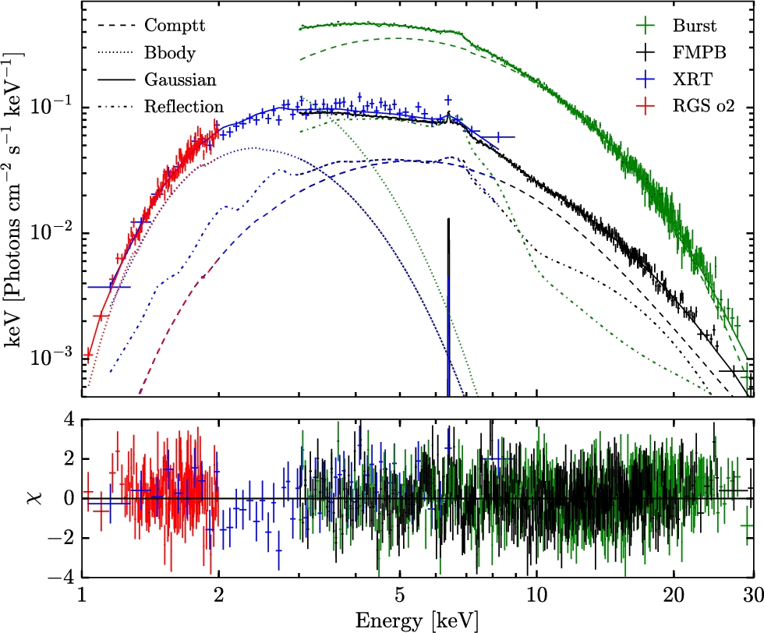
Figure 2. The NuSTAR (FMPB), XMM–Newton RGS (order 2) and Swift unfolded spectra with the best-fitting tbabs (comptt + ...
Notes:
Figure 2. The NuSTAR (FMPB), XMM–Newton RGS (order 2) and Swift unfolded spectra with the best-fitting tbabs (comptt + bbodyrad + relconv*reflionx + gauss) model. For clarity, we show only a single spectrum per telescope. For comparison, we also show the unfolded FMPA burst spectrum in green. The spectra have been rebinned for visual purposes in xspec using setplot rebin. Note that small deviations appear visible in the Swift-spectrum between 2 and 3 keV.
Unless provided in the caption above, the following copyright applies to the content of this slide: © 2016 The Authors Published by Oxford University Press on behalf of the Royal Astronomical Society

Slide 3
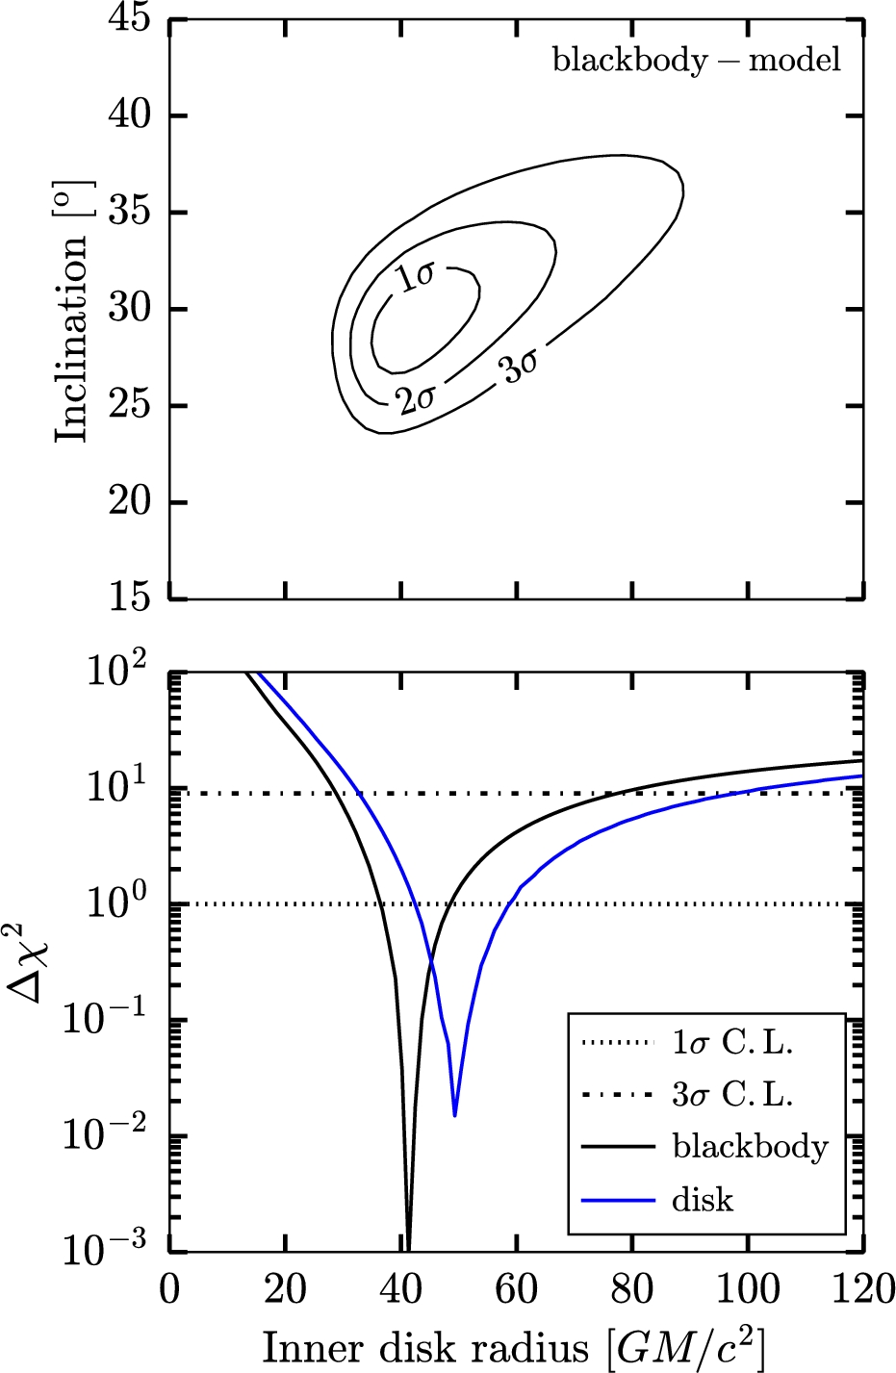
Figure 3. Top panel: 2D confidence contour for the inclination and inner disc radius or the BB-model. Bottom panel: ...
Notes:
Figure 3. Top panel: 2D confidence contour for the inclination and inner disc radius or the BB-model. Bottom panel: confidence plot of the inner disc radius for the blackbody and disc-models.
Unless provided in the caption above, the following copyright applies to the content of this slide: © 2016 The Authors Published by Oxford University Press on behalf of the Royal Astronomical Society

