Slide 1
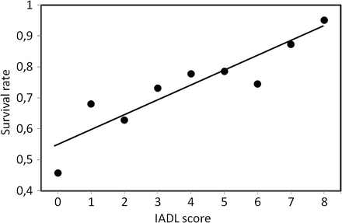
Figure 1. Distribution of the unadjusted survival rate of the patients after 1 year of follow-up according to ...
Notes:
Figure 1. Distribution of the unadjusted survival rate of the patients after 1 year of follow-up according to Instrumental Activities of Daily Living (IADL) score.
Unless provided in the caption above, the following copyright applies to the content of this slide: © The Author 2012. Published by Oxford University Press on behalf of The Gerontological Society of America. All rights reserved. For permissions, please e-mail: journals.permissions@oup.com.

Slide 2
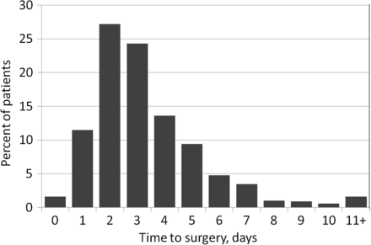
Figure 2. Distribution of the patients according to time to surgery.
Notes:
Figure 2. Distribution of the patients according to time to surgery.
Unless provided in the caption above, the following copyright applies to the content of this slide: © The Author 2012. Published by Oxford University Press on behalf of The Gerontological Society of America. All rights reserved. For permissions, please e-mail: journals.permissions@oup.com.

