Slide 1
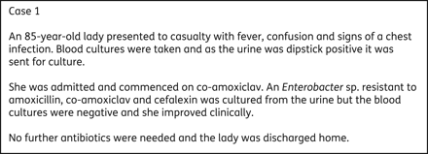
Figure 1. Case report 1: uncomplicated UTI in an elderly patient.
Notes:
Figure 1. Case report 1: uncomplicated UTI in an elderly patient.
Unless provided in the caption above, the following copyright applies to the content of this slide: © The Author 2010. Published by Oxford University Press on behalf of the British Society for Antimicrobial Chemotherapy

Slide 2
Figure 2. Case report 2: UTI in a catheterized elderly patient.
Notes:
Figure 2. Case report 2: UTI in a catheterized elderly patient.
Unless provided in the caption above, the following copyright applies to the content of this slide: © The Author 2010. Published by Oxford University Press on behalf of the British Society for Antimicrobial Chemotherapy

Slide 3
Figure 3. Case report 3: patient with asymptomatic bacteriuria.
Notes:
Figure 3. Case report 3: patient with asymptomatic bacteriuria.
Unless provided in the caption above, the following copyright applies to the content of this slide: © The Author 2010. Published by Oxford University Press on behalf of the British Society for Antimicrobial Chemotherapy

Slide 4
Figure 4. Case report 4: systemic sepsis and bacteraemia in a patient returning from foreign travel.
Notes:
Figure 4. Case report 4: systemic sepsis and bacteraemia in a patient returning from foreign travel.
Unless provided in the caption above, the following copyright applies to the content of this slide: © The Author 2010. Published by Oxford University Press on behalf of the British Society for Antimicrobial Chemotherapy

