Slide 1
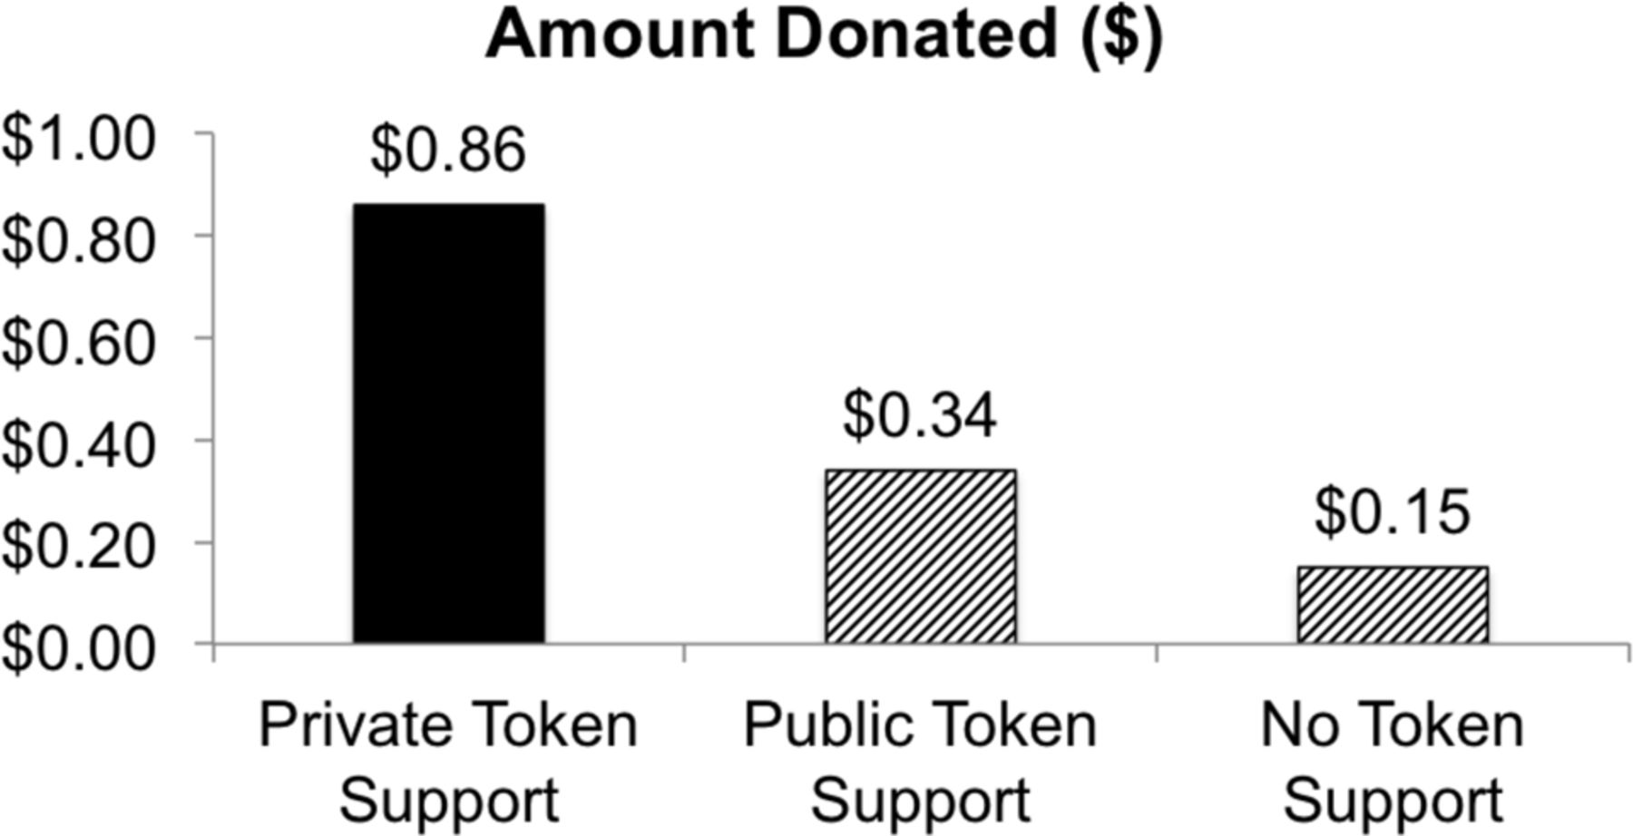
Figure 1. Average Amount Donated in Response to a Second Request for Meaningful Support (Study 1)
Notes:
Figure 1. Average Amount Donated in Response to a Second Request for Meaningful Support (Study 1)
Unless provided in the caption above, the following copyright applies to the content of this slide: © 2013 by JOURNAL OF CONSUMER RESEARCH, Inc.

Slide 2
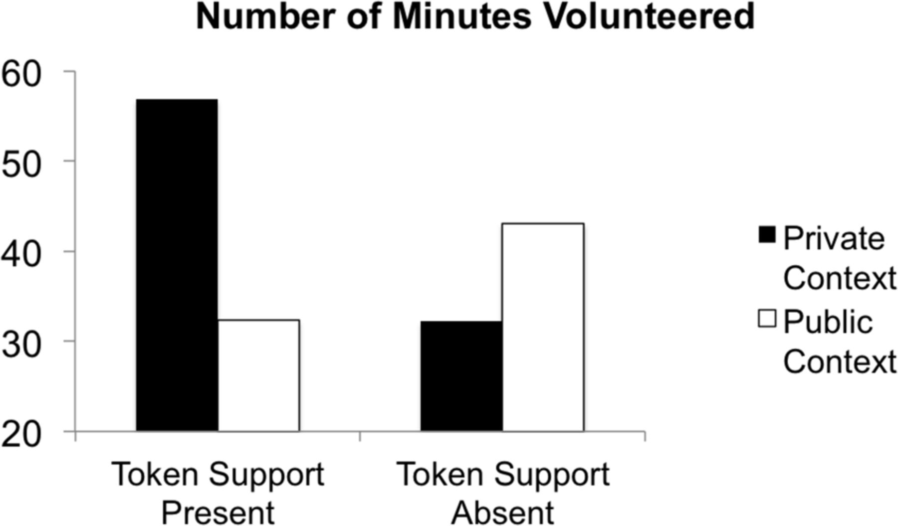
Figure 2. Number of Minutes Volunteered for Subsequent Request (to Stuff Envelopes) to Support Chosen Charity (Study ...
Notes:
Figure 2. Number of Minutes Volunteered for Subsequent Request (to Stuff Envelopes) to Support Chosen Charity (Study 2)
Unless provided in the caption above, the following copyright applies to the content of this slide: © 2013 by JOURNAL OF CONSUMER RESEARCH, Inc.

Slide 3
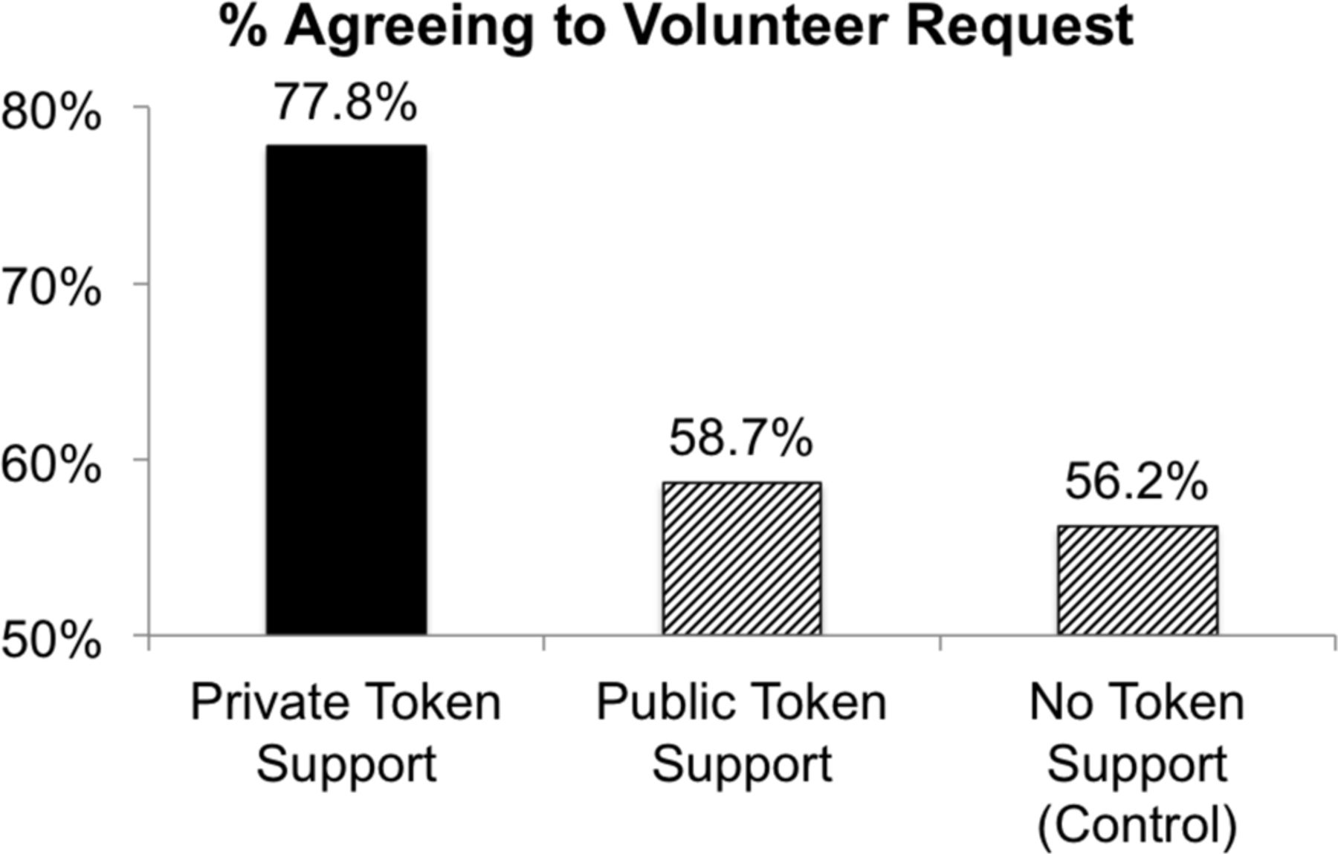
Figure 3. Percentage of Participants Agreeing to Subsequent Volunteer Support Request (Study 3)
Notes:
Figure 3. Percentage of Participants Agreeing to Subsequent Volunteer Support Request (Study 3)
Unless provided in the caption above, the following copyright applies to the content of this slide: © 2013 by JOURNAL OF CONSUMER RESEARCH, Inc.

Slide 4
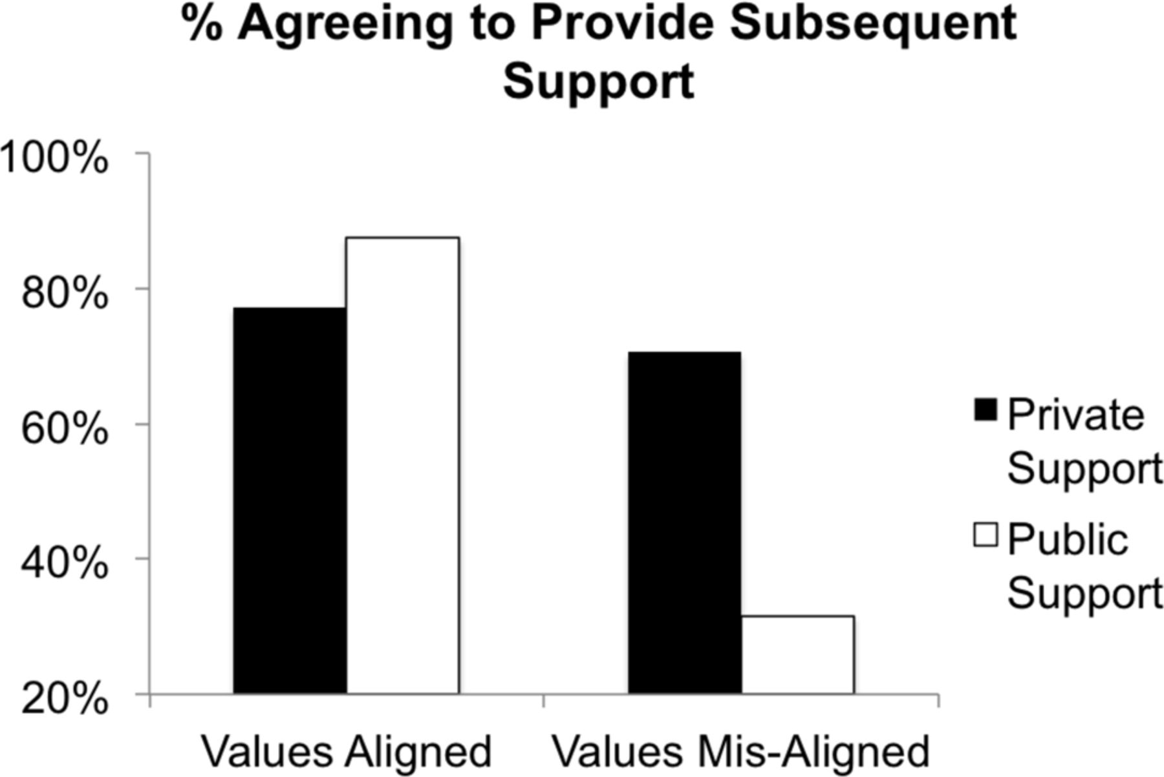
Figure 4. Percentage of Participants Agreeing to Subsequent Support Request (to Stuff Envelopes for Mail Campaign) as a ...
Notes:
Figure 4. Percentage of Participants Agreeing to Subsequent Support Request (to Stuff Envelopes for Mail Campaign) as a Function of Value Alignment (Study 4)
Unless provided in the caption above, the following copyright applies to the content of this slide: © 2013 by JOURNAL OF CONSUMER RESEARCH, Inc.

