Slide 1
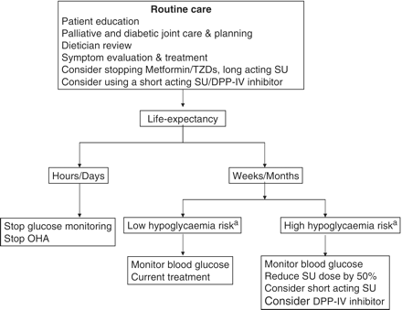
Figure 1. Suggested algorithm for the management of patients treated with oral hypoglycaemic agents during terminal ...
Notes:
Figure 1. Suggested algorithm for the management of patients treated with oral hypoglycaemic agents during terminal illness. aHigh hypoglycaemic risk: poor oral intake, nausea, vomiting, renal failure, hepatic failure. OHA: oral hypoglycaemic agent; SU: sulphonylurea.
Unless provided in the caption above, the following copyright applies to the content of this slide: © Crown copyright 2011.

Slide 2
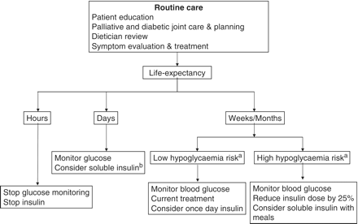
Figure 2. Suggested algorithm for the management of patients treated with insulin therapy during terminal illness. ...
Notes:
Figure 2. Suggested algorithm for the management of patients treated with insulin therapy during terminal illness. aHigh hypoglycaemic risk: poor oral intake, nausea, vomiting, renal failure, hepatic failure. bSoluble insulin: Actrapid, Novorapid, Humalog.
Unless provided in the caption above, the following copyright applies to the content of this slide: © Crown copyright 2011.

