Slide 1
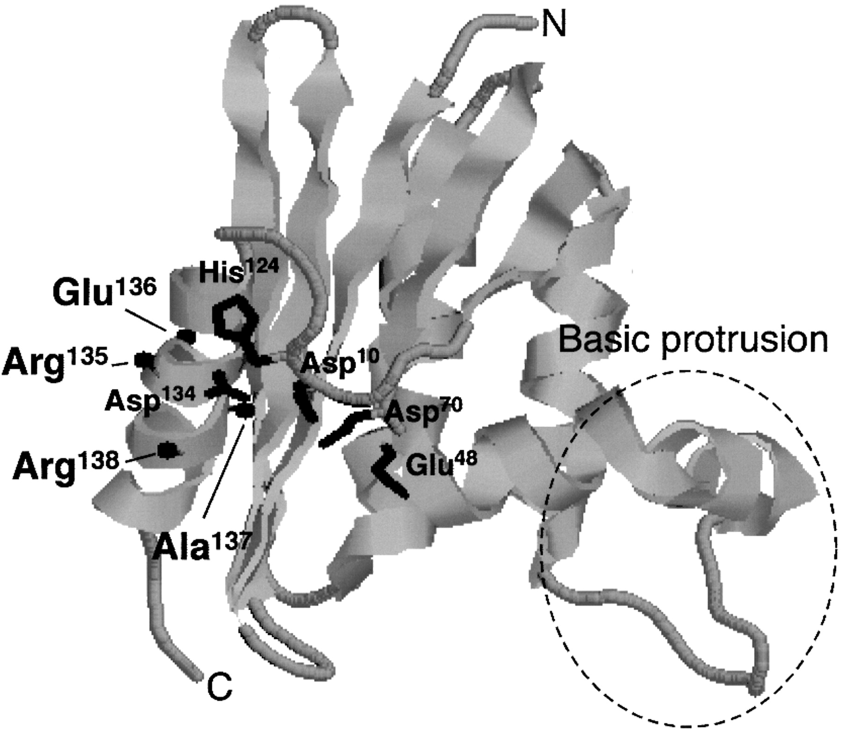
Fig. 1. Catalytic mechanism of the retaining glycosyl hydrolases. (I) Protonation of the glycosidic oxygen by the ...
Notes:
Fig. 1. Catalytic mechanism of the retaining glycosyl hydrolases. (I) Protonation of the glycosidic oxygen by the hydrogen donor (Glu261) and attack on the glucose C1 by the nucleophile (Asp231). Departure of the reducing end of the substrate. (II) Activation of a water molecule, cleavage of C1–Asp231 covalent bond. (III) Regeneration of the initial protonation states.
Unless provided in the caption above, the following copyright applies to the content of this slide: © Oxford University Press

Slide 2
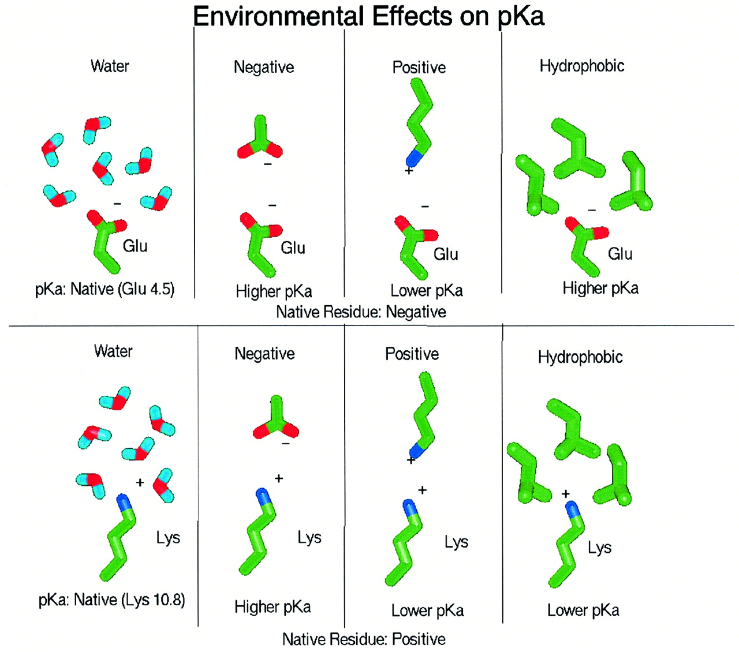
Fig. 2. Environmental effects on the pK_{a} of titratable residues. The effect of placing a titratable group ...
Notes:
Fig. 2. Environmental effects on the pKa of titratable residues. The effect of placing a titratable group in a negative, positive and hydrophobic environment is summarized.
Unless provided in the caption above, the following copyright applies to the content of this slide: © Oxford University Press

Slide 3
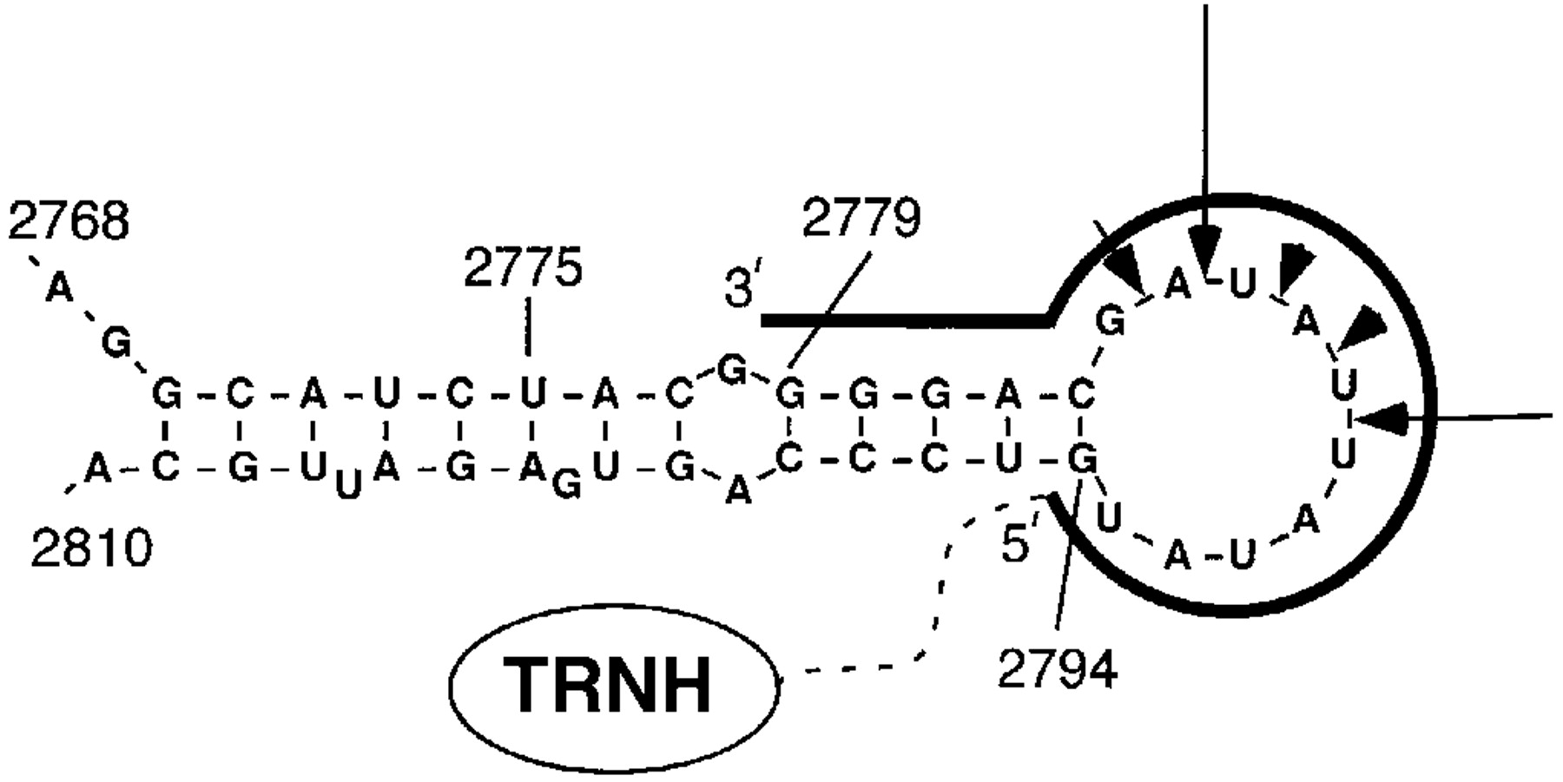
Fig. 3. The position of the point mutations in Ba2. Domain A, green; domain B, cyan; domain C, light grey. The ...
Notes:
Fig. 3. The position of the point mutations in Ba2. Domain A, green; domain B, cyan; domain C, light grey. The calcium ions are shown as red spheres and the sodium ion is shown as an orange sphere. The nonaose substrate used in the pKa calculations is shown in yellow. The active site acids Asp231, Glu261 and Asp328 are shown in red.
Unless provided in the caption above, the following copyright applies to the content of this slide: © Oxford University Press

Slide 4
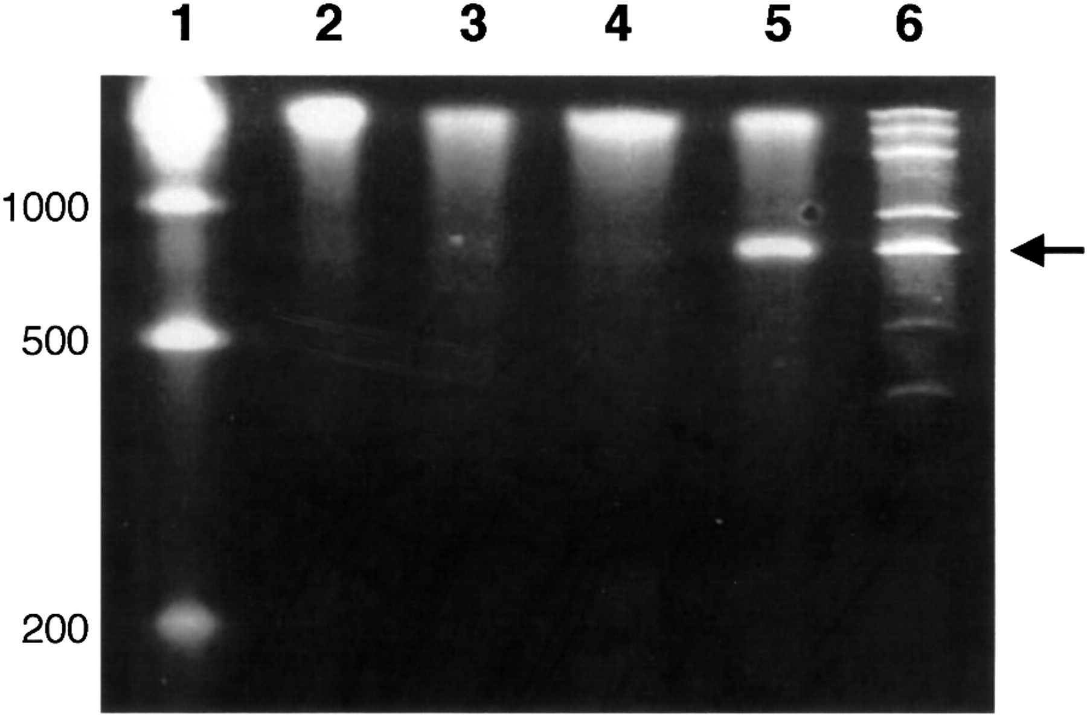
Fig. 4. pH–activity profiles for the Ba2 wt and the mutants. (a) wt, N190K, N190G and N190D; (b) wt, F290E, F290K and ...
Notes:
Fig. 4. pH–activity profiles for the Ba2 wt and the mutants. (a) wt, N190K, N190G and N190D; (b) wt, F290E, F290K and F290A; (c) wt, N326L, N326A and N326D; (d) wt, Q360K, Q360A and Q360E.
Unless provided in the caption above, the following copyright applies to the content of this slide: © Oxford University Press

Slide 5
Fig. 5. Calculated titration curves of the three active site acids Asp231, Glu261 and Asp328 in the apo-form and in ...
Notes:
Fig. 5. Calculated titration curves of the three active site acids Asp231, Glu261 and Asp328 in the apo-form and in the holo-form of the enzyme. Asp231, red; Glu261, magenta; Asp328, green.
Unless provided in the caption above, the following copyright applies to the content of this slide: © Oxford University Press

Slide 6
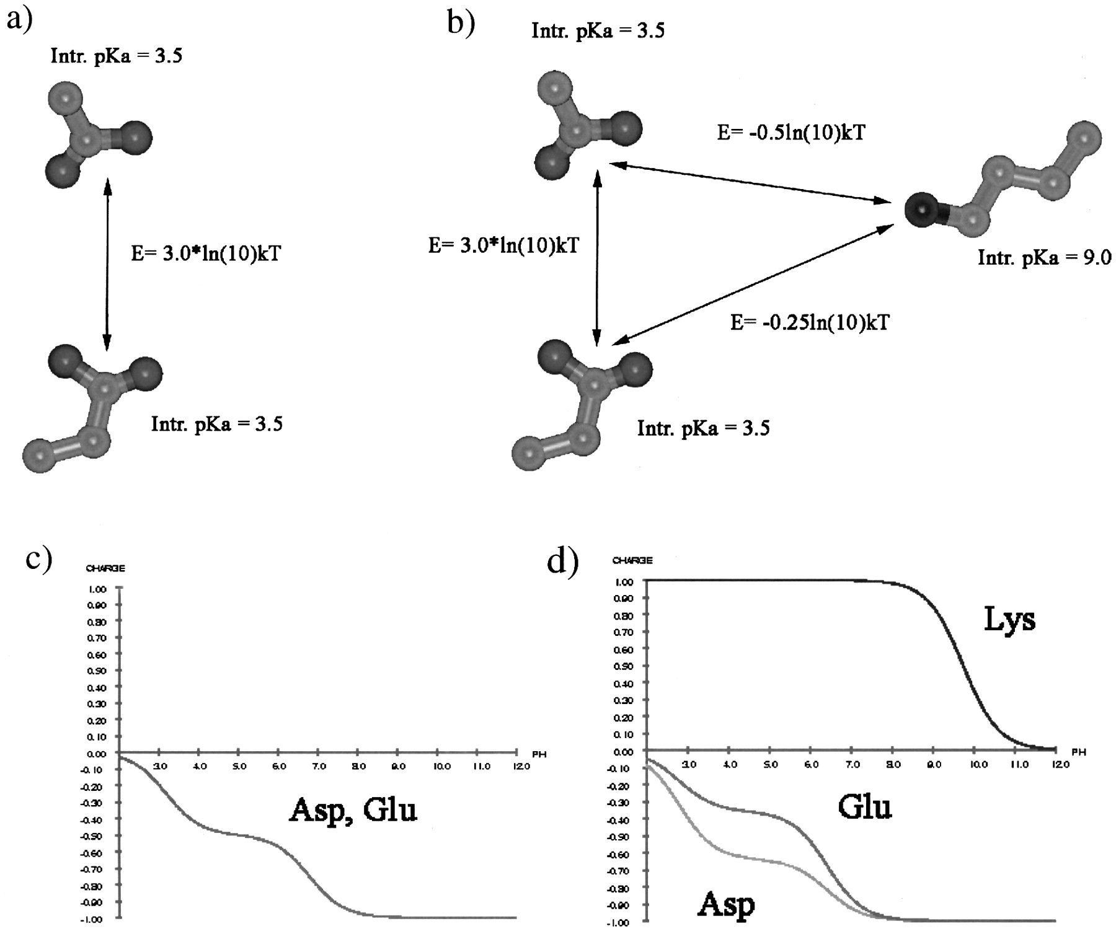
Fig. 6. An example of the effect of a charged point mutation on a hypothetical Glu–Asp system. It is seen that the ...
Notes:
Fig. 6. An example of the effect of a charged point mutation on a hypothetical Glu–Asp system. It is seen that the simple predictive rules in Figure 2 break down when the system of titratable groups is strongly coupled. The electrostatic interaction energies between the titratable groups corresponds approximately to the calculated interaction energies between Glu261, Asp328 and Lys 234 in Ba2. (a) Schematic representation of the Glu–Asp system. The pKa of each residue in the absence of the other is 3.5 (intrinsic pKa in the Figure). The interaction energy between the two groups is 3.0 ln(10)kT (298.15 K). (b) Schematic representation of the Glu–Asp–Lys system. The interaction energy between the Asp and the Glu is the same as in (a). The interaction energy with the Lys is twice as large for the Asp as for the Glu. (c) The titration curves for the Asp–Glu system shows that the Asp and the Glu have identical titration curves. (d) The titration curves for the Asp–Glu–Lys system shows that the titration curve of the Asp is shifted to more acidic pH values (= lower pKa), whereas the titration curve of the Glu is shifted to more basic pH values (= higher pKa), thus defying the rules specified in Figure 2.
Unless provided in the caption above, the following copyright applies to the content of this slide: © Oxford University Press

