Slide 1
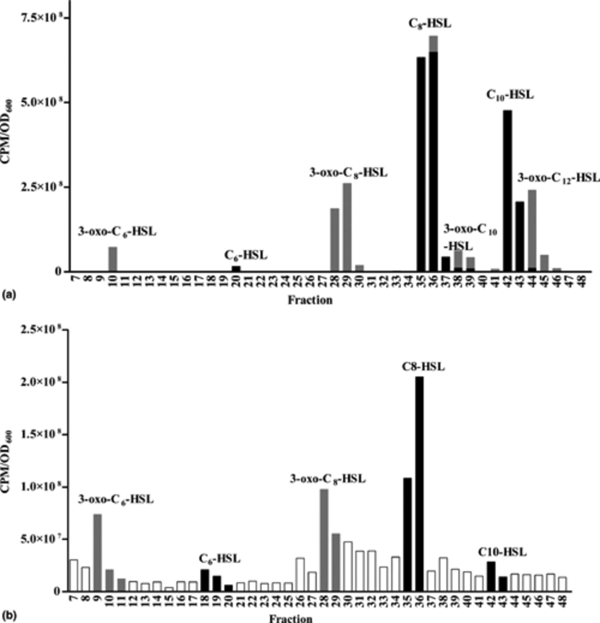
1 Separation of AHLs by reverse-phase FPLC and detection using A136 (pCF218)(pMV26). (a) Separation of AHL ...
Notes:
1 Separation of AHLs by reverse-phase FPLC and detection using A136 (pCF218)(pMV26). (a) Separation of AHL standards. Mixtures of 3-oxo substituted AHLs and unsubstituted AHLs were chromatographed and assayed separately. The amounts of each AHL applied to the column were as follows: 25 nmol C6-HSL, 7.5 nmol C8-HSL, 75 nmol C10-HSL, 75 nmol C12-HSL, 100 pmol 3-oxo-C6-HSL, 10 pmol 3-oxo-C8-HSL, 10 pmol 3-oxo-C10-HSL, and 10 pmol 3-oxo-C12-HSL. One milliliter fractions were collected and 5 μl and 50 μl of the 3-oxo-substituted and unsubstituted AHLs, respectively, were assayed using the lux reporter. (b) Separation of extract from mucopurulent respiratory secretions from specimen 41. Fractions containing activity at least twice that of the background were considered positive for AHL activity. Using these criteria, C10-HSL, C8-HSL, C6-HSL, 3-oxo-C8-HSL, and 3-oxo-C6-HSL were identified in the sample shown. In both panels the grey bars represent the 3-oxo-substituted AHLs, the black bars represent unsubstituted AHLs, and the open bars are used to indicate fractions that did not have activity greater than twice that of the background obtained with the buffers used to generate the acetonitrile gradients.
Unless provided in the caption above, the following copyright applies to the content of this slide: © 2005 Federation of European Microbiological Societies

