Slide 1
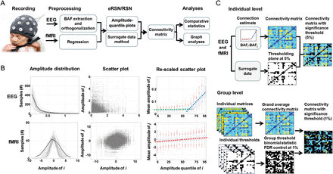
Figure 1. A methodological procedure in disclosing bimodality in the neonatal eRSN. (A) Signal processing workflow from ...
Notes:
Figure 1. A methodological procedure in disclosing bimodality in the neonatal eRSN. (A) Signal processing workflow from acquisition to statistical analyses. (B) Distribution of EEG amplitudes (BAFs; 25 time series of 1200 samples each in a single subject) is highly asymmetric as opposed to the normal-like distribution of fMRI time series (39 ROI time series of 1200 samples each in a single subject). Hence, the scatter plots of BAFs were asymmetrically clustered precluding conventional linear correlation analysis. Amplitude rescaling into quantiles reveals a robust bimodality where low (green line) and high (blue line) amplitude ranges show very different slope in linear amplitude relationships. Similar analysis of fMRI signals demonstrates a clearly unimodal, linear relationship across the full amplitude range. Scatter plots include all study subjects, that is, 300 BAF signal pairs (total 3.6 × 105 data points) and 741 pairs of ROI time series (total 1.48 × 105 data points). (C) The statistical procedures. Individual-level significance was tested using distributions derived from time shifting surrogates, while group-level testing was done using binomial statistics from the binary outputs of individual testing. After FDR correction for multiple comparisons, this yielded group-level thresholding of the grand average matrices. Rescaled scatter plots depict the grand mean and ±SD. See also Figure 2.
Unless provided in the caption above, the following copyright applies to the content of this slide: © The Author 2013. Published by Oxford University Press. All rights reserved. For Permissions, please e-mail: journals.permissions@oup.com

Slide 2
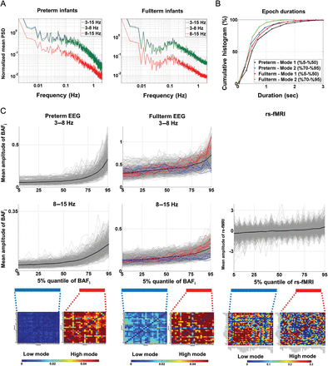
Figure 2. Frequency distribution of amplitude fluctuations, durations of high and low modes, as well as example of ...
Notes:
Figure 2. Frequency distribution of amplitude fluctuations, durations of high and low modes, as well as example of single subject findings. (A) Normalized mean power spectral density (PSD) of BAF signals. (B) Durations of low and high modes in both age groups. (C) Rescaled scatter plots of BAF amplitudes and rs-fMRI signals from a representative preterm BAF (left column), a representative fullterm BAF data (middle column), as well as a representative fMRI time series (right column). Data from different frequency bands are taken from the same patient, and red and blue lines represent the same BAF signal pairs at different frequency bands in the given baby. The graphs demonstrate how the chosen quantile range of low mode activity (5–50%) exhibits a clear linear relationship and can hence be analyzed using linear regression. The high mode range (70%–95%) was deliberately chosen with a little gap (50–70%) between the modes, because of the little interelectrode variance in the “inflection point.” The chosen range (70–95%) was found to be the best compromise to both suit all electrode pairs and be reasonably well estimated using linear regression. Note how virtually all electrode pairs (i.e., thin gray lines) in the preterm data show a clear upward inflection at higher quantiles indicating a global bimodality, while some signal pairs in the fullterm data are clearly bimodal (red traces) and the others are fairly unimodal (blue lines) across the whole amplitude range. A pure unimodal relationship was seen in the rs-fMRI data.
Unless provided in the caption above, the following copyright applies to the content of this slide: © The Author 2013. Published by Oxford University Press. All rights reserved. For Permissions, please e-mail: journals.permissions@oup.com

Slide 3
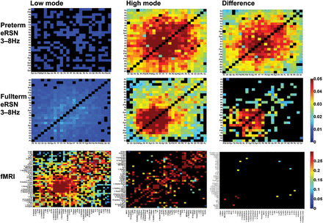
Figure 3. The group average of connectivity matrices demonstrates robust differences between the low and high activity ...
Notes:
Figure 3. The group average of connectivity matrices demonstrates robust differences between the low and high activity modes. Each element in the connectivity matrix shows the grand-average magnitude (slope) of linear relationships across the whole subject group, and the nonsignificant cells (at the group level) are depicted with black cells. Low mode activity in the electric domain (eRSN) shows very low levels of correlations, which dramatically increase when the brain shifts into high activity mode. The difference between modes is statistically significant in nearly all cells of both age groups. Notably, similar analysis with rs-fMRI demonstrates much less significant correlations and hardly any difference between high and low regimes. Matrices are reorganized using a method based on simulated annealing to aid visual interpretation. See also Figure 4.
Unless provided in the caption above, the following copyright applies to the content of this slide: © The Author 2013. Published by Oxford University Press. All rights reserved. For Permissions, please e-mail: journals.permissions@oup.com

Slide 4
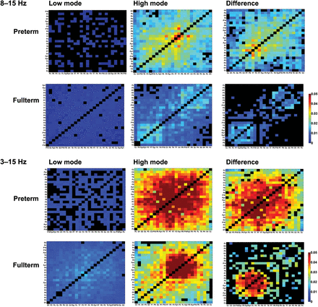
Figure 4. Comparison of connectivity matrices at the higher (8–15 Hz) and broad (3–15 Hz) frequency bands. The matrices ...
Notes:
Figure 4. Comparison of connectivity matrices at the higher (8–15 Hz) and broad (3–15 Hz) frequency bands. The matrices have been thresholded (black cells) to show only those links that exceed statistical threshold at the group level (Fig. 1C). Note how the overall finding is similar (Fig. 2) at all frequencies, with the clear increase in connectivity strength in high mode, and clear statistical difference between modes. Notably, difference between modes is more widespread in the preterm babies. For visual clarity, the matrices are reorganized using a method based on simulated annealing to squeeze the matrix elements along the main diagonal, which results in somewhat different ordering of rows (channels/ROIs) between matrices.
Unless provided in the caption above, the following copyright applies to the content of this slide: © The Author 2013. Published by Oxford University Press. All rights reserved. For Permissions, please e-mail: journals.permissions@oup.com

Slide 5
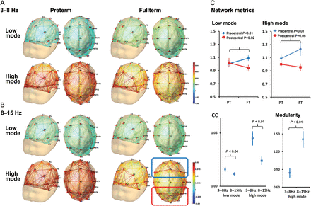
Figure 5. Topological visualization and metrics of emerging eRSN. (A and B) The 3-dimensional visualization of ...
Notes:
Figure 5. Topological visualization and metrics of emerging eRSN. (A and B) The 3-dimensional visualization of connectivity analysis demonstrates a robust difference between activity modes and suggests a developmental organization during late gestation at both lower (3–8 Hz; A) and higher (5–18 Hz; B) frequency oscillations. Each link between nodes depicts the connection strength (cf. Fig. 3), and the graphs within each frequency band are shown at the same scale. Note the virtual absence of networks in the low modes, the apparently random connectivity in the high mode in the preterm babies, as well as the visually conspicious frontally and occipitally prominent clustering in the high activity mode in the fullterm newborns. The blue and red squares in the lower right figure depict the group of pre- (blue) and postcentral (red) nodes used in the spatial comparison in (C) of this figure. (C) Graph analysis of the network structure shows salient, spatially selective developmental trajectories. Average clustering coefficient (CC) increases in the precentral and decreases in the postcentral areas, it is stronger at lower frequencies and, significantly stronger at the higher frequencies.
Unless provided in the caption above, the following copyright applies to the content of this slide: © The Author 2013. Published by Oxford University Press. All rights reserved. For Permissions, please e-mail: journals.permissions@oup.com

