Slide 1
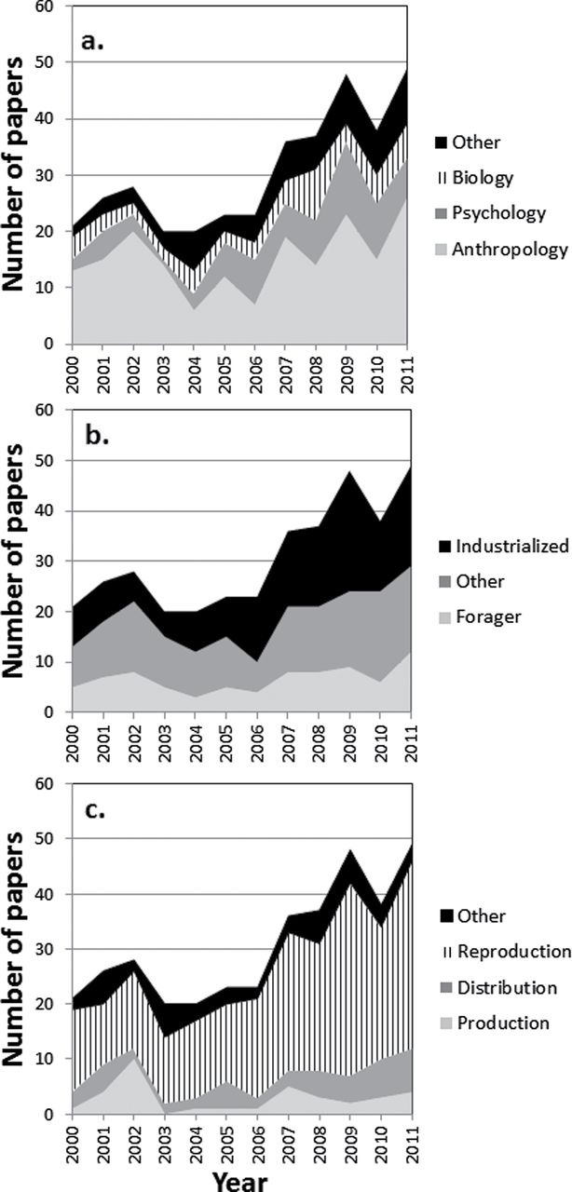
Figure 1 Number of published papers identified by year over the study period (a) by disciplinary affiliation of first ...
Notes:
Figure 1 Number of published papers identified by year over the study period (a) by disciplinary affiliation of first author; (b) by type of study population (other = agriculturalist, pastoralist, horticulturalist, or multiple types); (c) by tripartite classification of topic.
Unless provided in the caption above, the following copyright applies to the content of this slide: © The Author 2013. Published by Oxford University Press on behalf of the International Society for Behavioral Ecology. All rights reserved. For permissions, please e-mail: journals.permissions@oup.com

