Slide 1
Figure 1. Transcriptional regulatory activity is affected by i-EDG2-9. (A) Luciferase promoter assay. Allelic ...
Notes:
Figure 1. Transcriptional regulatory activity is affected by i-EDG2-9. (A) Luciferase promoter assay. Allelic differences in the relative luciferase activity were compared with or without 10 ng/ml of PMA. The promoter containing the susceptibility A allele showed significantly stronger activity upon PMA stimulation. Data show the mean ± SEM of values from four transfections. Asterisk and dagger indicate P < 0.05 and 0.01 by Student’s t-test, respectively. (B, C) EMSA. (B) Binding of i-EDG2-9 to components of nuclear extracts from E11 cells stimulated by PMA. Band 2 showed increased binding in a time-dependent manner. Band 1 did not change in intensity over the course of the experiment. (C) Allelic difference in binding. Band 2 indicates tighter binding of the oligonucleotide containing the A allele compared with that containing the G allele. This binding was blocked by addition of a 125-fold excess of unlabeled oligonucleotides as well as an oligonucleotide with the AP-1 binding motif. Band 1 did not show allelic difference or competition by the unlabeled oligonucleotide with AP-1 binding motif. The experiment was repeated three times with similar results.
Unless provided in the caption above, the following copyright applies to the content of this slide: © The Author 2008. Published by Oxford University Press. All rights reserved. For Permissions, please email: journals.permissions@oxfordjournals.org

Slide 2
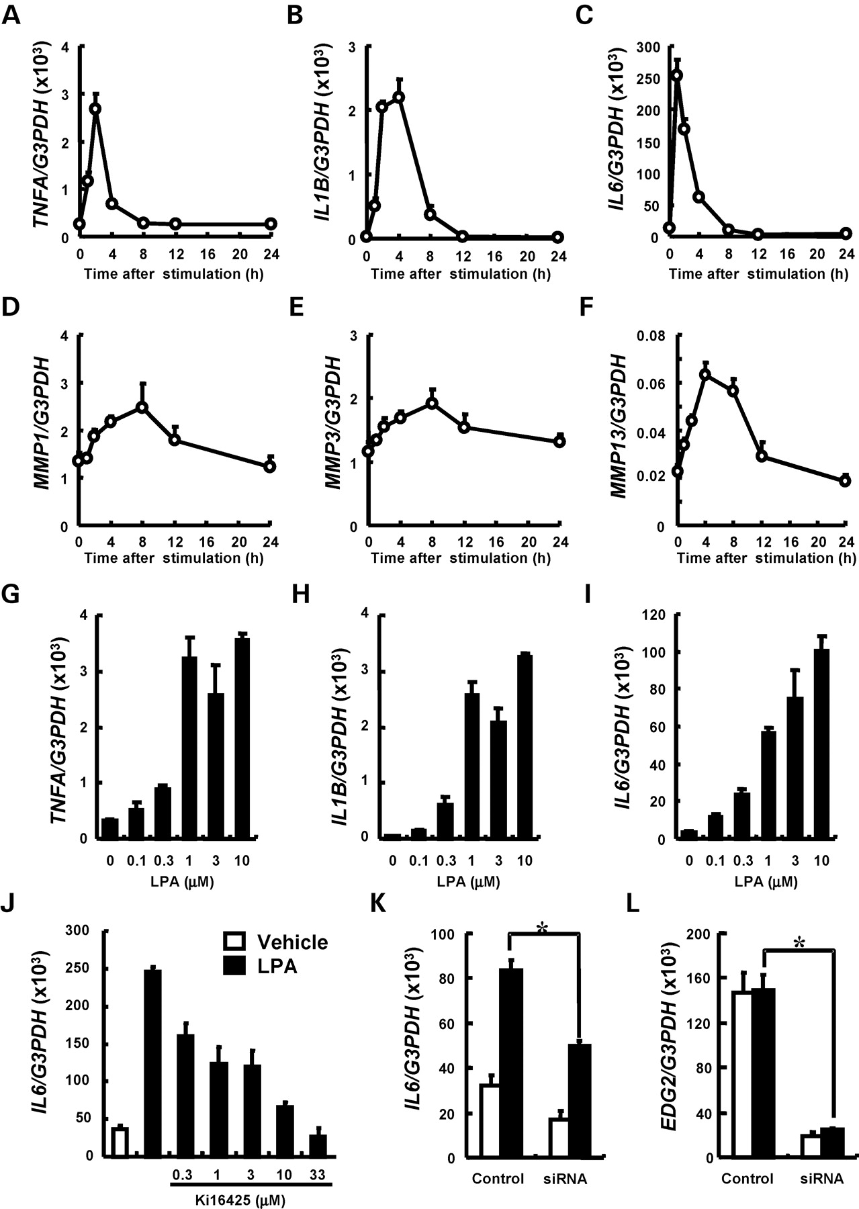
Figure 2. Induction of pro-inflammatory cytokines and MMPs by LPA. Real-time PCR in a human synovial cell line, ...
Notes:
Figure 2. Induction of pro-inflammatory cytokines and MMPs by LPA. Real-time PCR in a human synovial cell line, HFLS-OA. (A–F) Time course of induction by 10 mm LPA for pro-inflammatory cytokine genes (A) TNFA, (B) IL1B and (C) IL6 and MMP genes (D) MMP1, (E) MMP3 and (F) MMP13. (G–I) Dose-dependent induction by LPA of pro-inflammatory cytokine genes (G) TNFA, (H) IL1B and (I) IL6. (J–L) Inhibition of LPA-induced IL6 expression by an antagonist, Ki16425 (J) and siRNA (K) targeting EDG2 in HFLS-OA cells. Decreased expression of EDG2 was confirmed (L). Data show the mean ± SEM of triplicate or quadruplicate assay.
Unless provided in the caption above, the following copyright applies to the content of this slide: © The Author 2008. Published by Oxford University Press. All rights reserved. For Permissions, please email: journals.permissions@oxfordjournals.org

