Slide 1
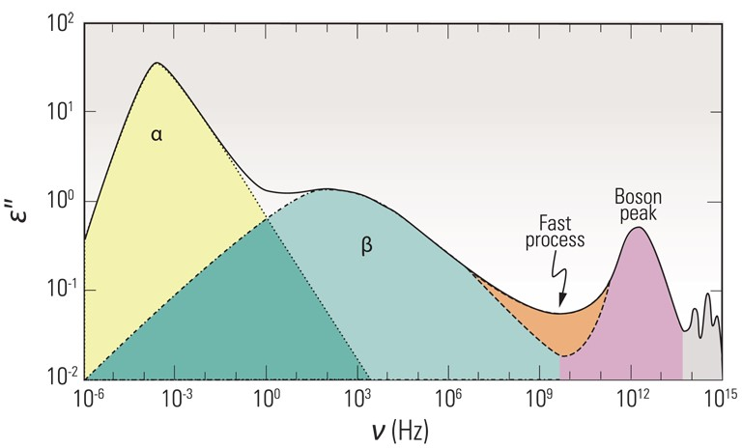
Figure 1. Schematic dielectric spectrum of relaxation dynamics of glass-forming liquids (Courtesy of P. Lunkenheimer, ...
Notes:
Figure 1. Schematic dielectric spectrum of relaxation dynamics of glass-forming liquids (Courtesy of P. Lunkenheimer, University of Augsburg, Germany).
Unless provided in the caption above, the following copyright applies to the content of this slide: © 2014 The Authors Published by Oxford University Press on behalf of the Royal Astronomical SocietyThis is an Open Access article distributed under the terms of the Creative Commons Attribution License (http://creativecommons.org/licenses/by/4.0/), which permits non-commercial reuse, distribution, and reproduction in any medium, provided the original work is properly cited. for commercial re-use, please contact journals.permissions@oup.com

Slide 2
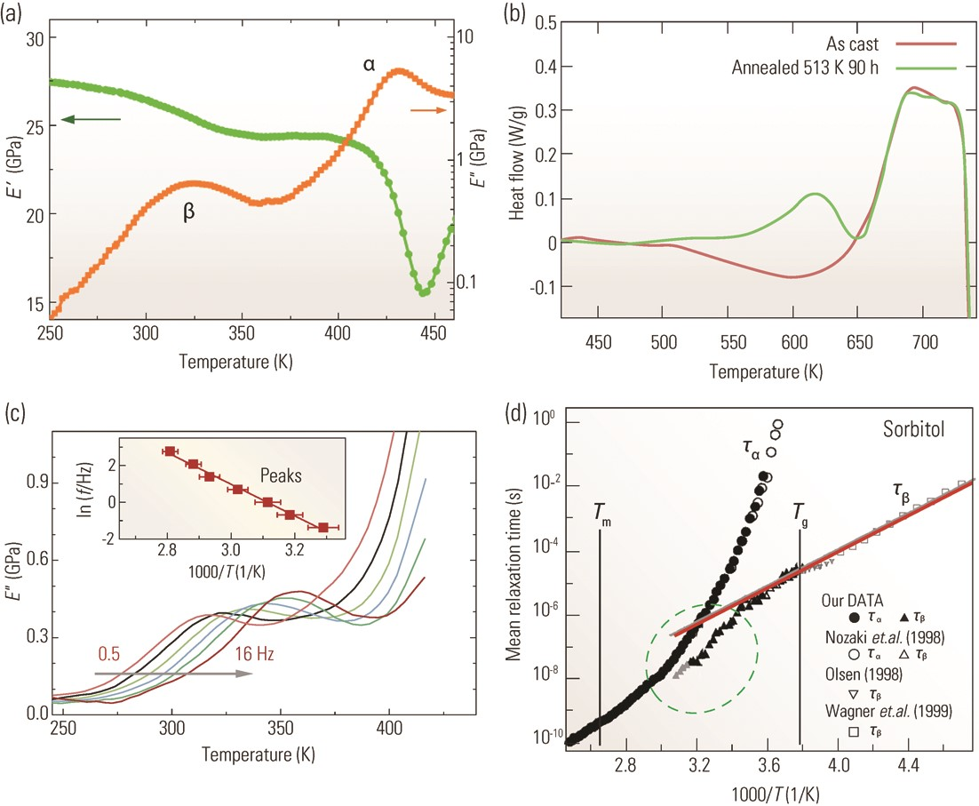
Figure 2. Typical features of β-relaxations. (a) The temperature-dependent E ′ (left axis) and ...
Notes:
Figure 2. Typical features of β-relaxations. (a) The temperature-dependent E ′ (left axis) and E ″ (right axis), measured by DMA at a test frequency of 1 Hz for a La68.5Ni16Al14Co1.5 MG [11,35]. (b) DSC curves of an as-cast and an annealed Zr65Cu27.5Al7.5 MG [55]. (c) Temperature-dependent E ″ of a La68.5Ni16Al14Co1.5 MG [11,35] at different frequencies (from left to right: 0.5, 1, 2, 4, 8, and 16 Hz); the inset is the Arrhenius plot of the peak temperature and frequency corresponding to the β-relaxation (Copyright 2011 American Physics Society). (d) Relaxation times for α and β-relaxations of sorbitol in the merging region, adapted from [73] (Copyright 2002 American Physics Society).
Unless provided in the caption above, the following copyright applies to the content of this slide: © 2014 The Authors Published by Oxford University Press on behalf of the Royal Astronomical SocietyThis is an Open Access article distributed under the terms of the Creative Commons Attribution License (http://creativecommons.org/licenses/by/4.0/), which permits non-commercial reuse, distribution, and reproduction in any medium, provided the original work is properly cited. for commercial re-use, please contact journals.permissions@oup.com

Slide 3
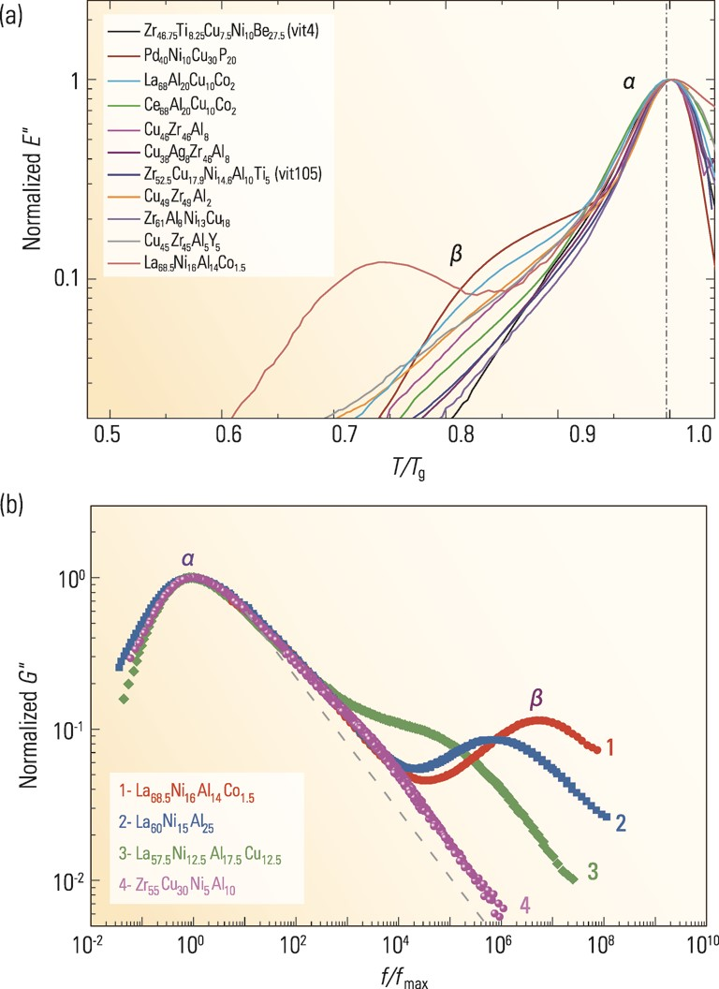
Figure 3. Comparison of the behavior of β-relaxations (measured by DMA) between typical MGs in (a) normalized ...
Notes:
Figure 3. Comparison of the behavior of β-relaxations (measured by DMA) between typical MGs in (a) normalized temperature frame (Copyright 2011 American Physics Society) and (b) normalized frequency frame [46] (Copyright 2011 American Institute of Physics).
Unless provided in the caption above, the following copyright applies to the content of this slide: © 2014 The Authors Published by Oxford University Press on behalf of the Royal Astronomical SocietyThis is an Open Access article distributed under the terms of the Creative Commons Attribution License (http://creativecommons.org/licenses/by/4.0/), which permits non-commercial reuse, distribution, and reproduction in any medium, provided the original work is properly cited. for commercial re-use, please contact journals.permissions@oup.com

Slide 4
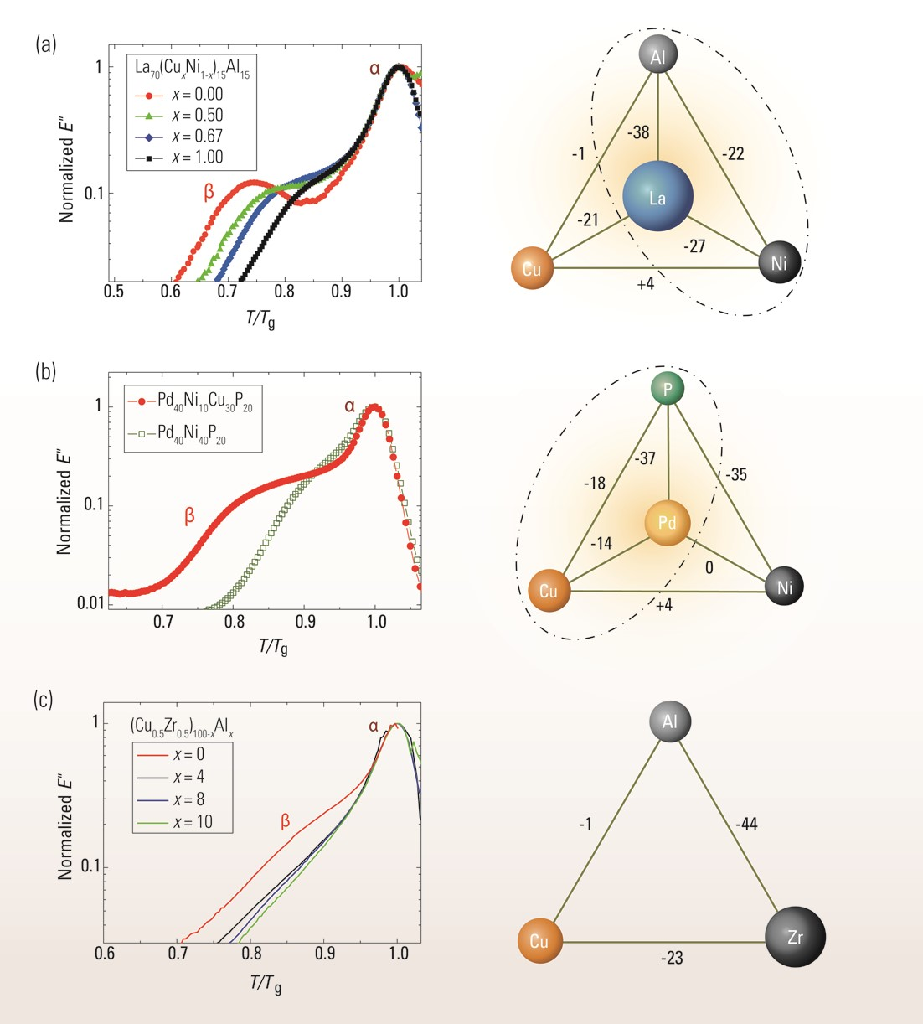
Figure 4. (Left panel) Chemical effects on β-relaxations in typical (a) La-based, (b) Pd-based, and (c) CuZr-based MGs. ...
Notes:
Figure 4. (Left panel) Chemical effects on β-relaxations in typical (a) La-based, (b) Pd-based, and (c) CuZr-based MGs. (Right panel) Enthalpy of mixing of corresponding MGs. The dash–dotted ellipses indicate compositions with pronounced β-relaxations [81] (Copyright 2013 Nature Publishing Group).
Unless provided in the caption above, the following copyright applies to the content of this slide: © 2014 The Authors Published by Oxford University Press on behalf of the Royal Astronomical SocietyThis is an Open Access article distributed under the terms of the Creative Commons Attribution License (http://creativecommons.org/licenses/by/4.0/), which permits non-commercial reuse, distribution, and reproduction in any medium, provided the original work is properly cited. for commercial re-use, please contact journals.permissions@oup.com

Slide 5
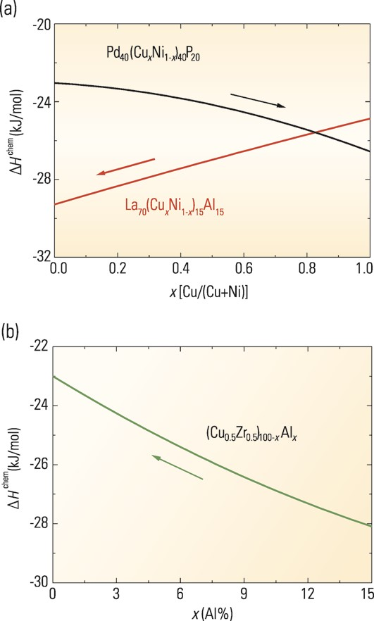
Figure 5. Composition-dependent mean chemical affinity ΔH^{chem} for (a) ...
Notes:
Figure 5. Composition-dependent mean chemical affinity ΔHchem for (a) La70(CuxNi1–x)15Al15 and Pd40(CuxNi1–x)40P20 MGs, and (b) (Cu0.5Zr0.5)100–xAlx MGs. The arrows indicate the directions along which β-relaxations become more pronounced with composition variations in each system [81] (Copyright 2013 Nature Publishing Group).
Unless provided in the caption above, the following copyright applies to the content of this slide: © 2014 The Authors Published by Oxford University Press on behalf of the Royal Astronomical SocietyThis is an Open Access article distributed under the terms of the Creative Commons Attribution License (http://creativecommons.org/licenses/by/4.0/), which permits non-commercial reuse, distribution, and reproduction in any medium, provided the original work is properly cited. for commercial re-use, please contact journals.permissions@oup.com

Slide 6
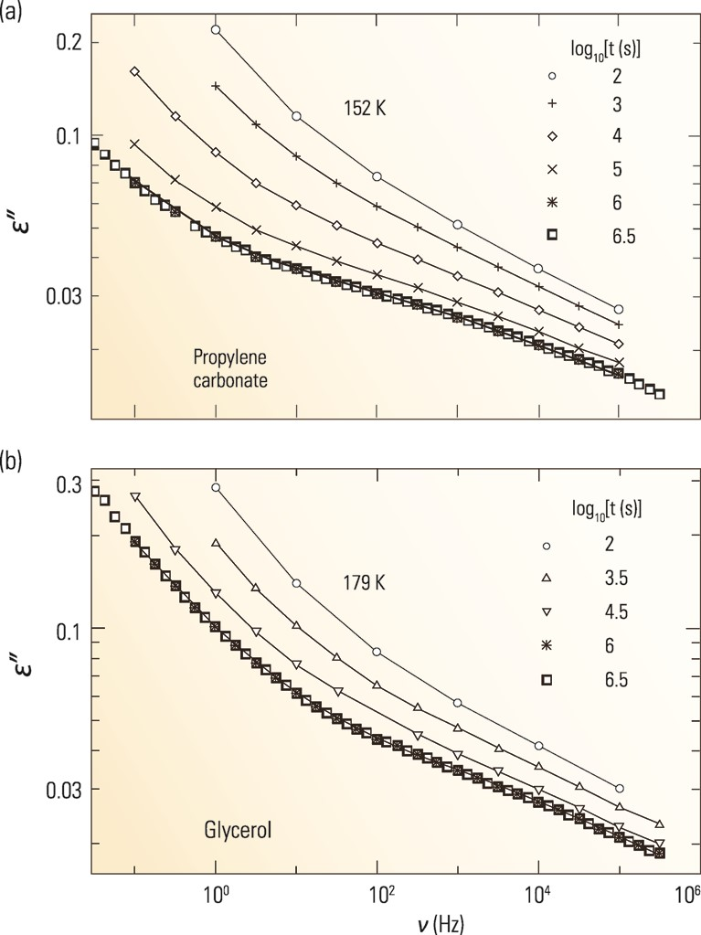
Figure 6. Aging effects on β-relaxation of (a) propylene carbonate and (b) glycerol for different aging times, measured ...
Notes:
Figure 6. Aging effects on β-relaxation of (a) propylene carbonate and (b) glycerol for different aging times, measured by dielectric loss spectra [86] (Copyright 2000 American Physics Society).
Unless provided in the caption above, the following copyright applies to the content of this slide: © 2014 The Authors Published by Oxford University Press on behalf of the Royal Astronomical SocietyThis is an Open Access article distributed under the terms of the Creative Commons Attribution License (http://creativecommons.org/licenses/by/4.0/), which permits non-commercial reuse, distribution, and reproduction in any medium, provided the original work is properly cited. for commercial re-use, please contact journals.permissions@oup.com

Slide 7
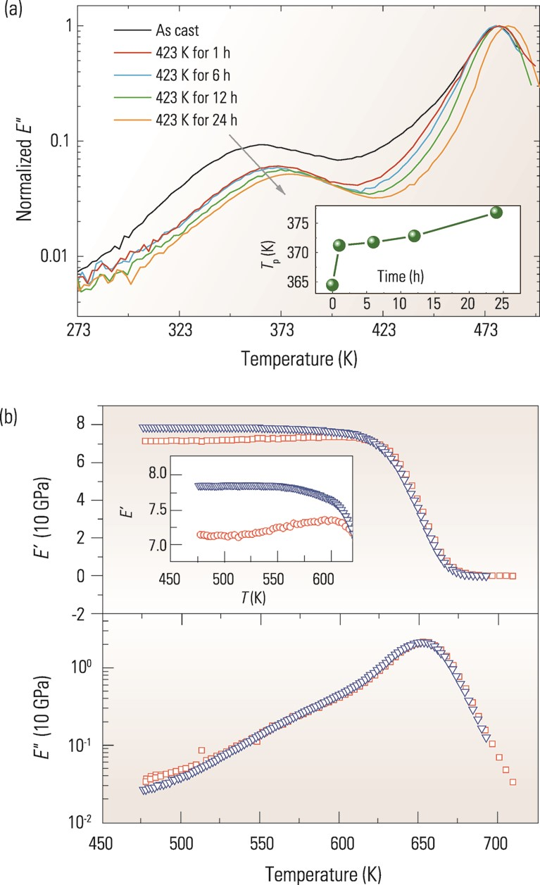
Figure 7. (a) Aging effects on β-relaxation of La-based MG [90]. (b) Effect of cooling rate on β-relaxation of Zr-based ...
Notes:
Figure 7. (a) Aging effects on β-relaxation of La-based MG [90]. (b) Effect of cooling rate on β-relaxation of Zr-based MG, measured by DMA loss spectra [89]; the blue triangles indicate as-cast MGs, while the red squares (circles, in the inset) indicate data measured at a cooling rate of 3 K/min (Copyright 2010 Wiley-VCH Verlag GmbH&Co. KGaA, Weinheim).
Unless provided in the caption above, the following copyright applies to the content of this slide: © 2014 The Authors Published by Oxford University Press on behalf of the Royal Astronomical SocietyThis is an Open Access article distributed under the terms of the Creative Commons Attribution License (http://creativecommons.org/licenses/by/4.0/), which permits non-commercial reuse, distribution, and reproduction in any medium, provided the original work is properly cited. for commercial re-use, please contact journals.permissions@oup.com

Slide 8
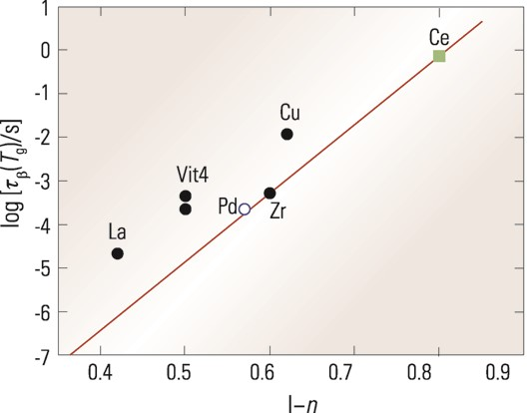
Figure 8. Connection between log[τ_{β}(T_{g})] and β_{KWW}≡(1−n) of the ...
Notes:
Figure 8. Connection between log[τβ(Tg)] and βKWW≡(1−n) of the Kohlrausch–Williams–Watts correlation function used to characterize the frequency dispersion of the α-relaxation. See [143] for the meanings of the labels (Copyright 2013 American Institute of Physics).
Unless provided in the caption above, the following copyright applies to the content of this slide: © 2014 The Authors Published by Oxford University Press on behalf of the Royal Astronomical SocietyThis is an Open Access article distributed under the terms of the Creative Commons Attribution License (http://creativecommons.org/licenses/by/4.0/), which permits non-commercial reuse, distribution, and reproduction in any medium, provided the original work is properly cited. for commercial re-use, please contact journals.permissions@oup.com

Slide 9
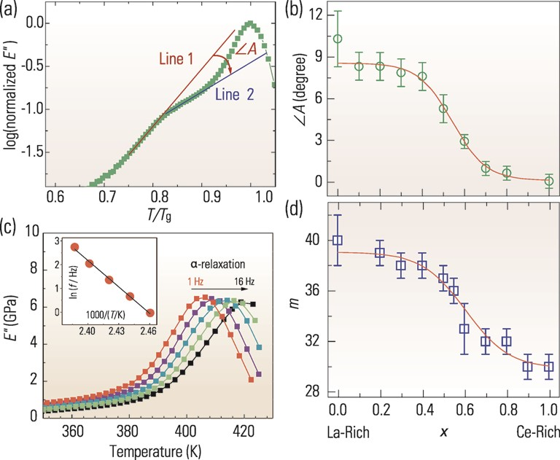
Figure 9. Correlation between β-relaxation and fragility in ...
Notes:
Figure 9. Correlation between β-relaxation and fragility in (CexLa1–x)68Al10Cu20Co2 MGs. (a) The definition of ∠A that characterizes the obviousness of the β-relaxation humps, with x = 0.2 as an example. (b) The dependence of ∠A on x. (c) E ″ data showing the α-relaxation (test frequencies are 1, 2, 4, 8, and 16 Hz, from left to right) for x = 0.2; the inset is an Arrhenius plot of α-relaxation peaks of the MG, from which fragility m can be extracted. (d) The dependence of m on x. Adapted from [11] (Copyright 2013 Elsevier Ltd).
Unless provided in the caption above, the following copyright applies to the content of this slide: © 2014 The Authors Published by Oxford University Press on behalf of the Royal Astronomical SocietyThis is an Open Access article distributed under the terms of the Creative Commons Attribution License (http://creativecommons.org/licenses/by/4.0/), which permits non-commercial reuse, distribution, and reproduction in any medium, provided the original work is properly cited. for commercial re-use, please contact journals.permissions@oup.com

Slide 10
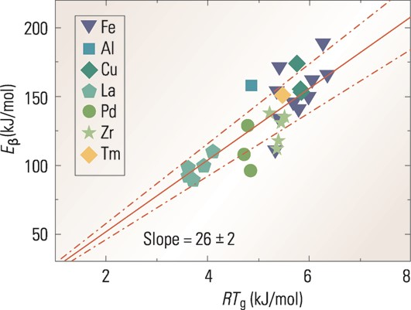
Figure 10. Relationship between E_{β} and RT_{g} for different MGs; the lines are least-squares linear ...
Notes:
Figure 10. Relationship between Eβ and RTg for different MGs; the lines are least-squares linear fits [11].
Unless provided in the caption above, the following copyright applies to the content of this slide: © 2014 The Authors Published by Oxford University Press on behalf of the Royal Astronomical SocietyThis is an Open Access article distributed under the terms of the Creative Commons Attribution License (http://creativecommons.org/licenses/by/4.0/), which permits non-commercial reuse, distribution, and reproduction in any medium, provided the original work is properly cited. for commercial re-use, please contact journals.permissions@oup.com

Slide 11
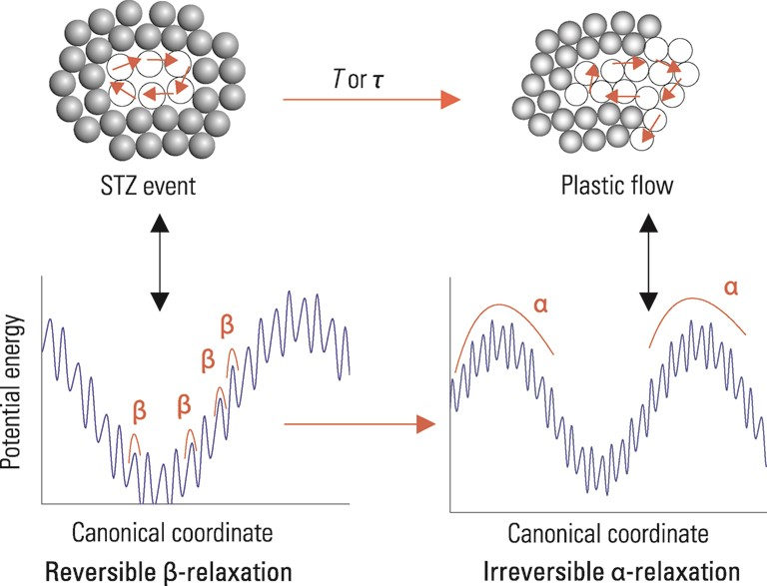
Figure 11. 2D schematic illustration of β-relaxation (STZ activation, top-left panel), α-relaxation (flow and yielding, ...
Notes:
Figure 11. 2D schematic illustration of β-relaxation (STZ activation, top-left panel), α-relaxation (flow and yielding, top-right panel), and their corresponding potential energy landscapes (bottom panel). The filled circles represent atoms with low propensity for motion, while the open circles represent atoms with high propensity for motion. The red/bold arrows indicate the possible motions of atoms. The β-relaxation (potential STZ event) is localized with a cooperative nature, and is reversible because the atoms are confined by their surroundings, while α-relaxation (percolation of STZs, or plastic flow and yielding) incorporates large-scale atomic migration and is irreversible.
Unless provided in the caption above, the following copyright applies to the content of this slide: © 2014 The Authors Published by Oxford University Press on behalf of the Royal Astronomical SocietyThis is an Open Access article distributed under the terms of the Creative Commons Attribution License (http://creativecommons.org/licenses/by/4.0/), which permits non-commercial reuse, distribution, and reproduction in any medium, provided the original work is properly cited. for commercial re-use, please contact journals.permissions@oup.com

Slide 12
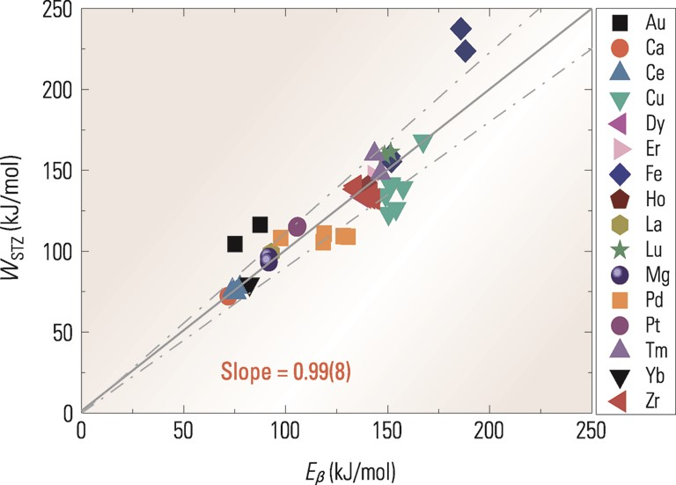
Figure 12. Relationship between E_{β} and W_{STZ} [11] (Copyright 2013 Elsevier Ltd).
Notes:
Figure 12. Relationship between Eβ and WSTZ [11] (Copyright 2013 Elsevier Ltd).
Unless provided in the caption above, the following copyright applies to the content of this slide: © 2014 The Authors Published by Oxford University Press on behalf of the Royal Astronomical SocietyThis is an Open Access article distributed under the terms of the Creative Commons Attribution License (http://creativecommons.org/licenses/by/4.0/), which permits non-commercial reuse, distribution, and reproduction in any medium, provided the original work is properly cited. for commercial re-use, please contact journals.permissions@oup.com

Slide 13
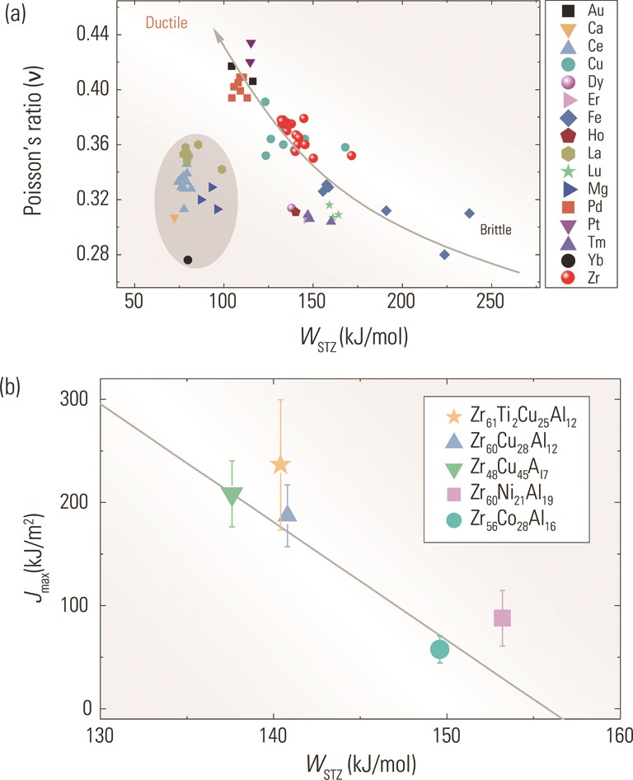
Figure 13. Correlations between (a) W_{STZ} and Poisson's ratio [42] (Copyright 2010 American Physics Society). ...
Notes:
Figure 13. Correlations between (a) WSTZ and Poisson's ratio [42] (Copyright 2010 American Physics Society). (b) WSTZ and fracture tolerance Jmax, redrawn using data from [157] (Copyright 2011 Acta Materiala Inc.).
Unless provided in the caption above, the following copyright applies to the content of this slide: © 2014 The Authors Published by Oxford University Press on behalf of the Royal Astronomical SocietyThis is an Open Access article distributed under the terms of the Creative Commons Attribution License (http://creativecommons.org/licenses/by/4.0/), which permits non-commercial reuse, distribution, and reproduction in any medium, provided the original work is properly cited. for commercial re-use, please contact journals.permissions@oup.com

Slide 14
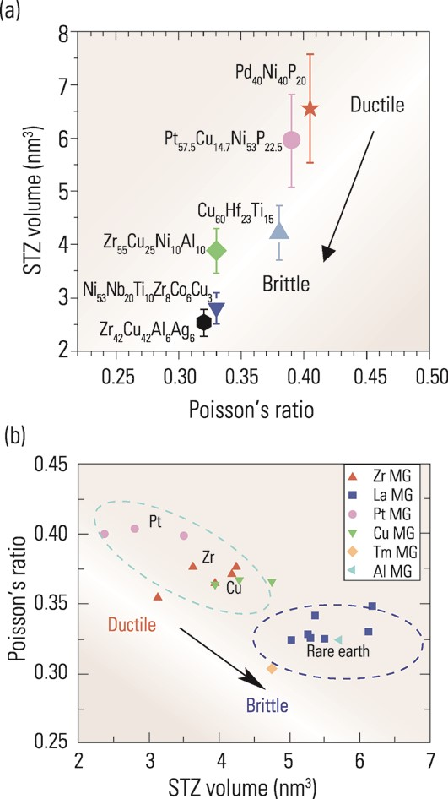
Figure 14. Relationship between Poisson's ratio and volume of STZ (a) from nanoindentation measurements of Pan et al. ...
Notes:
Figure 14. Relationship between Poisson's ratio and volume of STZ (a) from nanoindentation measurements of Pan et al. [158] (Copyright 2008 National Academy of Sciences, USA) and (b) inferred from β-relaxation data of Liu et al. [159] (Copyright 2012 Acta Materiala Inc.).
Unless provided in the caption above, the following copyright applies to the content of this slide: © 2014 The Authors Published by Oxford University Press on behalf of the Royal Astronomical SocietyThis is an Open Access article distributed under the terms of the Creative Commons Attribution License (http://creativecommons.org/licenses/by/4.0/), which permits non-commercial reuse, distribution, and reproduction in any medium, provided the original work is properly cited. for commercial re-use, please contact journals.permissions@oup.com

Slide 15
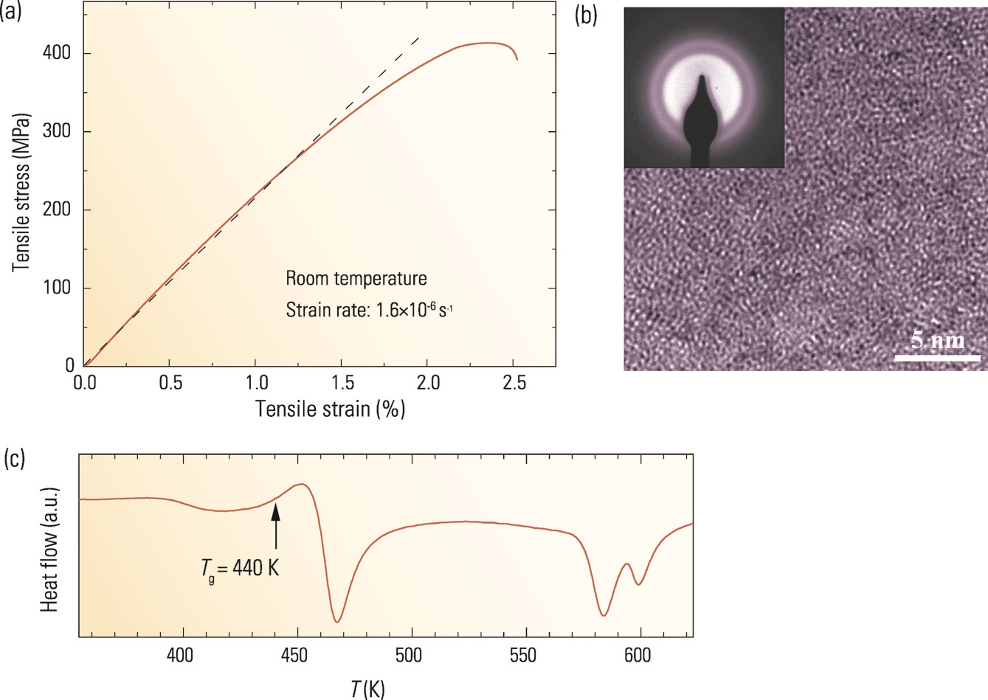
Figure 15. (a) Tensile stress–strain curve, (b) HRTEM with (inset) nanodiffraction, and (c) thermal properties measured ...
Notes:
Figure 15. (a) Tensile stress–strain curve, (b) HRTEM with (inset) nanodiffraction, and (c) thermal properties measured by DSC of a La68.5Ni16Al14Co1.5 MG.
Unless provided in the caption above, the following copyright applies to the content of this slide: © 2014 The Authors Published by Oxford University Press on behalf of the Royal Astronomical SocietyThis is an Open Access article distributed under the terms of the Creative Commons Attribution License (http://creativecommons.org/licenses/by/4.0/), which permits non-commercial reuse, distribution, and reproduction in any medium, provided the original work is properly cited. for commercial re-use, please contact journals.permissions@oup.com

Slide 16
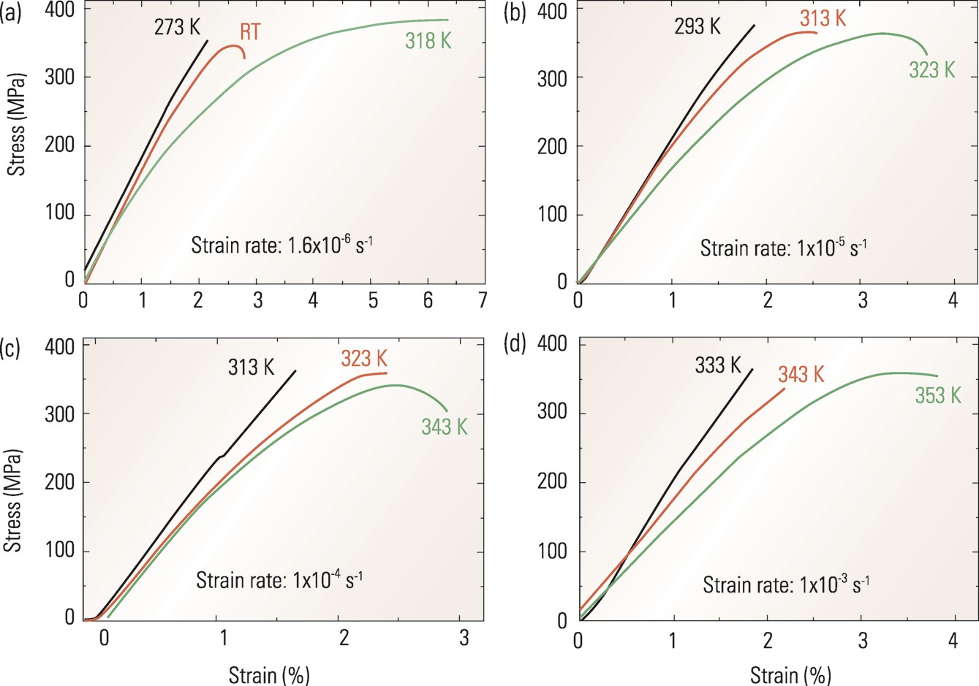
Figure 16. The engineering stress–strain curves (in tension) of a La MG tested at strain rates (a) 1.6 × 10⁻⁶ ...
Notes:
Figure 16. The engineering stress–strain curves (in tension) of a La MG tested at strain rates (a) 1.6 × 10−6 s−1, (b) 1 × 10−5 s−1, (c) 1 × 10−4 s−1, and (d) 1 × 10−3 s−1 [35] (Copyright 2012 American Physics Society).
Unless provided in the caption above, the following copyright applies to the content of this slide: © 2014 The Authors Published by Oxford University Press on behalf of the Royal Astronomical SocietyThis is an Open Access article distributed under the terms of the Creative Commons Attribution License (http://creativecommons.org/licenses/by/4.0/), which permits non-commercial reuse, distribution, and reproduction in any medium, provided the original work is properly cited. for commercial re-use, please contact journals.permissions@oup.com

Slide 17
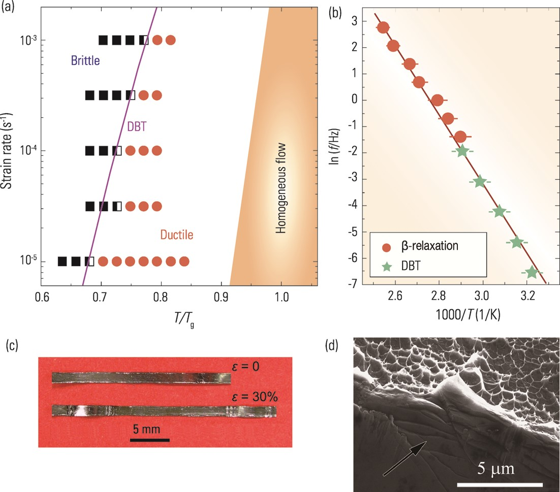
Figure 17. (a) Deformation mode map summarizing tensile tests at different temperatures and strain rates, see [35] for ...
Notes:
Figure 17. (a) Deformation mode map summarizing tensile tests at different temperatures and strain rates, see [35] for the meanings of the symbols. (b) Arrhenius plot of DBT and β-relaxation of the MG. (c) Image of the MG before and after tensile testing. (d) SEM image of a La MG ductile fracture surface (Copyright 2012 American Physics Society).
Unless provided in the caption above, the following copyright applies to the content of this slide: © 2014 The Authors Published by Oxford University Press on behalf of the Royal Astronomical SocietyThis is an Open Access article distributed under the terms of the Creative Commons Attribution License (http://creativecommons.org/licenses/by/4.0/), which permits non-commercial reuse, distribution, and reproduction in any medium, provided the original work is properly cited. for commercial re-use, please contact journals.permissions@oup.com

Slide 18
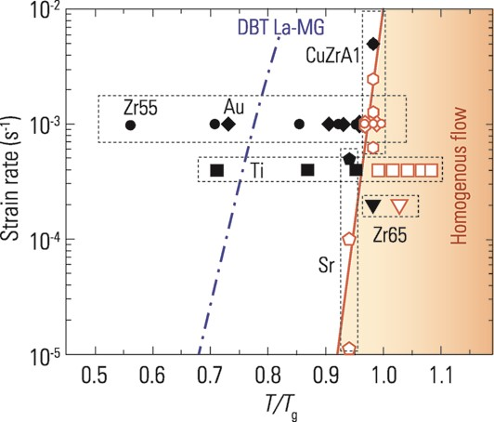
Figure 18. The deformation modes (brittle versus ductile) of six typical MGs compared with a La MG. They include ...
Notes:
Figure 18. The deformation modes (brittle versus ductile) of six typical MGs compared with a La MG. They include Zr55Al10Ni5Cu30 ([158], circles), Au49Ag5.5Pd2.3Cu26.9Si16.3 ([159], diamonds), Cu46Zr46Al8 ([162], hexagons), Ti40Zr25Ni3Cu12Be20 ([163], squares), Zn20Ca20Sr20Yb20Li11Mg9 ([164], pentagons), and Zr65Al7.5Ni10Cu17.5 ([165], triangles). The filled black symbols represent brittle fracture, while the open red symbols represent ductile deformation. The blue dashed curve is the brittle-to-ductile boundary of a La68.5Ni16Al14Co1.5 MG; to the right of this boundary the La MG shows significant tensile plasticity. In the shaded region, the MGs deform via homogeneous flow.
Unless provided in the caption above, the following copyright applies to the content of this slide: © 2014 The Authors Published by Oxford University Press on behalf of the Royal Astronomical SocietyThis is an Open Access article distributed under the terms of the Creative Commons Attribution License (http://creativecommons.org/licenses/by/4.0/), which permits non-commercial reuse, distribution, and reproduction in any medium, provided the original work is properly cited. for commercial re-use, please contact journals.permissions@oup.com

Slide 19
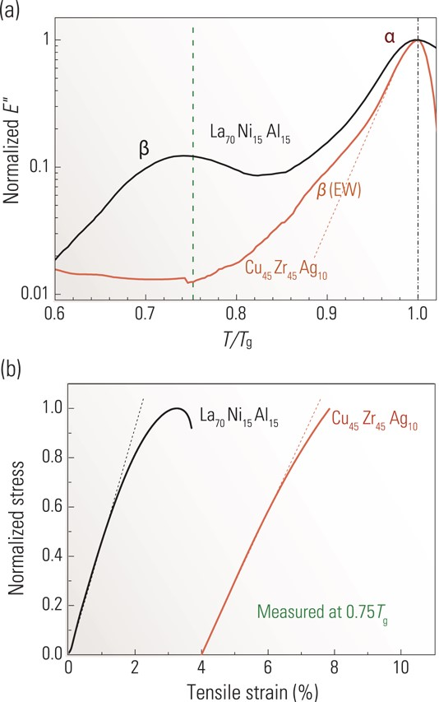
Figure 19. Comparative studies between a La MG and a CuZr MG (a) DMA spectra and (b) tensile stress–strain curves, ...
Notes:
Figure 19. Comparative studies between a La MG and a CuZr MG (a) DMA spectra and (b) tensile stress–strain curves, redrawn from [167].
Unless provided in the caption above, the following copyright applies to the content of this slide: © 2014 The Authors Published by Oxford University Press on behalf of the Royal Astronomical SocietyThis is an Open Access article distributed under the terms of the Creative Commons Attribution License (http://creativecommons.org/licenses/by/4.0/), which permits non-commercial reuse, distribution, and reproduction in any medium, provided the original work is properly cited. for commercial re-use, please contact journals.permissions@oup.com

Slide 20
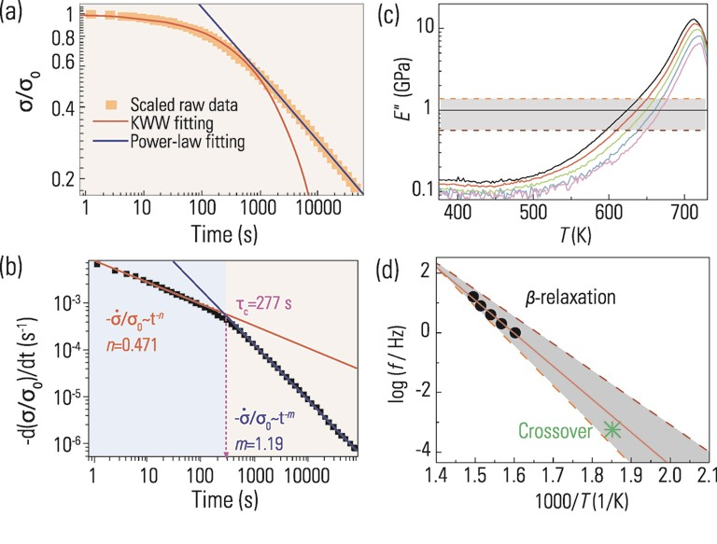
Figure 20. (a) Stress relaxation curve of a Zr MG, (b) derivative of (a) showing a crossover, (c) DMA spectrum of the Zr ...
Notes:
Figure 20. (a) Stress relaxation curve of a Zr MG, (b) derivative of (a) showing a crossover, (c) DMA spectrum of the Zr MG, and (d) comparison between the estimated β-relaxation time of the Zr MG and the crossover time in an Arrhenius frame. (a) and (b) are taken from [174] (Copyright 2013 American Institute Physics).
Unless provided in the caption above, the following copyright applies to the content of this slide: © 2014 The Authors Published by Oxford University Press on behalf of the Royal Astronomical SocietyThis is an Open Access article distributed under the terms of the Creative Commons Attribution License (http://creativecommons.org/licenses/by/4.0/), which permits non-commercial reuse, distribution, and reproduction in any medium, provided the original work is properly cited. for commercial re-use, please contact journals.permissions@oup.com

Slide 21
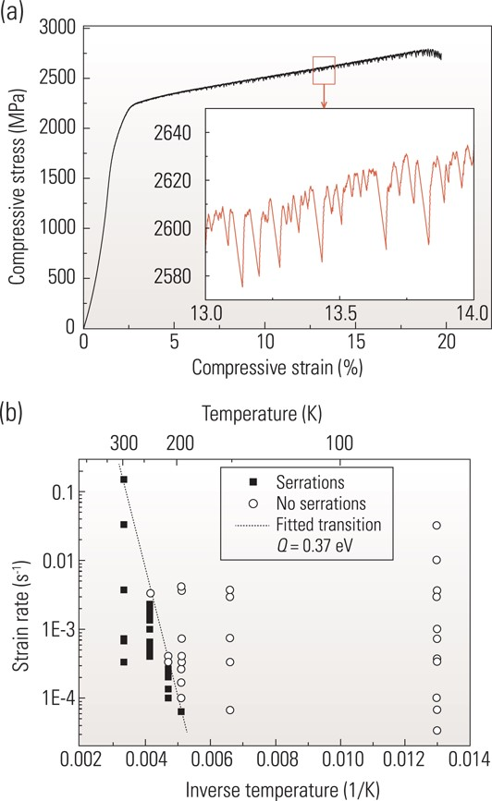
Figure 21. (a) A typical compressive deformation curve of a Zr MG; the inset shows serrated flow [177] (Copyright 2009 ...
Notes:
Figure 21. (a) A typical compressive deformation curve of a Zr MG; the inset shows serrated flow [177] (Copyright 2009 Acta Materialia Inc.). (b) Map of temperature and strain rate combinations for serrated flow, showing a boundary between serrated and non-serrated flow [179].
Unless provided in the caption above, the following copyright applies to the content of this slide: © 2014 The Authors Published by Oxford University Press on behalf of the Royal Astronomical SocietyThis is an Open Access article distributed under the terms of the Creative Commons Attribution License (http://creativecommons.org/licenses/by/4.0/), which permits non-commercial reuse, distribution, and reproduction in any medium, provided the original work is properly cited. for commercial re-use, please contact journals.permissions@oup.com

Slide 22
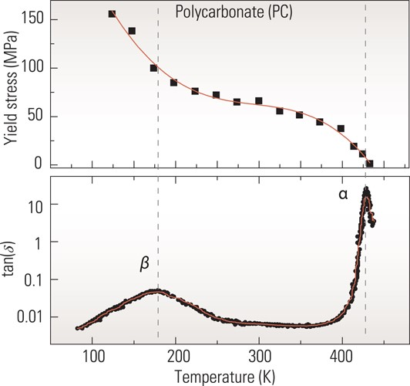
Figure 22. Comparison between (a) yield stress [15] and (b) tan(δ) [190] of a polycarbonate.
Notes:
Figure 22. Comparison between (a) yield stress [15] and (b) tan(δ) [190] of a polycarbonate.
Unless provided in the caption above, the following copyright applies to the content of this slide: © 2014 The Authors Published by Oxford University Press on behalf of the Royal Astronomical SocietyThis is an Open Access article distributed under the terms of the Creative Commons Attribution License (http://creativecommons.org/licenses/by/4.0/), which permits non-commercial reuse, distribution, and reproduction in any medium, provided the original work is properly cited. for commercial re-use, please contact journals.permissions@oup.com

Slide 23
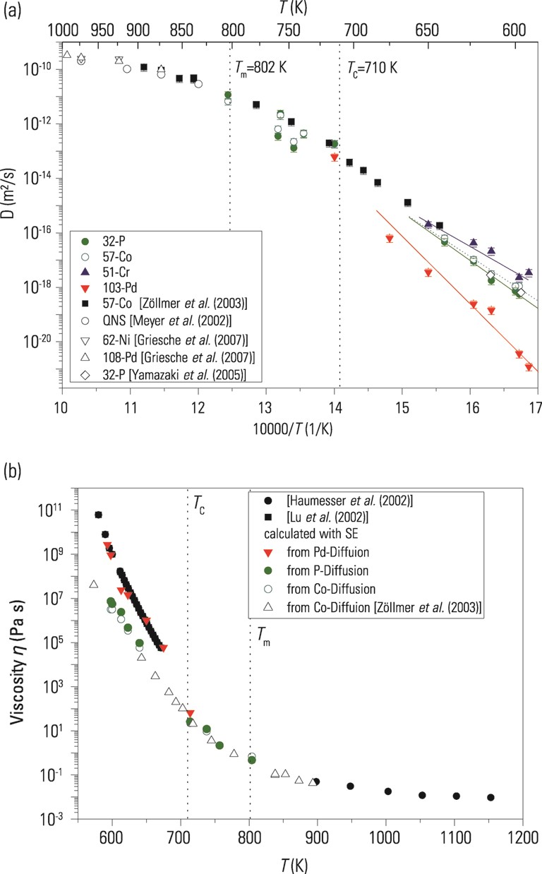
Figure 23. (a) Arrhenius plot for diffusion in liquid Pd₄₃Cu₂₇Ni₁₀P₂₀ ...
Notes:
Figure 23. (a) Arrhenius plot for diffusion in liquid Pd43Cu27Ni10P20 alloys. (b) Comparison of diffusion and viscosity [202]. See [202] for the meanings of the labels (Copyright 2010 American Physics Society).
Unless provided in the caption above, the following copyright applies to the content of this slide: © 2014 The Authors Published by Oxford University Press on behalf of the Royal Astronomical SocietyThis is an Open Access article distributed under the terms of the Creative Commons Attribution License (http://creativecommons.org/licenses/by/4.0/), which permits non-commercial reuse, distribution, and reproduction in any medium, provided the original work is properly cited. for commercial re-use, please contact journals.permissions@oup.com

Slide 24
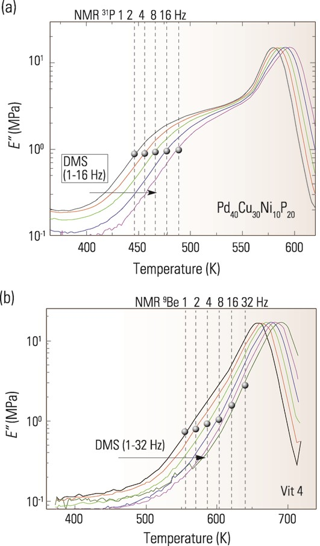
Figure 24. (a) Temperature dependence of E ″ of Pd₄₀Ni₁₀Cu₃₀P₂₀ ...
Notes:
Figure 24. (a) Temperature dependence of E ″ of Pd40Ni10Cu30P20 MG; the frequencies are 1, 2, 4, 8, and 16 Hz from left to right. The dashed lines are the NMR-probed P atom diffusive hopping rates (as indicated on the top) at the corresponding temperatures. (b) Same as (a) but for a Zr MG, where the dashed lines are the NMR-probed Be atom diffusive hopping rates. Adapted from [11,115] (Copyright 2013 American Physics Society).
Unless provided in the caption above, the following copyright applies to the content of this slide: © 2014 The Authors Published by Oxford University Press on behalf of the Royal Astronomical SocietyThis is an Open Access article distributed under the terms of the Creative Commons Attribution License (http://creativecommons.org/licenses/by/4.0/), which permits non-commercial reuse, distribution, and reproduction in any medium, provided the original work is properly cited. for commercial re-use, please contact journals.permissions@oup.com

Slide 25
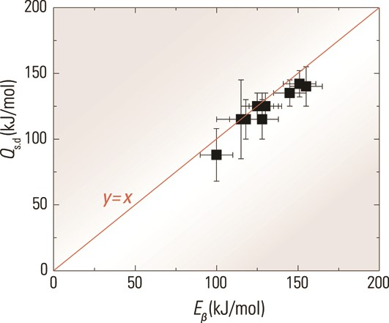
Figure 25. Comparison between the activation energy of β-relaxation E_{β} and the activation energy of ...
Notes:
Figure 25. Comparison between the activation energy of β-relaxation Eβ and the activation energy of self-diffusion of the smallest constituent atoms Qs.d, in different MGs. A linear relation y = x (the line) fits the data well [115] (Copyright 2013 American Physics Society).
Unless provided in the caption above, the following copyright applies to the content of this slide: © 2014 The Authors Published by Oxford University Press on behalf of the Royal Astronomical SocietyThis is an Open Access article distributed under the terms of the Creative Commons Attribution License (http://creativecommons.org/licenses/by/4.0/), which permits non-commercial reuse, distribution, and reproduction in any medium, provided the original work is properly cited. for commercial re-use, please contact journals.permissions@oup.com

Slide 26
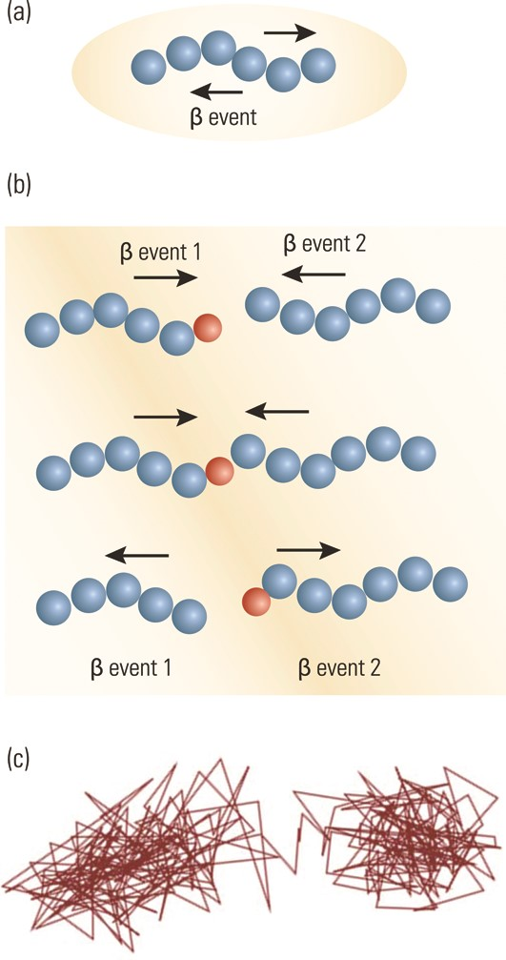
Figure 26. (a) Schematic diagram of atomic configurations and motions of a β-event in an MG. The ellipse represents the ...
Notes:
Figure 26. (a) Schematic diagram of atomic configurations and motions of a β-event in an MG. The ellipse represents the confinement of the elastic matrix. The two arrows represent the atoms moving back and forth reversibly. (b) Schematic diagram showing the relationship between β-events and diffusion. The smaller red circle indicates a diffusing atom. (c) The net motions corresponding to the smallest atoms in (b). (a) and (b) are adapted from [115] (Copyright 2013 American Physics Society).
Unless provided in the caption above, the following copyright applies to the content of this slide: © 2014 The Authors Published by Oxford University Press on behalf of the Royal Astronomical SocietyThis is an Open Access article distributed under the terms of the Creative Commons Attribution License (http://creativecommons.org/licenses/by/4.0/), which permits non-commercial reuse, distribution, and reproduction in any medium, provided the original work is properly cited. for commercial re-use, please contact journals.permissions@oup.com

Slide 27
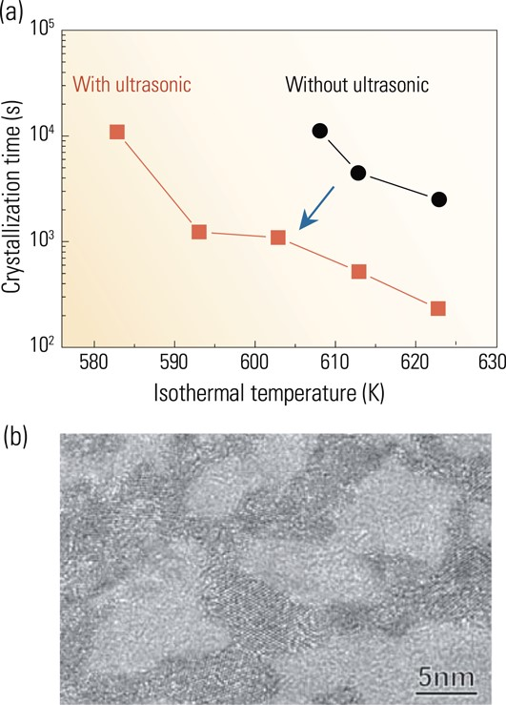
Figure 27. (a) Time–temperature-transformation diagram for ...
Notes:
Figure 27. (a) Time–temperature-transformation diagram for Pd42.5Ni7.5Cu30P20 with or without ultrasonic perturbation, redrawn from the data of [221]. (b) Typical HRTEM image of the Pd MG after annealing at 290°C for 10 h under ultrasonic vibrations of 0.35 MHz [219] (Copyright 2005 American Physics Society).
Unless provided in the caption above, the following copyright applies to the content of this slide: © 2014 The Authors Published by Oxford University Press on behalf of the Royal Astronomical SocietyThis is an Open Access article distributed under the terms of the Creative Commons Attribution License (http://creativecommons.org/licenses/by/4.0/), which permits non-commercial reuse, distribution, and reproduction in any medium, provided the original work is properly cited. for commercial re-use, please contact journals.permissions@oup.com

Slide 28
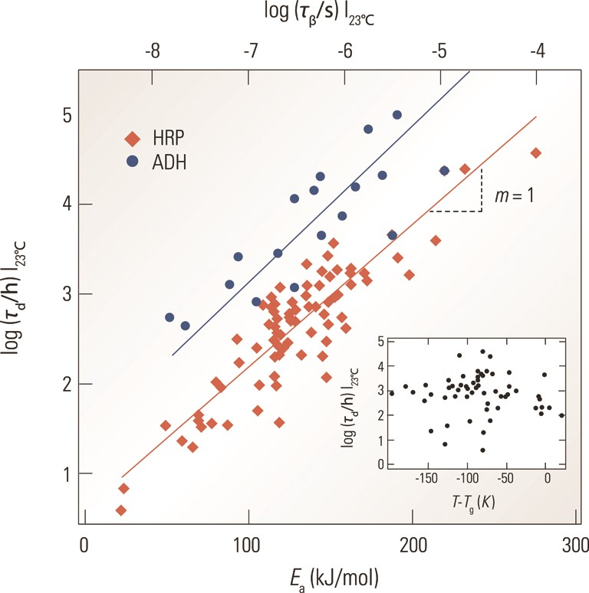
Figure 28. Comparison between β-relaxation time and the enzyme degradation rates at 23°C in hundreds of plasticized and ...
Notes:
Figure 28. Comparison between β-relaxation time and the enzyme degradation rates at 23°C in hundreds of plasticized and antiplasticized sugar glasses. Adapted from [222].
Unless provided in the caption above, the following copyright applies to the content of this slide: © 2014 The Authors Published by Oxford University Press on behalf of the Royal Astronomical SocietyThis is an Open Access article distributed under the terms of the Creative Commons Attribution License (http://creativecommons.org/licenses/by/4.0/), which permits non-commercial reuse, distribution, and reproduction in any medium, provided the original work is properly cited. for commercial re-use, please contact journals.permissions@oup.com

Slide 29
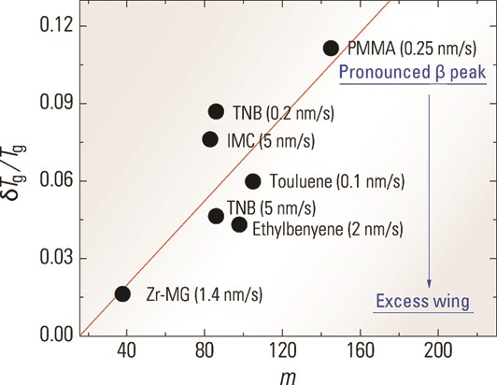
Figure 29. Correlation between fragility index m and δT_{g}/T_{g} for different SGs; values in the ...
Notes:
Figure 29. Correlation between fragility index m and δTg/Tg for different SGs; values in the parentheses are the deposition rates (Copyright 2013 Wiley-VCH Verlag GmbH&Co. KGaA, Weinheim) [55].
Unless provided in the caption above, the following copyright applies to the content of this slide: © 2014 The Authors Published by Oxford University Press on behalf of the Royal Astronomical SocietyThis is an Open Access article distributed under the terms of the Creative Commons Attribution License (http://creativecommons.org/licenses/by/4.0/), which permits non-commercial reuse, distribution, and reproduction in any medium, provided the original work is properly cited. for commercial re-use, please contact journals.permissions@oup.com

