Slide 1
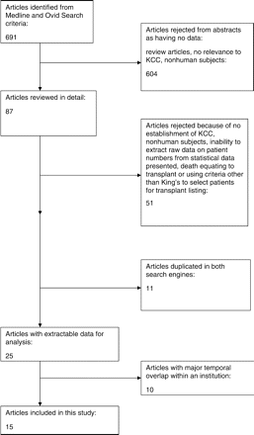
Figure 1. Flow chart showing article selection process.
Notes:
Figure 1. Flow chart showing article selection process.
Unless provided in the caption above, the following copyright applies to the content of this slide: © The Author 2008. Published by Oxford University Press on behalf of the Association of Physicians. All rights reserved. For Permissions, please email: journals.permissions@oxfordjournals.org

Slide 2
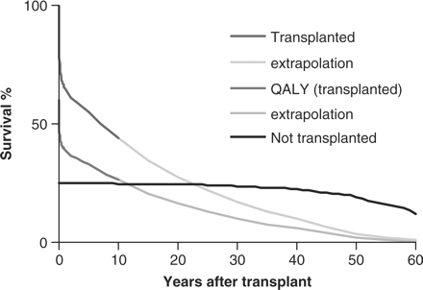
Figure 2. Estimated survival curves depending on decision to transplant a 20-year-old with KCC for paracetamol induced ...
Notes:
Figure 2. Estimated survival curves depending on decision to transplant a 20-year-old with KCC for paracetamol induced liver failure. Pooled data show survival of 24.9% (95% CI 20.8–29.4) in patients meeting KCC who are not transplanted. Liver transplant recipients after acute liver failure by comparison have survival at 10 years of 44% (95% CI 38–50). Thus, the odds ratio for 10-year survival might be estimated as favouring transplant recipients (OR 1.77; 95% CI 1.29–2.40). However, the survival advantage becomes increasingly unfavourable with extrapolation, and even more so when using QALY.
Unless provided in the caption above, the following copyright applies to the content of this slide: © The Author 2008. Published by Oxford University Press on behalf of the Association of Physicians. All rights reserved. For Permissions, please email: journals.permissions@oxfordjournals.org

Slide 3
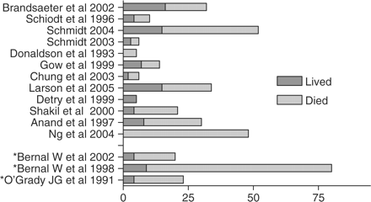
Figure 3. Number of people who lived and died after meeting KCC for paracetamol induced liver ...
Notes:
Figure 3. Number of people who lived and died after meeting KCC for paracetamol induced liver failure.8,9,12,16–19,22–25,27,28,31,33 Asterisk indicate Study from King's unit.
Unless provided in the caption above, the following copyright applies to the content of this slide: © The Author 2008. Published by Oxford University Press on behalf of the Association of Physicians. All rights reserved. For Permissions, please email: journals.permissions@oxfordjournals.org

