Slide 1
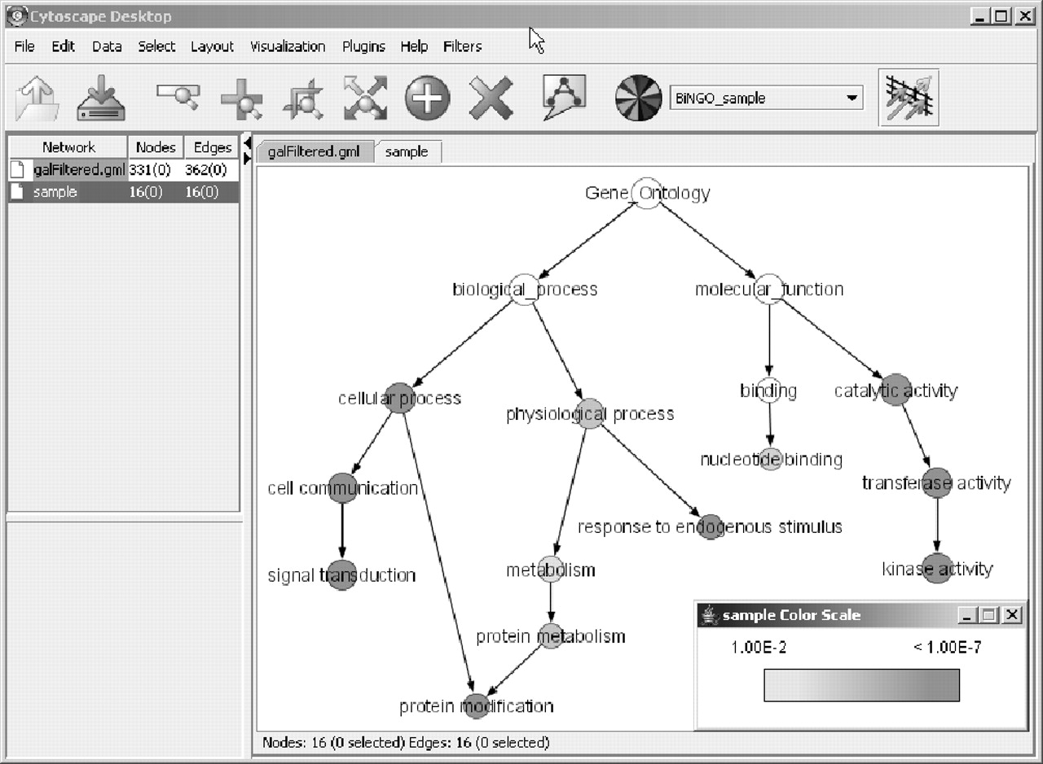
Fig. 1 A sample BiNGO result for a set of Arabidopsis protein kinases, as visualized in Cytoscape. Dark grey ...
Notes:
Fig. 1 A sample BiNGO result for a set of Arabidopsis protein kinases, as visualized in Cytoscape. Dark grey categories are most significantly overrepresented. White nodes are not significantly overrepresented, they are included to show the grey nodes in the context of the GO hierarchy. The area of a node is proportional to the number of genes in the test set annotated to the corresponding GO category.
Unless provided in the caption above, the following copyright applies to the content of this slide: © The Author 2005. Published by Oxford University Press. All rights reserved. For Permissions, please email: journals.permissions@oupjournals.org

