Slide 1
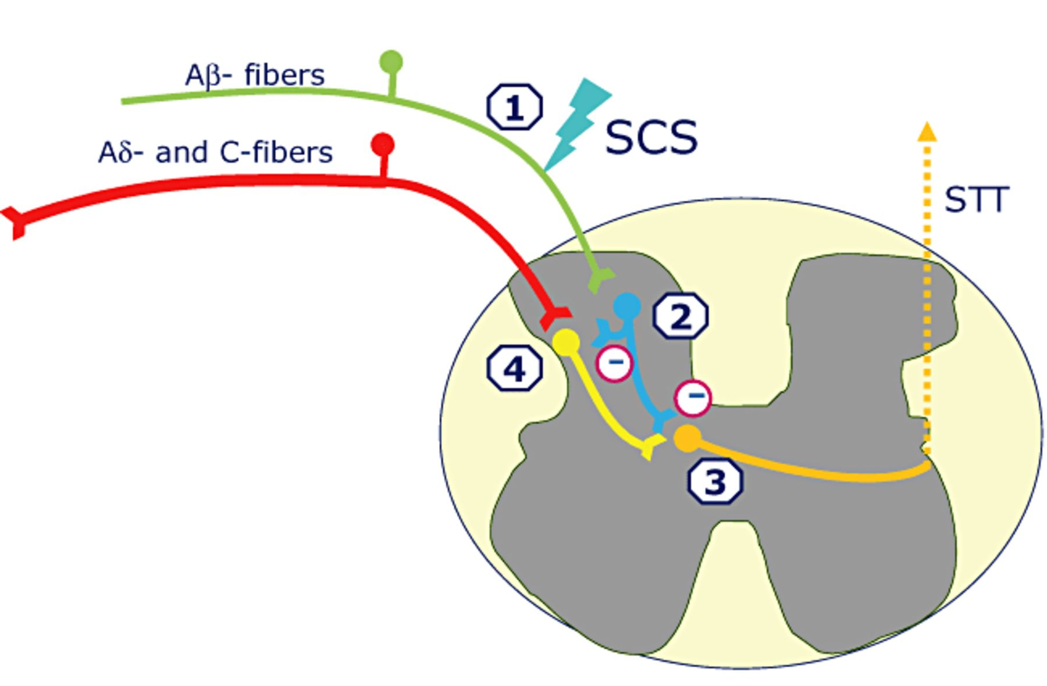
Figure 1 A suggested mechanism for spinal cord stimulation (SCS) pain control, via effects on spinal neurophysiology. ...
Notes:
Figure 1 A suggested mechanism for spinal cord stimulation (SCS) pain control, via effects on spinal neurophysiology. (1) SCS activates low-threshold, large diameter Aβ-fibers, which synapse (2) onto inhibitory (GABA-ergic or cholinergic) interneurons in the dorsal horn. (3) These inhibitory interneurons release transmitter (e.g., GABA, acting via GABAB receptors) to reduce the excitability of spinal projection neurons, such that subsequent inputs from Aδ and C fibers are attenuated. GABA = gamma-aminobutyric acid; STT = spinothalamic tract.
Unless provided in the caption above, the following copyright applies to the content of this slide: Wiley Periodicals, Inc.

Slide 2
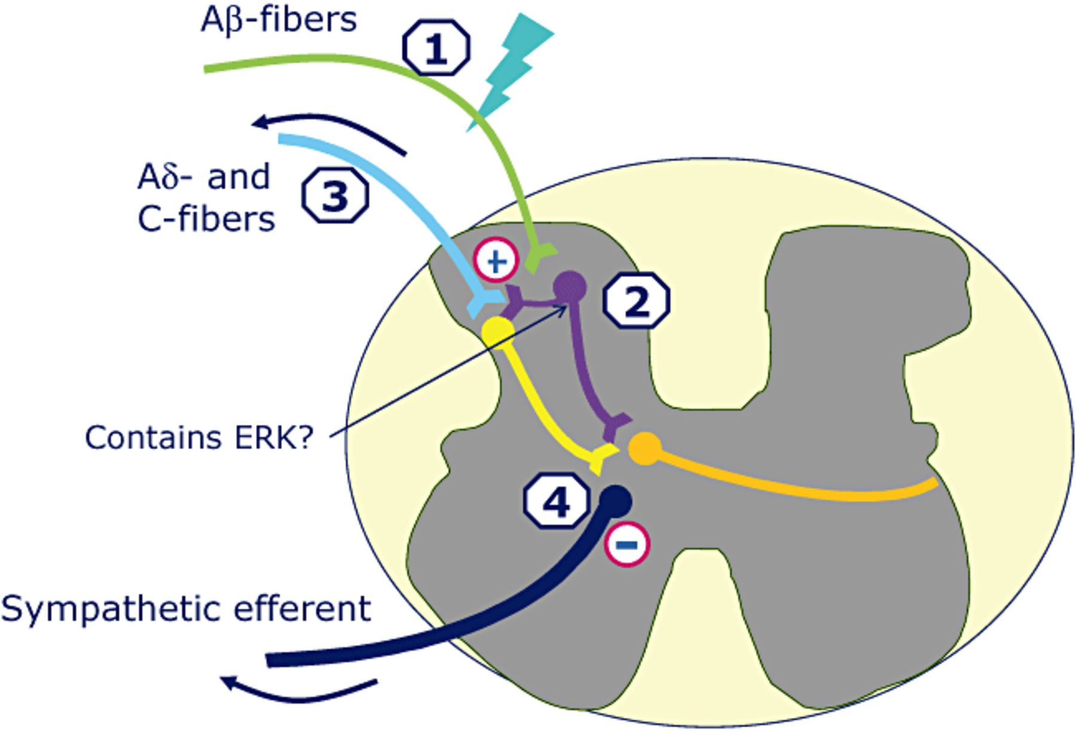
Figure 2 A suggested mechanism for spinal cord stimulation (SCS) effects on vasodilation, via effects on spinal ...
Notes:
Figure 2 A suggested mechanism for spinal cord stimulation (SCS) effects on vasodilation, via effects on spinal neurophysiology. (1) SCS at dorsal columns activates large-diameter fibers, mainly Aβ-fibers. Branches of these fibers in the superficial laminae connect to spinal interneurons (2), which are activated following SCS and subsequently activate small-diameter, high-threshold sensory afferent fibers (3), activating both the central terminals and antidromic activation of neurotransmitter release from peripheral terminals, and also leading to (4) inhibition of the sympathetic efferent fiber.
Unless provided in the caption above, the following copyright applies to the content of this slide: Wiley Periodicals, Inc.

