Slide 1
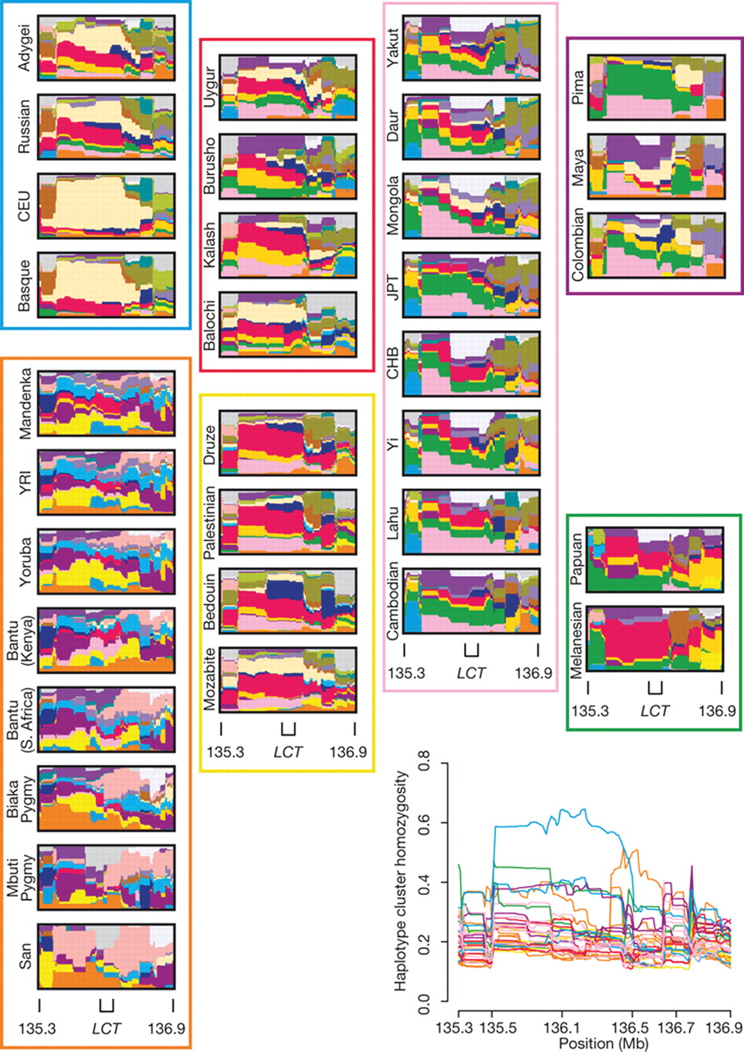
Figure 1. Haplotype cluster frequencies for 156 consecutive SNPs on chromosome 2 in the region surrounding the LCT ...
Notes:
Figure 1. Haplotype cluster frequencies for 156 consecutive SNPs on chromosome 2 in the region surrounding the LCT gene (136.373–136.478 Mb). At each SNP, relative frequencies of haplotype clusters are displayed on a thin vertical line. Each color depicts a haplotype cluster, and the proportion in a color gives the frequency of 1 of 20 distinct clusters. Interpretation of colors is made locally, as clustering varies along the chromosome, reflecting a gradual decay of LD. Moving horizontally, changes in color patterns illustrate the change in haplotypic composition across physical position. CEU, Utah residents with ancestry from northern and western Europe; CHB, Han Chinese from Beijing; JPT, Japanese from Tokyo; YRI, Yoruba from Ibadan, Nigeria. Reprinted by permission from Macmillan Publishers Ltd: [Nature] ( 15 ), © (2008).
Unless provided in the caption above, the following copyright applies to the content of this slide: © The Author 2008. Published by Oxford University Press. All rights reserved. For Permissions, please email: journals.permissions@oxfordjournals.org

