Slide 1
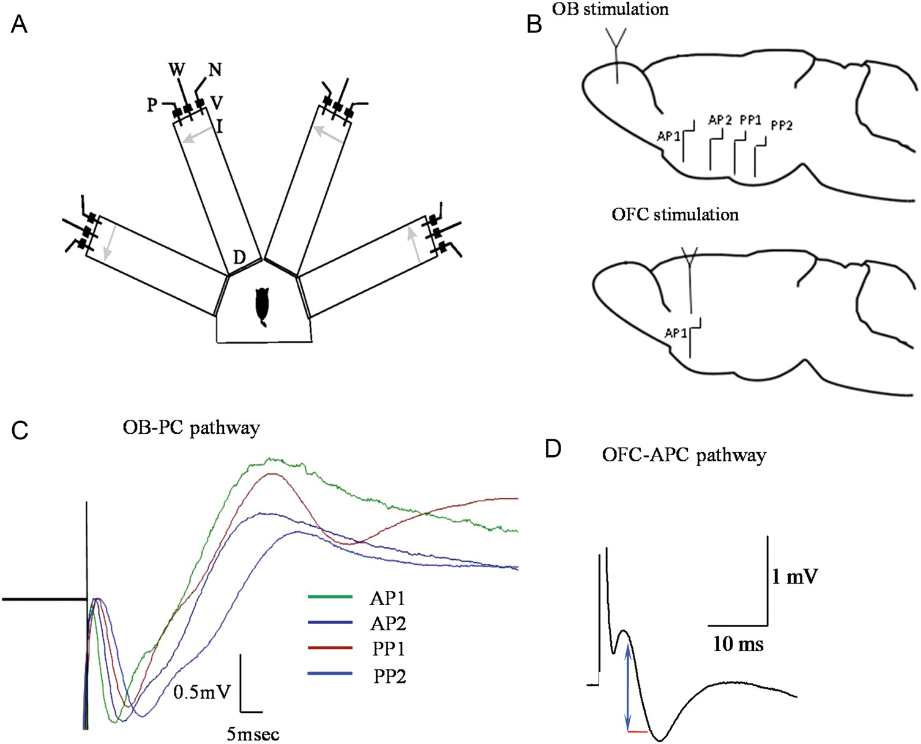
Figure 1. Olfactory discrimination training-apparatus and in vivo fPSPs recordings. (A) Schematic description of the ...
Notes:
Figure 1. Olfactory discrimination training-apparatus and in vivo fPSPs recordings. (A) Schematic description of the 4-arm maze. Protocols for trained and pseudo-trained rats are similar: an electronic “start” command opens randomly 2 of 8 valves (V), releasing a positive-cue odor (P) into one of the arms and a negative-cue odor (N) into another. Eight seconds later, the 2 corresponding guillotine doors (D) are lifted to allow the rat to enter the selected arms. Upon reaching the far end of an arm (90 cm long), the rat body interrupts an infrared beam (I, arrow) and a drop of drinking water is released from a water hose (W) into a small drinking well (for a trained rat—only if the arm contains the positive-cue odor, for pseudo-trained rat—randomly). A trial ends when the rat interrupts a beam, or in 10 s, if no beam is interrupted. A fan is operated for 15 s between trials, to remove odors. (B) Top: Location of stimulating electrode in the OB and of the 4 recording electrodes in the PC. To record responses to ascending input stimulation, 2 recording electrodes are located in layer Ia of the anterior PC (APC1 and APC2) and 2 in layer Ia of the posterior PC (PPC1 and PPC2). Bottom: Location of stimulating electrode in the OFC and of the recording electrode in the anterior PC. To record responses to descending input stimulation, one recording electrode is located in layer Ib/II of the anterior PC (APC). (C) Simultaneous recordings the PC in response to stimulation of the ascending pathway for the OB. (D) Typical responses recorded in layer Ib of the anterior PC in response to stimuli applied in the descending pathway form the OFC (see Cohen et al. 2008 for detailed description of location of stimulating and recording electrodes). Arrow in blue and line red show amplitude measurement of 10%–90% and time distance between the 2 points, used to measure the fPSP slope.
Unless provided in the caption above, the following copyright applies to the content of this slide: © The Author 2013. Published by Oxford University Press. All rights reserved. For Permissions, please e-mail: journals.permissions@oup.com

Slide 2
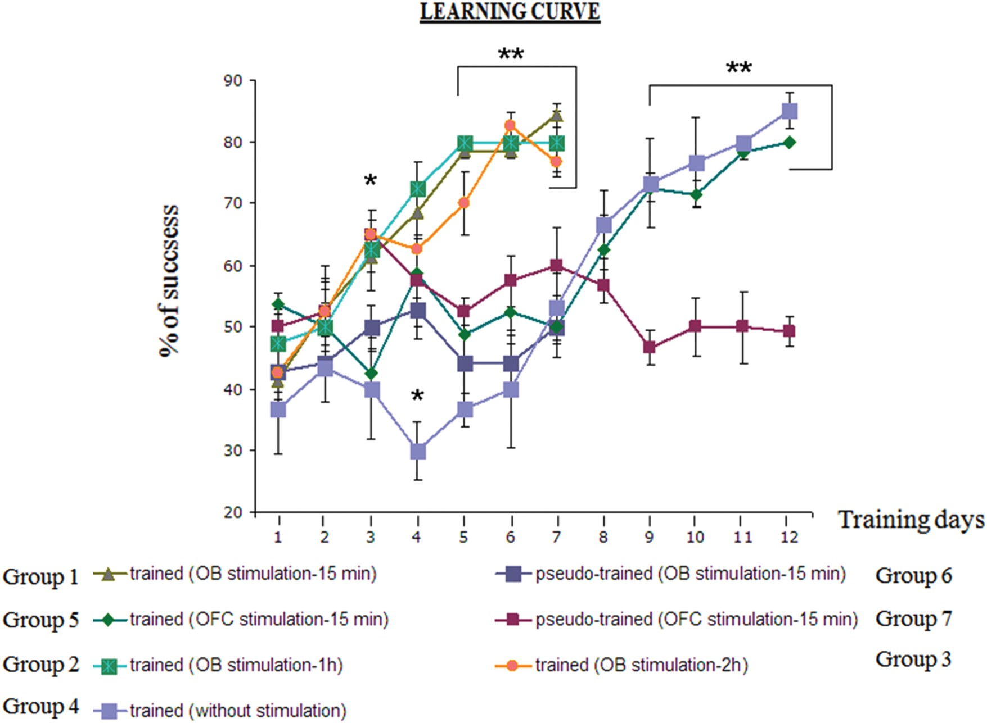
Figure 2. Learning curves of the different experimental groups. Learning curve for trained and pseudo-trained rats ...
Notes:
Figure 2. Learning curves of the different experimental groups. Learning curve for trained and pseudo-trained rats expressed as correct choices in the last 10 trials of the day. The learning curve shows a gradual improvement in performance in all groups of trained rats and no learning in pseudo-trained rats, which show no preference for any of the odors during the entire training period. Notably, when daily stimulation was applied to the OB, learning was completed within 5 days, while rats stimulated at the OFC show no advantage in learning over naive rats implemented with stimulating electrodes but not stimulated. Values represent mean ± SE. *P < 0.05. **P < <0.05. Numbers of rats are noted in the text.
Unless provided in the caption above, the following copyright applies to the content of this slide: © The Author 2013. Published by Oxford University Press. All rights reserved. For Permissions, please e-mail: journals.permissions@oup.com

Slide 3
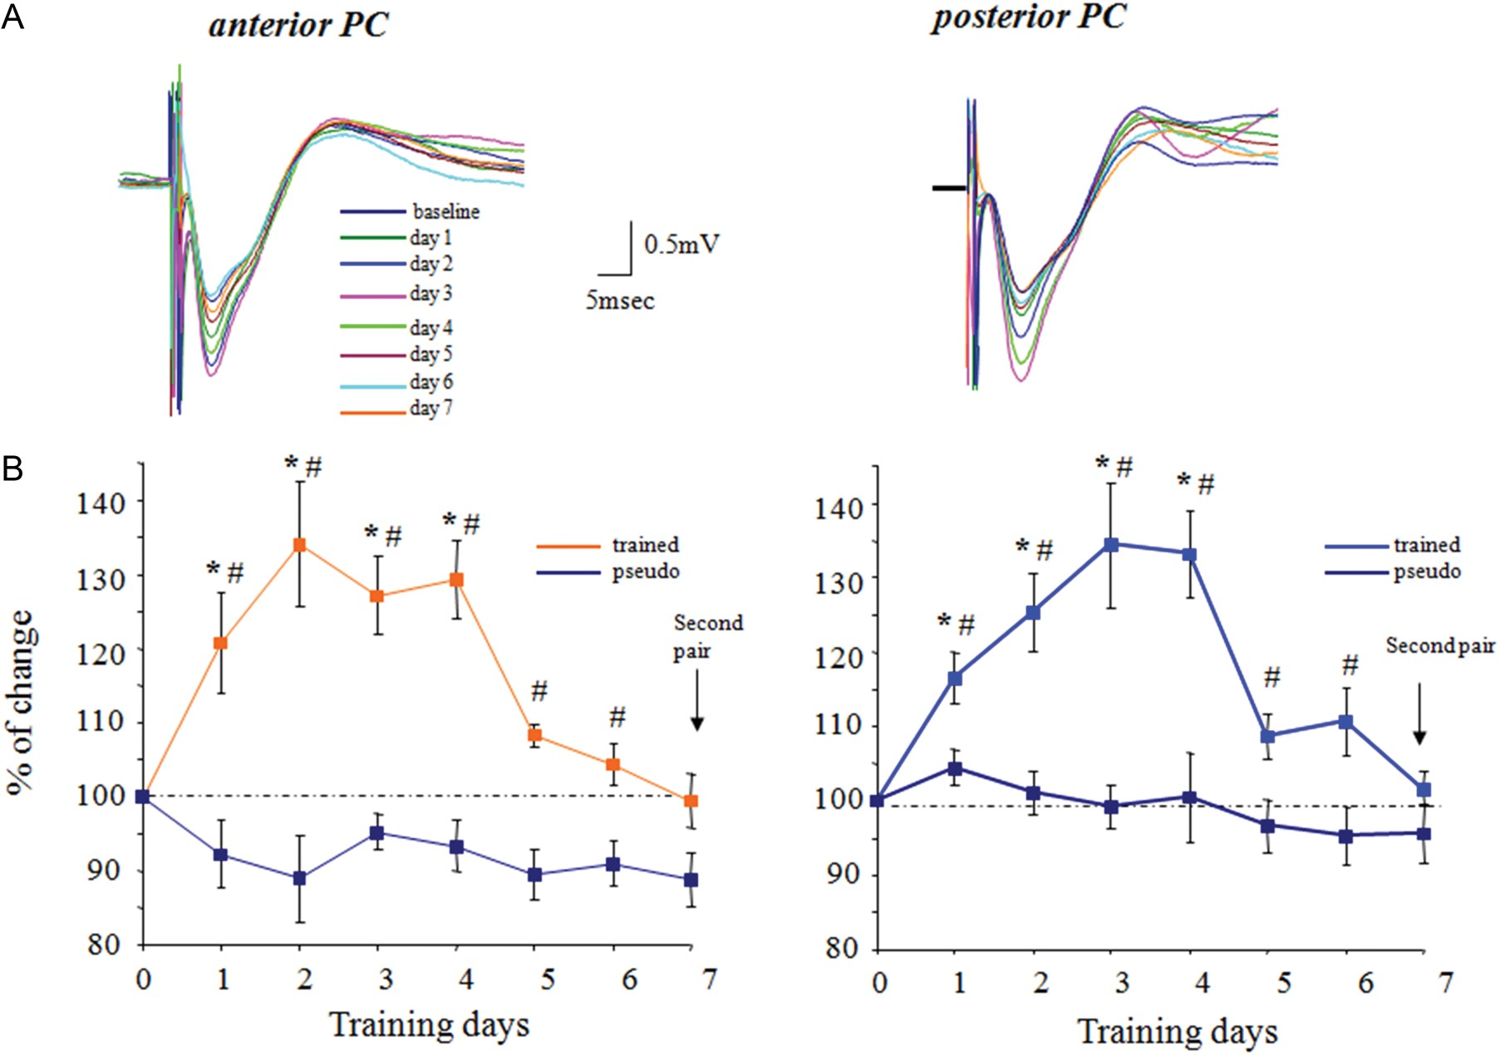
Figure 3. Rule learning-induced enhancement of synaptic transmission in the ascending pathway is similar for the APC ...
Notes:
Figure 3. Rule learning-induced enhancement of synaptic transmission in the ascending pathway is similar for the APC and PPC. (A) Examples of synaptic response evoked each day after training in response to stimulation at intensity of 1 mA in the APC and PPC from the same rat. In both recording sites, the maximal response occurs at the third day during learning. (B) Time course and enhancement of the synaptic response evoked by stimulating the ascending pathway is similar throughout the piriform cortex. For each rat, responses recorded with the 2 electrodes in the APC were averaged to calculate the APC response, and responses recorded with the 2 electrodes in the PPC were averaged to calculate the PPC response. Recordings from 5 rats were averaged for each group. Values represent mean ± SE. *P < 0.05 between a particular training day and the baseline recoding in trained rat prior to training. #P < 0.05 between trained and pseudo-trained rats.
Unless provided in the caption above, the following copyright applies to the content of this slide: © The Author 2013. Published by Oxford University Press. All rights reserved. For Permissions, please e-mail: journals.permissions@oup.com

Slide 4
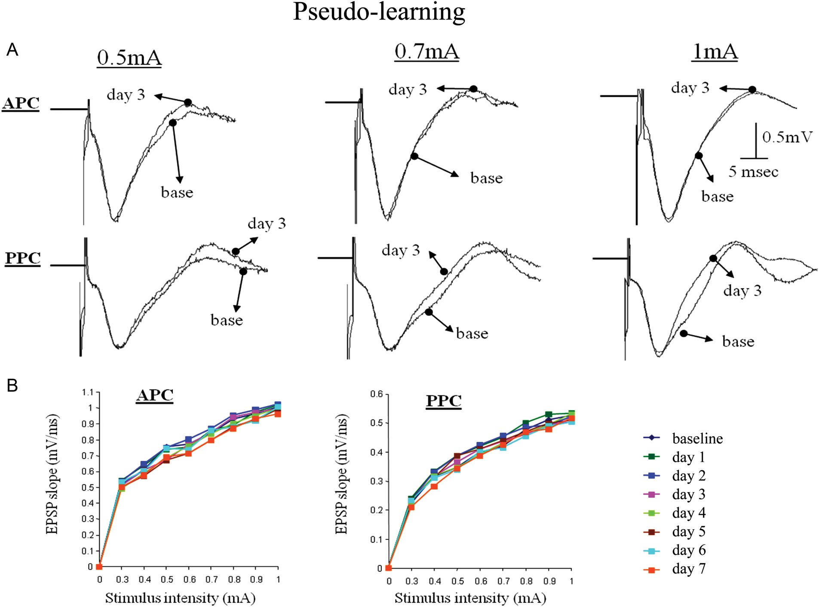
Figure 4. Synaptic connectivity in ascending pathway is not modified in pseudo-trained rats. (A) Examples of responses ...
Notes:
Figure 4. Synaptic connectivity in ascending pathway is not modified in pseudo-trained rats. (A) Examples of responses to OB stimulation in the anterior and posterior PC before learning (base) and 3 days during learning. Traces for 3 stimulation intensities are shown. (B) Example of analysis of the input–output function of the synaptic response in the ascending input to APC and PPC. The strength of synaptic response remained stable for all stimulus intensities throughout the training period.
Unless provided in the caption above, the following copyright applies to the content of this slide: © The Author 2013. Published by Oxford University Press. All rights reserved. For Permissions, please e-mail: journals.permissions@oup.com

Slide 5
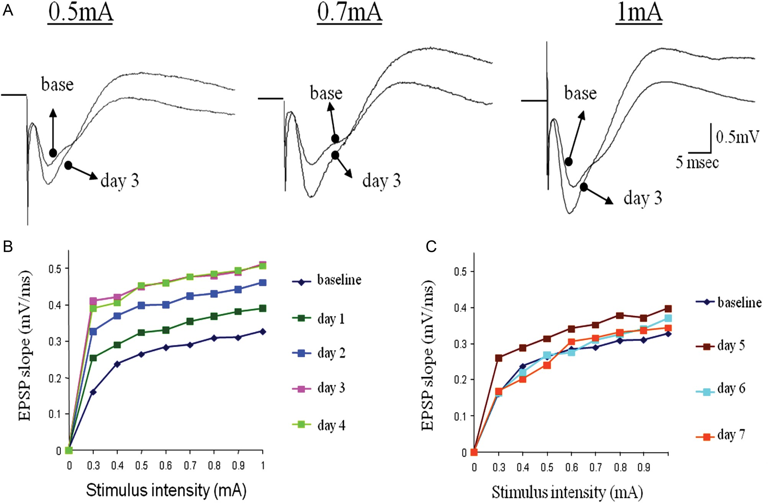
Figure 5. Transient enhancement synaptic connectivity from the olfactory bulb to the anterior PC during rule learning. ...
Notes:
Figure 5. Transient enhancement synaptic connectivity from the olfactory bulb to the anterior PC during rule learning. (A) Examples of responses to OB stimulation in the anterior PC before learning (base) and 3 days during learning. Enhanced synaptic responses are evident for all 3 shown stimulation intensities. (B) Example of analysis of the input–output function of the synaptic response in the ascending input to APC on the first 4 days of training. The strength of synaptic response increases each day for all stimulus intensities until it reaches its peak on the third and fourth day of training, before rule learning is completed (see Fig. 2). (C) Example of analysis of the input–output function of the synaptic response in the ascending input to APC starting 5 days of training. The strength of synaptic response first decreases slightly between the fifth and sixth day of training, and then resumes its pretraining value (base). Notably, although training on the seventh day was performed with a pair of new odors, the synaptic response did not potentiate again.
Unless provided in the caption above, the following copyright applies to the content of this slide: © The Author 2013. Published by Oxford University Press. All rights reserved. For Permissions, please e-mail: journals.permissions@oup.com

Slide 6
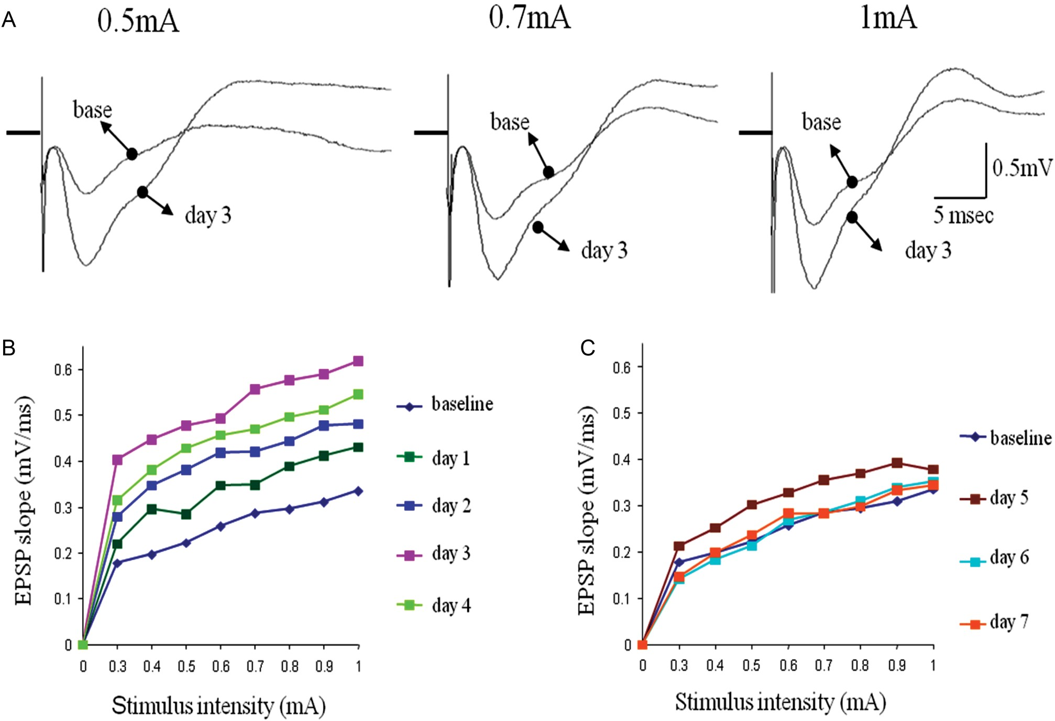
Figure 6. Transient enhancement synaptic connectivity from the olfactory bulb to the posterior PC during rule learning. ...
Notes:
Figure 6. Transient enhancement synaptic connectivity from the olfactory bulb to the posterior PC during rule learning. (A) Examples of responses to OB stimulation in the posterior PC before learning (base) and 3 days during learning. Enhanced synaptic responses are evident for all 3 shown stimulation intensities. (B) Example of analysis of the input–output function of the synaptic response in the ascending input to APC on the first 4 days of training. Here too, the strength of synaptic response increases each day for all stimulus intensities until it reaches its peak on the fourth day of training, before rule learning is completed (see Fig. 2). (C) Example of analysis of the input–output function of the synaptic response in the ascending input to APC starting 5 days of training. Here too, the strength of synaptic response first decreases slightly between the fifth and sixth day of training, and then resumes its pretraining value (base). Notably, although training on the seventh day was performed with a pair of new odors, the synaptic did not potentiate again.
Unless provided in the caption above, the following copyright applies to the content of this slide: © The Author 2013. Published by Oxford University Press. All rights reserved. For Permissions, please e-mail: journals.permissions@oup.com

Slide 7
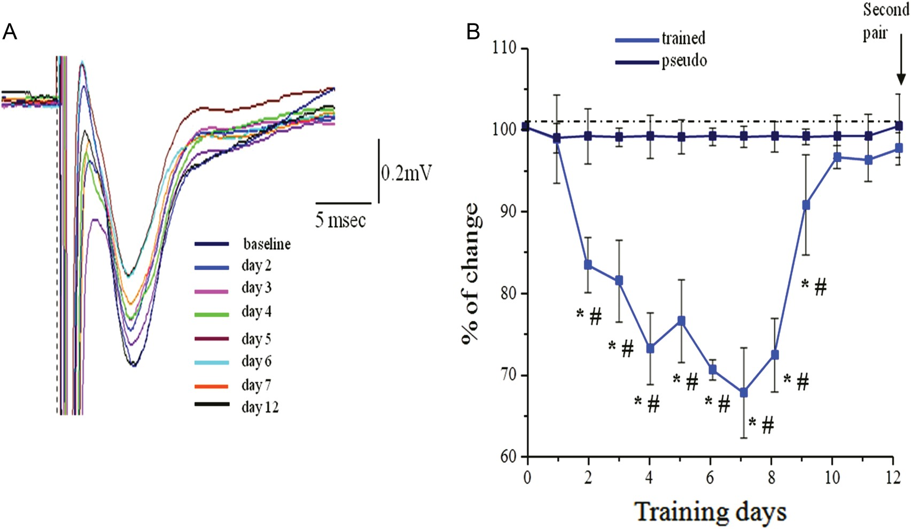
Figure 7. Time course of reduced transmission in the descending pathway. (A) Examples of synaptic response evoked each ...
Notes:
Figure 7. Time course of reduced transmission in the descending pathway. (A) Examples of synaptic response evoked each day after training in response to stimulation at intensity of 1 mA in the APC. In this example, the maximal response occurs at the fifth and sixth day during learning. (B) Time course of reduction in the synaptic response evoked by stimulating the descending. For each rat, responses recorded with one electrode in the APC. Recordings from 5 rats were averaged for each group. Values represent mean ± SE. *P < 0.05 between a particular training day and the baseline recoding in trained rat prior to training. #P < 0.05 between trained and pseudo-trained rats. Note that the averaged value resumes its initial value on the ninth day of training, somewhat before when rule learning is completed.
Unless provided in the caption above, the following copyright applies to the content of this slide: © The Author 2013. Published by Oxford University Press. All rights reserved. For Permissions, please e-mail: journals.permissions@oup.com

Slide 8
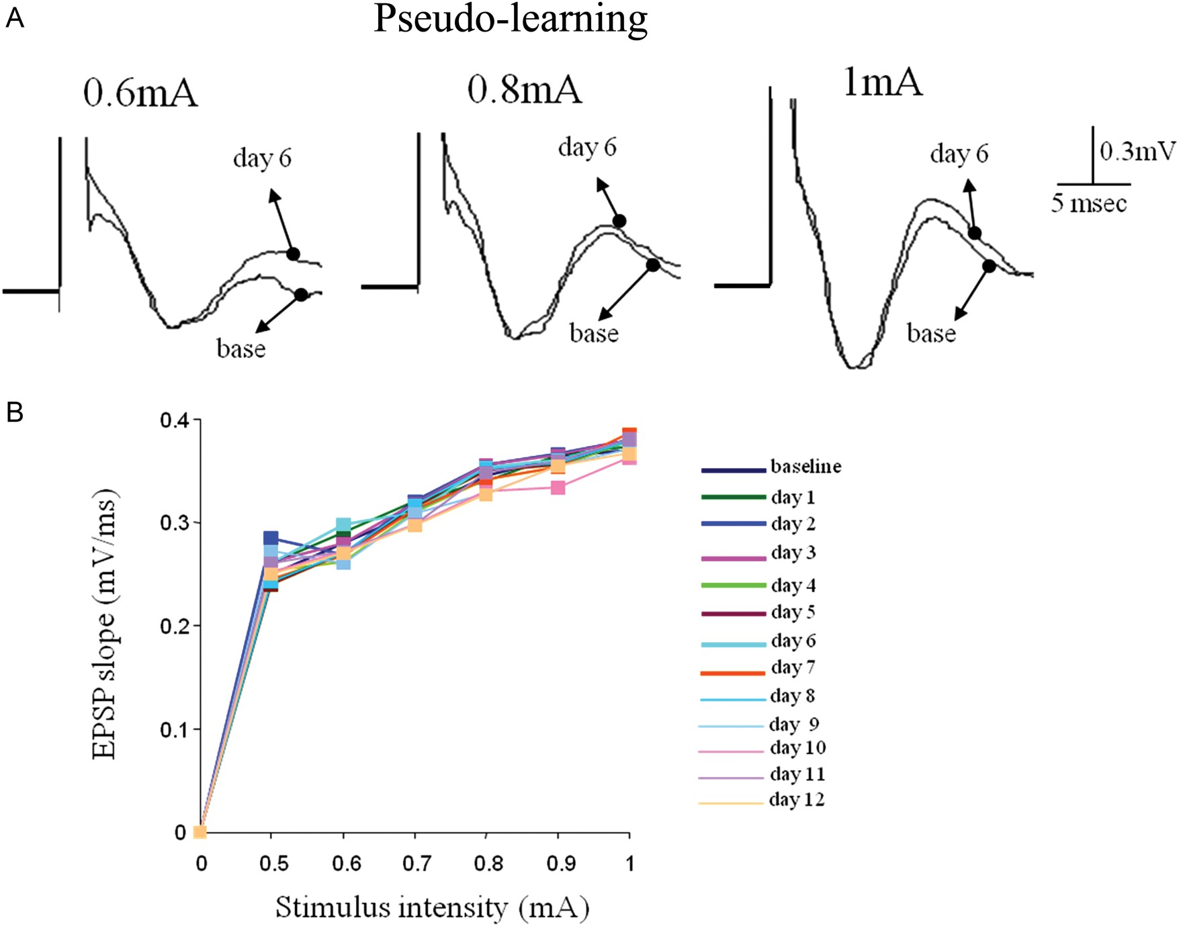
Figure 8. Synaptic connectivity in descending pathway is not modified in pseudo-trained rats. (A) Examples of responses ...
Notes:
Figure 8. Synaptic connectivity in descending pathway is not modified in pseudo-trained rats. (A) Examples of responses to OFC stimulation in the anterior PC before learning (base) and 3 days during learning. Traces for 3 stimulation intensities are shown. (B) Example of analysis of the input–output function of the synaptic response in the descending input to APC. The strength of synaptic response remained stable for all stimulus intensities throughout the training period.
Unless provided in the caption above, the following copyright applies to the content of this slide: © The Author 2013. Published by Oxford University Press. All rights reserved. For Permissions, please e-mail: journals.permissions@oup.com

Slide 9
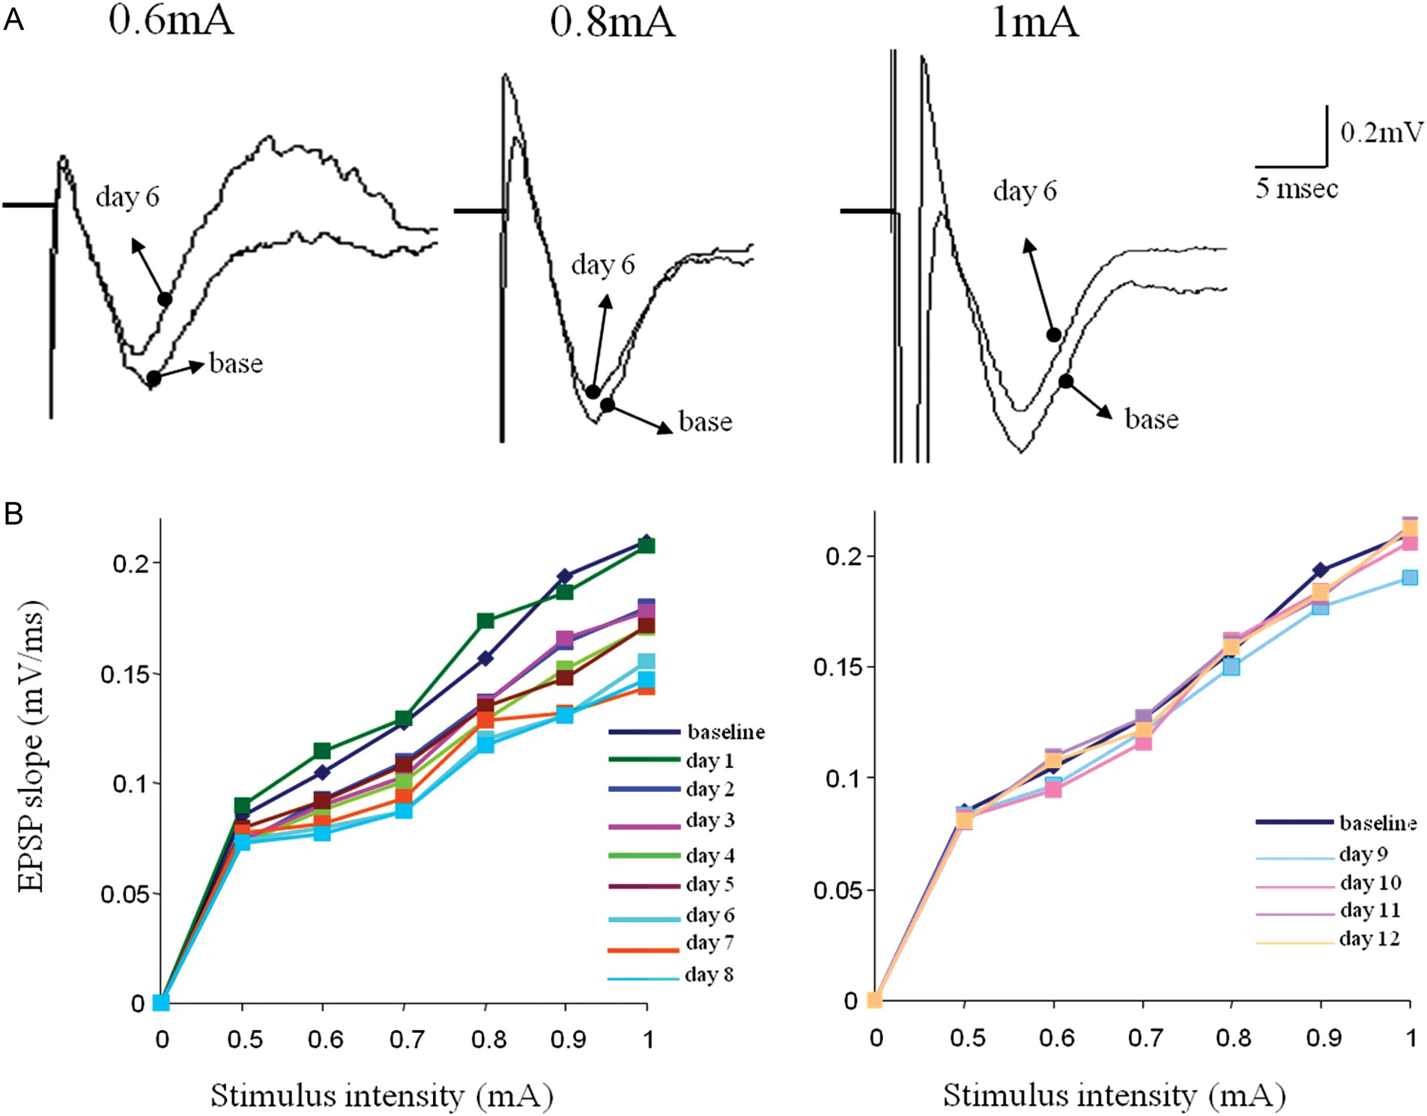
Figure 9. Transient decrease in synaptic connectivity from the orbitofrontal to the anterior PC during rule learning. ...
Notes:
Figure 9. Transient decrease in synaptic connectivity from the orbitofrontal to the anterior PC during rule learning. (A) Examples of responses to OFC stimulation in the anterior PC before learning (base) and 6 days during learning. Reduced synaptic responses are evident for all 3 shown stimulation intensities. (B) Example of analysis of the input–output function of the synaptic response in the descending input to APC on the first 8 days of training. The strength of synaptic response decreased each day for all stimulus intensities until it reaches its lowest peak on the sixth day of training, before rule learning is completed (see Fig. 7). (C) Example of analysis of the input–output function of the synaptic response in the ascending input to APC starting 9 days of training. The strength of synaptic response remains slightly decreases during the ninth day of training, and then resumes its pretraining value (base). Notably, although training on the 12th day was performed with a pair of new odors, the synaptic was not reduced again.
Unless provided in the caption above, the following copyright applies to the content of this slide: © The Author 2013. Published by Oxford University Press. All rights reserved. For Permissions, please e-mail: journals.permissions@oup.com

