Slide 1
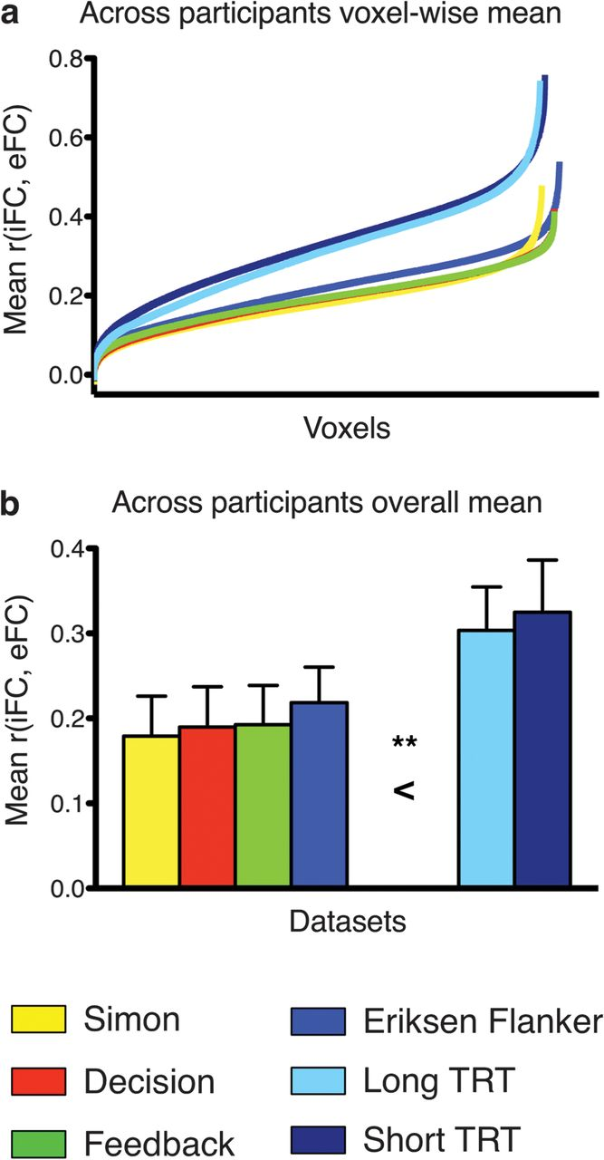
Figure 1. Distribution and overall mean of iFC-eFC correlations observed for each data set. (a) iFC-eFC correlation for ...
Notes:
Figure 1. Distribution and overall mean of iFC-eFC correlations observed for each data set. (a) iFC-eFC correlation for each voxel in each data set sorted from weakest to strongest. (b) Mean iFC-eFC correlation across voxels for each data set. A one-way analysis of variance including data set as factor indicated that the overall mean iFC-eFC correlations did not vary significantly between task data sets but were significantly lower than the mean iFC-iFC correlations obtained for the resting-state data sets (**P < 0.001). TRT: resting-state Test–ReTest data set.
Unless provided in the caption above, the following copyright applies to the content of this slide: © The Author 2012. Published by Oxford University Press. All rights reserved. For permissions, please e-mail: journals.permissions@oup.com

Slide 2
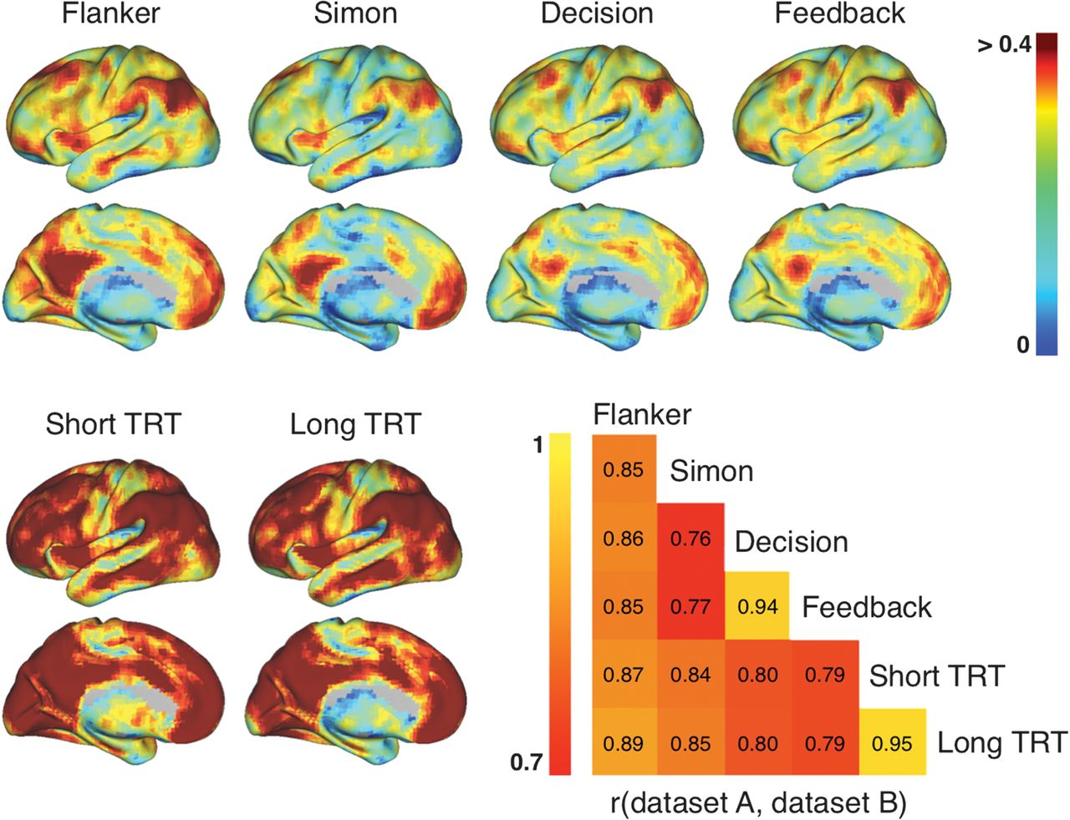
Figure 2. Surface topography showing the mean voxelwise iFC-eFC correlations obtained for each data set. All surface ...
Notes:
Figure 2. Surface topography showing the mean voxelwise iFC-eFC correlations obtained for each data set. All surface maps are scaled identically (r = 0–0.4). As is clear from the surface maps, the iFC-eFC topography generalized across data sets. Between-data set correlations ranged from 0.76 to 0.95 and are illustrated in the correlation matrix. See Figure 3 for single participant iFC and eFC maps obtained for 2 regions showing respectively weak and strong iFC-eFC correlations.
Unless provided in the caption above, the following copyright applies to the content of this slide: © The Author 2012. Published by Oxford University Press. All rights reserved. For permissions, please e-mail: journals.permissions@oup.com

Slide 3
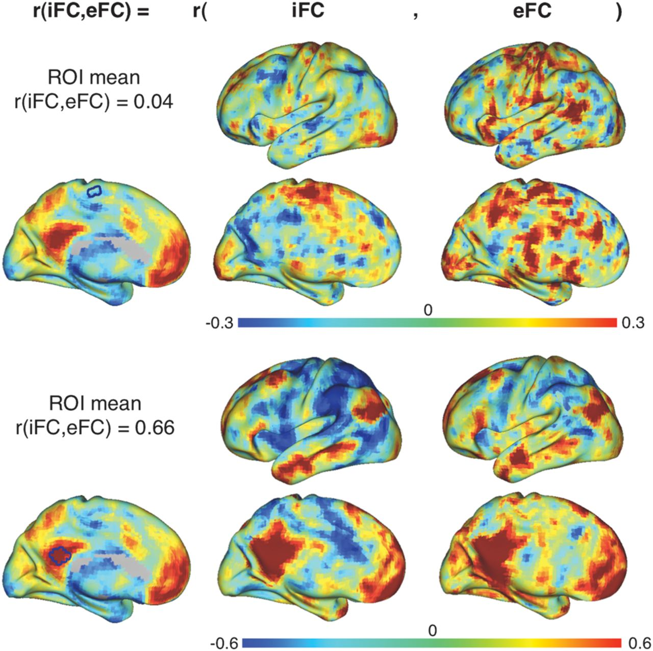
Figure 3. Illustration of weak versus strong iFC-eFC correlations in a single participant. For a participant from the ...
Notes:
Figure 3. Illustration of weak versus strong iFC-eFC correlations in a single participant. For a participant from the Simon data set, we calculated iFC and eFC maps for a seed region in supplementary motor cortex (top) and posterior cingulate cortex (bottom). These seed regions exhibited respectively weak and strong iFC-eFC correlations. Of note, for illustration purposes, we used seed regions of interest (ROIs) comprising 33 voxels for calculating the iFC and eFC maps shown in this figure, all other analyses were done for each voxel individually.
Unless provided in the caption above, the following copyright applies to the content of this slide: © The Author 2012. Published by Oxford University Press. All rights reserved. For permissions, please e-mail: journals.permissions@oup.com

Slide 4
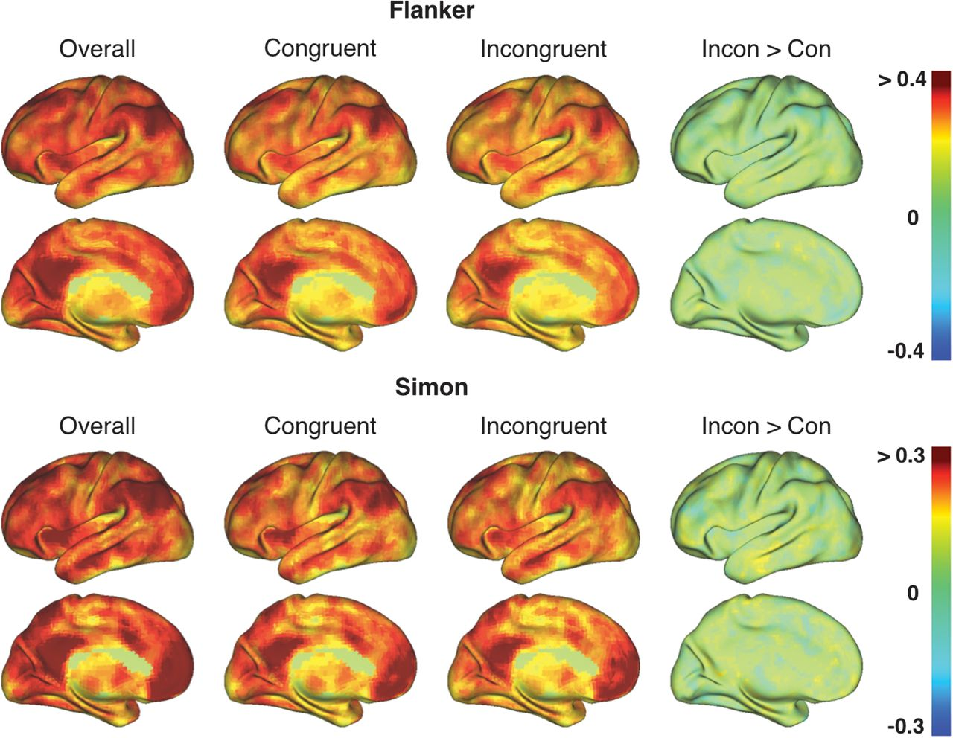
Figure 4. The topography of iFC-eFC correlations calculated using eFC based on the individual trial types (congruent or ...
Notes:
Figure 4. The topography of iFC-eFC correlations calculated using eFC based on the individual trial types (congruent or incongruent) in the Flanker and Simon task was similar to the iFC-eFC topography obtained when calculating eFC based on all trials (Overall = congruent + incongruent > baseline). However, when iFC-eFC correlations were calculated using eFC based on the “tight” incongruent > congruent contrast (Incon > Con), mean iFC-eFC correlations were low and yielded no specific spatial topography. See Supplementary Table 2 for between-data set correlations.
Unless provided in the caption above, the following copyright applies to the content of this slide: © The Author 2012. Published by Oxford University Press. All rights reserved. For permissions, please e-mail: journals.permissions@oup.com

