Slide 1
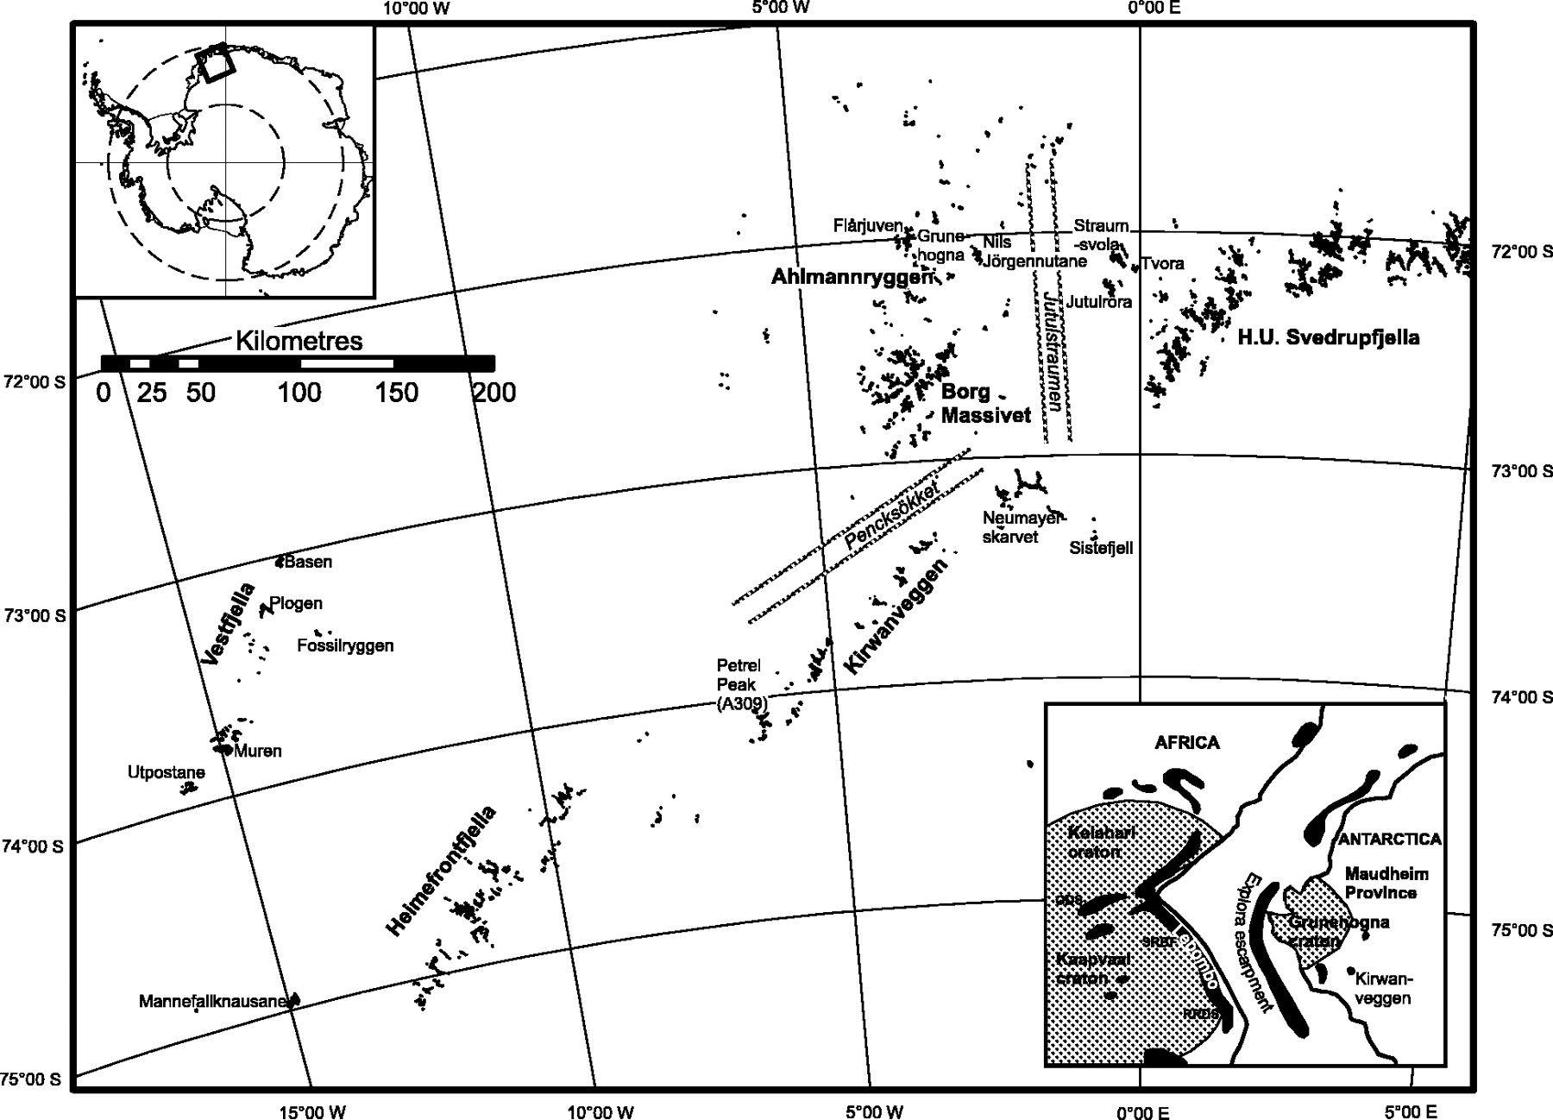
Fig. 1. Location map of rock outcrops in western Dronning Maud Land (Antarctica) from Vestfjella to H. U. ...
Notes:
Fig. 1. Location map of rock outcrops in western Dronning Maud Land (Antarctica) from Vestfjella to H. U. Svedrupfjella. The inset is a pre-break-up Gondwana reconstruction of Africa and Antarctica showing the extent of the Kaapvaal–Grunehogna craton and the outcrop of Early–Middle Jurassic age Karoo igneous rocks (after Luttinen & Furnes, 2000). ODS, Okavango dyke swarm; SRBF, Sabie River Basalt Formation; RRDS, Rooi Rand dyke swarm.
Unless provided in the caption above, the following copyright applies to the content of this slide: © The Author 2005. Published by Oxford University Press. All rights reserved. For Permissions, please email: journals.permissions@oupjournals.org

Slide 2
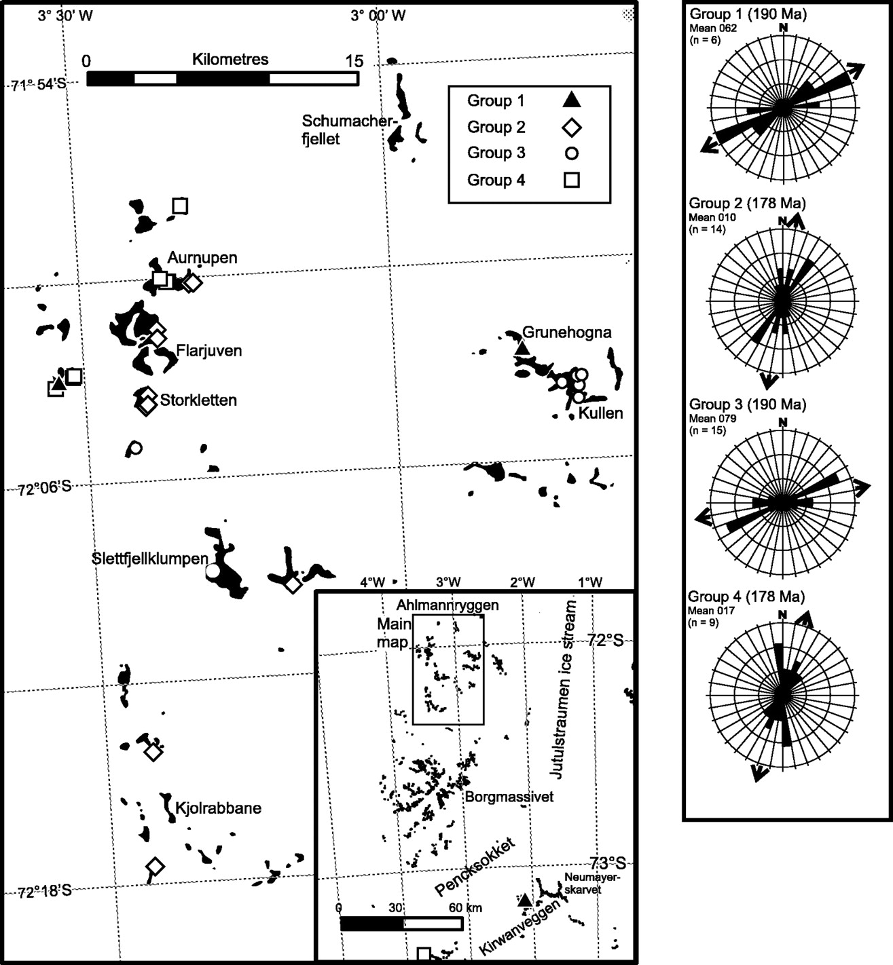
Fig. 2. Geographical distribution of the Ahlmannryggen minor intrusions by geochemical group. The four geochemical ...
Notes:
Fig. 2. Geographical distribution of the Ahlmannryggen minor intrusions by geochemical group. The four geochemical groups (1–4) are defined in the text. Two samples (Groups 1 and 4) from the Kirwanveggen are also shown in the inset map. The right-hand panel shows frequency strike plots for geochemical Groups 1–4 and their mean strike directions (arrows).
Unless provided in the caption above, the following copyright applies to the content of this slide: © The Author 2005. Published by Oxford University Press. All rights reserved. For Permissions, please email: journals.permissions@oupjournals.org

Slide 3
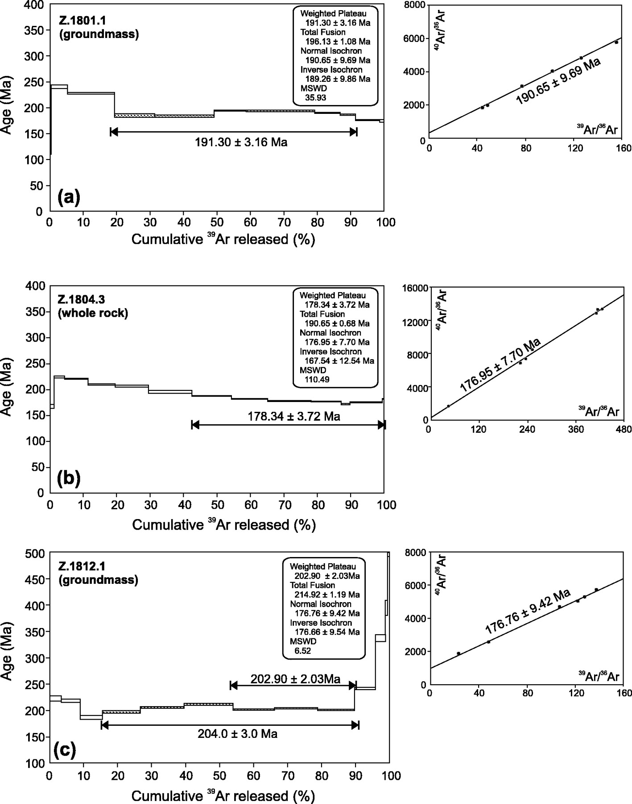
Fig. 3. ³⁹Ar release spectra for samples Z.1801.1, Z.1804.3, Z.1812.1, Z.1814.1 and Z.1816.1. All samples ...
Notes:
Fig. 3. 39Ar release spectra for samples Z.1801.1, Z.1804.3, Z.1812.1, Z.1814.1 and Z.1816.1. All samples generate plateaux but fail to satisfy the criteria of three release steps comprising 50% of the total release. Also shown are the isochron diagrams for the five samples.
Unless provided in the caption above, the following copyright applies to the content of this slide: © The Author 2005. Published by Oxford University Press. All rights reserved. For Permissions, please email: journals.permissions@oupjournals.org

Slide 4
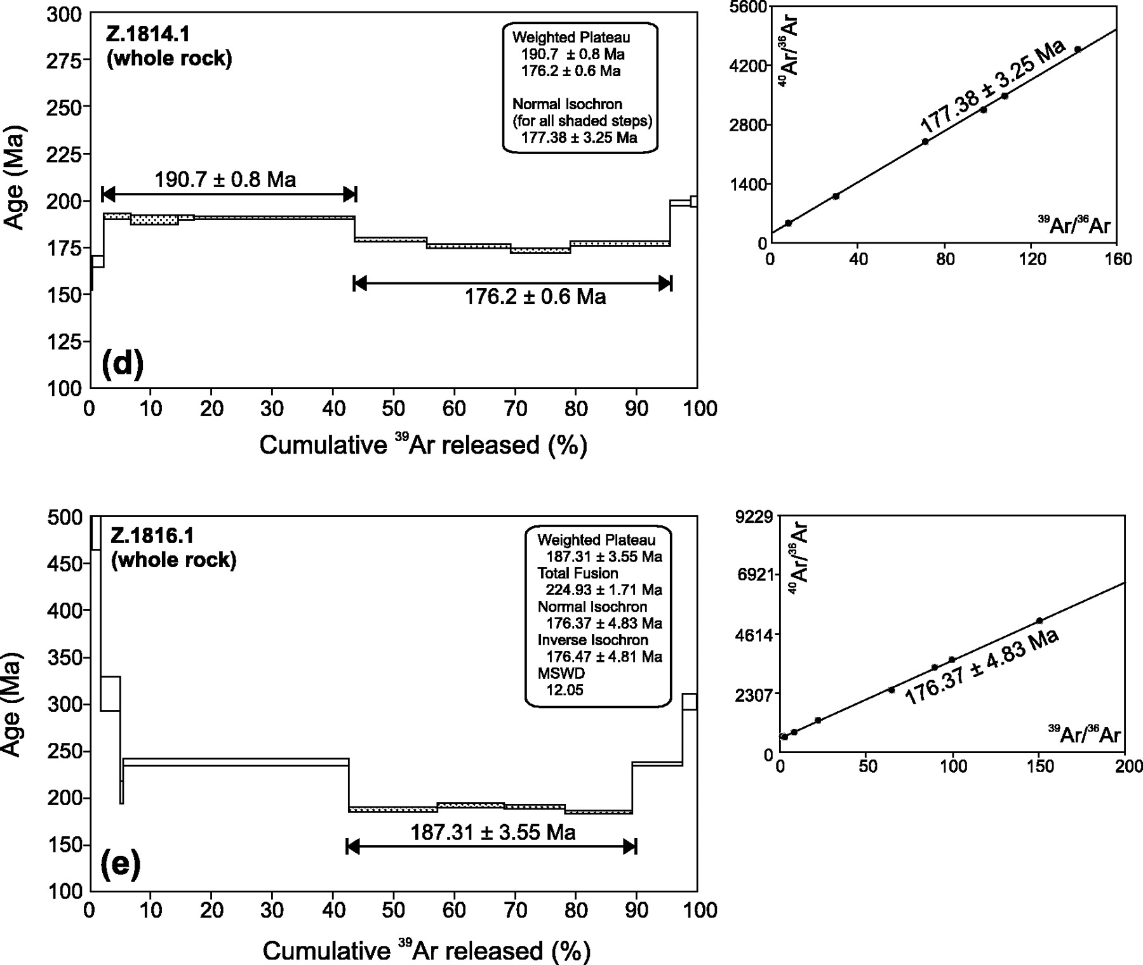
Fig. 3. ³⁹Ar release spectra for samples Z.1801.1, Z.1804.3, Z.1812.1, Z.1814.1 and Z.1816.1. All samples ...
Notes:
Fig. 3. 39Ar release spectra for samples Z.1801.1, Z.1804.3, Z.1812.1, Z.1814.1 and Z.1816.1. All samples generate plateaux but fail to satisfy the criteria of three release steps comprising 50% of the total release. Also shown are the isochron diagrams for the five samples.
Unless provided in the caption above, the following copyright applies to the content of this slide: © The Author 2005. Published by Oxford University Press. All rights reserved. For Permissions, please email: journals.permissions@oupjournals.org

Slide 5
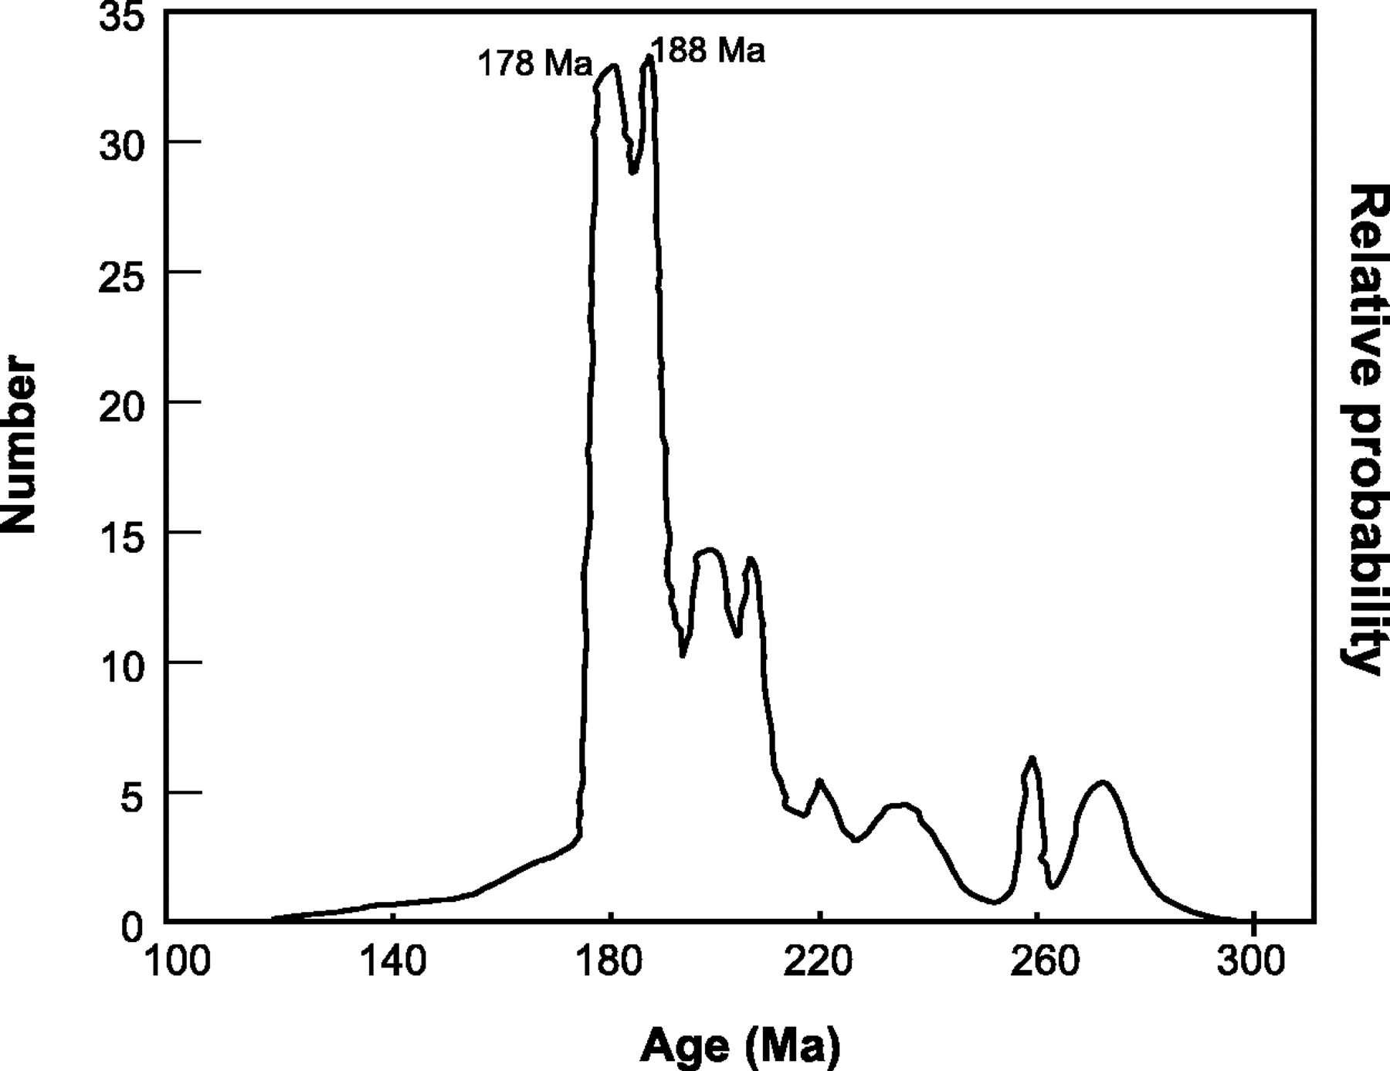
Fig. 4. Cumulative probability curve for the ages of basic minor intrusions of western Dronning Maud Land (A. Fazel, ...
Notes:
Fig. 4. Cumulative probability curve for the ages of basic minor intrusions of western Dronning Maud Land (A. Fazel, unpublished data). The main peak includes two smaller peaks at ∼178 Ma and 188 Ma, which correspond closely to the proposed intrusive episodes at 178 and 190 Ma.
Unless provided in the caption above, the following copyright applies to the content of this slide: © The Author 2005. Published by Oxford University Press. All rights reserved. For Permissions, please email: journals.permissions@oupjournals.org

Slide 6
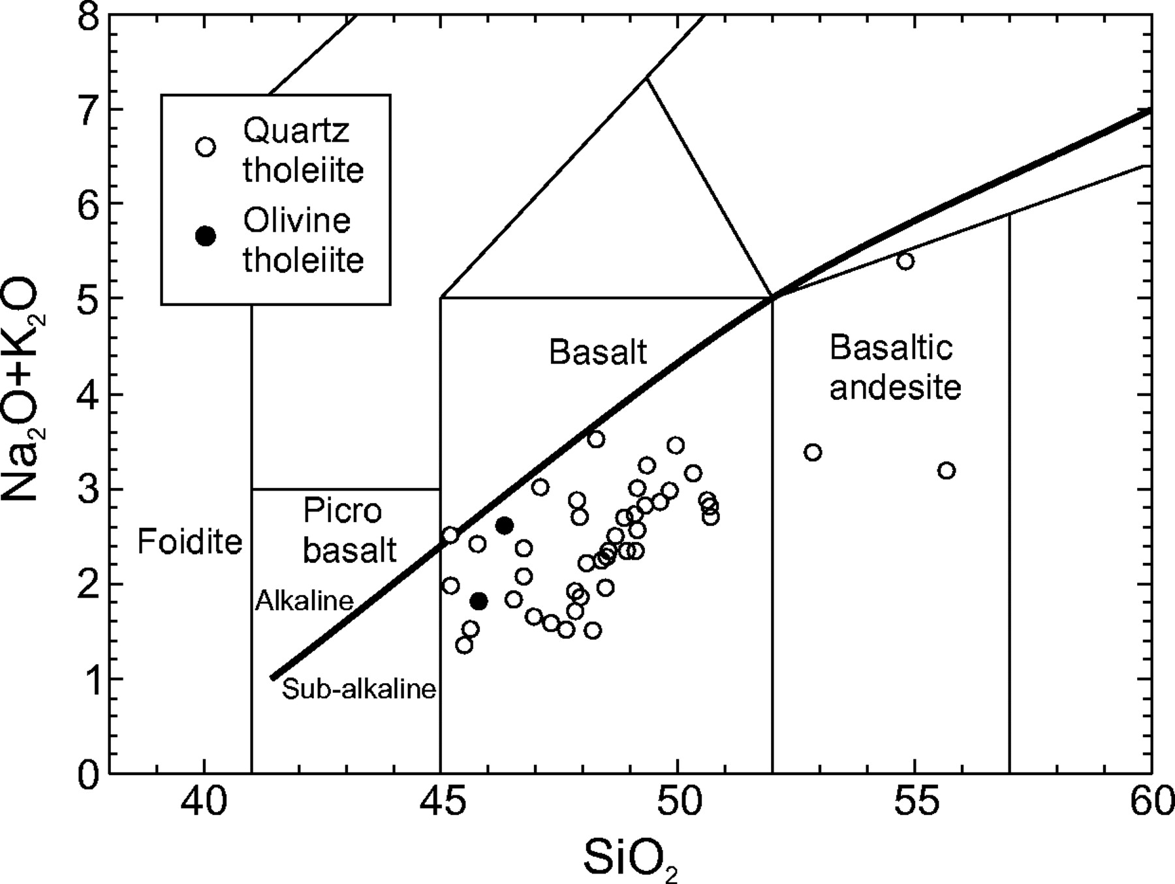
Fig. 5. Total alkali vs SiO₂ diagram (wt %) for the minor intrusions from the Ahlmannryggen. The samples ...
Notes:
Fig. 5. Total alkali vs SiO2 diagram (wt %) for the minor intrusions from the Ahlmannryggen. The samples are classified as quartz or olivine tholeiites based on their CIPW norms (see Table 2 for details). Classification boundaries are from Le Bas et al. (1986).
Unless provided in the caption above, the following copyright applies to the content of this slide: © The Author 2005. Published by Oxford University Press. All rights reserved. For Permissions, please email: journals.permissions@oupjournals.org

Slide 7
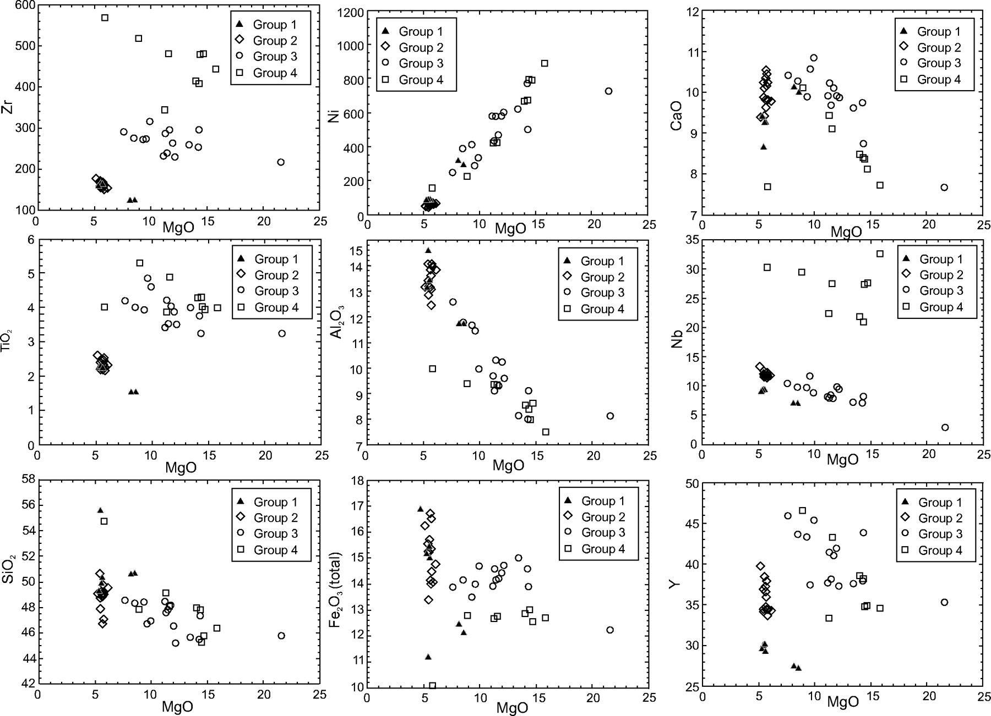
Fig. 6. Variations in Zr, TiO₂, SiO₂, Ni, Al₂O₃, ...
Notes:
Fig. 6. Variations in Zr, TiO2, SiO2, Ni, Al2O3, Fe2O3, CaO, Nb and Y vs MgO. The four geochemical groups are defined as discussed in the text.
Unless provided in the caption above, the following copyright applies to the content of this slide: © The Author 2005. Published by Oxford University Press. All rights reserved. For Permissions, please email: journals.permissions@oupjournals.org

Slide 8
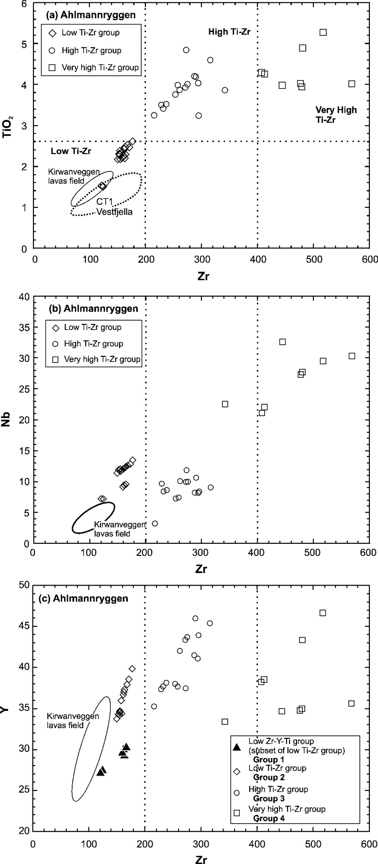
Fig. 7. Variations in (a) Zr vs TiO₂, (b) Zr vs Nb and (c) Zr vs Y for Early–Middle Jurassic basic dykes ...
Notes:
Fig. 7. Variations in (a) Zr vs TiO2, (b) Zr vs Nb and (c) Zr vs Y for Early–Middle Jurassic basic dykes from the Ahlmannryggen.
Unless provided in the caption above, the following copyright applies to the content of this slide: © The Author 2005. Published by Oxford University Press. All rights reserved. For Permissions, please email: journals.permissions@oupjournals.org

Slide 9
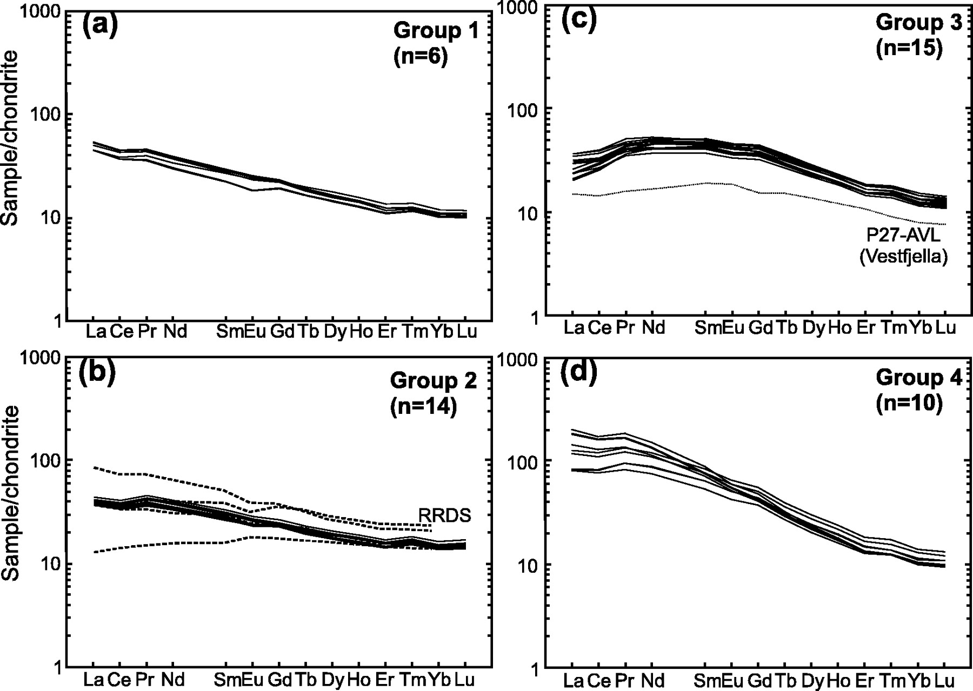
Fig. 8. Chondrite-normalized REE diagrams for (a) Group 1, (b) Group 2, (c) Group 3 and (d) Group 4 of the ...
Notes:
Fig. 8. Chondrite-normalized REE diagrams for (a) Group 1, (b) Group 2, (c) Group 3 and (d) Group 4 of the Ahlmannryggen dykes. Normalizing values are taken from Nakamura (1974). Data for Rooi Rand dykes (RRDS; dashed lines) are taken from Duncan et al. (1990) and P27-AVL (CT2) from Vestfjella from Luttinen & Furnes (2000).
Unless provided in the caption above, the following copyright applies to the content of this slide: © The Author 2005. Published by Oxford University Press. All rights reserved. For Permissions, please email: journals.permissions@oupjournals.org

Slide 10
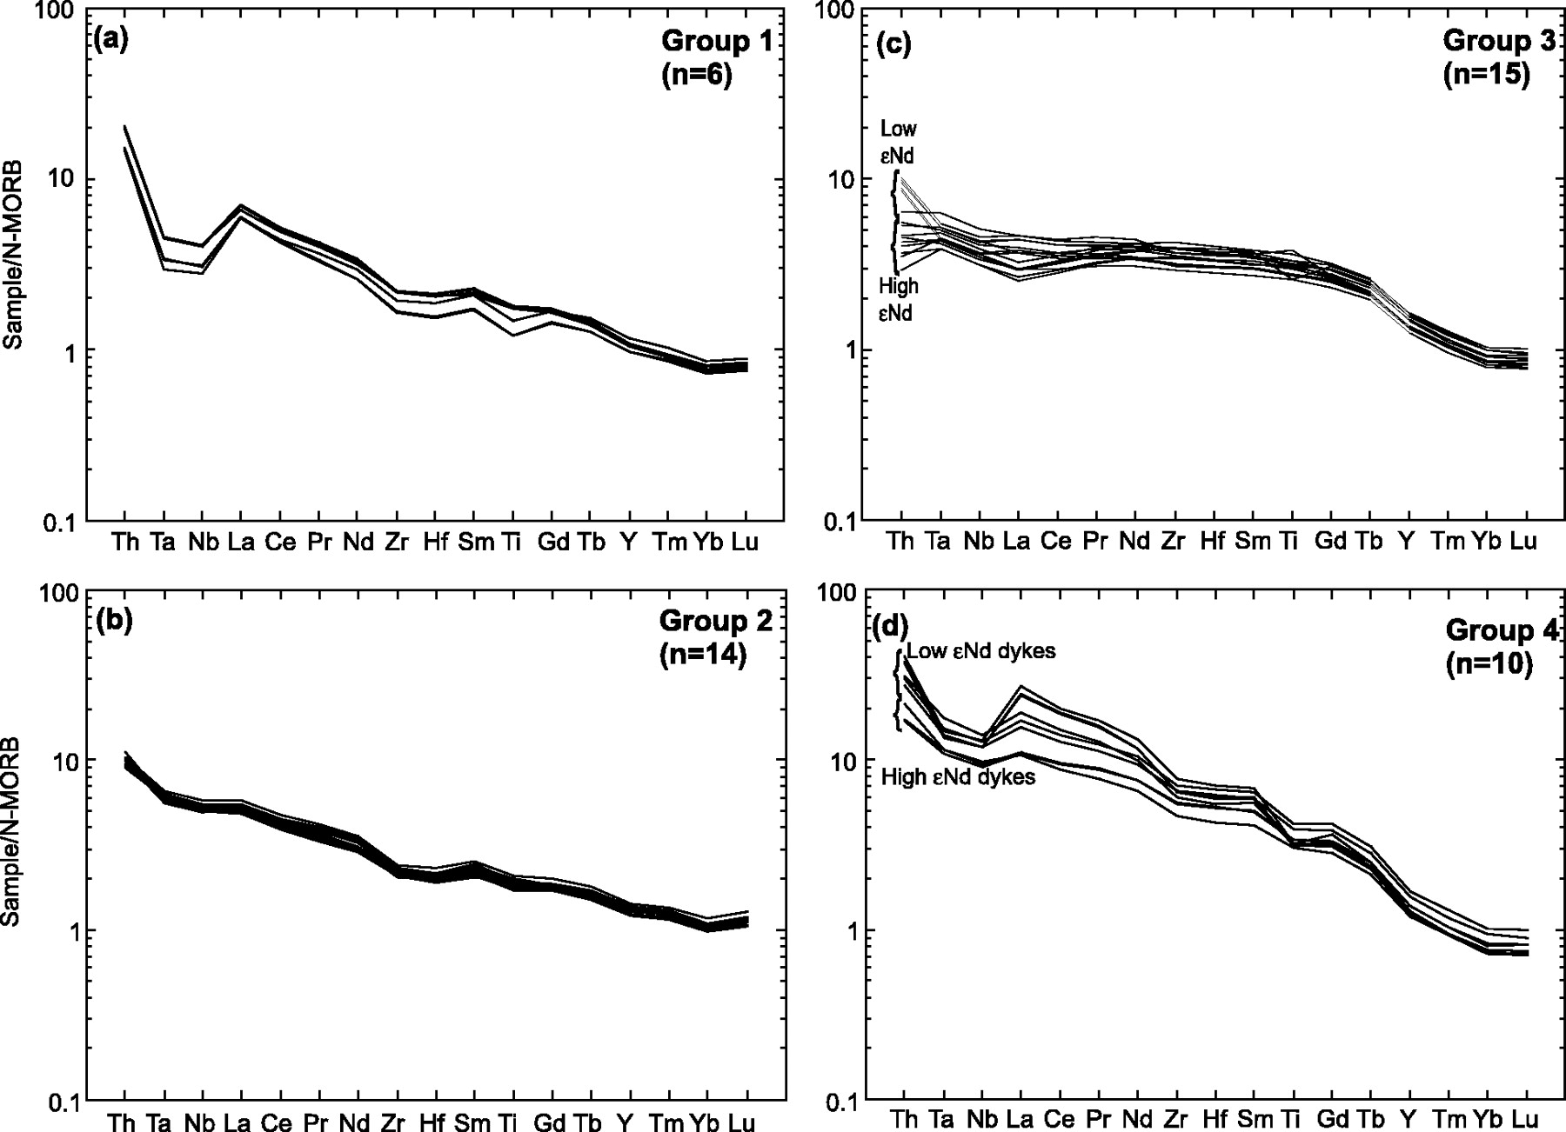
Fig. 9. N-MORB-normalized incompatible element diagrams for (a) Group 1, (b) Group 2, (c) Group 3 and (d) Group 4 of ...
Notes:
Fig. 9. N-MORB-normalized incompatible element diagrams for (a) Group 1, (b) Group 2, (c) Group 3 and (d) Group 4 of the Ahlmannryggen. Normalizing values are from Sun & McDonough (1989).
Unless provided in the caption above, the following copyright applies to the content of this slide: © The Author 2005. Published by Oxford University Press. All rights reserved. For Permissions, please email: journals.permissions@oupjournals.org

Slide 11
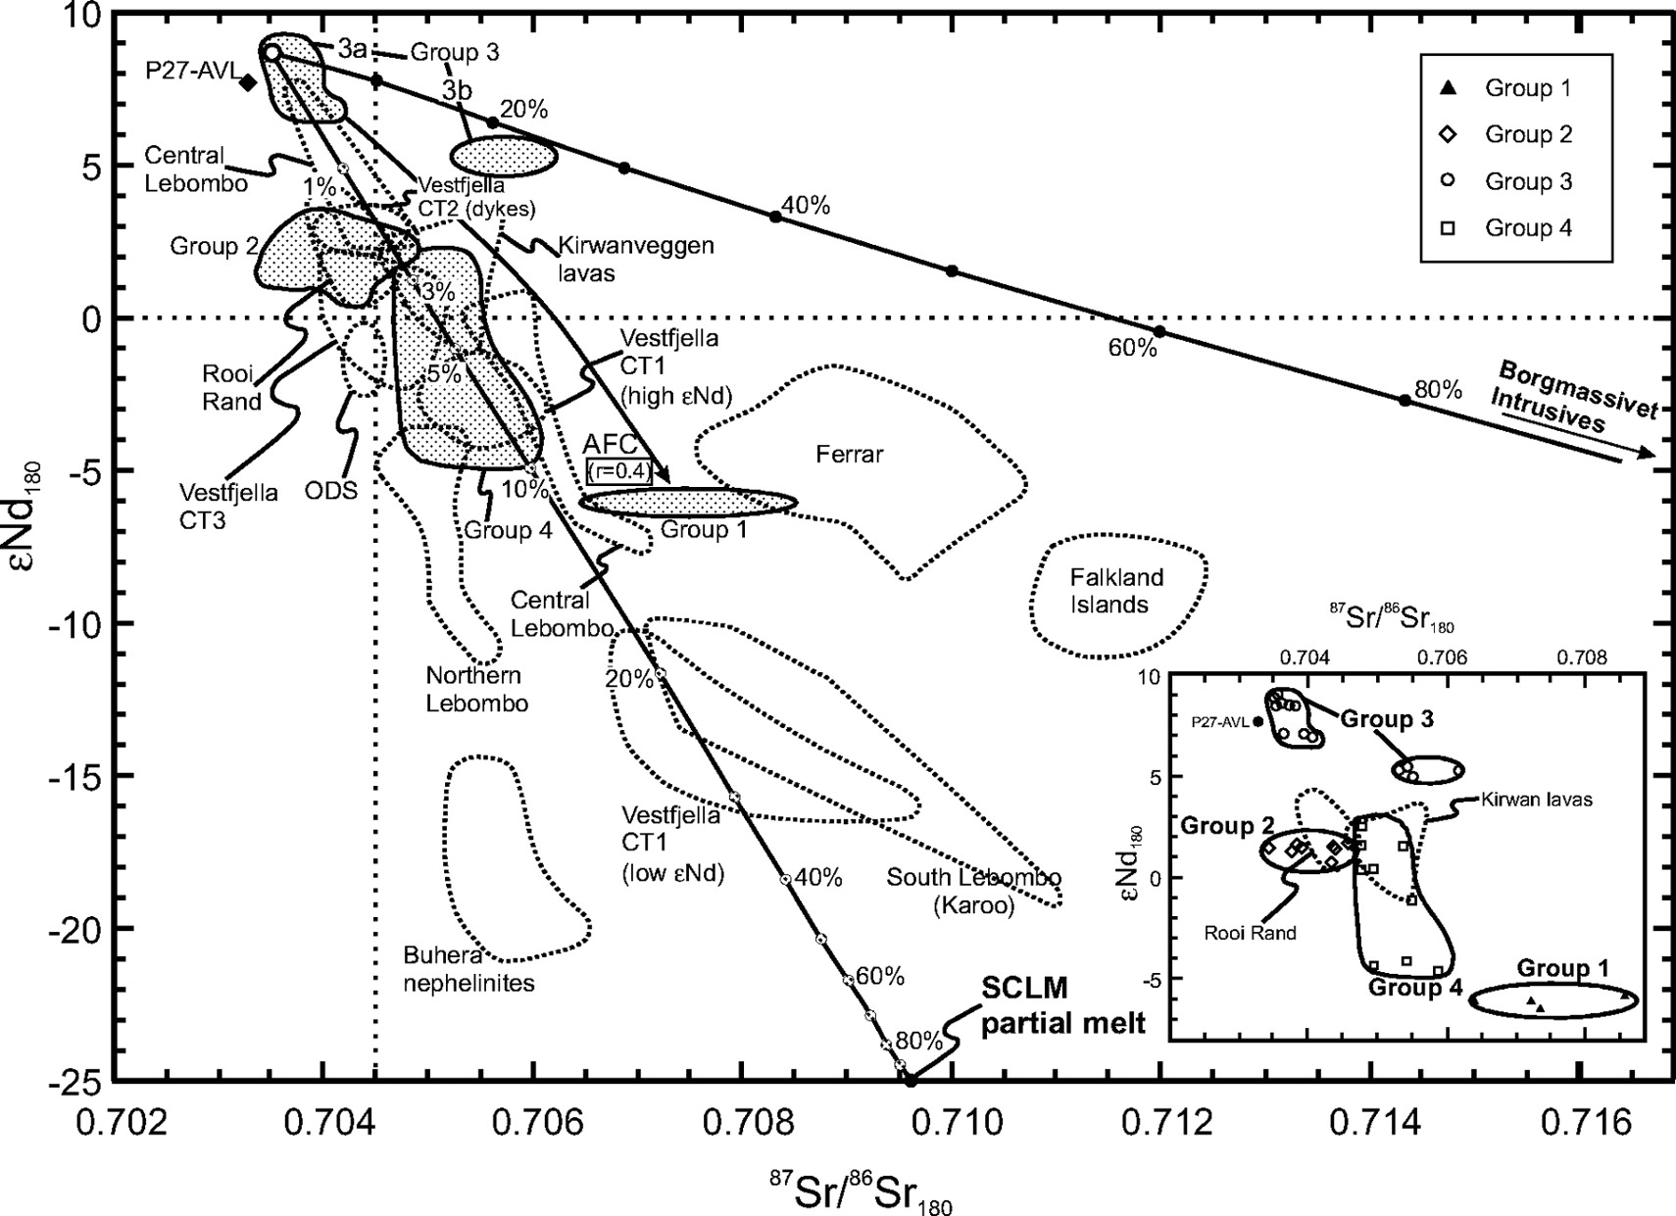
Fig. 10. Initial εNd and ⁸⁷Sr/⁸⁶Sr (T = 180 Ma for all rocks shown) for Groups 1–4 from the ...
Notes:
Fig. 10. Initial εNd and 87Sr/86Sr (T = 180 Ma for all rocks shown) for Groups 1–4 from the Ahlmannryggen; the four main groups are highlighted by continuous lines. Other rocks from the Karoo and Ferrar magmatic provinces are highlighted by dotted lines. Data sources: Duncan et al. (1990); Harris et al. (1990); Hergt et al. (1991); Sweeney et al. (1994); Fleming et al. (1995); Harmer et al. (1998); Mitchell et al. (1999); Elburg & Goldberg (2000); Luttinen & Furnes (2000). All data are age corrected to 180 Ma. ODS, Okavango dyke swarm, P27-AVL [most depleted composition of Luttinen & Furnes (2000)]. Binary bulk mixing curves are indicated between Group 3 and Borgmassivet Intrusions, and Group 3 (Z.1816.2) and SCLM partial melt. Group 3: 87Sr/86Sr = 0·7035, Sr 300 ppm, εNd = 8·5, Nd 25 ppm; lamproite (SCLM partial melt): 87Sr/86Sr = 0·7096, Sr 1830 ppm, εNd = −25, Nd 150 ppm. Borgmassivet Intrusions: 87Sr/86Sr = 0·7240, Sr 130 ppm, εNd = −11, Nd 13 ppm. AFC model curve: Archaean crust contaminant (Luttinen & Furnes, 2000): 87Sr/86Sr = 0·710, Sr 500 ppm, εNd = −52, Nd 11 ppm, r value = 0·4.
Unless provided in the caption above, the following copyright applies to the content of this slide: © The Author 2005. Published by Oxford University Press. All rights reserved. For Permissions, please email: journals.permissions@oupjournals.org

Slide 12
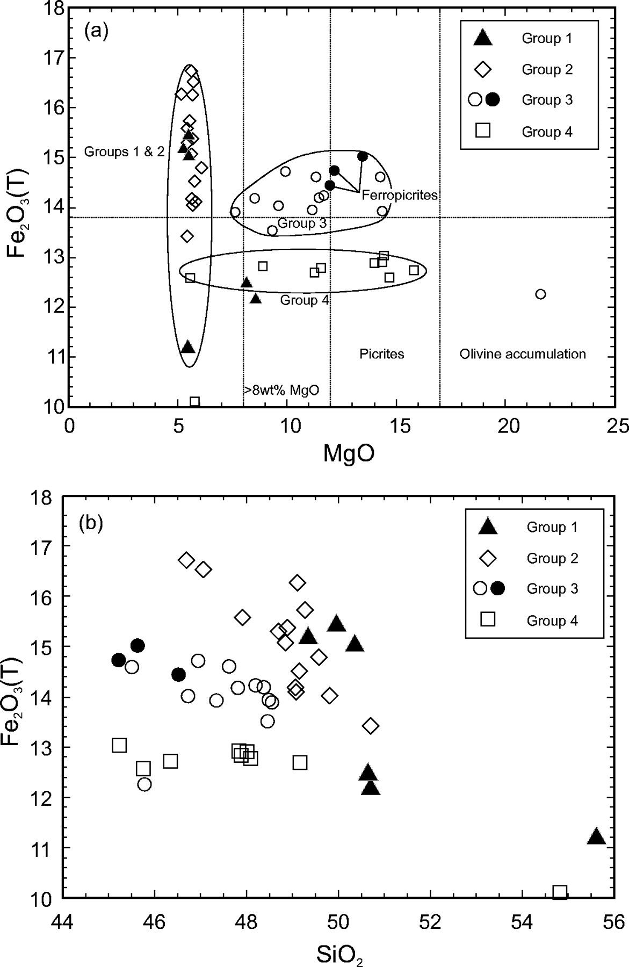
Fig. 11. Variation in Fe₂O₃(T) vs (a) MgO and (b) SiO₂ for Groups 1–4 from the ...
Notes:
Fig. 11. Variation in Fe2O3(T) vs (a) MgO and (b) SiO2 for Groups 1–4 from the Ahlmannryggen. (a) highlights the fields for ferropicrites (•) [MgO >12 wt % and Fe2O3 >13·8 wt % (>12 wt % FeO); Gibson et al., 2000] and picrites (MgO >12 wt %; Le Bas, 2000); (b) shows a general trend of decreasing Fe2O3 with increasing SiO2 for all four dyke groups.
Unless provided in the caption above, the following copyright applies to the content of this slide: © The Author 2005. Published by Oxford University Press. All rights reserved. For Permissions, please email: journals.permissions@oupjournals.org

Slide 13
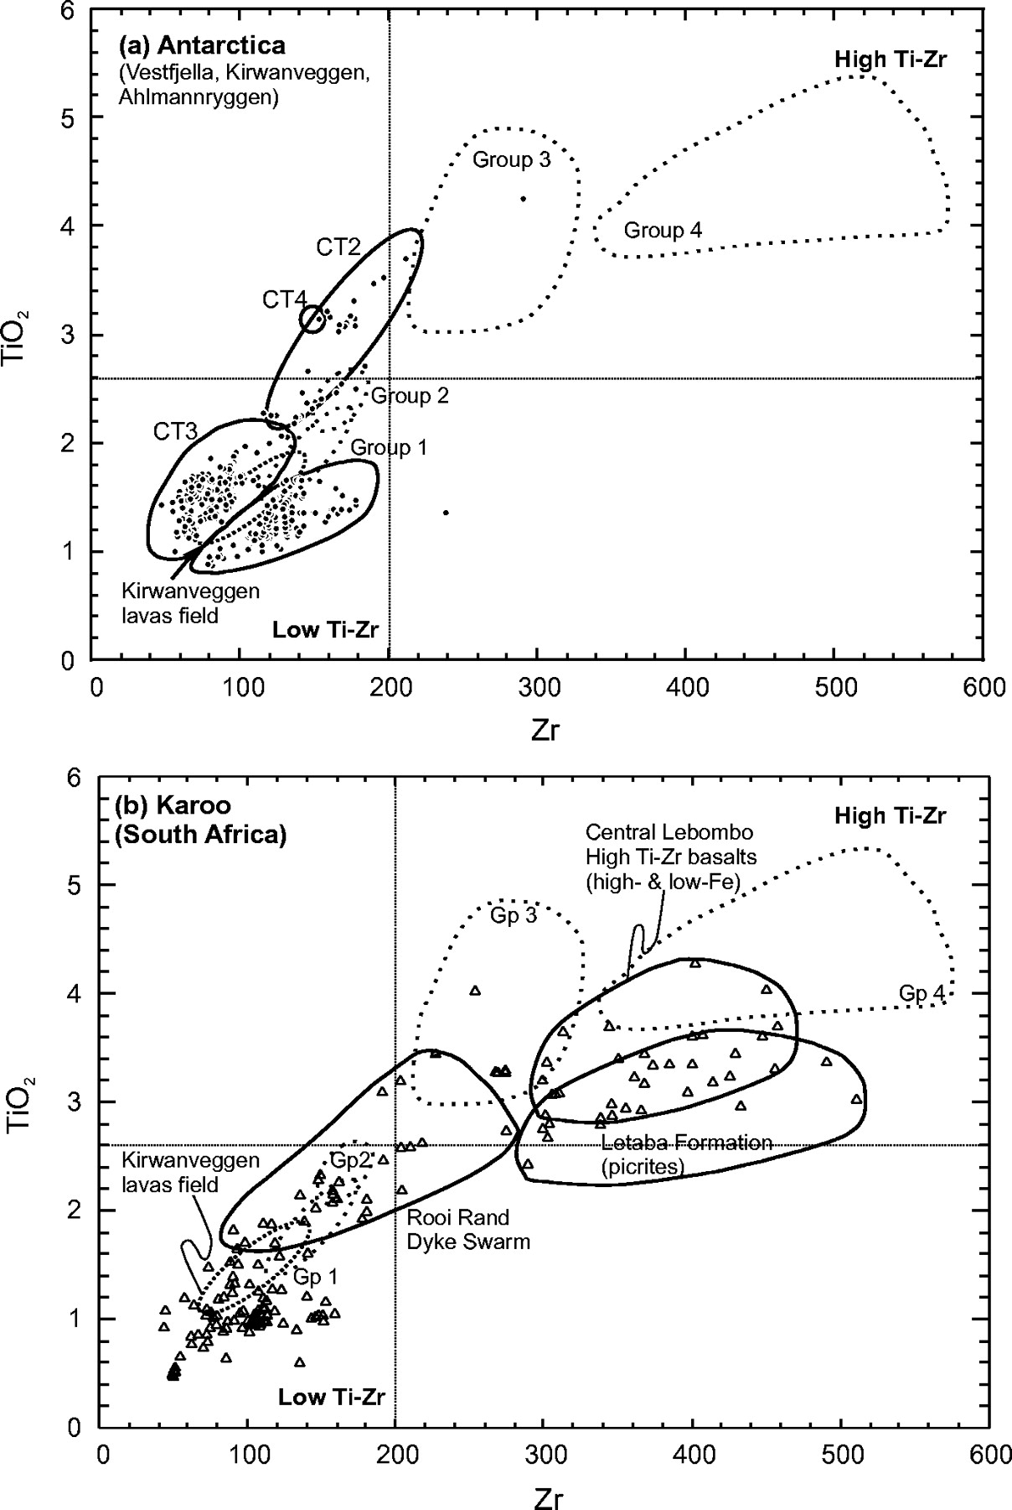
Fig. 12. Variation in TiO₂ vs Zr for Early Jurassic basic igneous rocks from (a) Antarctica: Vestfjella and ...
Notes:
Fig. 12. Variation in TiO2 vs Zr for Early Jurassic basic igneous rocks from (a) Antarctica: Vestfjella and Kirwanveggen (Furnes et al., 1982, 1987; Harris et al., 1990; Luttinen et al., 1998; Luttinen & Furnes, 2000); (b) Karoo, South Africa (Sweeney et al., 1994; Mitchell et al., 1996, 1999; Reid et al., 1997; Harmer et al., 1998; Marsh & Mndaweni, 1998; De Bruiyn et al., 2000; Elburg & Goldberg, 2000). Also shown are the fields for Groups 1–4 from the Ahlmannryggen (this study).
Unless provided in the caption above, the following copyright applies to the content of this slide: © The Author 2005. Published by Oxford University Press. All rights reserved. For Permissions, please email: journals.permissions@oupjournals.org

Slide 14
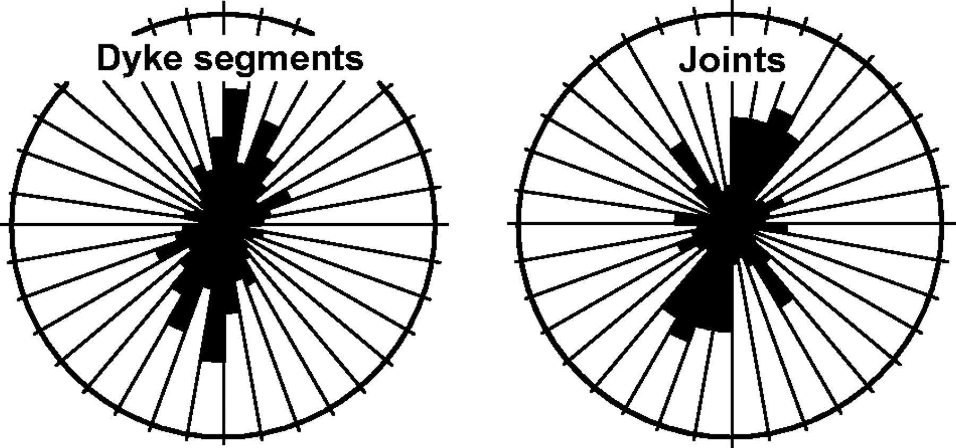
Fig. 13. Frequency orientation plots for total dyke segments (left) and joints (right) within the Ahlmannryggen study ...
Notes:
Fig. 13. Frequency orientation plots for total dyke segments (left) and joints (right) within the Ahlmannryggen study area. The dominant trend of the dyke segments is parallel to regional joint orientation.
Unless provided in the caption above, the following copyright applies to the content of this slide: © The Author 2005. Published by Oxford University Press. All rights reserved. For Permissions, please email: journals.permissions@oupjournals.org

Slide 15
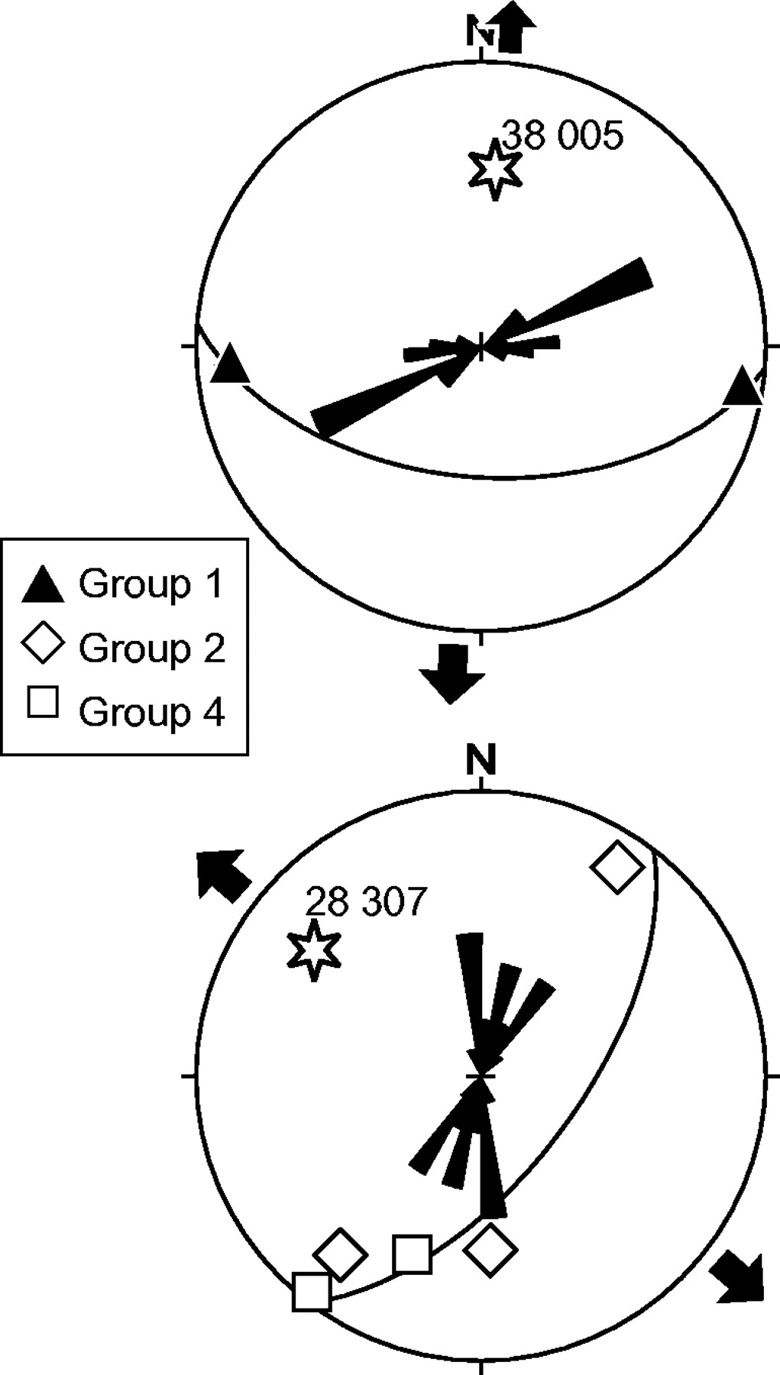
Fig. 14. Stereograms showing the poles to constructed dilation planes for dykes representing Groups 1, 2 and 4, using ...
Notes:
Fig. 14. Stereograms showing the poles to constructed dilation planes for dykes representing Groups 1, 2 and 4, using the method of Bussell (1989). Star represents the pole to the best-fit girdle to the poles of dilation planes, and an approximation for the dilation vector of the dyke populations. The frequency orientation plots at the centre of the stereograms represent Mesozoic dykes of the relevant geochemical groups that make up the dyke populations related to two distinct dilation directions (see text for details).
Unless provided in the caption above, the following copyright applies to the content of this slide: © The Author 2005. Published by Oxford University Press. All rights reserved. For Permissions, please email: journals.permissions@oupjournals.org

Slide 16
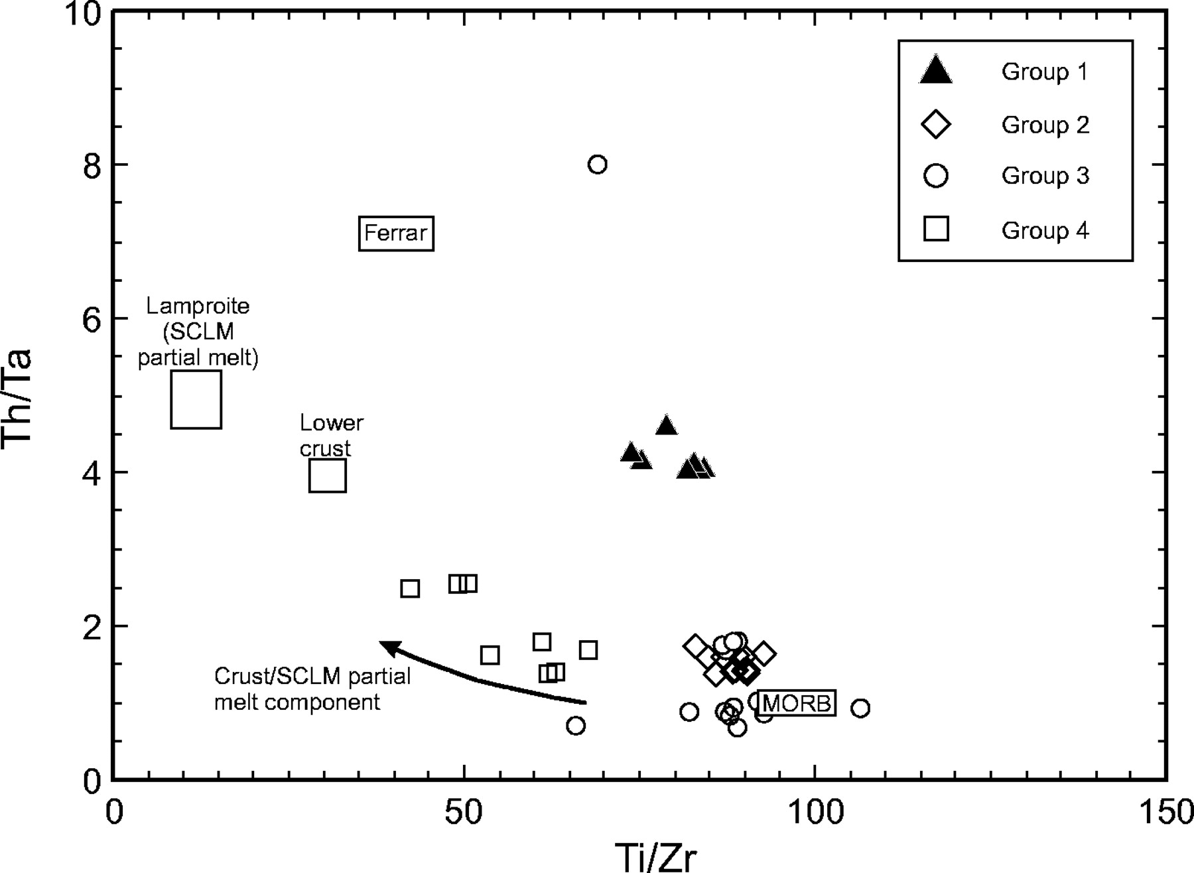
Fig. 15. Variation in Th/Ta vs Ti/Zr for Ahlmannryggen minor intrusions, Groups 1–4. The field for MORB is from the ...
Notes:
Fig. 15. Variation in Th/Ta vs Ti/Zr for Ahlmannryggen minor intrusions, Groups 1–4. The field for MORB is from the GERM website (http://www.earthref.org/GERM); average lamproite is from Rock (1991); lower crust is from Rudnick & Fountain (1995); the Ferrar province is from Fleming et al. (1995).
Unless provided in the caption above, the following copyright applies to the content of this slide: © The Author 2005. Published by Oxford University Press. All rights reserved. For Permissions, please email: journals.permissions@oupjournals.org

Slide 17
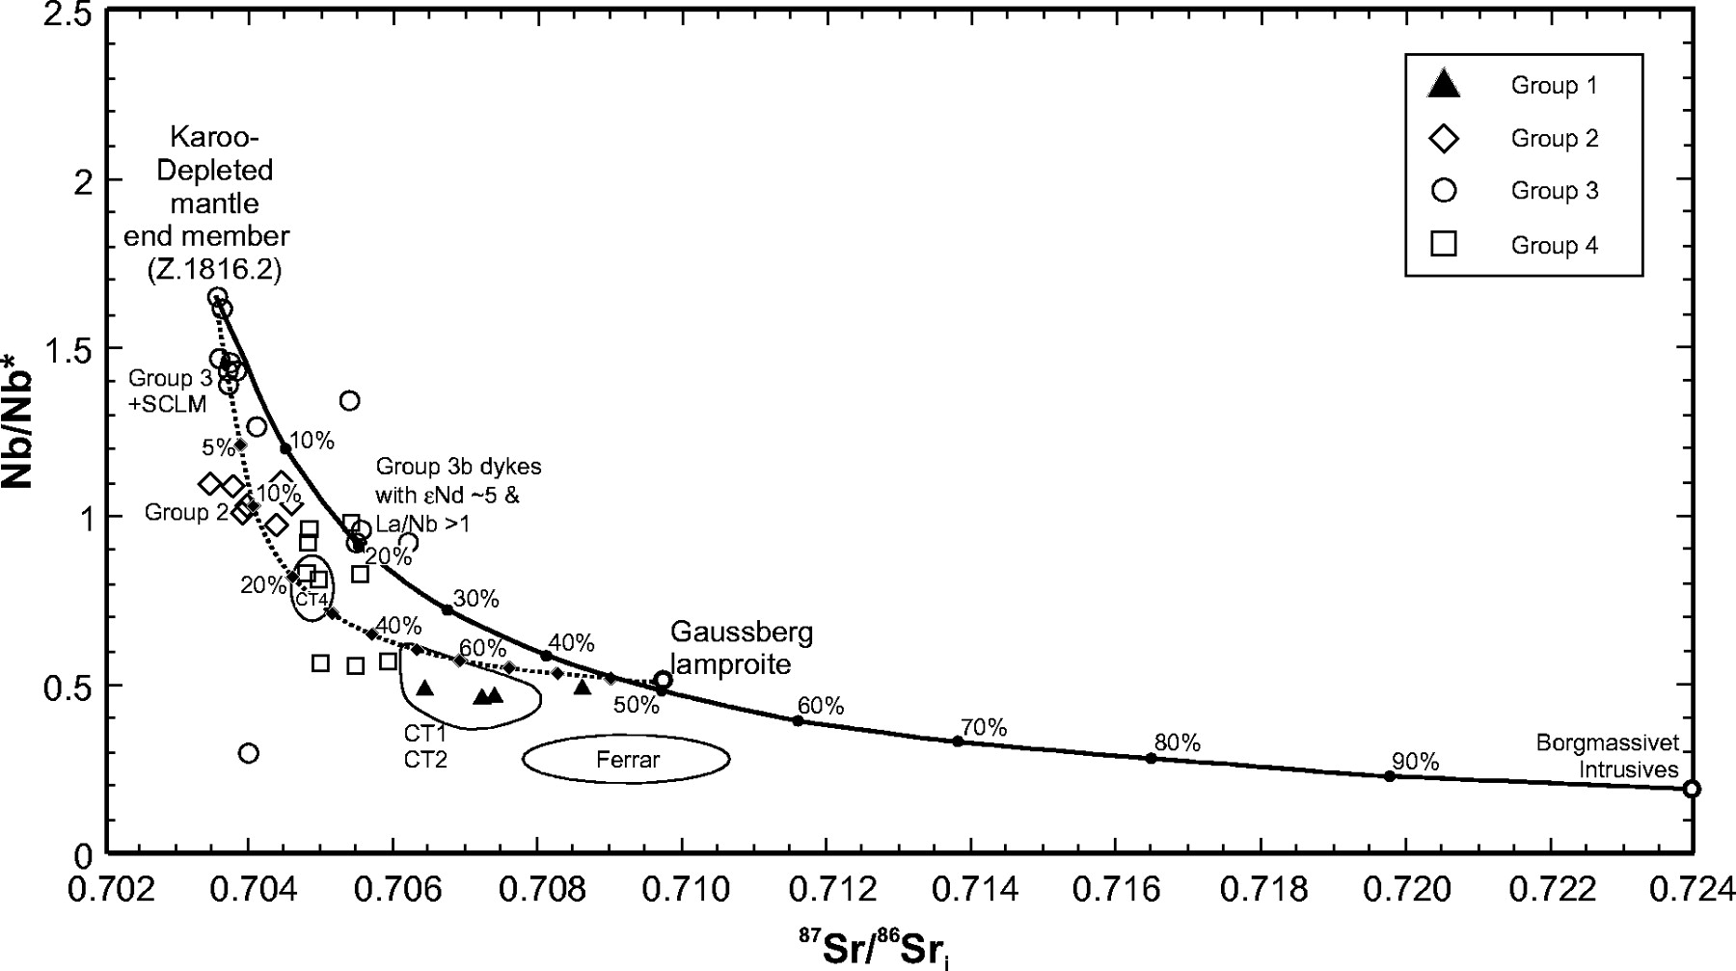
Fig. 16. Magnitude of the Nb anomaly, measured as Nb/Nb* [=Nb_{N}/√(Th_{N} × ...
Notes:
Fig. 16. Magnitude of the Nb anomaly, measured as Nb/Nb* [=NbN/√(ThN × LaN); normalized to primitive mantle] vs 87Sr/86Sr. The size of the Nb anomaly is used as a proxy for the extent of crustal contamination in mantle-derived magmas. Binary mixing curves are shown between a depleted end-member basalt (Z.1816.2; Group 3) and upper continental crust (Borgmassivet Intrusives) and SCLM partial melt (lamproite). The depleted end-member is a Group 3 basalt from the Ahlmannryggen; 87Sr/86Sr = 0·7035, Sr 300 ppm, Nb/Nb* = 1·65. The local upper crust is represented by Borgmassivet Intrusions: 87Sr/86Sr = 0·7240, Sr 130 ppm, Nb/Nb* = 0·19; the enriched subcontinental lithospheric mantle proxy partial melt is Gaussberg lamproite (Bergman, 1987): 87Sr/86Sr = 0·7096, Sr 1830 ppm, Nb/Nb* = 0·5. Fields for CT1, CT2 and CT4 lavas from Vestfjella are from Luttinen et al. (1998). Field of average Ferrar dolerite is taken from Molzahn et al. (1996).
Unless provided in the caption above, the following copyright applies to the content of this slide: © The Author 2005. Published by Oxford University Press. All rights reserved. For Permissions, please email: journals.permissions@oupjournals.org

Slide 18
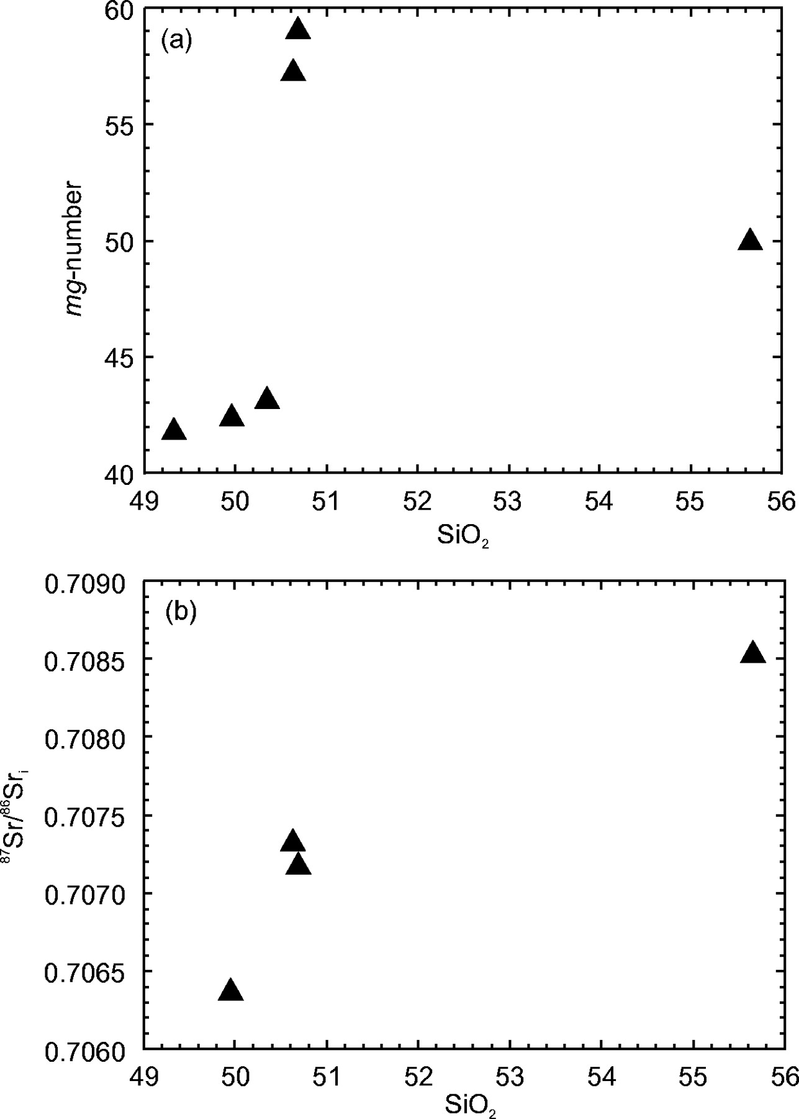
Fig. 17. Variations in SiO₂ vs (a) mg-number and (b) ⁸⁷Sr/⁸⁶Sr_{i} for Group ...
Notes:
Fig. 17. Variations in SiO2 vs (a) mg-number and (b) 87Sr/86Sri for Group 1 dykes from the Ahlmannryggen. The trend is suggestive, in part, of AFC proceeses.
Unless provided in the caption above, the following copyright applies to the content of this slide: © The Author 2005. Published by Oxford University Press. All rights reserved. For Permissions, please email: journals.permissions@oupjournals.org

Slide 19
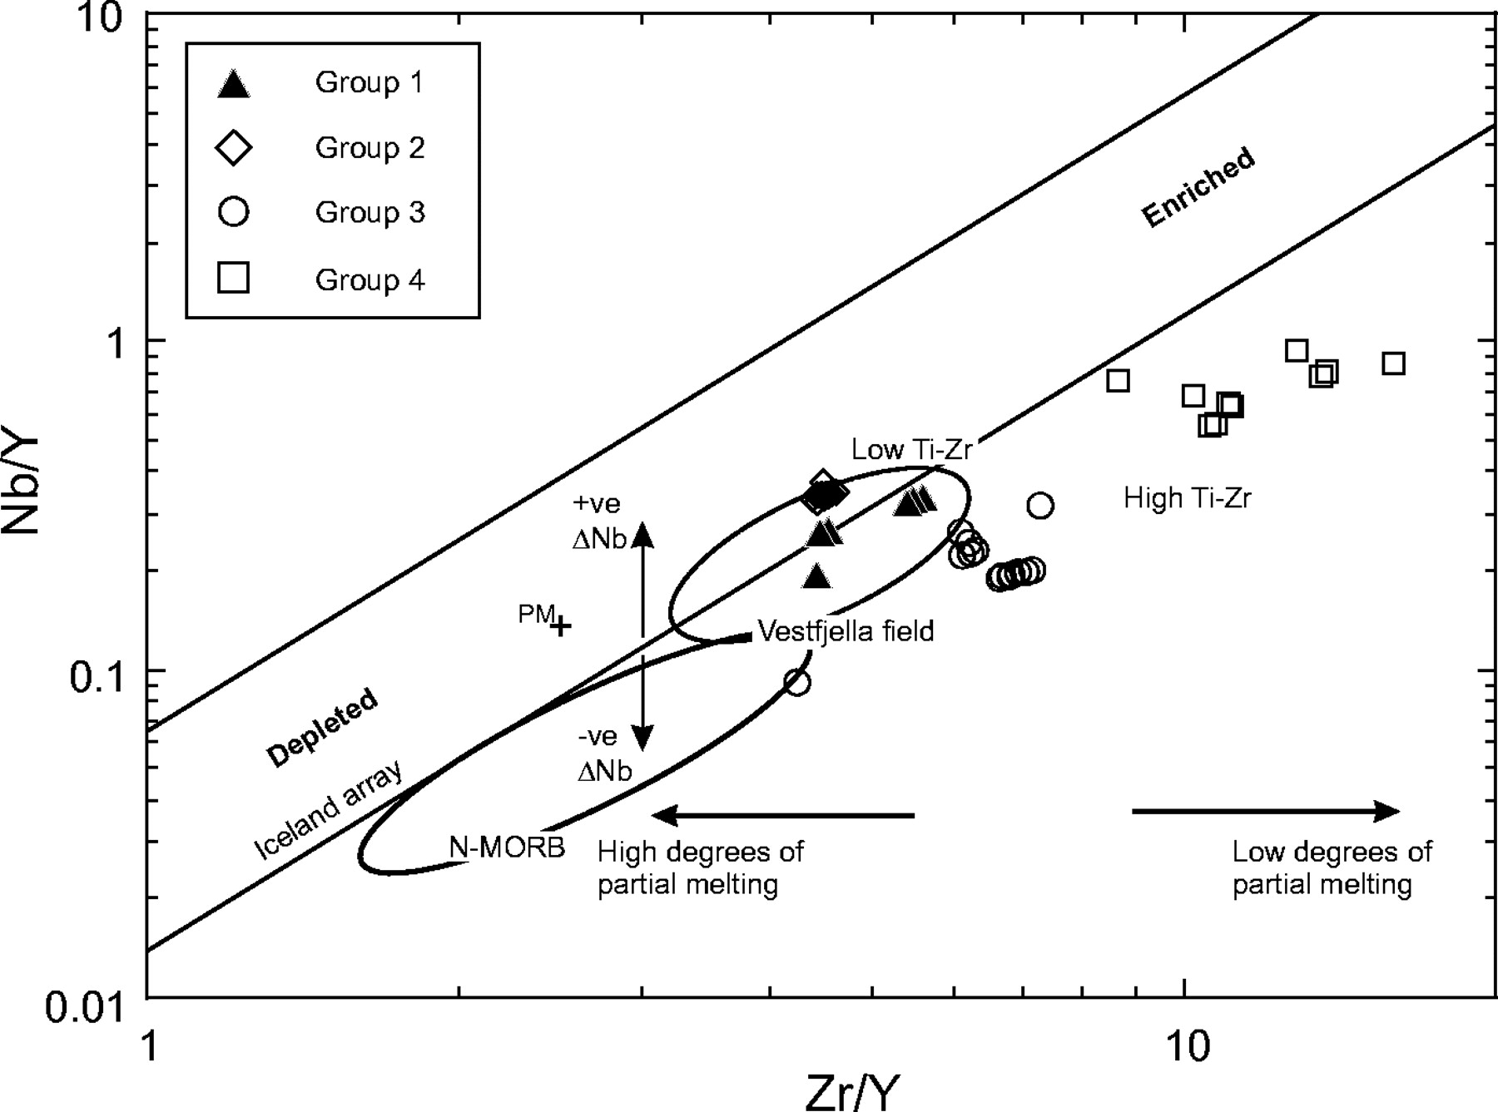
Fig. 18. Nb/Y vs Zr/Y for Groups 1–4 from the Ahlmannryggen. The parallel lines represent the Iceland array of Fitton ...
Notes:
Fig. 18. Nb/Y vs Zr/Y for Groups 1–4 from the Ahlmannryggen. The parallel lines represent the Iceland array of Fitton et al. (1997). PM, primitive mantle. Samples that plot below the lower line have negative ΔNb whereas those above this line have positive ΔNb [ΔNb = 1·74 + log (Nb/Y) − 1·92 log (Zr/Y); Fitton et al., 1997]. The high Zr/Y samples represent small degree partial melts (Groups 3 and 4) and those at low Zr/Y are larger degree partial melts.
Unless provided in the caption above, the following copyright applies to the content of this slide: © The Author 2005. Published by Oxford University Press. All rights reserved. For Permissions, please email: journals.permissions@oupjournals.org

Slide 20
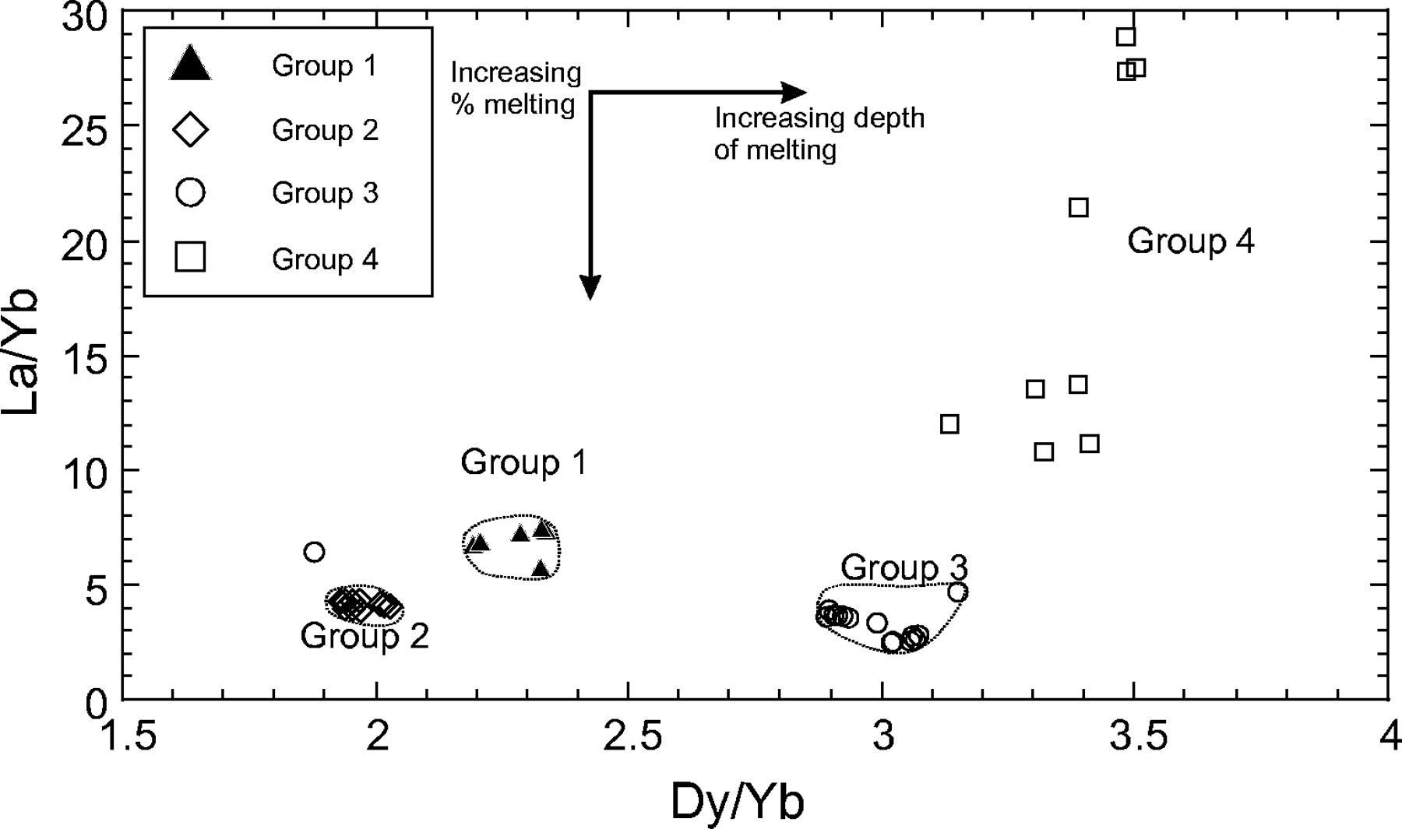
Fig. 19. Variation in La/Yb vs Dy/Yb for Groups 1–4 from the Ahlmannryggen. The increase in Dy/Yb reflects the ...
Notes:
Fig. 19. Variation in La/Yb vs Dy/Yb for Groups 1–4 from the Ahlmannryggen. The increase in Dy/Yb reflects the increased depth of melting and decreasing La/Yb reflects an increase in the amount of partial melting.
Unless provided in the caption above, the following copyright applies to the content of this slide: © The Author 2005. Published by Oxford University Press. All rights reserved. For Permissions, please email: journals.permissions@oupjournals.org

