Slide 1
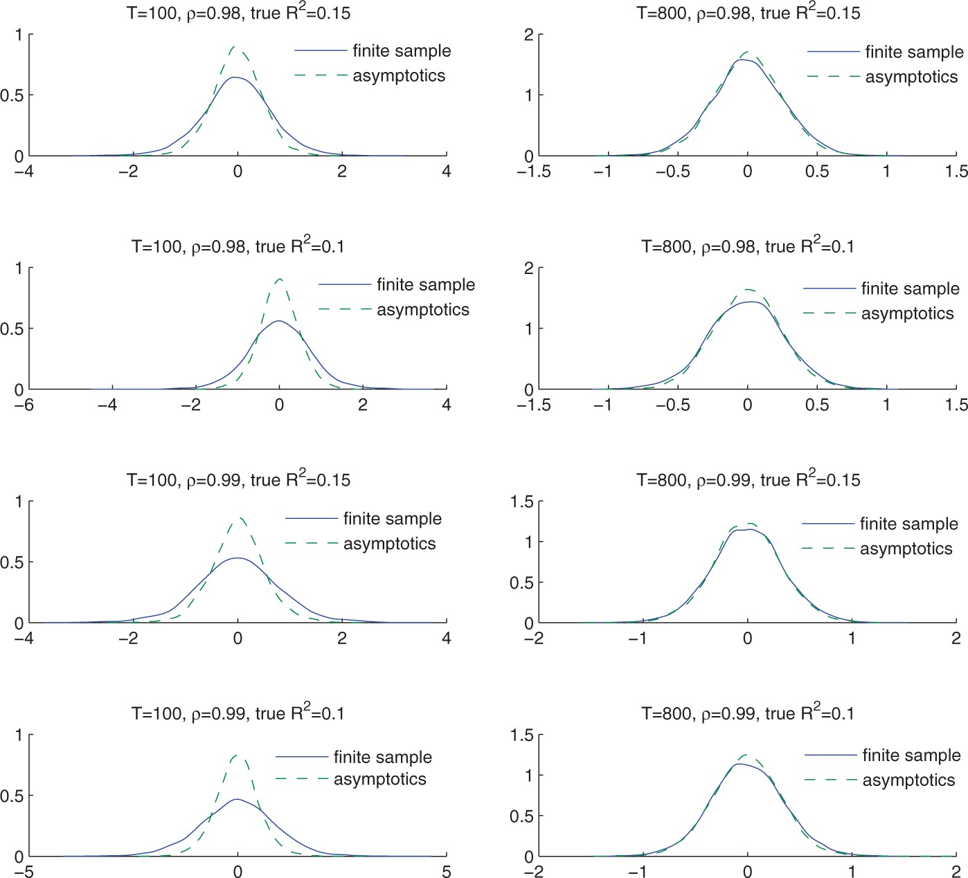
Figure 1 Finite sample distributions versus asymptotic distributions: slope estimate.
Notes:
Figure 1 Finite sample distributions versus asymptotic distributions: slope estimate.
Unless provided in the caption above, the following copyright applies to the content of this slide: © The Author, 2013. Published by Oxford University Press. All rights reserved. For Permissions, please email: journals.permissions@oup.com

Slide 2
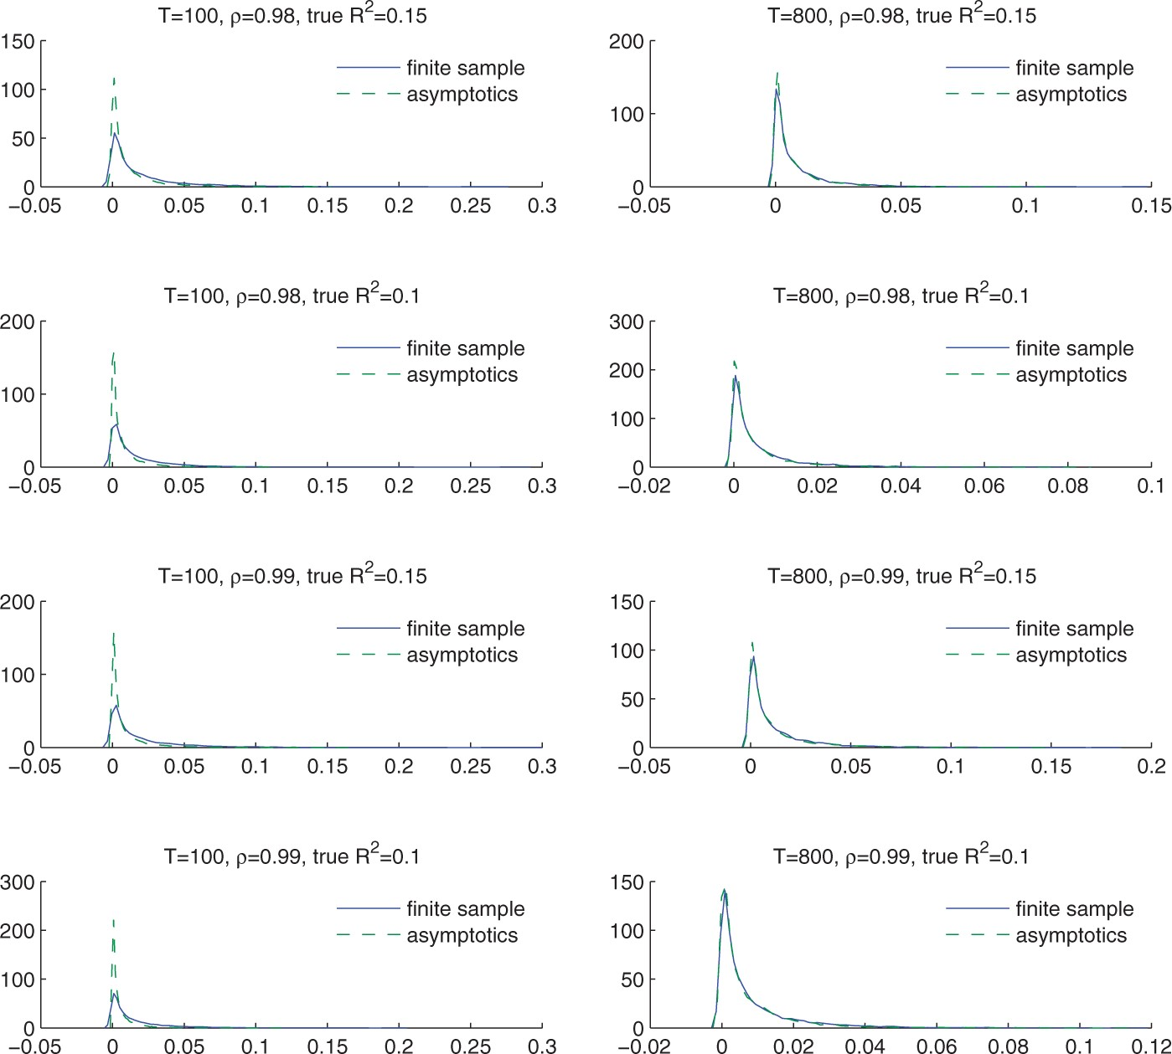
Figure 2 Finite sample distributions versus asymptotic distributions: regression R².
Notes:
Figure 2 Finite sample distributions versus asymptotic distributions: regression R2.
Unless provided in the caption above, the following copyright applies to the content of this slide: © The Author, 2013. Published by Oxford University Press. All rights reserved. For Permissions, please email: journals.permissions@oup.com

Slide 3
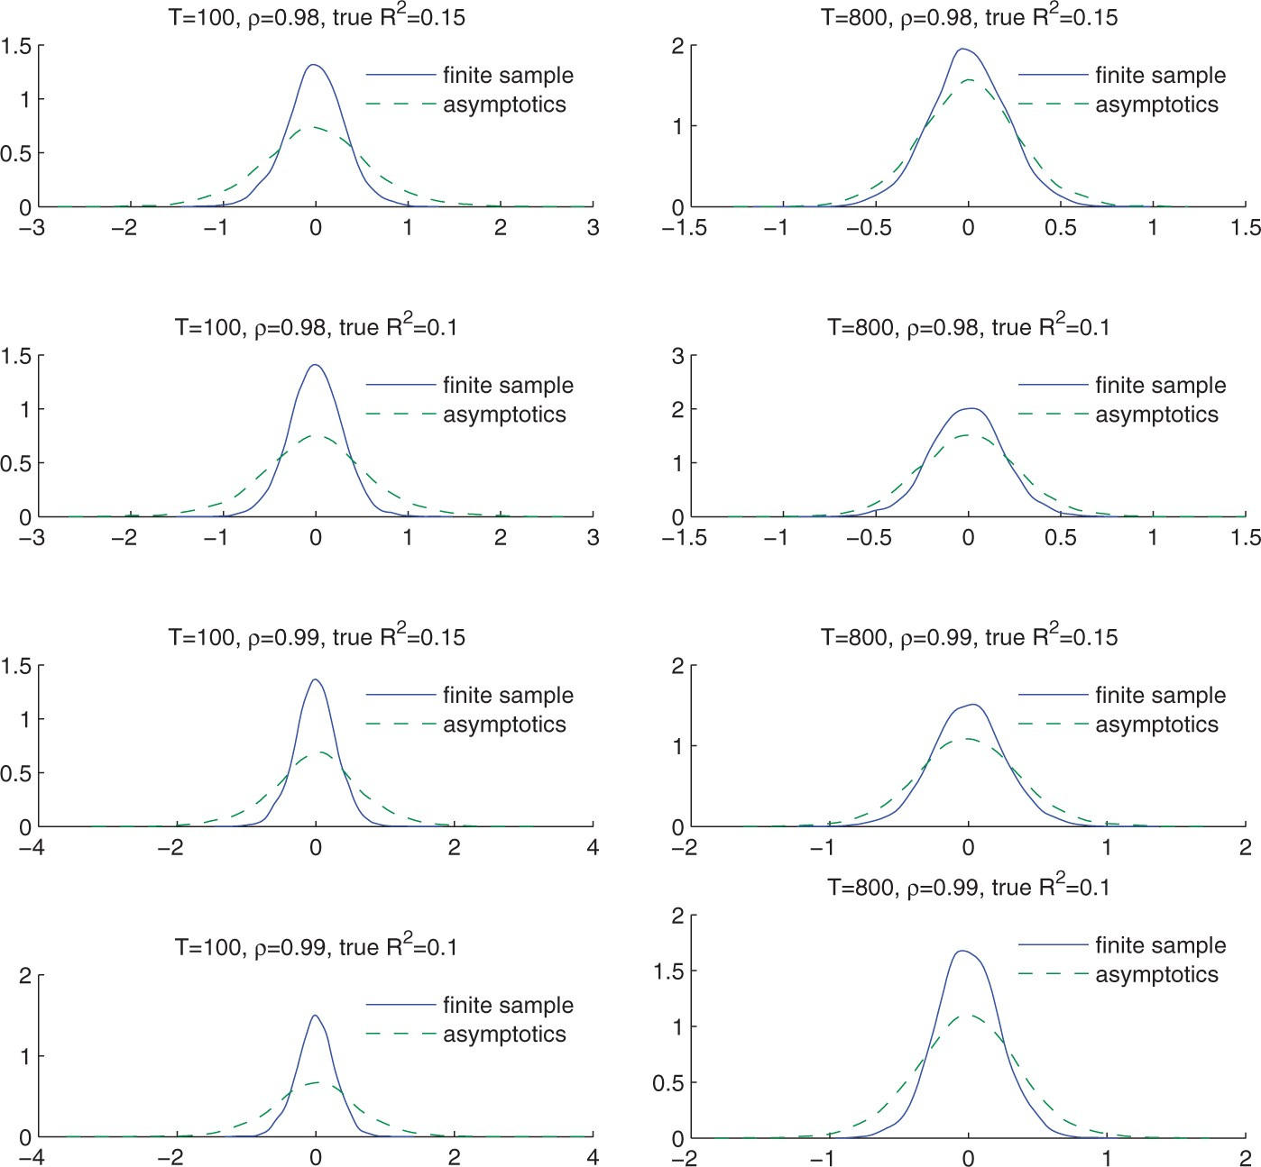
Figure 3 Finite sample distributions versus asymptotic distributions: HAC t test.
Notes:
Figure 3 Finite sample distributions versus asymptotic distributions: HAC t test.
Unless provided in the caption above, the following copyright applies to the content of this slide: © The Author, 2013. Published by Oxford University Press. All rights reserved. For Permissions, please email: journals.permissions@oup.com

Slide 4
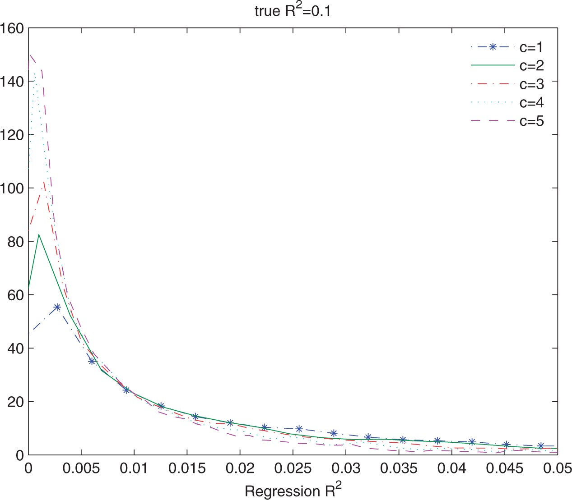
Figure 4 Interaction between persistence and regression R².
Notes:
Figure 4 Interaction between persistence and regression R2.
Unless provided in the caption above, the following copyright applies to the content of this slide: © The Author, 2013. Published by Oxford University Press. All rights reserved. For Permissions, please email: journals.permissions@oup.com

Slide 5
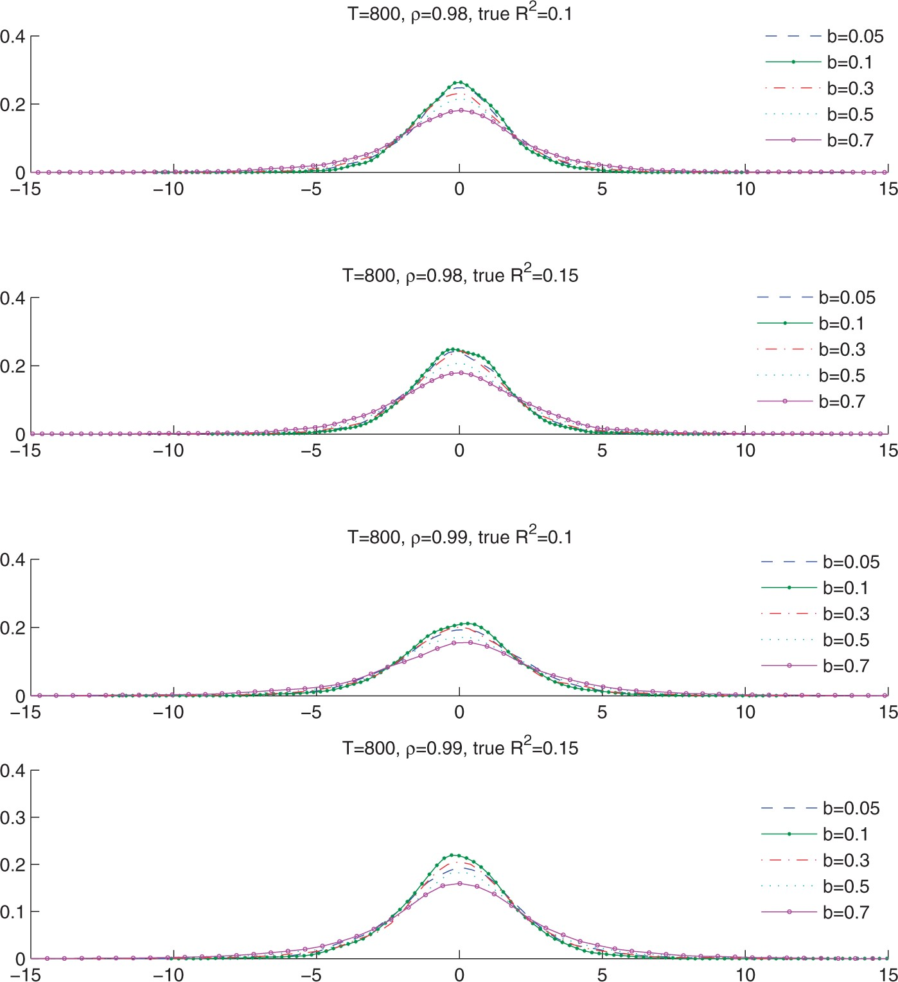
Figure 5 Convergent t distributions with varying b.
Notes:
Figure 5 Convergent t distributions with varying b.
Unless provided in the caption above, the following copyright applies to the content of this slide: © The Author, 2013. Published by Oxford University Press. All rights reserved. For Permissions, please email: journals.permissions@oup.com

Slide 6
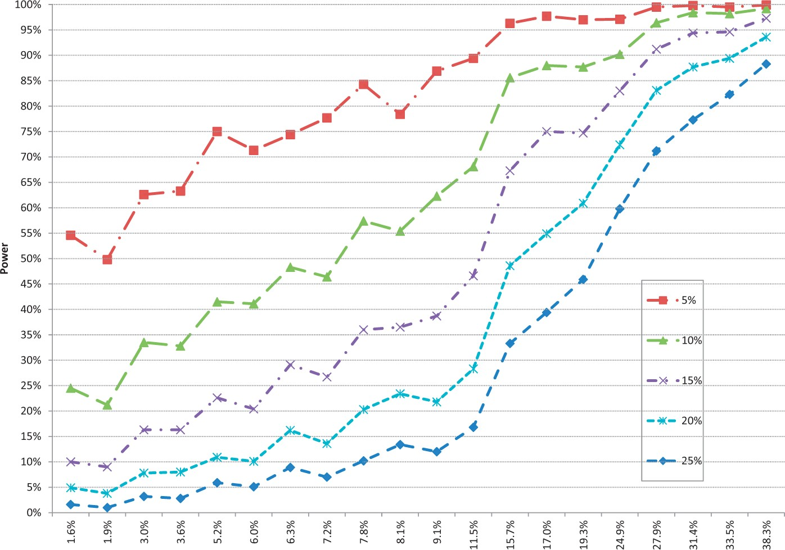
Figure 6 Simulated approximate size and power for different critical values.
Notes:
Figure 6 Simulated approximate size and power for different critical values.
Unless provided in the caption above, the following copyright applies to the content of this slide: © The Author, 2013. Published by Oxford University Press. All rights reserved. For Permissions, please email: journals.permissions@oup.com

Slide 7
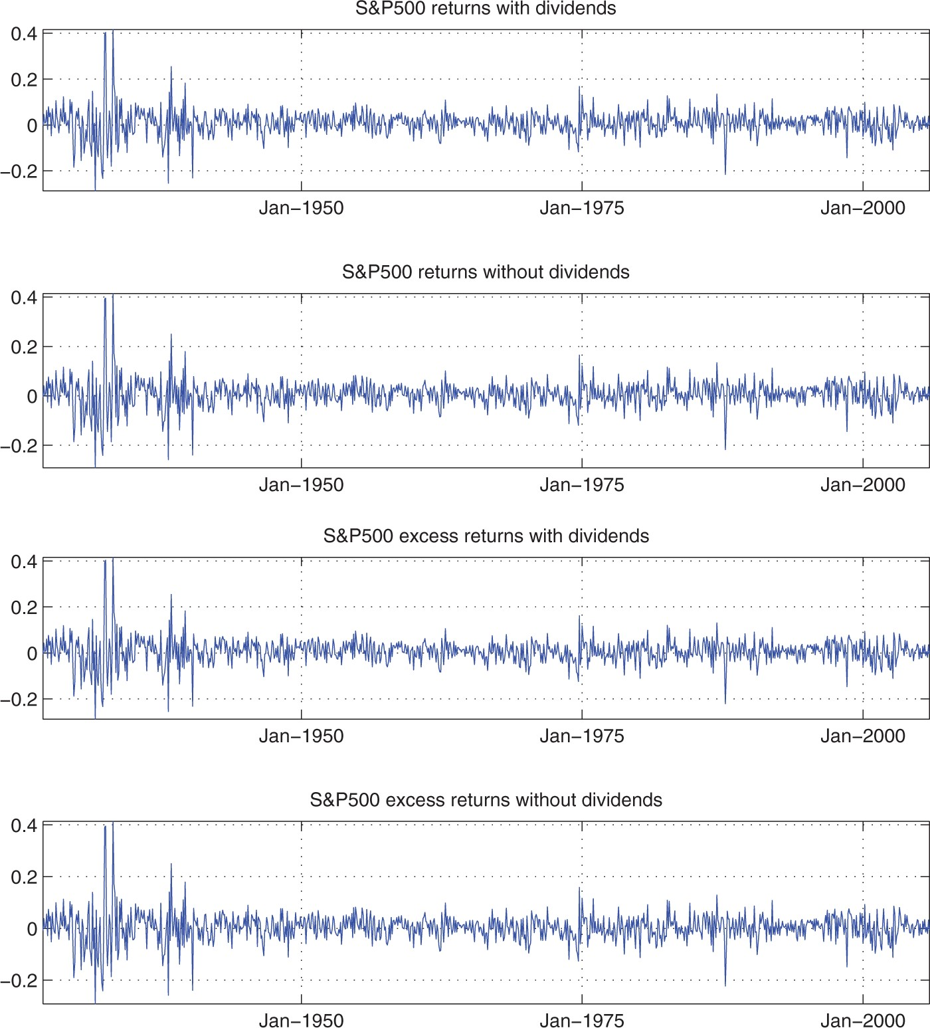
Figure 7 CRSP S&P500 return series.
Notes:
Figure 7 CRSP S&P500 return series.
Unless provided in the caption above, the following copyright applies to the content of this slide: © The Author, 2013. Published by Oxford University Press. All rights reserved. For Permissions, please email: journals.permissions@oup.com

