Slide 1
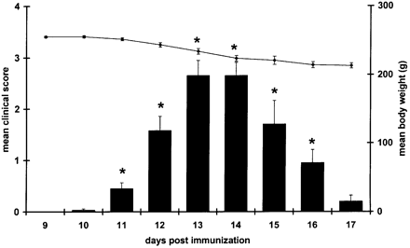
Fig. 1 Clinical scores of EAE animals in time. Time course of clinical scores (bar) and body weight (line) in ...
Notes:
Fig. 1 Clinical scores of EAE animals in time. Time course of clinical scores (bar) and body weight (line) in acute EAE of Lewis rats. Lewis rats were immunized with MBP emulsified in CFA at day 0. Neurological symptoms were scored daily. Data represent mean ± SEM; *P < 0.05.
Unless provided in the caption above, the following copyright applies to the content of this slide: The Guarantors of Brain 2004

Slide 2
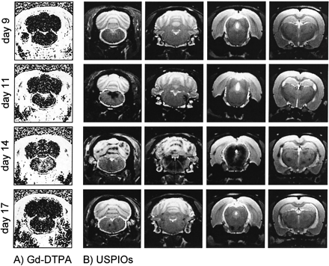
Fig. 2 Typical examples of BBB leakage and cellular infiltration as monitored by Gd‐DTPA (A) and USPIO (B) ...
Notes:
Fig. 2 Typical examples of BBB leakage and cellular infiltration as monitored by Gd‐DTPA (A) and USPIO (B) contrast imaging. (A) Examples of GE‐T1W difference images. These images show the relative increase of the T1‐weighted signal intensity after a bolus of 0.5 mM Gd‐DTPA (8 min in circulation) at different stages of EAE. Compared with an EAE animal at day 9 post immunization, signal intensities start to increase in the cerebellum and brain stem from day 11 due to the leakage of the BBB. This leakage is even more pronounced at day 14. Eventually, the BBB integrity is restored at day 17. (B) T2‐weighted images of animals from different brain areas that were acquired 24 h after an i.v. bolus of 600 µmol Fe/kg USPIO 7228. Note that USPIOs start to accumulate in the brain (as observed by an reduction of the T2‐weighted signal intensities) from day 11 after immunization. Massive USPIO accumulation was observed at the peak of the disease (day 14), whereas in the recovery phase (day 17), only few USPIOs were present in the CNS.
Unless provided in the caption above, the following copyright applies to the content of this slide: The Guarantors of Brain 2004

Slide 3
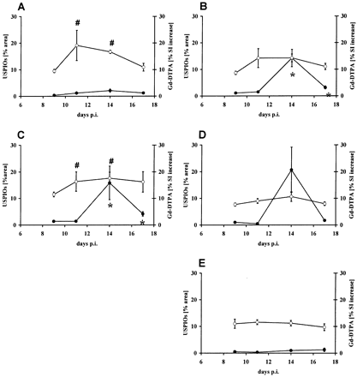
Fig. 3 Quantification of Gd‐DTPA and USPIO burden in the CNS of EAE animals. Quantification of Gd‐DTPA ...
Notes:
Fig. 3 Quantification of Gd‐DTPA and USPIO burden in the CNS of EAE animals. Quantification of Gd‐DTPA leakage (open circles, right axis) and USPIO burden (closed circles, left axis) in the spinal cord (A), cerebellum (B), brainstem (C), basal ganglia (D) and cortex (E) in the course of EAE (day 9, 11, 14 and 17). As an objective measurement for Gd‐DTPA, we calculated the increase of the T1‐weighted signal intensity due to Gd‐DTPA leakage. As an objective measurement for USPIO accumulation, we calculated the percentage affected area with abnormal T2 values (for details see Material and methods). Data are expressed as mean ± SEM; #P < 0.05 versus Gd‐DTPA leakage in CFA control animals; *P < 0.05 versus USPIO load in CFA control animals.
Unless provided in the caption above, the following copyright applies to the content of this slide: The Guarantors of Brain 2004

Slide 4
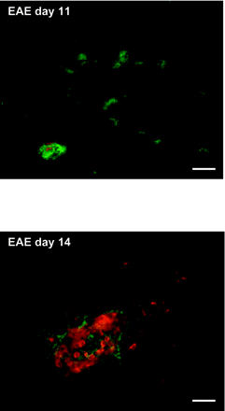
Fig. 4 Immunohistochemical analysis of BBB leakage and cellular infiltration. (A) Leakage of the serum ...
Notes:
Fig. 4 Immunohistochemical analysis of BBB leakage and cellular infiltration. (A) Leakage of the serum protein fibrinogen around the brain vessels (in green) was already detected in EAE animals as early as day 11 post injection, whereas hardly any cellular infiltrates (stained for monocytes by ED1 in red) could be detected, indicating BBB dysfunction (upper panel). At day 14, fibrinogen (in green) and mononuclear infiltrates (stained for monocytes by ED1 in red) were detected during EAE (middle panel). Scale bar = 35 µm. In a CFA control animal, neither fibrinogen leakage nor cellular infiltration were detected (data not shown). (B) Quantitative analysis of cellular infiltrates throughout the course of the disease. At day 14, massive infiltrates of monocyte‐derived macrophages were observed by immunohistochemistry. Cellular infiltrates, monocyte‐derived macrophages (ED1 positive) and T‐cells (TCRαβ positive), and the presence of activated perivascular macrophages (ED2 positive) were determined in brain sections at the level of cerebellum and brainstem of EAE animals (day 9, 11, 14 and 17) and CFA control animals (day 14) by immunohistochemical analysis. The influx of these cells is presented in arbitrary units (see also Material and methods) and presented as a mean of two animals ± SD. *P < 0.05 versus ED1 expression in CFA control animals; #P < 0.05 versus T‐cell expression in CFA control animals.
Unless provided in the caption above, the following copyright applies to the content of this slide: The Guarantors of Brain 2004

Slide 5
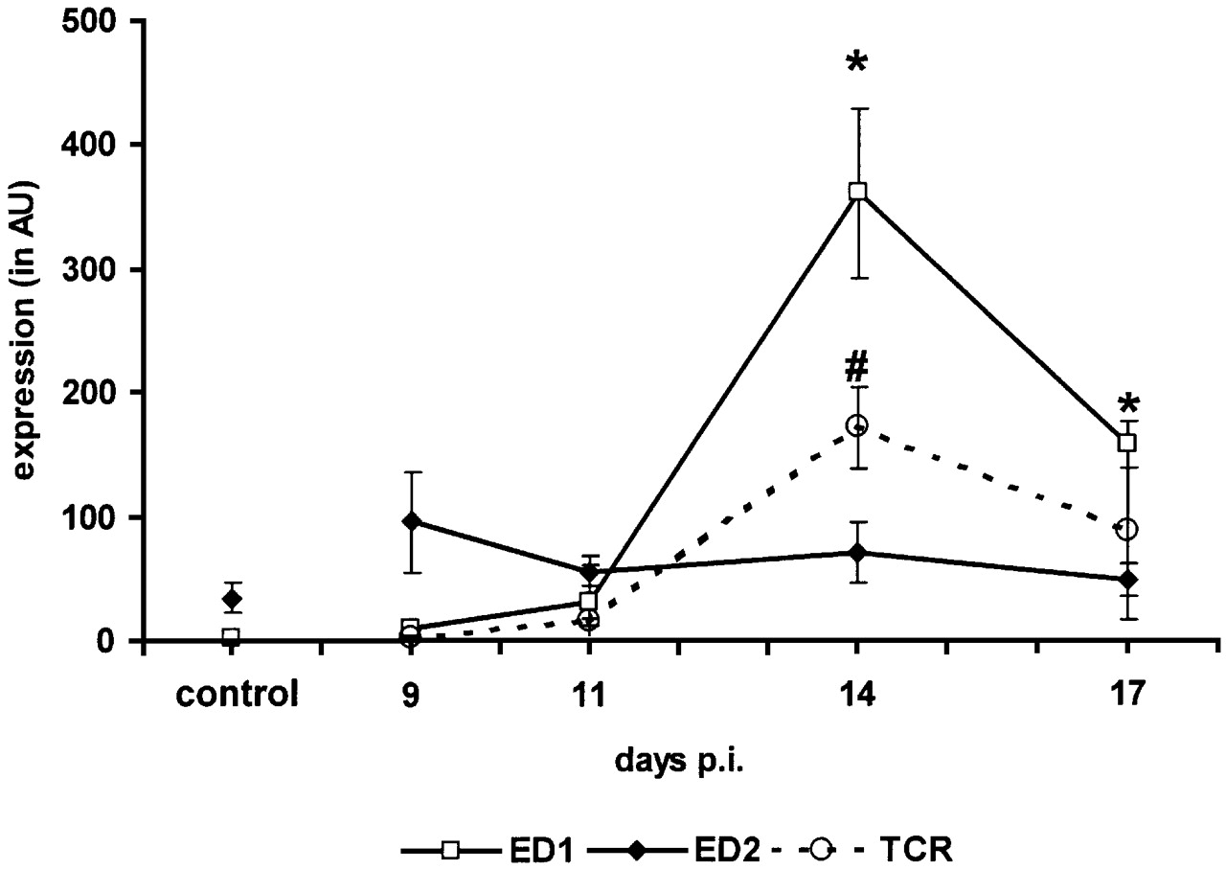
Fig. 4 Immunohistochemical analysis of BBB leakage and cellular infiltration. (A) Leakage of the serum ...
Notes:
Fig. 4 Immunohistochemical analysis of BBB leakage and cellular infiltration. (A) Leakage of the serum protein fibrinogen around the brain vessels (in green) was already detected in EAE animals as early as day 11 post injection, whereas hardly any cellular infiltrates (stained for monocytes by ED1 in red) could be detected, indicating BBB dysfunction (upper panel). At day 14, fibrinogen (in green) and mononuclear infiltrates (stained for monocytes by ED1 in red) were detected during EAE (middle panel). Scale bar = 35 µm. In a CFA control animal, neither fibrinogen leakage nor cellular infiltration were detected (data not shown). (B) Quantitative analysis of cellular infiltrates throughout the course of the disease. At day 14, massive infiltrates of monocyte‐derived macrophages were observed by immunohistochemistry. Cellular infiltrates, monocyte‐derived macrophages (ED1 positive) and T‐cells (TCRαβ positive), and the presence of activated perivascular macrophages (ED2 positive) were determined in brain sections at the level of cerebellum and brainstem of EAE animals (day 9, 11, 14 and 17) and CFA control animals (day 14) by immunohistochemical analysis. The influx of these cells is presented in arbitrary units (see also Material and methods) and presented as a mean of two animals ± SD. *P < 0.05 versus ED1 expression in CFA control animals; #P < 0.05 versus T‐cell expression in CFA control animals.
Unless provided in the caption above, the following copyright applies to the content of this slide: The Guarantors of Brain 2004

Slide 6
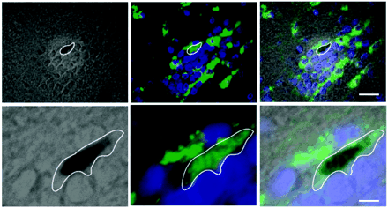
Fig. 5 USPIOs are located in infiltrated monocytes. (A) Immunohistochemical localization of USPIOs in ...
Notes:
Fig. 5 USPIOs are located in infiltrated monocytes. (A) Immunohistochemical localization of USPIOs in monocyte‐derived macrophages. In the brain sections of an EAE animal at the peak of the disease (day 14), the presence of USPIOs was determined by Prussian blue staining (black spot within delineated cell) (left panels: brightfield Differential Interference Contrast, DIC images, 3I Marianas™ digital microscope). The same brain section was immunohistochemically analysed for the presence of monocyte‐derived macrophages (determined by ED‐1 positivity in green), nuclei were detected by Hoechst (in blue) (middle panels: darkfield images). The right panels display overlays and clearly show the co‐localization of Prussian blue (in black) with ED1 positive cellular infiltrate. Upper panels: low magnification (bar = 10 µm); lower panels: higher magnification (bar = 5 µm). (B) Electron microscope analysis reveals the presence of USPIOs (indicated with arrows) in the cytoplasm of cellular infiltrates in the cerebellum of an EAE animal at the peak of the disease (day 14). Bar = 5 µm (left panel) and 1 µm (right panel).
Unless provided in the caption above, the following copyright applies to the content of this slide: The Guarantors of Brain 2004

Slide 7
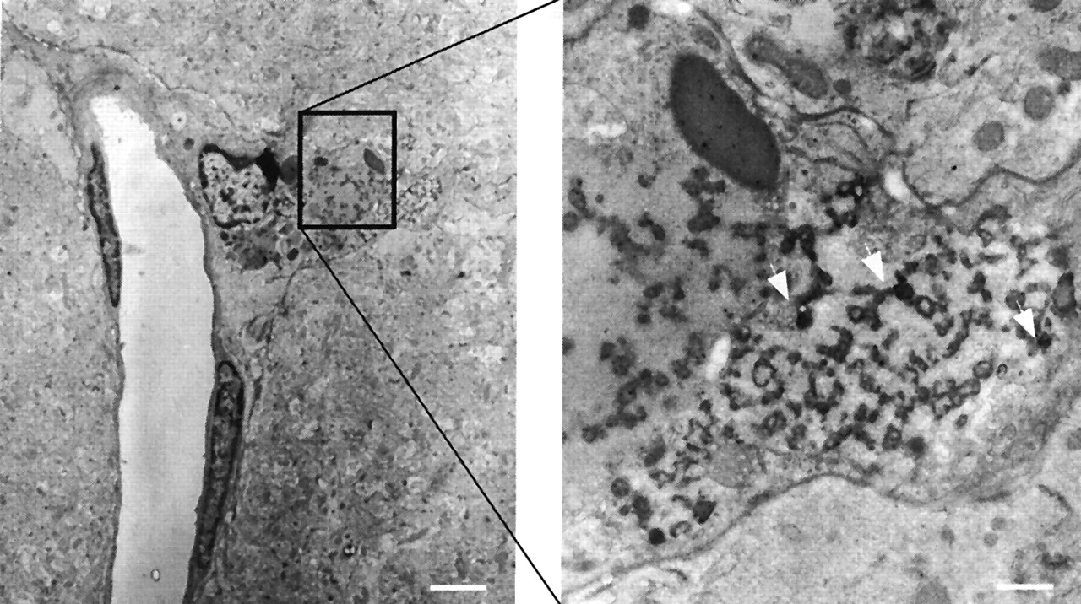
Fig. 5 USPIOs are located in infiltrated monocytes. (A) Immunohistochemical localization of USPIOs in ...
Notes:
Fig. 5 USPIOs are located in infiltrated monocytes. (A) Immunohistochemical localization of USPIOs in monocyte‐derived macrophages. In the brain sections of an EAE animal at the peak of the disease (day 14), the presence of USPIOs was determined by Prussian blue staining (black spot within delineated cell) (left panels: brightfield Differential Interference Contrast, DIC images, 3I Marianas™ digital microscope). The same brain section was immunohistochemically analysed for the presence of monocyte‐derived macrophages (determined by ED‐1 positivity in green), nuclei were detected by Hoechst (in blue) (middle panels: darkfield images). The right panels display overlays and clearly show the co‐localization of Prussian blue (in black) with ED1 positive cellular infiltrate. Upper panels: low magnification (bar = 10 µm); lower panels: higher magnification (bar = 5 µm). (B) Electron microscope analysis reveals the presence of USPIOs (indicated with arrows) in the cytoplasm of cellular infiltrates in the cerebellum of an EAE animal at the peak of the disease (day 14). Bar = 5 µm (left panel) and 1 µm (right panel).
Unless provided in the caption above, the following copyright applies to the content of this slide: The Guarantors of Brain 2004

Slide 8
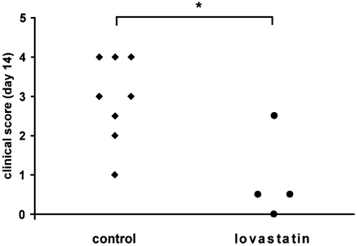
Fig. 6 Lovastatin treatment of EAE animals reduces mononuclear cell accumulation. (A) Lovastatin treatment of ...
Notes:
Fig. 6 Lovastatin treatment of EAE animals reduces mononuclear cell accumulation. (A) Lovastatin treatment of EAE animals significantly ameliorates clinical signs. EAE animals (four) were treated daily with the immunomodulator lovastatin (daily, 4 mg/kg, i.p.). Clinical scores of individual animals at day 14 are presented. Lovastatin treatment significantly reduced the clinical scores of EAE animals; *P < 0.05 versus untreated EAE animals. (B) MRI monitoring of USPIO burden in the CNS of animals treated with lovastatin. Lovastatin treatment of EAE animals reduced cellular infiltration, as determined by diminished USPIO load on quantitative T2 images at day 14 of the disease. Data are presented as mean ± SEM; *P < 0.05 versus untreated EAE animals.
Unless provided in the caption above, the following copyright applies to the content of this slide: The Guarantors of Brain 2004

Slide 9
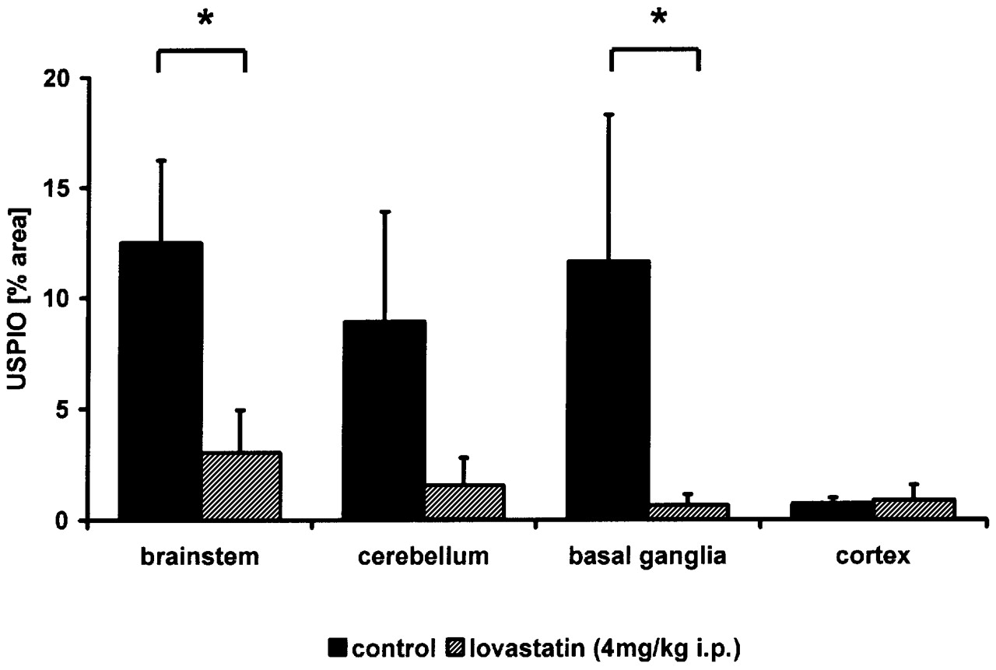
Fig. 6 Lovastatin treatment of EAE animals reduces mononuclear cell accumulation. (A) Lovastatin treatment of ...
Notes:
Fig. 6 Lovastatin treatment of EAE animals reduces mononuclear cell accumulation. (A) Lovastatin treatment of EAE animals significantly ameliorates clinical signs. EAE animals (four) were treated daily with the immunomodulator lovastatin (daily, 4 mg/kg, i.p.). Clinical scores of individual animals at day 14 are presented. Lovastatin treatment significantly reduced the clinical scores of EAE animals; *P < 0.05 versus untreated EAE animals. (B) MRI monitoring of USPIO burden in the CNS of animals treated with lovastatin. Lovastatin treatment of EAE animals reduced cellular infiltration, as determined by diminished USPIO load on quantitative T2 images at day 14 of the disease. Data are presented as mean ± SEM; *P < 0.05 versus untreated EAE animals.
Unless provided in the caption above, the following copyright applies to the content of this slide: The Guarantors of Brain 2004

