Slide 1
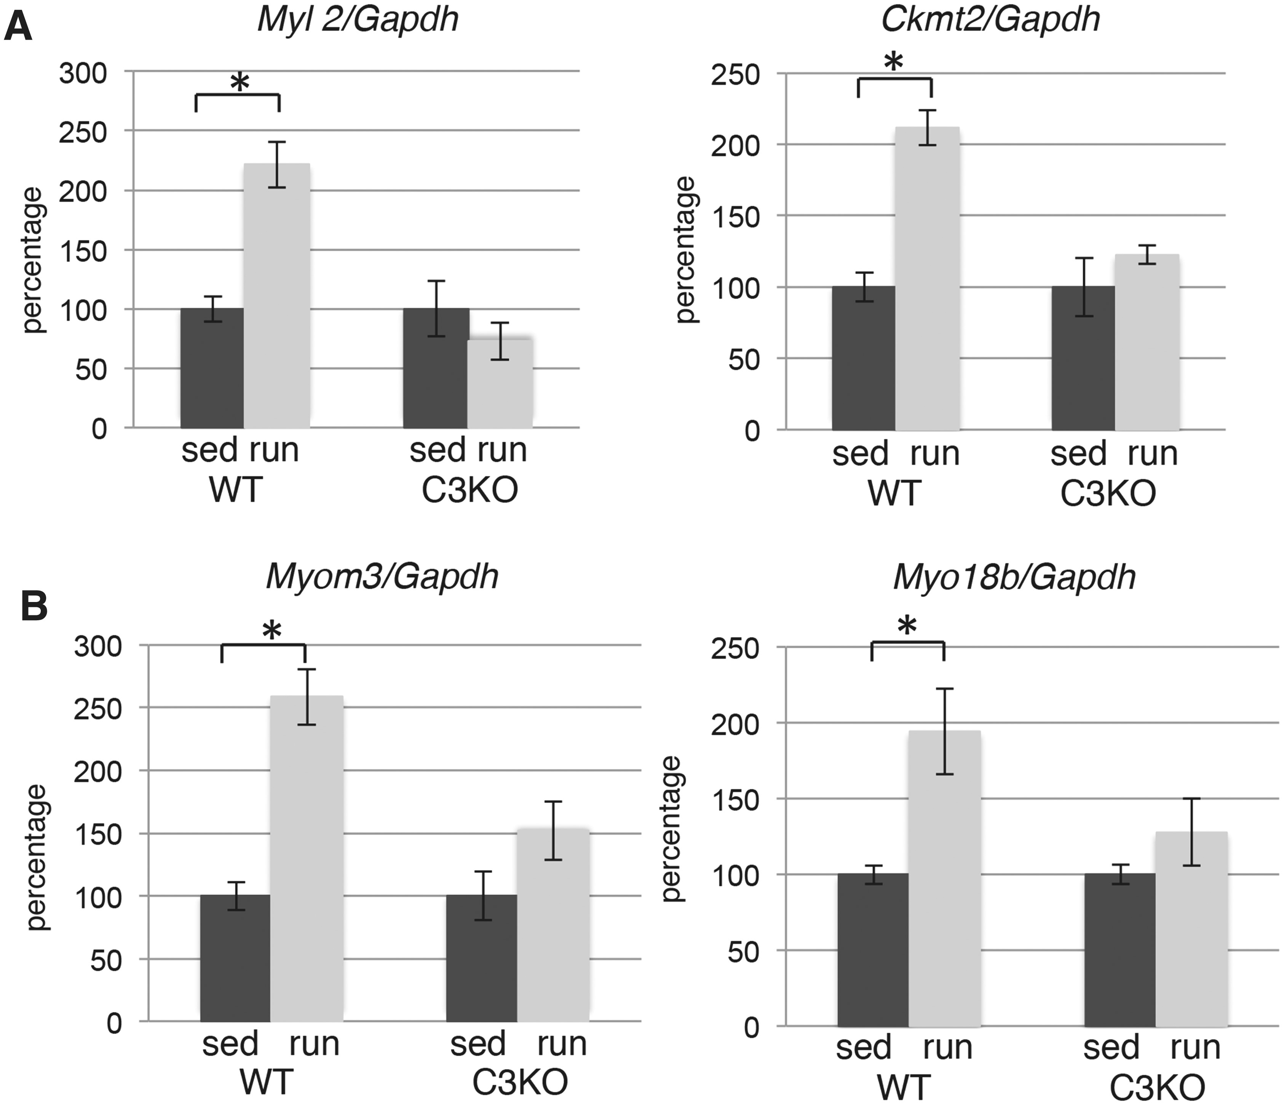
Figure 1. Exercise does not induce proper myofibrillar gene expression in C3KO muscles. RT-PCR validation of gene ...
Notes:
Figure 1. Exercise does not induce proper myofibrillar gene expression in C3KO muscles. RT-PCR validation of gene expression levels for sarcomere-associated proteins ( Myl2 —regulatory myosin light chain 2, cardiac, slow; Ckmt2 —mitochondrial creatine kinase; Myom3 —myomesin 3; Myo18b —myosin 18b) in plantaris muscles. In each graph, the expression level of the exercised (run) group is graphed relative to the sedentary (sed) controls; the average expression of each gene in the sedentary control group was set at 100% for each genotype. Asterisks indicate statistical significance by two-tailed Student’s t -test with P < 0.05 considered statistically significant. All groups had n = 4.
Unless provided in the caption above, the following copyright applies to the content of this slide: © The Author 2016. Published by Oxford University Press. All rights reserved. For permissions, please e-mail: journals.permissions@oup.com

Slide 2
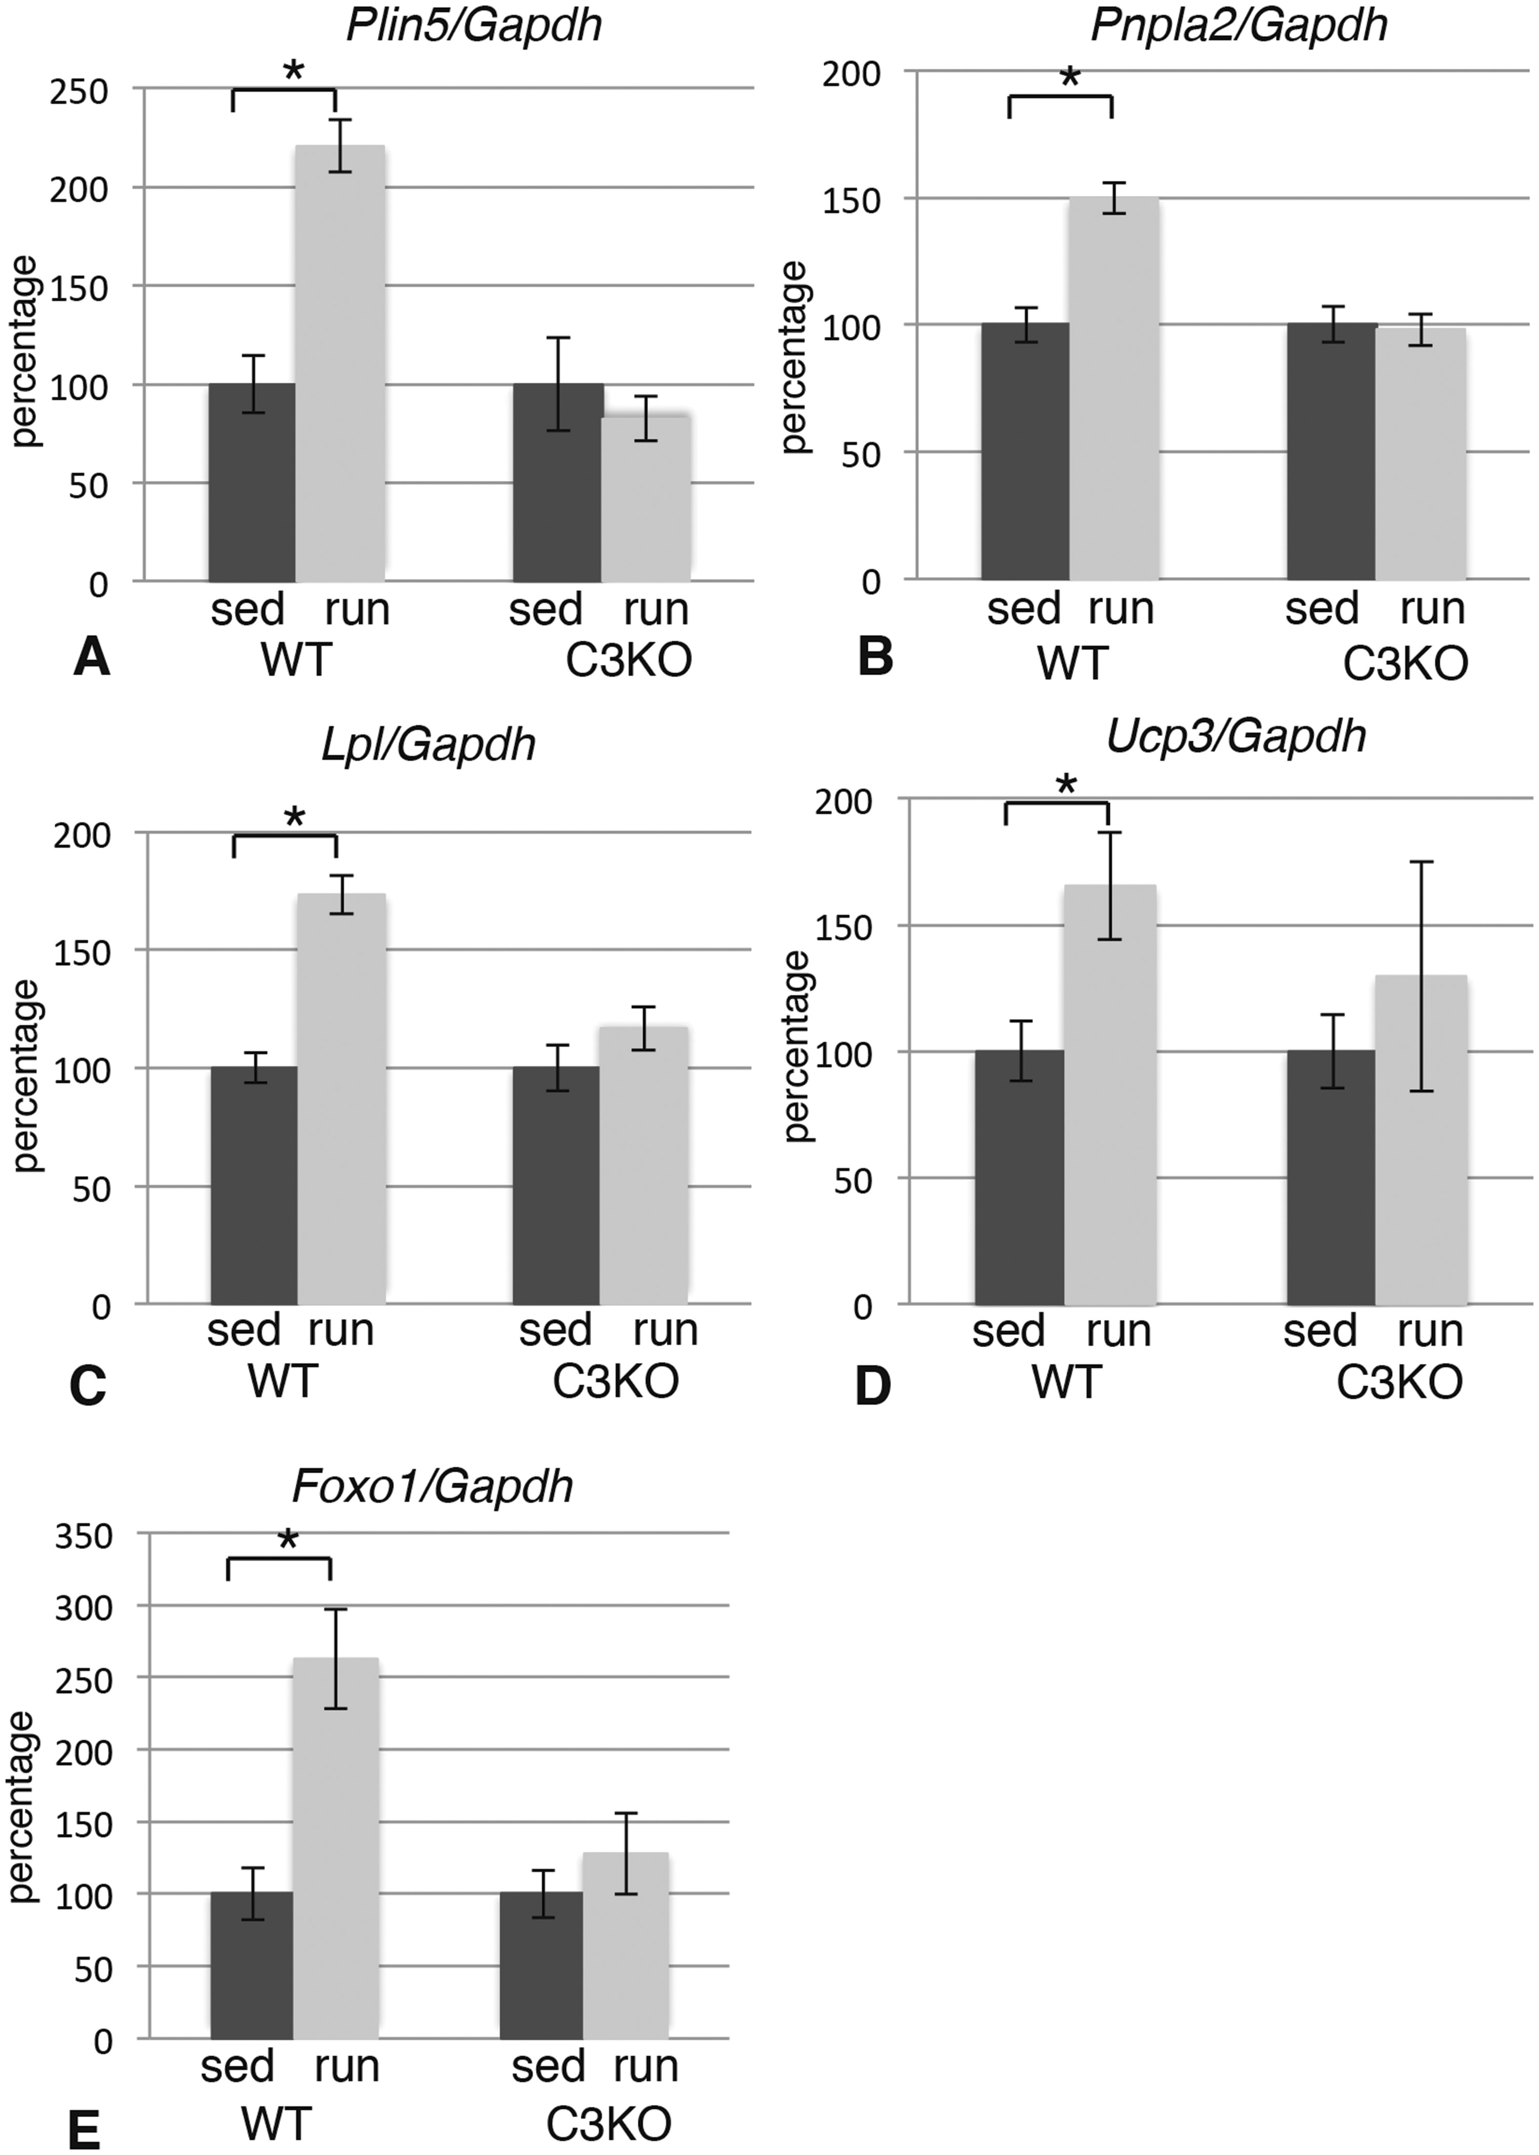
Figure 2. Exercise does not properly induce expression of lipid metabolism genes in C3KO muscles. RT-PCR validation of ...
Notes:
Figure 2. Exercise does not properly induce expression of lipid metabolism genes in C3KO muscles. RT-PCR validation of the expression levels of genes encoding proteins involved in lipid metabolism and mitochondrial oxidation ( Plin5 —perilipin 5; Pnpla2 —diacylglycerol acyltransferase, ATGL; Lpl —lipoprotein lipase; Ucp3 —uncoupling protein 3; Foxo1 —transcription factor FOXO1) in plantaris muscles. In each graph, the expression level of the exercised (run) group is graphed relative to the sedentary (sed) control; the average expression of each gene in the sedentary control group was set at 100% for each genotype. Asterisk indicates statistical significance by two-tailed Student’s t -test with P < 0.05 considered statistically significant. All groups had n = 4.
Unless provided in the caption above, the following copyright applies to the content of this slide: © The Author 2016. Published by Oxford University Press. All rights reserved. For permissions, please e-mail: journals.permissions@oup.com

Slide 3
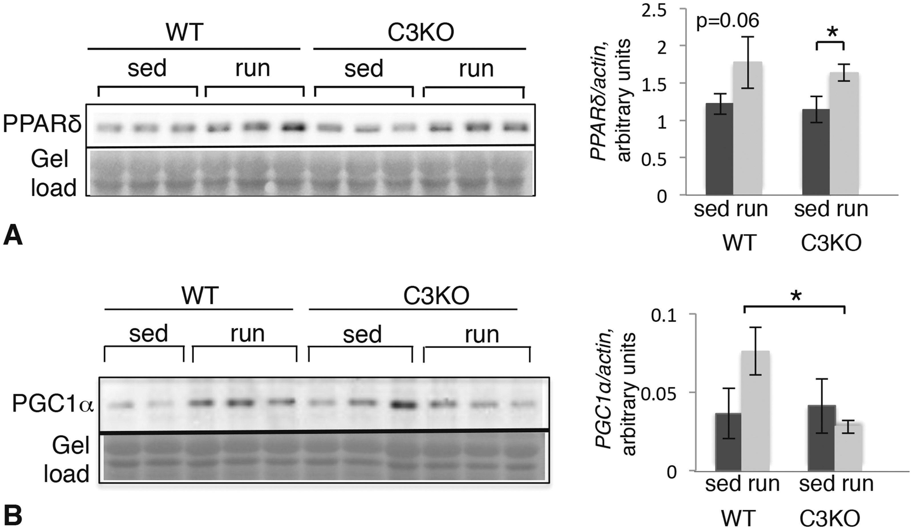
Figure 3. Expression of PPARδ and PGC1α in WT and C3KO muscle after 5 days of running exercise. Western blotting of ...
Notes:
Figure 3. Expression of PPARδ and PGC1α in WT and C3KO muscle after 5 days of running exercise. Western blotting of whole muscle extracts from sedentary (sed) and exercised (run) animals. ( A ) Blot probed with a PPARδ-specific antibody. Quantification of the blot by densitometry is shown to the right. ( B ) Blot probed with a PGC1α-specific antibody. Quantification by densitometry is shown to the right. All vertical bars indicate standard error. Asterisk indicates statistical significance by two-tailed t -test with P < 0.05 considered significant.
Unless provided in the caption above, the following copyright applies to the content of this slide: © The Author 2016. Published by Oxford University Press. All rights reserved. For permissions, please e-mail: journals.permissions@oup.com

Slide 4
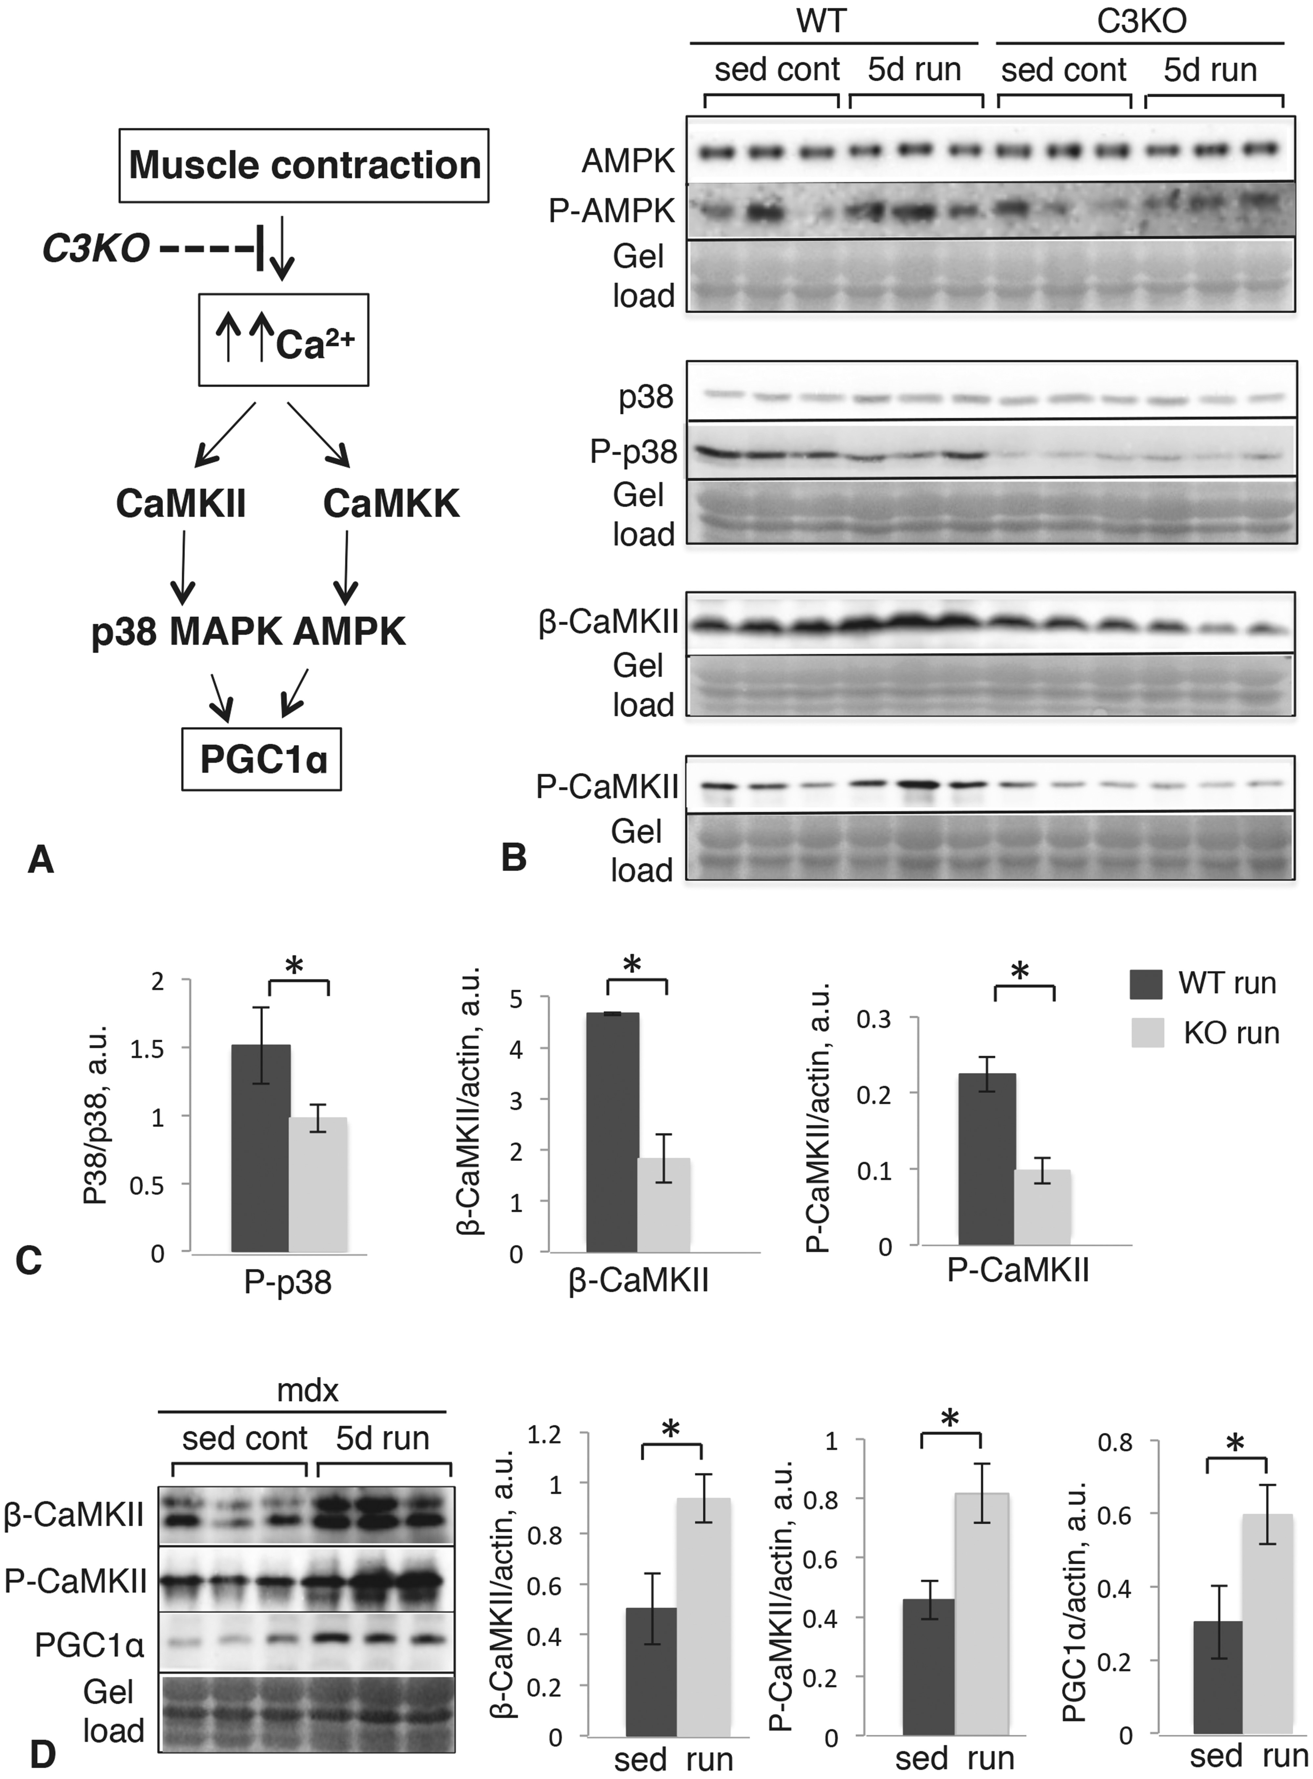
Figure 4. Western blot analysis of the upstream components of the pathways controlling PGC1α levels in WT and C3KO ...
Notes:
Figure 4. Western blot analysis of the upstream components of the pathways controlling PGC1α levels in WT and C3KO muscles. ( A ) Schematic representation of the molecular pathways controlling PGC1α. ( B ) Western blots of whole plantaris muscle extracts stained with antibodies to total AMPK and phospho-AMPK (top), total p38 and phospho-p38 (middle), β-CaMKII and phospho-CaMKII (bottom). ( C ) Quantification of the corresponding blots by densitometry; asterisk indicates statistical significance by t -test ( P < 0.05). ( D ) Western blots of whole plantaris muscle extracts of sedentary and exercised mdx muscles stained with antibodies to β-CaMKII (top), phospho-CaMKII (middle) and PGC1a (bottom). Quantification of the corresponding blots by densitometry is shown to the right; asterisk indicates statistical significance by t -test ( P < 0.05). Vertical bars represent standard error.
Unless provided in the caption above, the following copyright applies to the content of this slide: © The Author 2016. Published by Oxford University Press. All rights reserved. For permissions, please e-mail: journals.permissions@oup.com

Slide 5
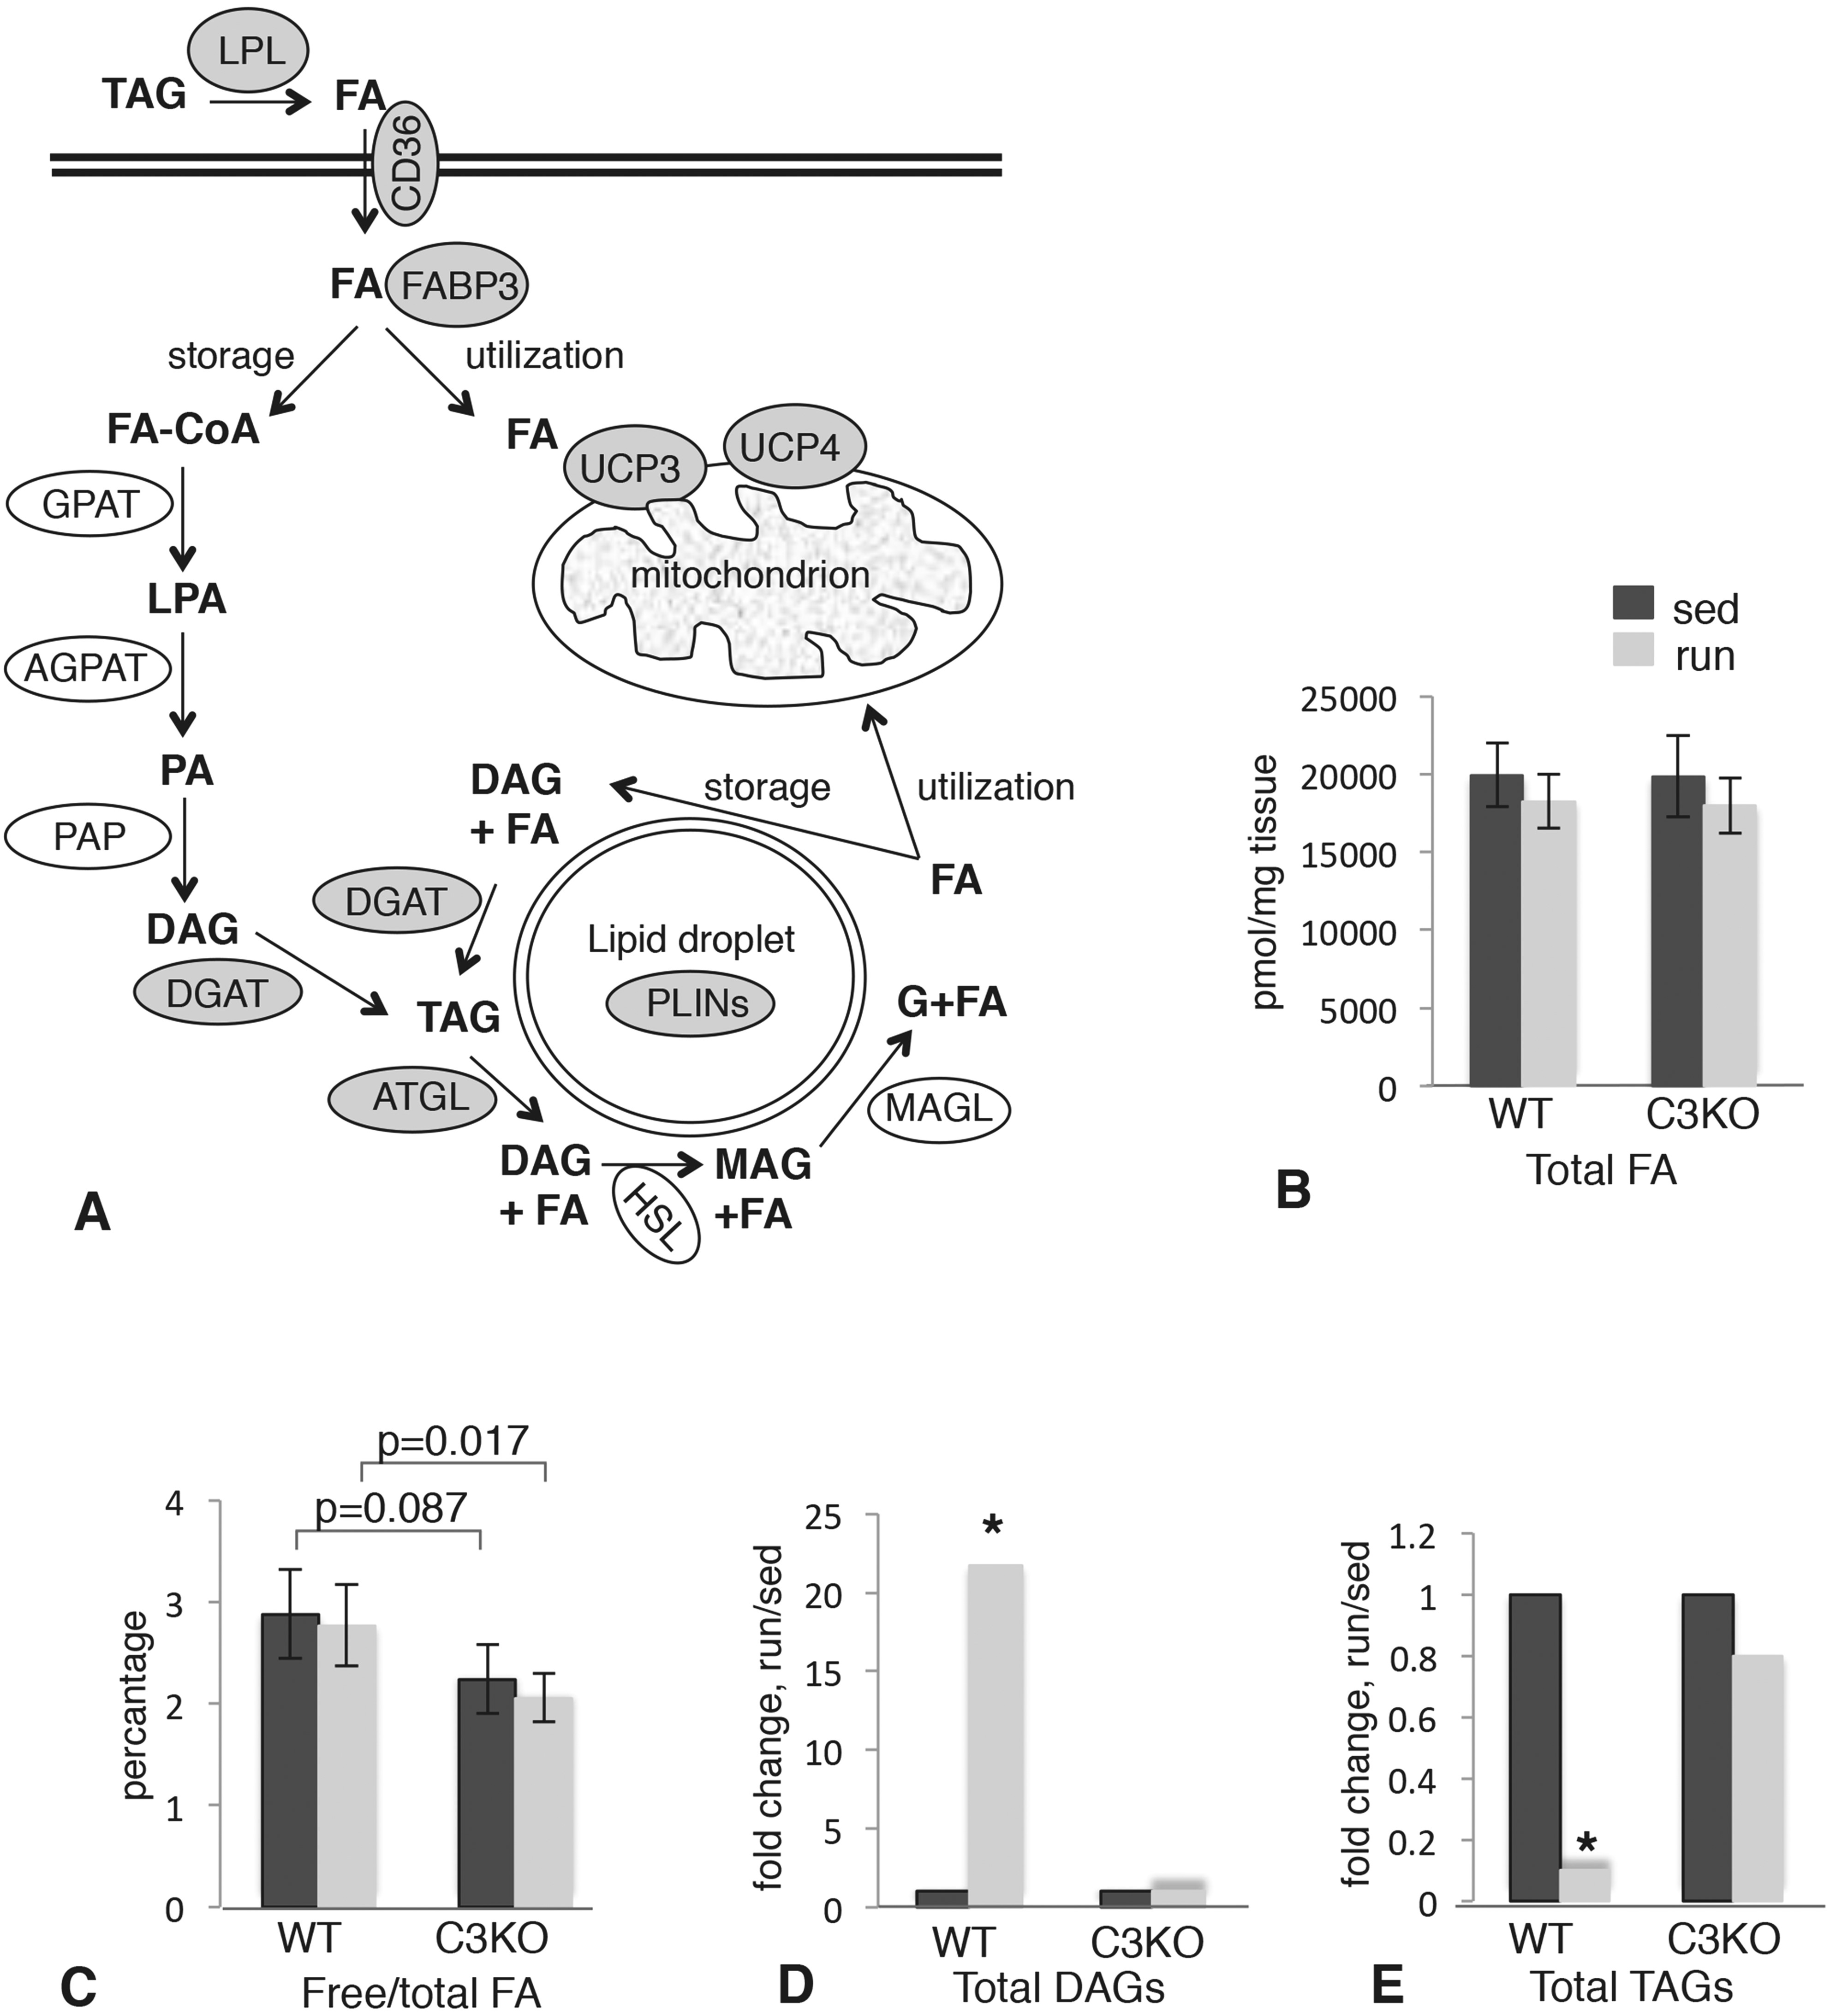
Figure 5. Mass spectrometric analysis of FA metabolites in WT and C3KO muscles. ( A ) Diagram summarizing lipid ...
Notes:
Figure 5. Mass spectrometric analysis of FA metabolites in WT and C3KO muscles. ( A ) Diagram summarizing lipid metabolic pathways in skeletal muscle. All of the genes that were induced by exercise in WT but not in C3KO muscles are shown in gray ovals. LPL, lipoprotein lipase; FABP3, FA binding protein 3; GPAT, glycerol-3-phosphate acyltransferase; AGPAT, acyl-CoA:acylglycerol-3-phosphate acyltransferase; PAP, phosphatidic acid phosphohydrolase; DGAT, diacylglycerol acyltransferase; ATGL, adipose triglyceride lipase; HSL, hormone-sensitive lipase; MAGL, monoacylglycerol lipase; PLINs, perilipins; UCP3 and 4, uncoupling proteins 3 and 4; DAG, diacylglycerol; MAG, monoacylglycerol; G, glycerol; FA-CoA, fatty acyl-CoA; LPA, lysophosphatidic acid; PA, phosphatidic acid. ( B ) Total FA content in sedentary and run muscles; ( C ) pool of free FA in in sedentary and run muscles; ( D ) total DAGs in sedentary and run muscles; ( E ) total TAGS in sedentary and run muscles. Asterisk indicates statistical significance by t -test ( P < 0.05). All groups had n = 5.
Unless provided in the caption above, the following copyright applies to the content of this slide: © The Author 2016. Published by Oxford University Press. All rights reserved. For permissions, please e-mail: journals.permissions@oup.com

Slide 6
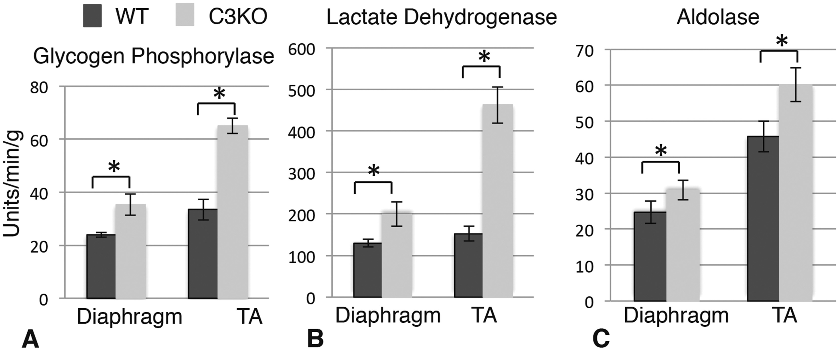
Figure 6. Activities of glycolytic enzymes are increased in C3KO muscles. Activities of glycogen phosphorylase ( A ), ...
Notes:
Figure 6. Activities of glycolytic enzymes are increased in C3KO muscles. Activities of glycogen phosphorylase ( A ), lactate dehydrogenase ( B ) and aldolase ( C ) were measured in tibialis anterior (TA) and diaphragm muscles from WT and C3KO mice. All enzyme activities are expressed as units per min per gram of wet muscle weight. Asterisk indicates statistical significance by two-tailed Student’s t -test with P < 0.05 considered statistically significant. All groups had n = 5.
Unless provided in the caption above, the following copyright applies to the content of this slide: © The Author 2016. Published by Oxford University Press. All rights reserved. For permissions, please e-mail: journals.permissions@oup.com

Slide 7
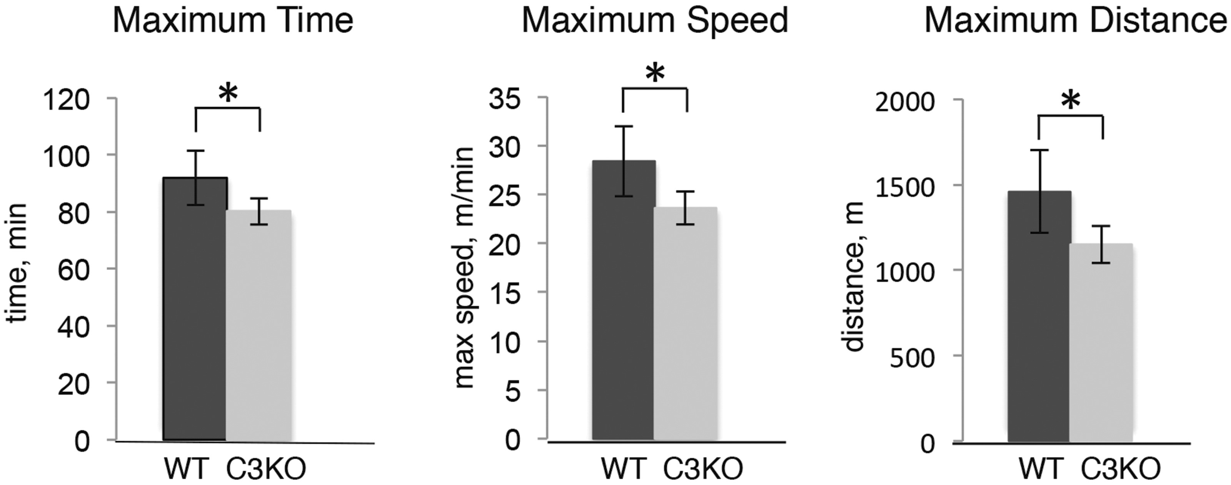
Figure 7. C3KO mice show decreased exercise performance. Results of the run to exhaustion test, performed as described ...
Notes:
Figure 7. C3KO mice show decreased exercise performance. Results of the run to exhaustion test, performed as described in Materials and Methods section. All mice were age-matched males ( n = 5 for each genotype). Asterisk indicates statistical significance by t -test ( P < 0.05). Vertical bars represent standard errors.
Unless provided in the caption above, the following copyright applies to the content of this slide: © The Author 2016. Published by Oxford University Press. All rights reserved. For permissions, please e-mail: journals.permissions@oup.com

Slide 8
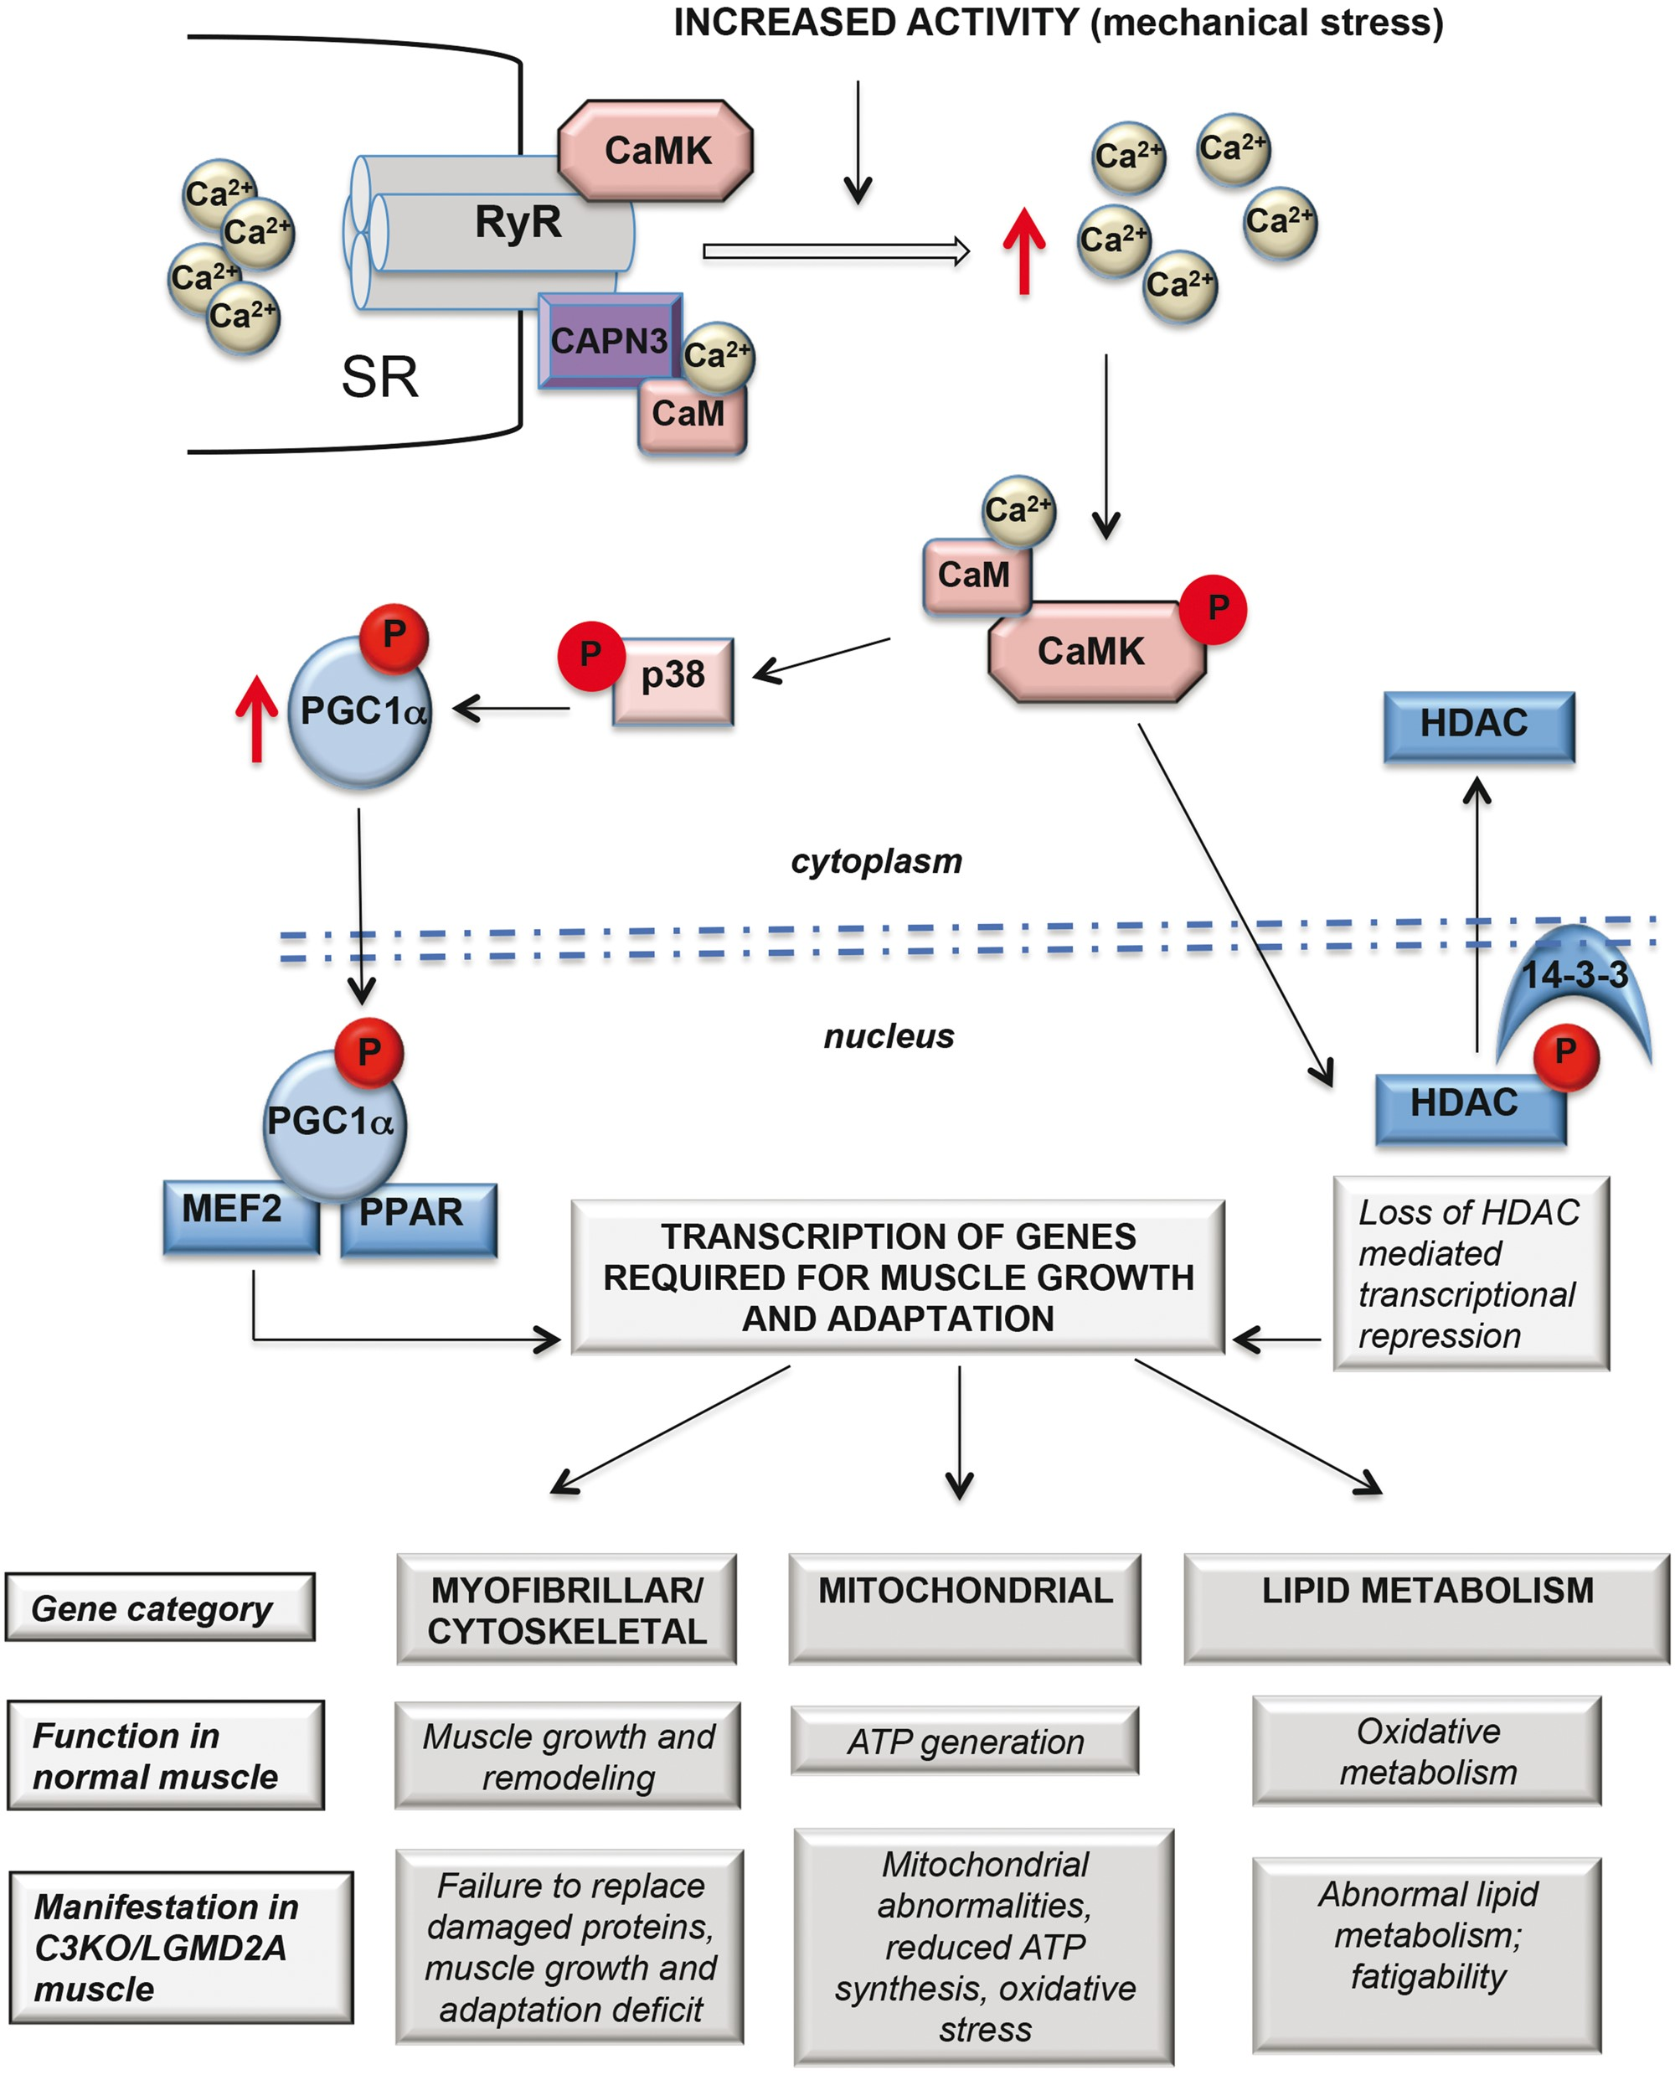
Figure 8. Proposed hypothesis of regulation of muscle adaptation genes mediates by Ca ²⁺ -CaMKII-mediated ...
Notes:
Figure 8. Proposed hypothesis of regulation of muscle adaptation genes mediates by Ca 2+ -CaMKII-mediated signaling. According to the hypothesis, CAPN3 (shown in purple) is associated with the muscle triad through its interaction with RyR1. In WT mice, muscle activity leads to increased Ca 2+ release through RyR and concomitant activation of CaMKII signaling, which acts ( 1 ) to activate p38 MAPK, which stabilizes the transcriptional co-activator PGC1α, leading to increased transcription of muscle adaptation genes controlled by MEF2, PPAR and, possibly, other transcription factors and ( 2 ) to phosphorylate transcriptional inhibitor HDAC, leading to its relocation from the nucleus to the cytoplasm, thus alleviating transcriptional repression. As was demonstrated here and in our previous studies ( 12 , 16 ), in the absence of CAPN3 the levels of RyR and the amplitude of Ca 2+ release are reduced leading to decreased activation of CaMKII. As a result, both branches of downstream events are blunted leading to an inability to up-regulate transcription of genes, necessary for muscle adaptation. Possible physiological and pathogenic consequences of impairments in the proposed pathways are presented below the schematic.
Unless provided in the caption above, the following copyright applies to the content of this slide: © The Author 2016. Published by Oxford University Press. All rights reserved. For permissions, please e-mail: journals.permissions@oup.com

