Slide 1
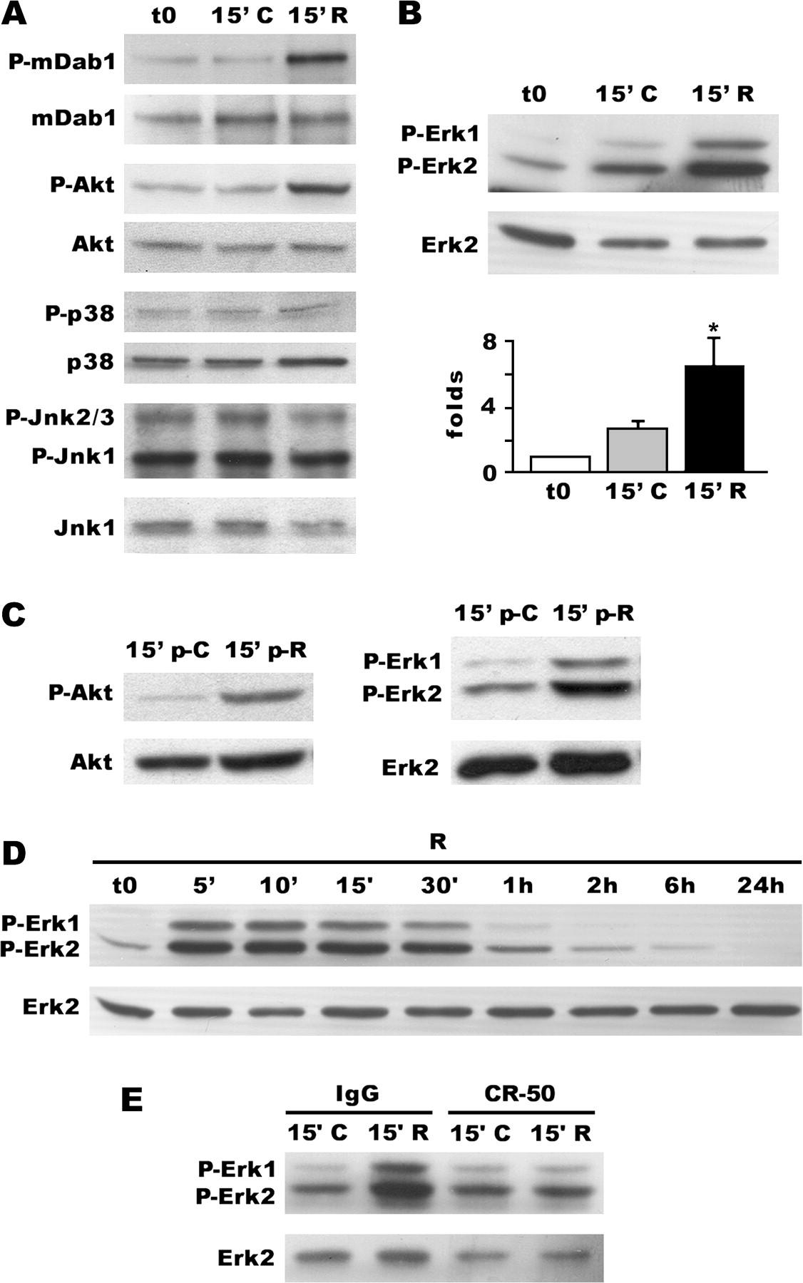
Figure 1 Reelin-dependent phosphorylation of MAPK Erk1/2 proteins. Neuronal cultures were treated for 15 min (except ...
Notes:
Figure 1 Reelin-dependent phosphorylation of MAPK Erk1/2 proteins. Neuronal cultures were treated for 15 min (except in panel D) with control mock supernatant (C), Reelin-containing supernatant (R), or kept untreated (t0). (A) WB analyses of phospho-mDab1, phospho-Akt1, phospho-p38, and phospho-Jnk1/2/3 (lanes 1, 3, 5, and 7) and their loading controls (lanes 2, 4, 6, and 8). Reelin induces phosphorylation of mDab1 and Akt1, but not of p38 or Jnk1/2/3. (B) WB assay demonstrating Reelin-dependent phosphorylation of Erk1/2 (lane 1); lane 2 shows the loading control. Densitometric analyses of 5 independent experiments (normalized to untreated samples [t0]) showing Reelin-dependent Erk1/2 phosphorylation. Differences between Reelin-treated and controls or untreated cultures are indicated (mean ± standard error of the mean; *P < 0.05). (C) Phosphorylation of Akt1 (left) and Erk1/2 (right) induced by treatment with partially purified Reelin (2 ng/ml). (D) Neuronal cultures were treated with Reelin for between 5 min and 24 h. Erk1/2 activation was observed from 5 to 30 min, with maximal phosphorylation levels at 10–15 min. (E) Reelin-dependent Erk1/2 phosphorylation is blocked by preincubation with the CR-50 antibody, but not with control IgGs.
Unless provided in the caption above, the following copyright applies to the content of this slide: © The Author 2006. Published by Oxford University Press. All rights reserved. For permissions, please e-mail: journals.permissions@oxfordjournals.orgThe online version of this article has been published under an open access model. Users are entitled to use, reproduce, disseminate, or display the open access version of this article for non-commercial purposes provided that: the original authorship is properly and fully attributed; the Journal and Oxford University Press are attributed as the original place of publication with the correct citation details given; if an article is subsequently reproduced or disseminated not in its entirety but only in part or as a derivative work this must be clearly indicated. For commercial re-use, please contact journals.permissions@oxfordjournals.org.

Slide 2
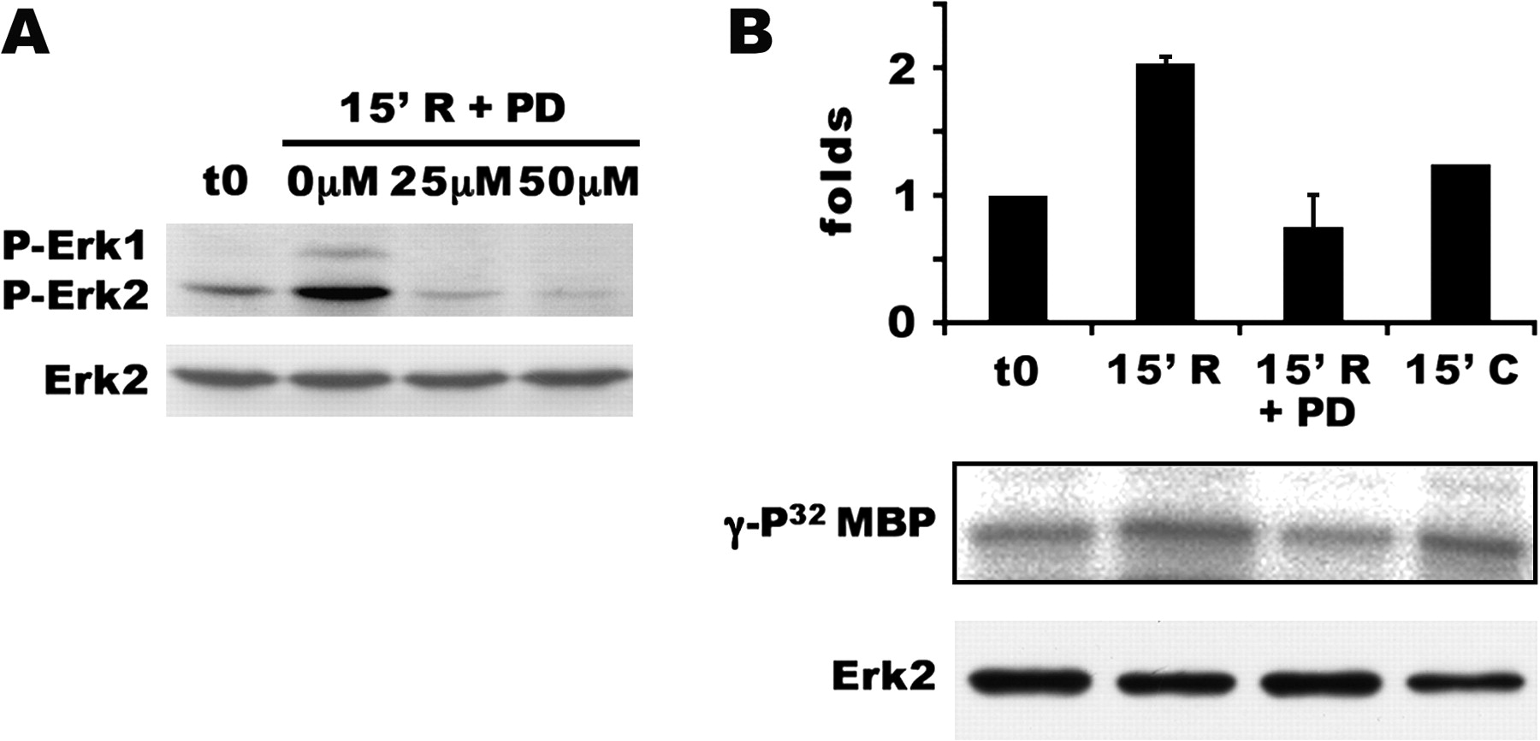
Figure 2 Reelin activates Erk1/2 in a MEK-dependent manner. Treatment of neuronal cultures with the MEK inhibitor PD ...
Notes:
Figure 2 Reelin activates Erk1/2 in a MEK-dependent manner. Treatment of neuronal cultures with the MEK inhibitor PD 98059 blocks the Reelin-induced phosphorylation and activation of Erk1/2. (A) Starved neuronal cultures were preincubated for 1 h with 25 μM or 50 μM of PD 98059 (PD). Cultures were then treated with Reelin, and the phosphorylation state of Erk1/2 was analyzed by WB; lane 1 shows the phospho-Erk1/2 WB and lane 2 the loading control. PD 98059 blocked Reelin-induced phosphorylation of Erk1/2. (B) An in vitro assay was performed to determine the enzymatic activity of Erk1/2 using the artificial substrate MBP. Samples treated with Reelin (R) showed an increase in the activity of Erk1/2, as detected by γ-P32 labeling of MBP. No differences with untreated samples are observed with control mock treatments (C) or with PD 98059 preincubation before Reelin stimulation (R + PD). The histogram (mean ± standard error of the mean, from 2 separate experiments) shows the quantification of γ-P32-MBP (lane 1), standardized with loading control of samples (lane 2).
Unless provided in the caption above, the following copyright applies to the content of this slide: © The Author 2006. Published by Oxford University Press. All rights reserved. For permissions, please e-mail: journals.permissions@oxfordjournals.orgThe online version of this article has been published under an open access model. Users are entitled to use, reproduce, disseminate, or display the open access version of this article for non-commercial purposes provided that: the original authorship is properly and fully attributed; the Journal and Oxford University Press are attributed as the original place of publication with the correct citation details given; if an article is subsequently reproduced or disseminated not in its entirety but only in part or as a derivative work this must be clearly indicated. For commercial re-use, please contact journals.permissions@oxfordjournals.org.

Slide 3
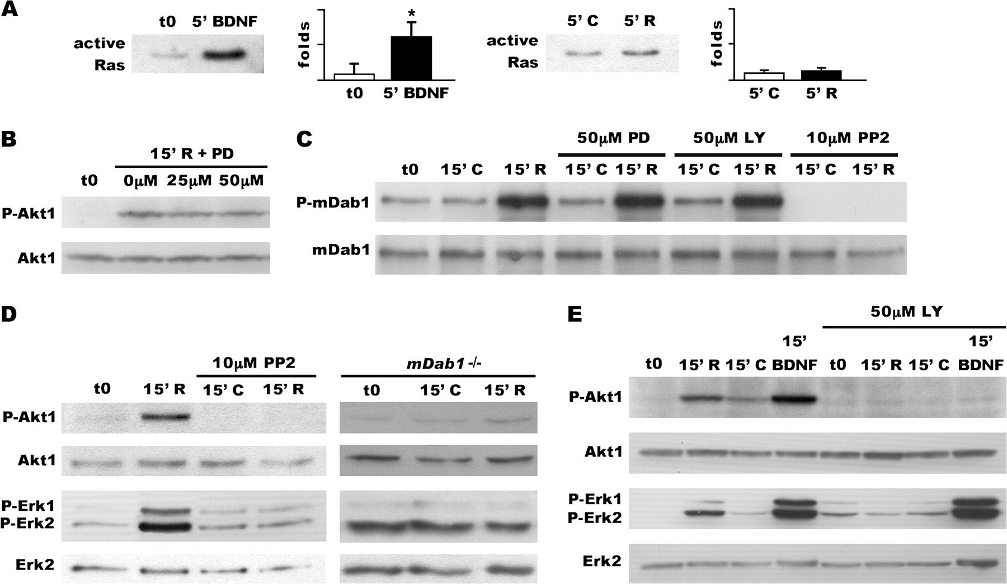
Figure 3 Reelin-dependent ERK activation requires SFK, mDab1, and PI3K activation. Neuronal cultures were treated for ...
Notes:
Figure 3 Reelin-dependent ERK activation requires SFK, mDab1, and PI3K activation. Neuronal cultures were treated for 5 or 15 min with control mock (C) or Reelin-containing (R) supernatant or kept untreated (t0). (A) Reelin (2 ng/ml) induces a modest activation of Ras. BDNF (25 μg/ml) was used as a positive control. Pull-downs of activated Ras were detected by WB using anti-Ras antibodies (left); Densitometric analyses (right) revealed nonsignificant Ras activation after Reelin treatment (1.5-fold) in comparison with BDNF treatment (9-fold) (*P ≤ 0.05). (B) Effect of MEK pathway inhibition on Reelin-induced phosphorylation of Akt1. MEK blockade with PD 98059 (50 μM) has no effect on phosphorylation levels of Akt1 after Reelin treatment (lane 1; loading controls are in lane 2). (C) Analysis of Reelin-induced phosphorylation of mDab1 in the presence of inhibitors for SFK (PP2, 10 μM), PI3K (LY 294002, 50 μM), or MEK (PD 98059, 50 μM). SFK inhibition blocks Reelin-induced phosphorylation of mDab1, but PI3K inhibition and MEK inhibition has no effect on mDab1 phosphorylation after Reelin treatment (lane 1; loading controls are in lane 2). (D) Effect of SFK inhibition and mDab1 deficiency on Reelin-induced phosphorylation of Akt1 and Erk1/2. SFK inhibition with PP2 (10 μM) blocks Reelin-dependent phosphorylation on Akt1 and Erk1/2 proteins (lanes 1 and 3; loading controls are in lanes 2 and 4). Similarly, in cultures from mDab1-deficient (mDab1 -/-) embryos, Akt1, and Erk1/2 were not phosphorylated after Reelin treatment (lane 1 and 3; loading controls are in lane 2 and 4). (E) Comparison of Reelin- and BDNF-induced phosphorylation levels of Akt1 and Erk1/2 (lanes 1 and 3); Reelin induction of Erk1/2 and Akt1 is similar and significantly weaker than BDNF induction. The PI3K inhibitor LY 294002 (50 μM) blocks Reelin- and BDNF-induced phosphorylation of Akt1 (lane 1; loading controls are in lane 2). LY 294002 also inhibits Reelin-dependent, but not BDNF-dependent, phosphorylation of Erk1/2 (lane 3; loading controls are in lane 4).
Unless provided in the caption above, the following copyright applies to the content of this slide: © The Author 2006. Published by Oxford University Press. All rights reserved. For permissions, please e-mail: journals.permissions@oxfordjournals.orgThe online version of this article has been published under an open access model. Users are entitled to use, reproduce, disseminate, or display the open access version of this article for non-commercial purposes provided that: the original authorship is properly and fully attributed; the Journal and Oxford University Press are attributed as the original place of publication with the correct citation details given; if an article is subsequently reproduced or disseminated not in its entirety but only in part or as a derivative work this must be clearly indicated. For commercial re-use, please contact journals.permissions@oxfordjournals.org.

Slide 4
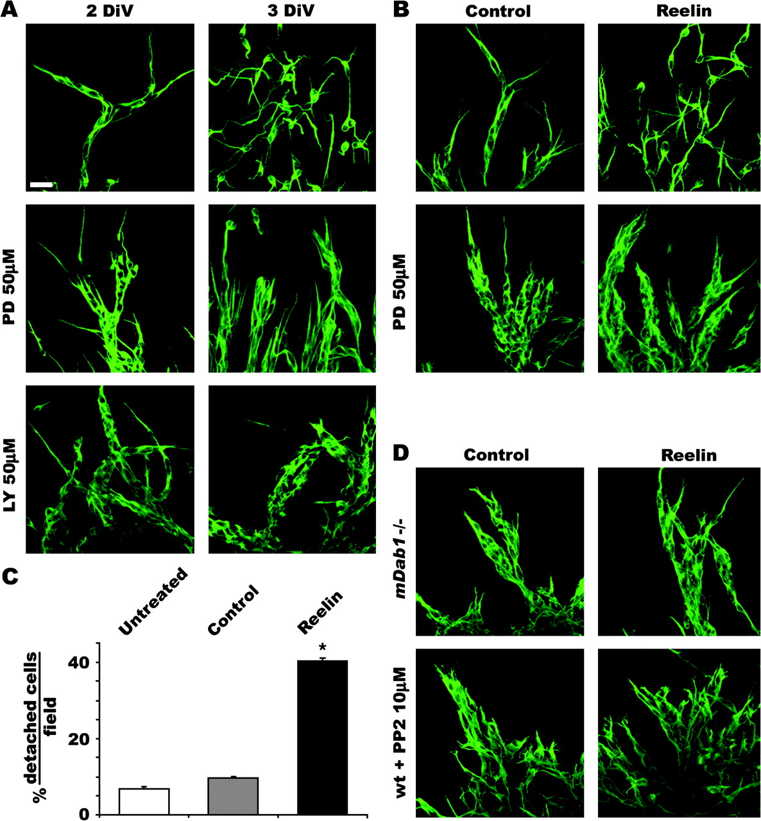
Figure 4 MAPK are involved in Reelin-induced detachment of migrating neurons from the SVZ in vitro. SVZ explants (P5) ...
Notes:
Figure 4 MAPK are involved in Reelin-induced detachment of migrating neurons from the SVZ in vitro. SVZ explants (P5) were cultured for 2 (A [left panels], B, and D) or 3 (A [right panels]) DIV, fixed, and processed for immunostaining against β-III-tubulin. (A) After 2 DIV, chains of neurons migrate out of the explants (top left panel). Neuronal chains start to disorganize at 3 DIV (top right panel). In the presence of the MEK inhibitor PD 98059 (50 μM) or LY 294002 (50 μM), neuronal chains are apparent both at 2 and 3 DIV (middle and bottom panels). (B) SVZ explants cultured for 2 DIV in the presence of control mock (left panels) or Reelin-containing (right panels) supernatants. Reelin (top right panel) induces the detachment of migrating neurons from the SVZ at 2 DIV. The presence of the MEK inhibitor PD 98059 (50 μM) in the culture medium blocks the detachment of SVZ neurons induced by Reelin (bottom panels). (C) Quantification of the percentage of detached cells per field (0.03 mm2) was performed at 2 DIV. Reelin treatment produces a marked increase of detached cells compared with control mock-treated or untreated samples (mean ± standard error of the mean; *P < 0.05). (D) SVZ cultures from mDab1-deficient (mDab1 -/-) (top panels) animals and PP2-treated cultures (bottom panels) were stimulated with control mock (left panels) or Reelin-containing (right panels) supernatants. Reelin does not induce neuronal detachment in these conditions. Scale bar, 20 μm (A, B, and D).
Unless provided in the caption above, the following copyright applies to the content of this slide: © The Author 2006. Published by Oxford University Press. All rights reserved. For permissions, please e-mail: journals.permissions@oxfordjournals.orgThe online version of this article has been published under an open access model. Users are entitled to use, reproduce, disseminate, or display the open access version of this article for non-commercial purposes provided that: the original authorship is properly and fully attributed; the Journal and Oxford University Press are attributed as the original place of publication with the correct citation details given; if an article is subsequently reproduced or disseminated not in its entirety but only in part or as a derivative work this must be clearly indicated. For commercial re-use, please contact journals.permissions@oxfordjournals.org.

Slide 5
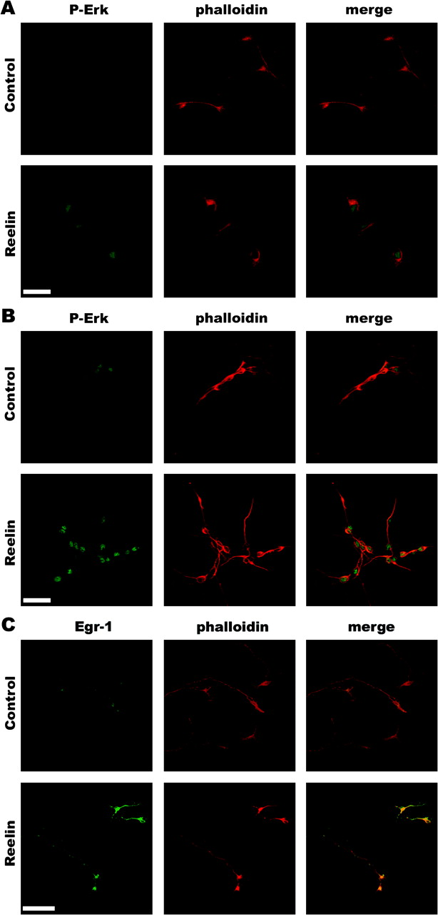
Figure 5 Reelin induces the translocation of P-Erk1/2 and the increase of Egr-1 protein levels in neuronal cultures. ...
Notes:
Figure 5 Reelin induces the translocation of P-Erk1/2 and the increase of Egr-1 protein levels in neuronal cultures. (A) Immunostaining of telencephalic neuronal cultures with antiphospho-Erk1/2 antibodies (left panels) after incubation with control mock or Reelin-containing media for 15 min (Control or Reelin, respectively). Note increased phospho-Erk1/2-immunostaining and accumulation of labeling in the nuclei after Reelin treatment. Middle panels show counterstaining of actin filaments with Texas-Red-phalloidin and right panels show merged images. (B) Immunostaining of SVZ neuronal cultures with phospho-Erk1/2 antibodies (left panels) after incubation with control or Reelin-containing media for 15 min (Control or Reelin, respectively). SVZ neuronal cultures show an increased phospho-Erk1/2 immunolabeling in the nuclei after Reelin treatment. Middle panels show counterstaining of actin filaments with Texas-Red-phalloidin, and right panels show merged images. (C) Reelin induces a similar increase in Egr-1 protein expression, which is localized in neuronal nuclei (bottom left panel), compared with controls (top left panel). An increase in Egr-1 protein in telencephalic neuronal cultures is detected 1 h after Reelin addition (bottom left panel). Middle panels show counterstaining of actin filaments with Texas-Red-phalloidin, and right panels show merged images. Scale bar, 30 μm (A), 30 μm (B), and 50 μm (C).
Unless provided in the caption above, the following copyright applies to the content of this slide: © The Author 2006. Published by Oxford University Press. All rights reserved. For permissions, please e-mail: journals.permissions@oxfordjournals.orgThe online version of this article has been published under an open access model. Users are entitled to use, reproduce, disseminate, or display the open access version of this article for non-commercial purposes provided that: the original authorship is properly and fully attributed; the Journal and Oxford University Press are attributed as the original place of publication with the correct citation details given; if an article is subsequently reproduced or disseminated not in its entirety but only in part or as a derivative work this must be clearly indicated. For commercial re-use, please contact journals.permissions@oxfordjournals.org.

Slide 6
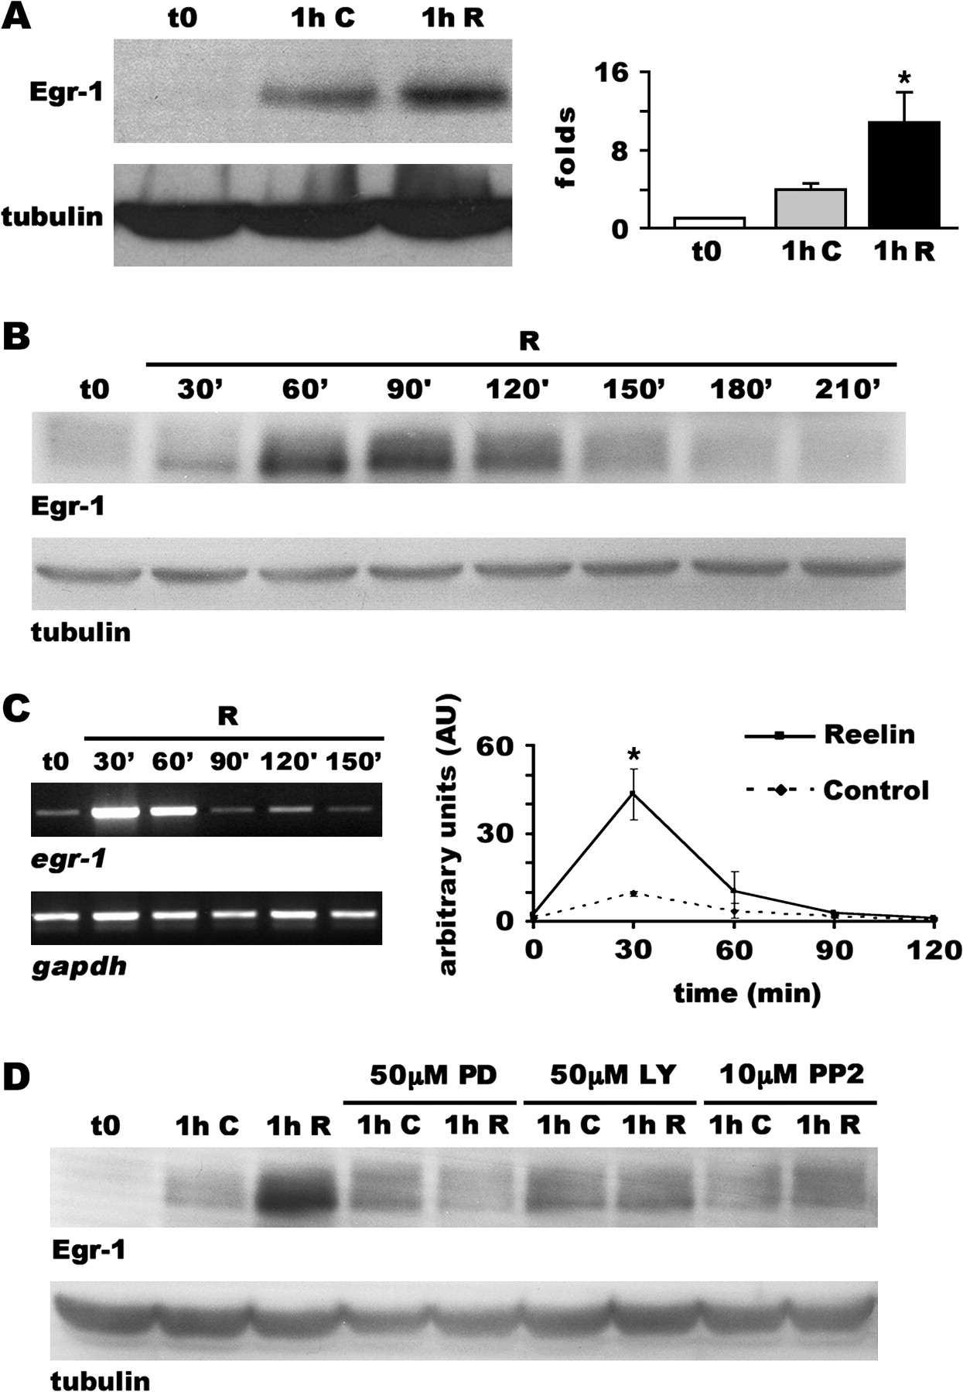
Figure 6 Reelin induces the expression of Egr-1 through the ERK pathway. (A) Expression of Egr-1 protein was analyzed ...
Notes:
Figure 6 Reelin induces the expression of Egr-1 through the ERK pathway. (A) Expression of Egr-1 protein was analyzed in neuronal cultures by WB after incubation with control mock or Reelin-containing supernatants for 1 h. The WB on the left shows a marked increase in Egr-1 protein content after Reelin treatment (lane 1); β-III-tubulin staining was used as a loading control (lane 2). A histogram summarizing the densitometric quantitative data obtained in 4 independent/separate experiments is shown on the right (mean ± standard error of the mean; *P < 0.05). (B) Time course analysis of Egr-1 levels by WB in cultured neurons treated with Reelin (R) for 0–210 min, showing maximum content at 30–120 min. An antibody against β-III-tubulin was used as loading control blot (lane 2). (C) Semiquantitative reverse transcription–polymerase chain reaction analyses of Egr-1 mRNA. Gapdh mRNA was used as a loading control. A marked significant increase in Egr-1 transcription occurs at 30–60 min when neuronal cultures are treated with Reelin-containing supernatant (left). Quantitative representation of 3 independent experiments (Right panel; *P < 0.05). (D) Effects of 50 μM PD 98059 (PD), 50 μM LY 294002 (LY), or 10 μM PP2 on Reelin-induced Egr-1 protein increase. Neuronal cultures were incubated with control mock or Reelin-containing supernatants in the presence of the above inhibitors for 1 h. WB analysis was probed for Egr-1 (lane 1), stripped and reprobed against β-III-tubulin as loading control (lane 2). All 3 pharmacological inhibitors prevent the Reelin-induced increase in Egr-1 at the protein level.
Unless provided in the caption above, the following copyright applies to the content of this slide: © The Author 2006. Published by Oxford University Press. All rights reserved. For permissions, please e-mail: journals.permissions@oxfordjournals.orgThe online version of this article has been published under an open access model. Users are entitled to use, reproduce, disseminate, or display the open access version of this article for non-commercial purposes provided that: the original authorship is properly and fully attributed; the Journal and Oxford University Press are attributed as the original place of publication with the correct citation details given; if an article is subsequently reproduced or disseminated not in its entirety but only in part or as a derivative work this must be clearly indicated. For commercial re-use, please contact journals.permissions@oxfordjournals.org.

Slide 7
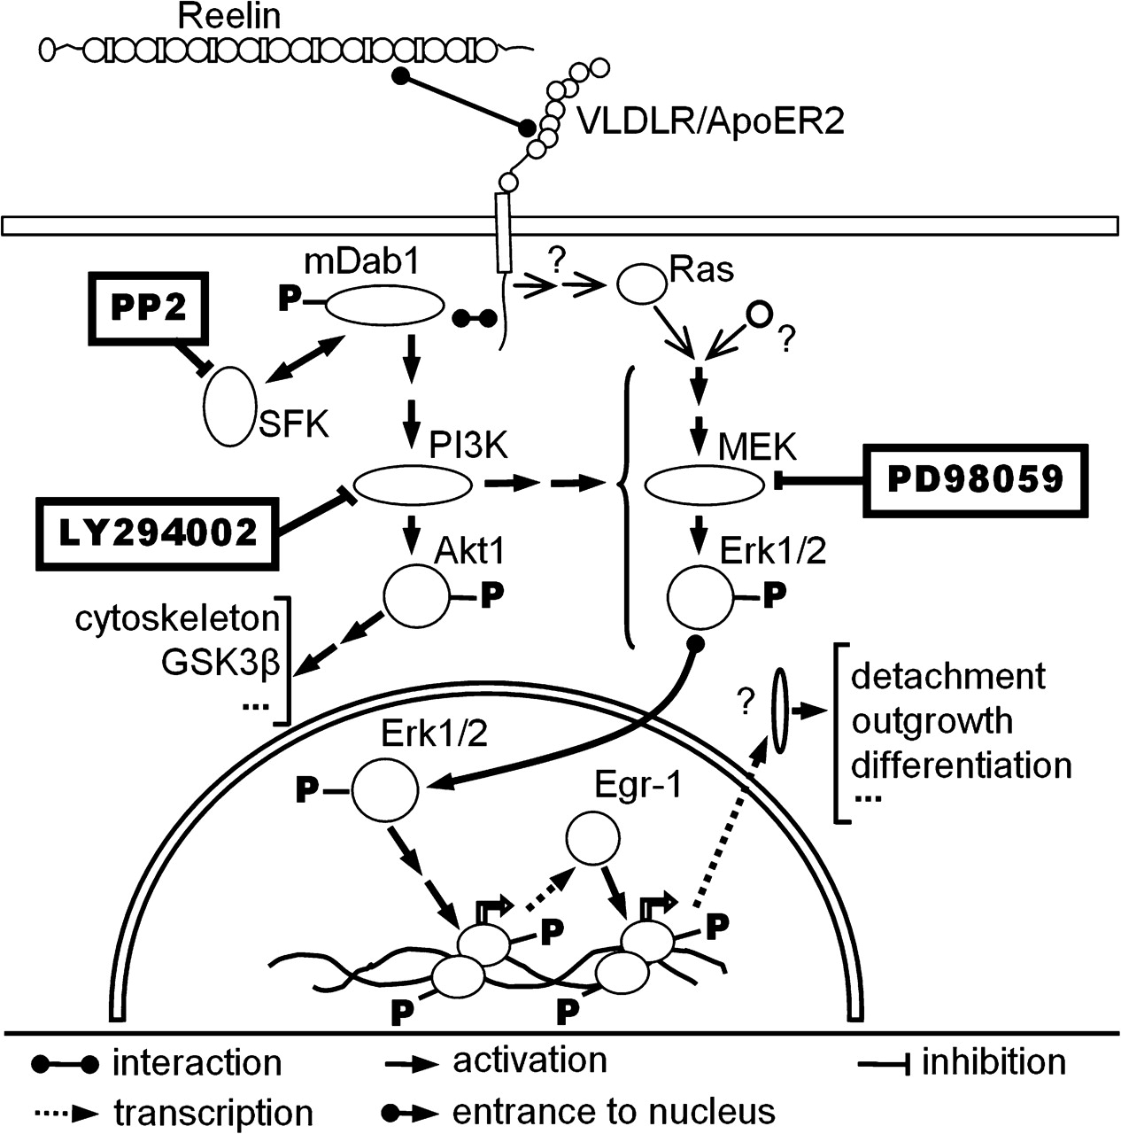
Figure 7 Summary diagram integrating the ERK pathway in the Reelin-signaling pathway. Reelin binds VLDLR and ApoER2 ...
Notes:
Figure 7 Summary diagram integrating the ERK pathway in the Reelin-signaling pathway. Reelin binds VLDLR and ApoER2 receptors, thereby inducing the phosphorylation of mDab1 by SFK. Transduction involves the PI3K pathway and the subsequent phosphorylation of Akt1 and GSK3β and downstream cytoskeletal proteins. PI3K is also required for the activation of the ERK pathway and phosphorylation of Erk1/2 proteins. The contribution of Ras to Reelin-dependent ERK activation cannot be discarded, but the sequential activation of SFK and PI3K appears to be the major pathway that produces ERK activation. ERK activation leads, in turn, to the transcriptional activation of Egr-1, which may in turn control several cellular events. The sites of action of the pharmacological inhibitors PP2, LY 294002, and PD 98059 are indicated in the context of Reelin signaling.
Unless provided in the caption above, the following copyright applies to the content of this slide: © The Author 2006. Published by Oxford University Press. All rights reserved. For permissions, please e-mail: journals.permissions@oxfordjournals.orgThe online version of this article has been published under an open access model. Users are entitled to use, reproduce, disseminate, or display the open access version of this article for non-commercial purposes provided that: the original authorship is properly and fully attributed; the Journal and Oxford University Press are attributed as the original place of publication with the correct citation details given; if an article is subsequently reproduced or disseminated not in its entirety but only in part or as a derivative work this must be clearly indicated. For commercial re-use, please contact journals.permissions@oxfordjournals.org.

