Slide 1
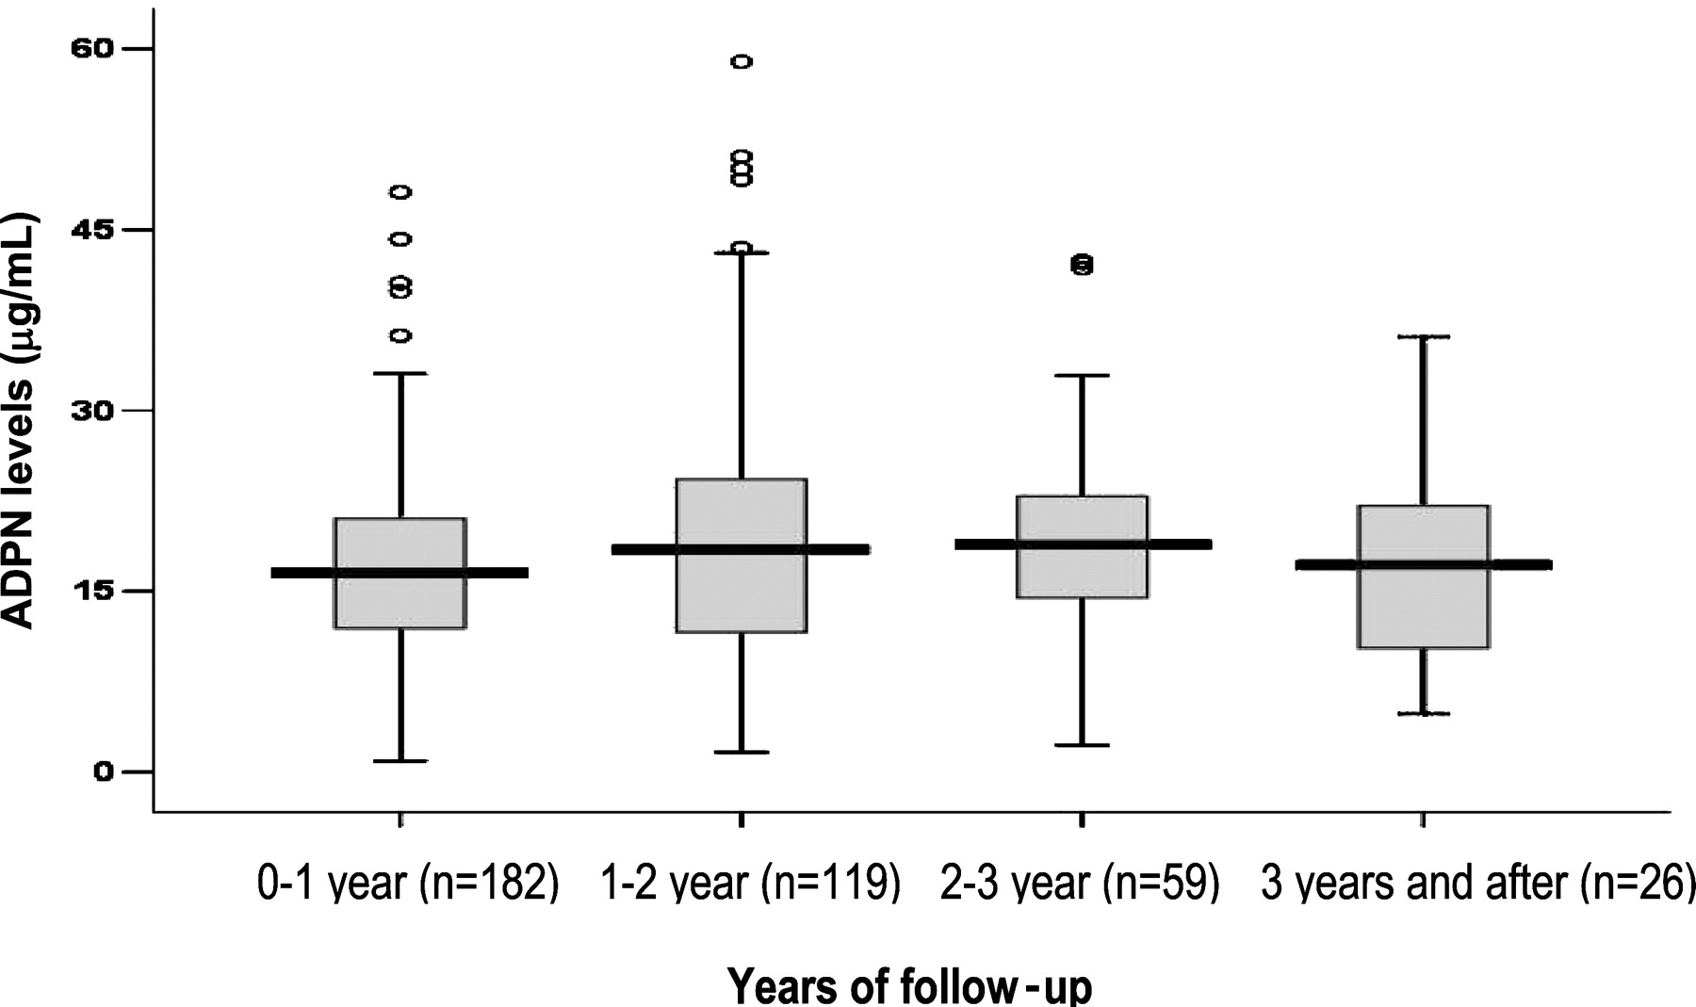
Fig. 1 Box plots of plasma ADPN levels measured annually, showing the number of patients with repeated measurements ...
Notes:
Fig. 1 Box plots of plasma ADPN levels measured annually, showing the number of patients with repeated measurements (ranging from two to five or more) each year.
Unless provided in the caption above, the following copyright applies to the content of this slide: © Oxford University Press 2008

Slide 2
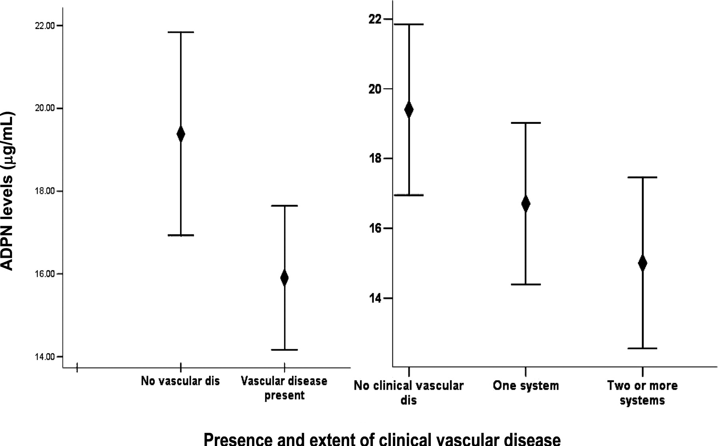
Fig. 2 Error bars (estimated mean ± SEM) ADPN levels among patients with and without clinical CVD and with ...
Notes:
Fig. 2 Error bars (estimated mean ± SEM) ADPN levels among patients with and without clinical CVD and with increasing extent of clinical CVD.
Unless provided in the caption above, the following copyright applies to the content of this slide: © Oxford University Press 2008

Slide 3
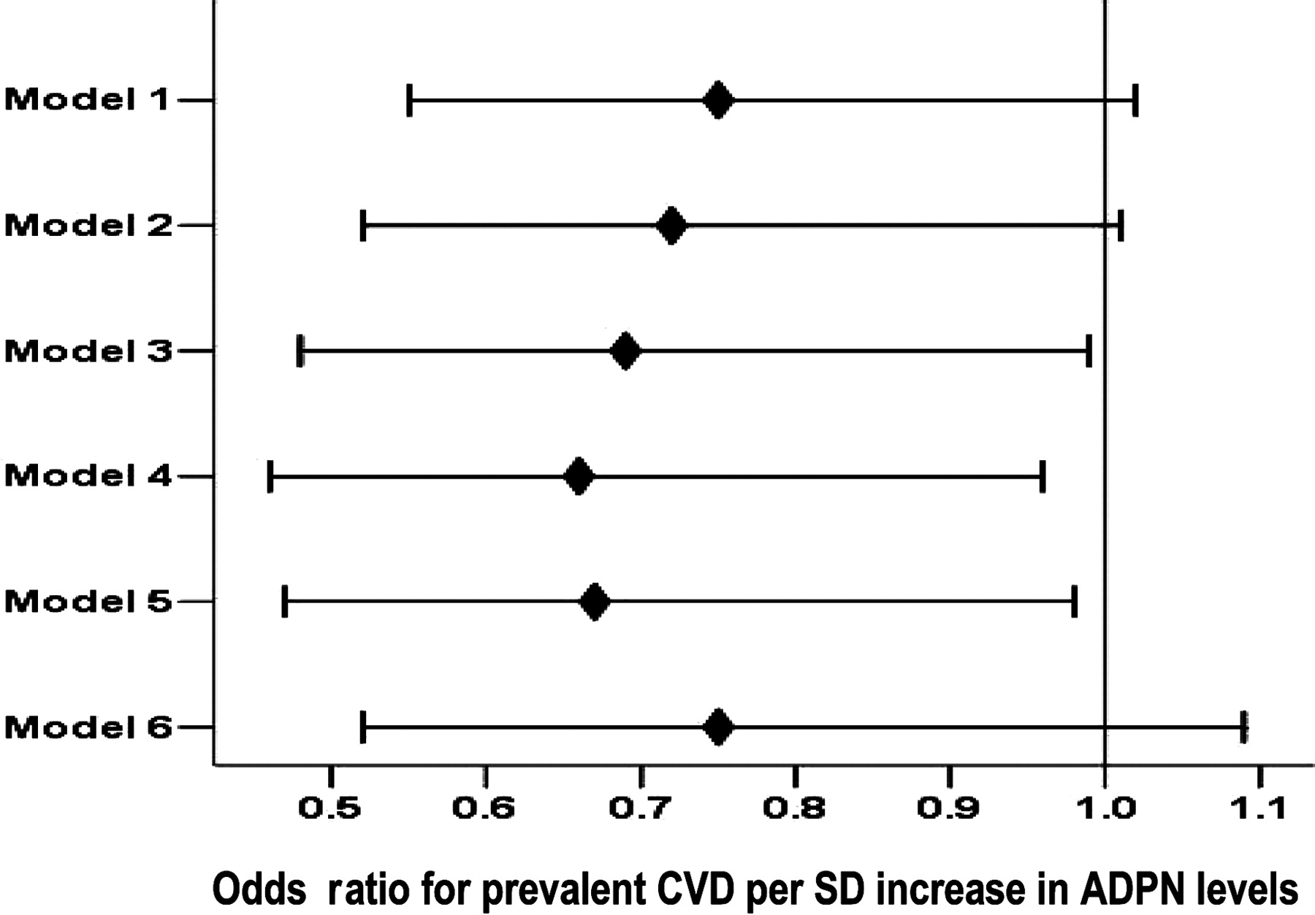
Fig. 3 Odds ratio for a one-SD increase in plasma ADPN for prevalent CVD for a univariate model and after sequential ...
Notes:
Fig. 3 Odds ratio for a one-SD increase in plasma ADPN for prevalent CVD for a univariate model and after sequential adjustment for covariates. The multivariate analysis sequentially adjusted models for covariates as follows: Model 1, unadjusted; Model 2, adjusted for age, gender, race and duration on HD; Model 3, adjusted in addition for diabetes, (log)BMI, serum albumin; Model 4, adjusted in addition for smoking; Model 5, adjusted in addition for (log)IL-6; Model 6, adjusted in addition for (log)CRP but not (log)IL-6.
Unless provided in the caption above, the following copyright applies to the content of this slide: © Oxford University Press 2008

Slide 4
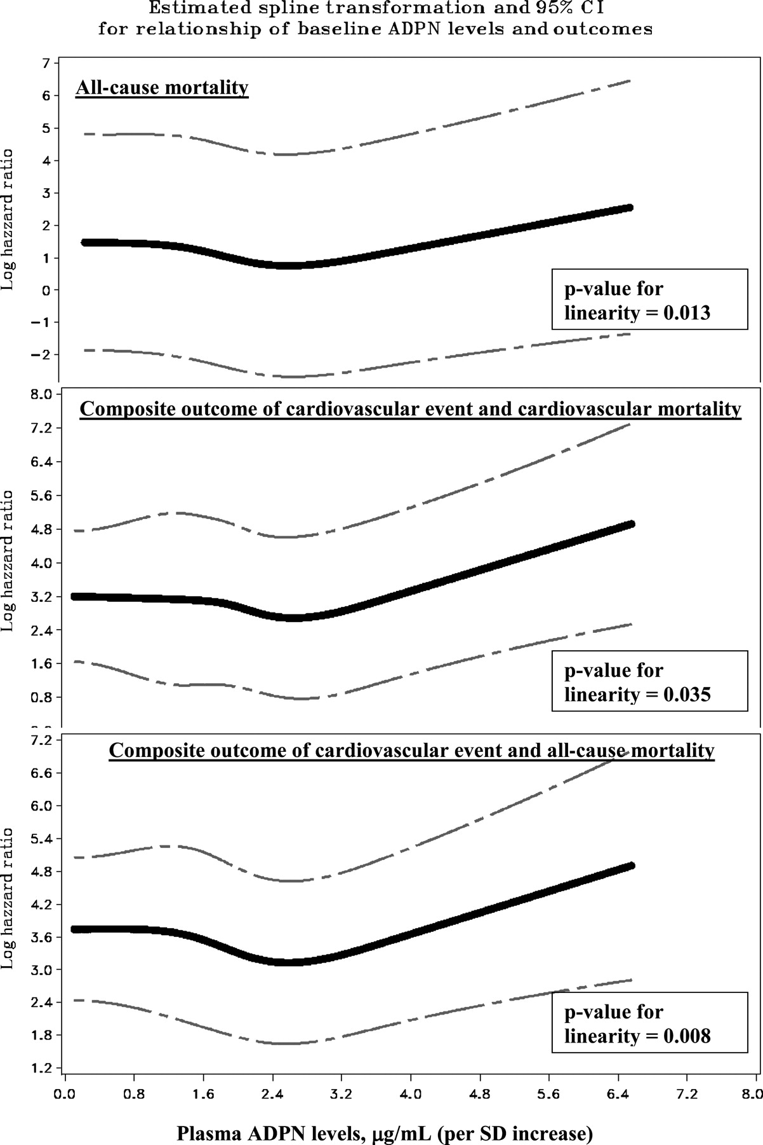
Fig. 4 Estimated spline transformation and confidence interval for the relationship of increasing plasma ADPN ...
Notes:
Fig. 4 Estimated spline transformation and confidence interval for the relationship of increasing plasma ADPN levels with cardiovascular and mortality outcomes, while controlling for covariates (the covariates shown to be significant in the adjusted models for each outcome in Table 3 ) showing that the relationship between increasing levels of ADPN and outcomes is non-linear. The spline reflects only the non-linearity and not the actual magnitude of the association for increasing ADPN levels scaled per SD.
Unless provided in the caption above, the following copyright applies to the content of this slide: © Oxford University Press 2008

